Slide 1
Setup Tutorial
Author : KhangTN Edit: MinhKH

Slide 2
Required tool and environment
Setup Java environment (version 7u79)
Setup maven environment (version 3.3.3)
Setup Intellij (version 13.1.6)
Setup Tomcat7 (version 7.0.61)
Setup MySQL (version 5.6.24) and MySQL Workbench (version 6.3.3)
Run Example Project

Slide 3
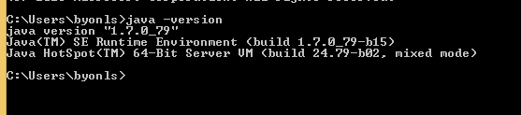
Setup Java environment
Download Java SE Development Kit at http://www.oracle.com/technetwork/java/javase/downloads/jdk7-downloads-1880260.html
Setup Java environment for window
http://sinhvienit.net/forum/cai-dat-va-thiet-lap-moi-truong-java-tren-windows-8-8-1.337376.html
Check java versoon.
open cmd:
java –version

Slide 4
Setup Maven environment
Download maven
http://maven.apache.org/download.cgi
Unzip apache-maven-3.3.3-bin.zip.
Go to Control Panel\System and Security\System\ Advance System Setting\ Environment Variable

Slide 5
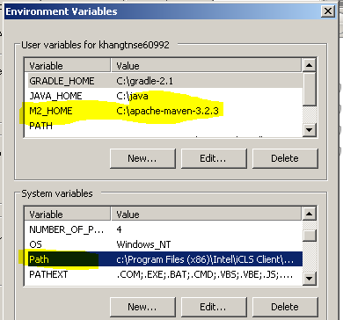
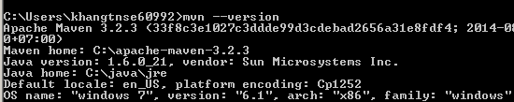
Setup Maven environment
Add M2_HOME with value is PATH of Maven folder ( user variable )
adding or selecting the PATH variable in the System variables with the value C:\..\maven_folder_path\bin.

Slide 6
Setup IntelliJ
Download Intellij http://download.jetbrains.com/idea/ideaIU-13.1.6.exe
Install with all default option

Slide 7
Open Project
Check out :
https://github.com/sicacho/Spring-MVC-Structure

Slide 8
Setup Tomcat
Download tomcat http://tomcat.apache.org/download-70.cgi
Unzip the archive

Slide 9
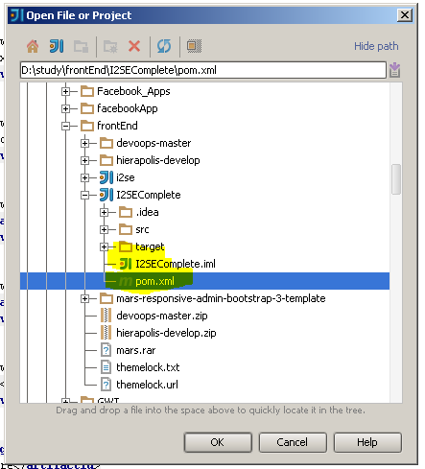
Setup Tomcat
Open IntelliJ

Slide 10
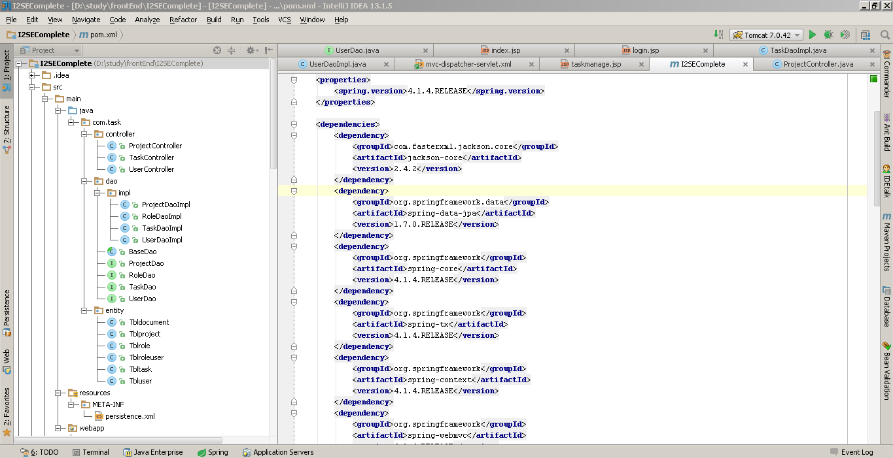
Setup Tomcat

Slide 11
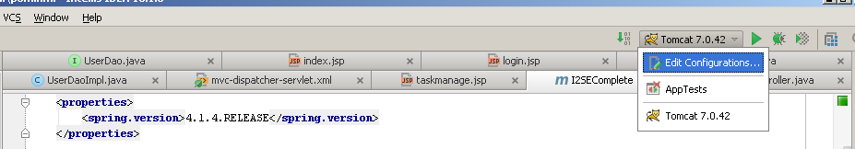
Setup Tomcat

Slide 12
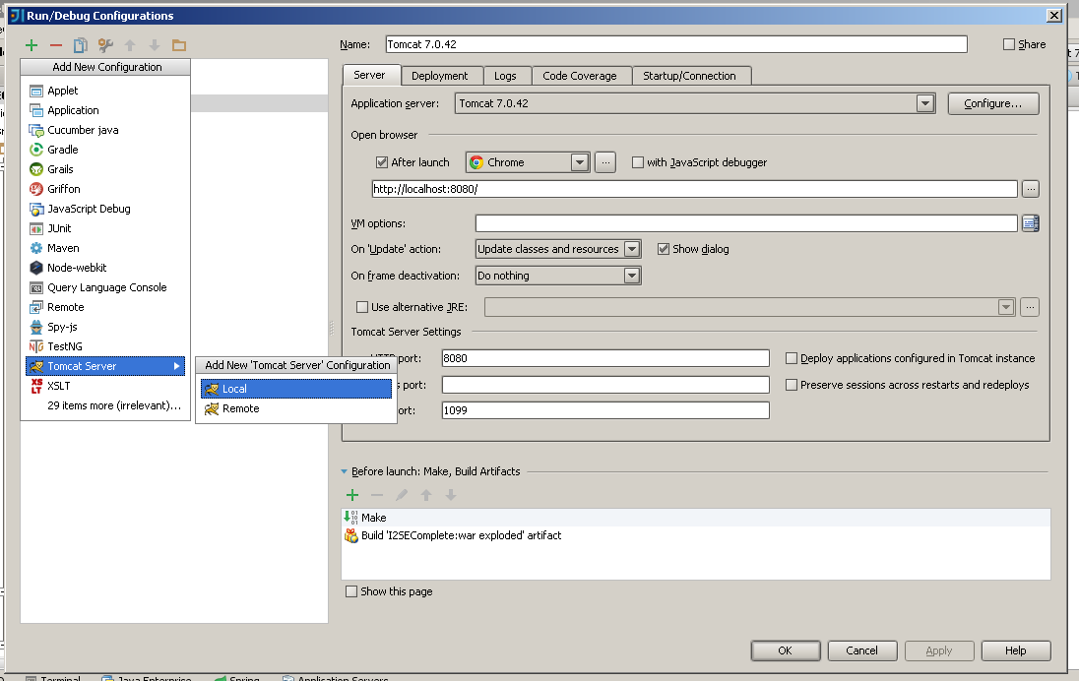
Setup Tomcat

Slide 13
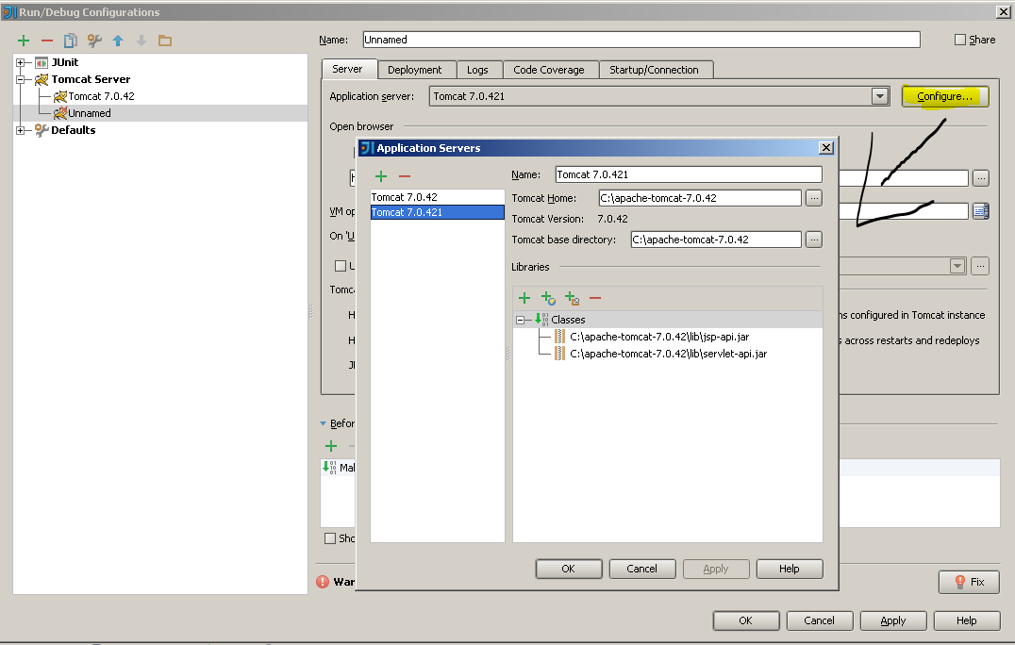
Setup Tomcat
Select Tomcat Base Directory ( tomcat folder ) and OK

Slide 14
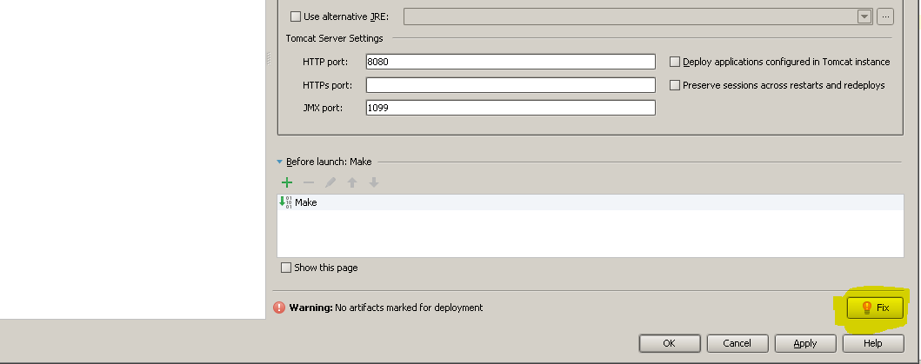
Setup Tomcat
After finish slide 19 , check button FIX right bottom of panel , press it to deploy War file

Slide 15
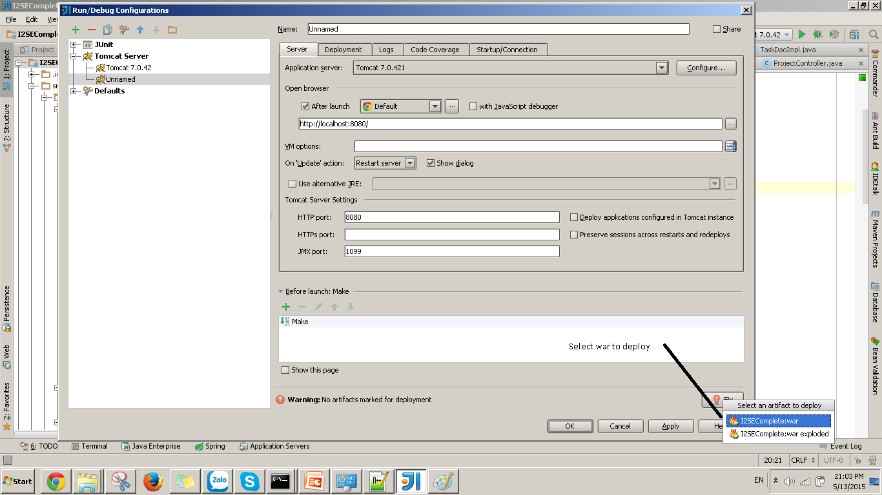
Setup Tomcat

Slide 16
Setup MYSQL
Download and install MySQL Server http://dev.mysql.com/downloads/mysql/
Download and install MySQL Server management tool http://dev.mysql.com/downloads/workbench/

Slide 17
Import Database
Create database : officei2se
Import Database

Slide 18
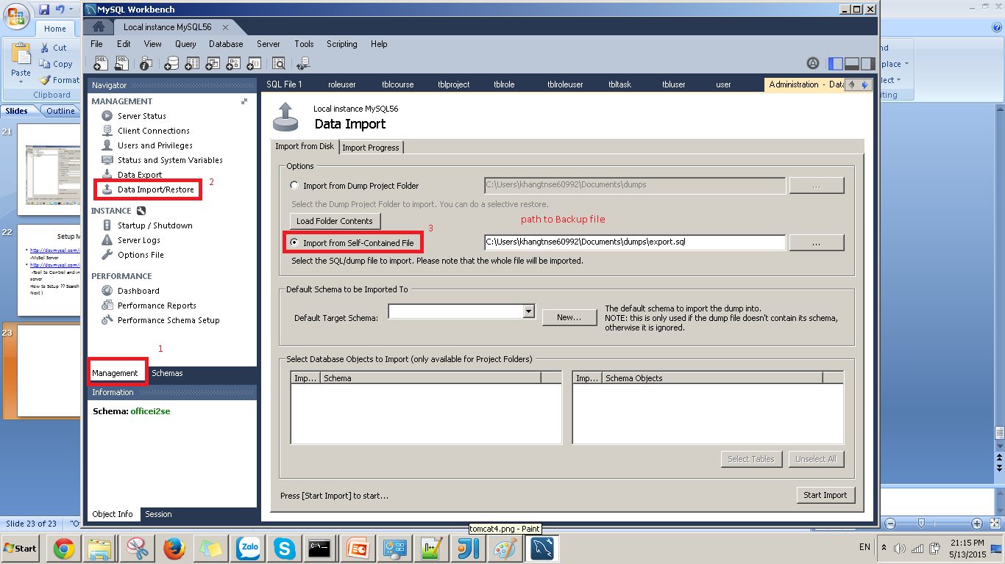
Import Database

Slide 19
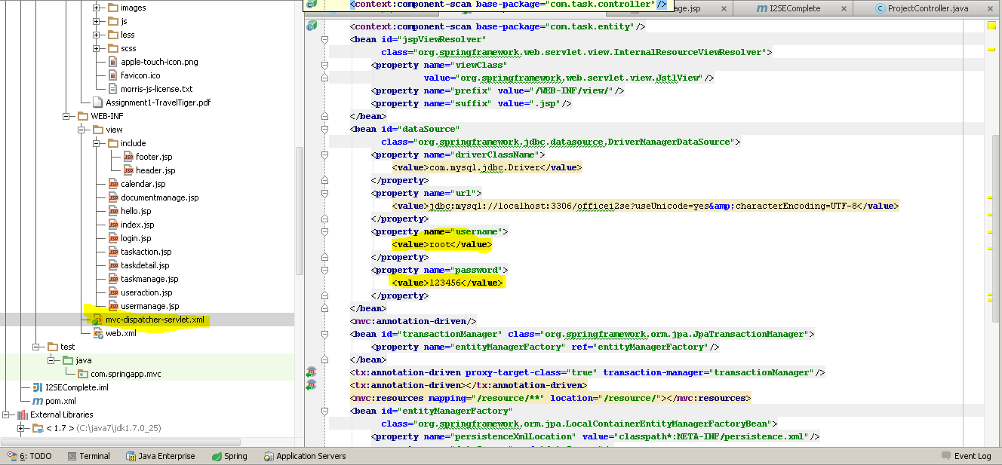
Run Example Project
Select mvc-dispatcher-servlet.xml
Edit username and password
Run

