Slide 1
Host guide: Smart-REPLIC review
For the presenter only. Each page shows one slide of the real deck, what to say, and the question it is likely to bring.
Computer Networks | Faculty: Anuradha G | 9 Oct 2026

Slide 2
Plan for the session
Total talking time about 15 minutes, then questions.
# | Slide | Time | # | Slide | Time
1 | Title | 0:20 | 21 | How we tested | 0:40
2 | Why | 0:40 | 22 | Issues | 0:50
3 | What we built | 0:40 | 23 | Changes | 1:00
4 | Headline results | 1:00 | 24 | Limits | 0:50
5 | Up to 83% less time | 0:40 | 25 | Learned | 0:50
6 | Scorecard | 1:00 | 26 | Thank you | 0:15
7 | Real clock | 1:00 | 27 | Neural agent in the C transport | 1:00
8 | Window picture | 0:40 | 28 | Safety net: hand over to AIMD | 0:50
9 | Kernel | 1:00 | 29 | More evidence: baselines, SACK, reordering | 1:00
10 | Changing paths | 1:00 | 30 | Fairness, ablations, chat fixes | 0:50
11 | Fairness | 1:00 | 31 | Fairness and file transfer | 0:50
12 | Two machines | 0:45 | 32 | Closing gaps: fairness and cross traffic | 0:50
13 | REPLIC Drop | 1:00 | 33 | Real sockets found what the emulator could not | 0:50
14 | Chat | 1:00 | 34 | Problems we hit and fixed | 0:40
15 | Packet Tracer | 0:50 | 35 | Our first learned agent: an honest result | 0:50
16 | Wireshark | 0:40 | 36 | Benchmark results | 0:40
17 | Protocol | 0:50 | 37 | Literature behind the design | 0:30
18 | Selective Repeat | 0:50 | 38 | Smart-REPLIC: a Q-learning window controller | 0:50
19 | Controllers | 0:50 | 39 | The AI agent in our code | 1:00
20 | Ablation | 0:50 | 40 | Appendix: slow start and congestion avoidance | -
Rules: say the limits before she asks; answer in one or two sentences; if you do not know, say what you would check.

Slide 3
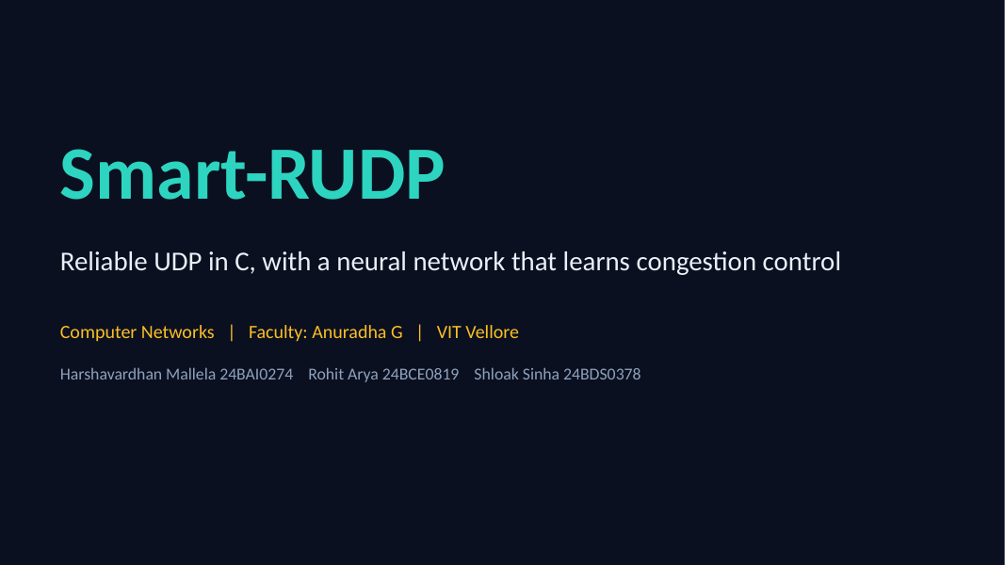
1. Title
Time on this slide: 0:20
SAY
We built REPLIC, a reliable protocol on UDP in C, and taught a neural network to control its congestion window.
IF ASKED Who did what? Harsh: transport and agent; Rohit and Shloak: network design and tools.

Slide 4
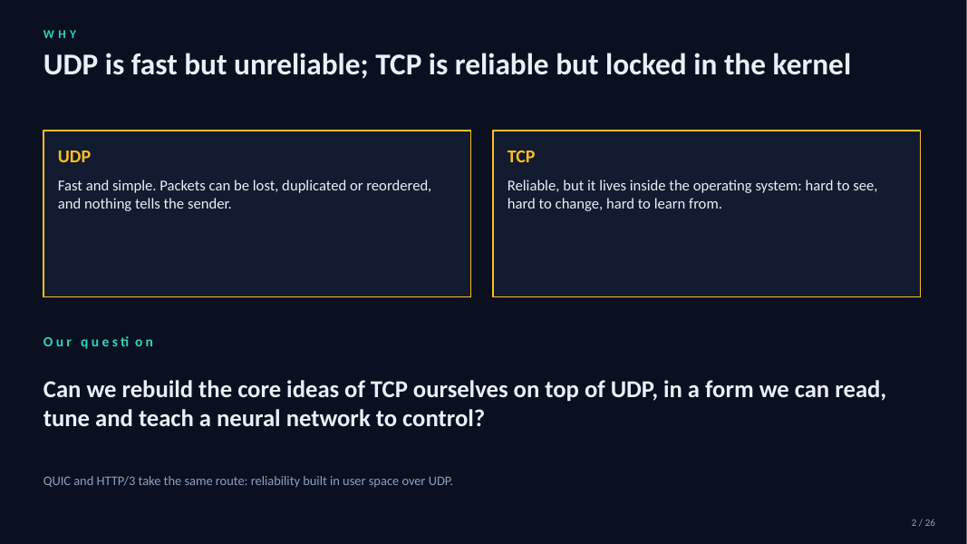
2. Why
Time on this slide: 0:40
SAY
UDP is fast but unreliable. TCP is reliable but sits in the kernel.
Our question: can we rebuild TCP's core ideas ourselves, in a form we can read, tune and teach a network to control?
IF ASKED Is this like QUIC? Same idea: reliability in user space over UDP.

Slide 5
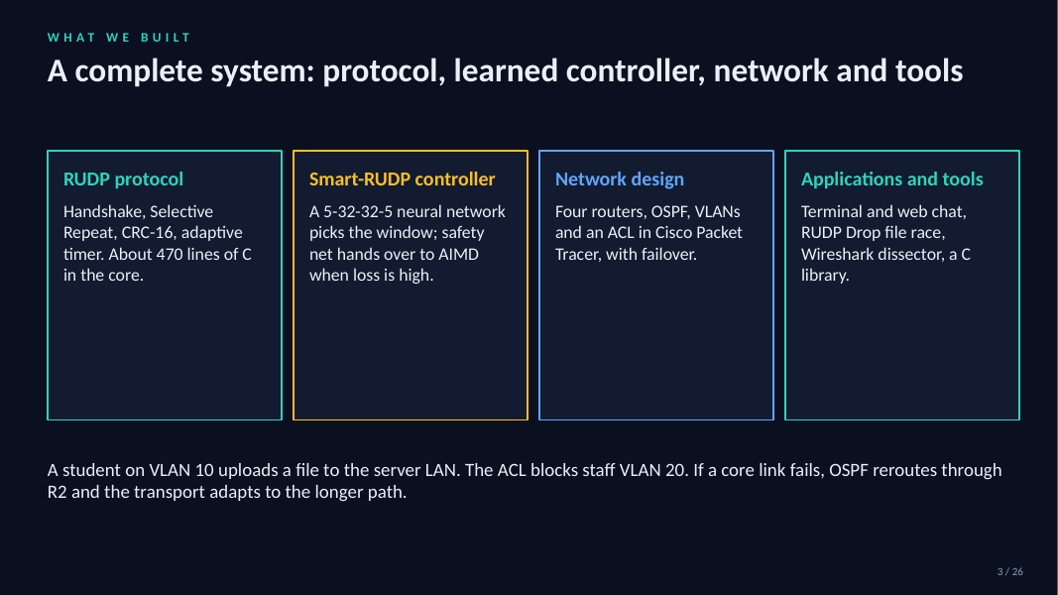
3. What we built
Time on this slide: 0:40
SAY
Four parts: the protocol, the learned controller, the Packet Tracer network, and the tools (chat, Drop, Wireshark dissector).
IF ASKED How big is the core? About 470 lines of C.

Slide 6
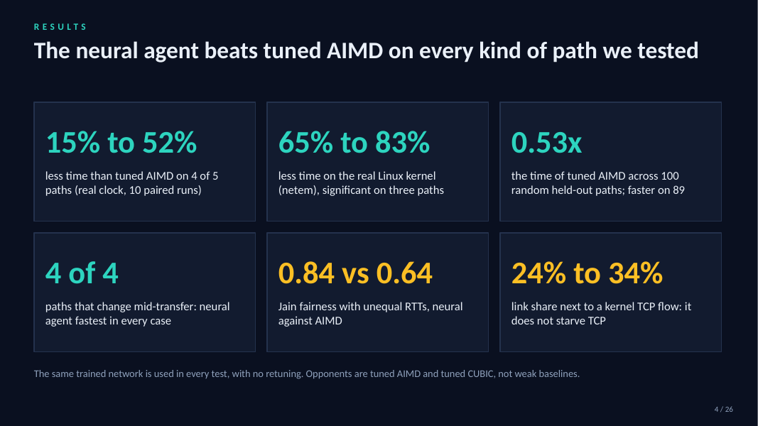
4. Headline results
Time on this slide: 1:00
SAY
Lead with the numbers: 15 to 52% less time on emulated paths, 65 to 83% on the real Linux kernel, 0.53x on 100 random unseen paths.
Fastest in all four changing-path cases. Fairer than AIMD, and it takes 24 to 34% next to kernel TCP.
IF ASKED Against what? Tuned AIMD and tuned CUBIC, not weak baselines.

Slide 7
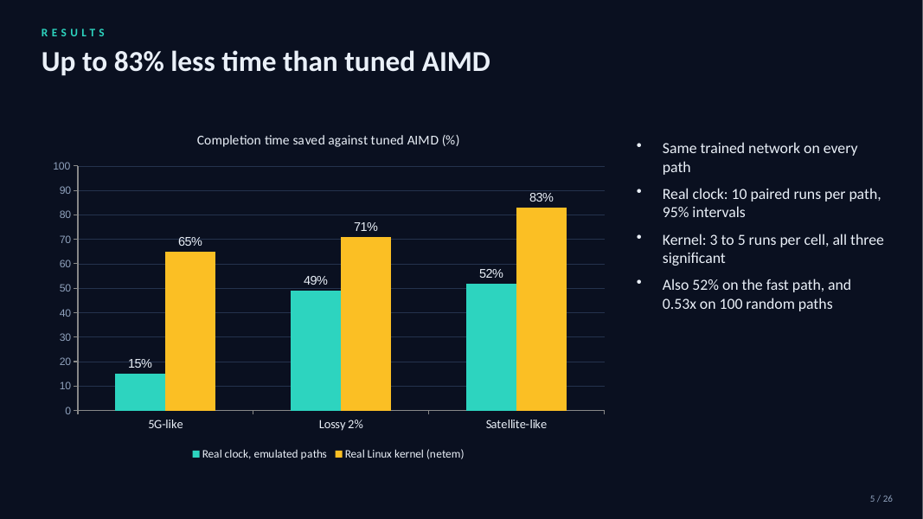
5. Up to 83% less time
Time on this slide: 0:40
SAY
Same trained network on every path, no retuning. Left bars real clock, right bars real kernel.
IF ASKED Why is the kernel gain bigger? Tuned AIMD does badly with netem's real queues.

Slide 8
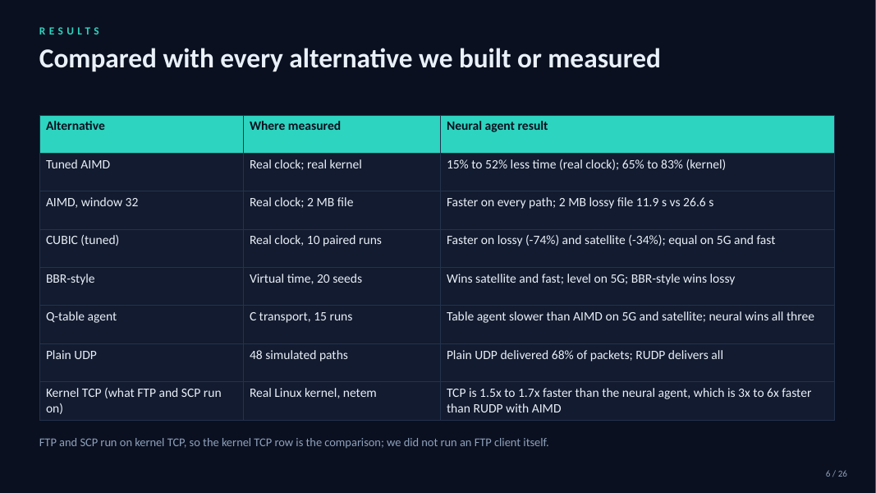
6. Scorecard
Time on this slide: 1:00
SAY
One table of every alternative: AIMD, CUBIC, BBR-style, Q-table, plain UDP and kernel TCP.
Honest row: kernel TCP is 1.5 to 1.7x faster than the agent. FTP and SCP run on TCP so that row stands for them.
IF ASKED Did you run FTP? No; it runs on kernel TCP, so the TCP row is the comparison.

Slide 9
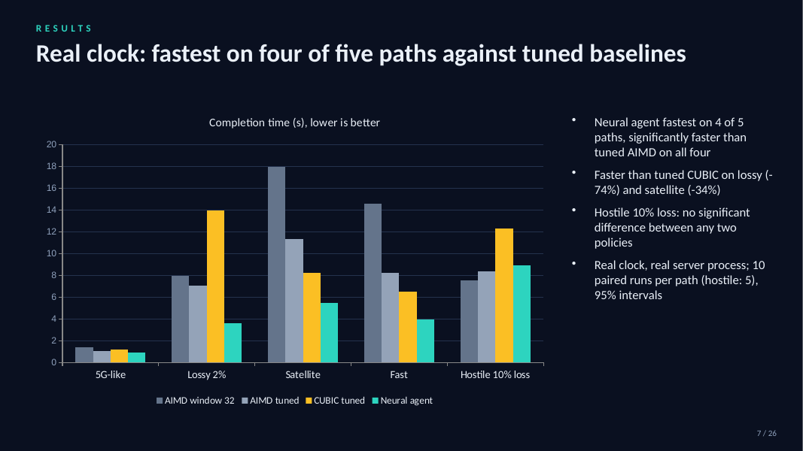
7. Real clock
Time on this slide: 1:00
SAY
Fastest on four of five paths. Lossy 3.6 s against 7.1 s tuned AIMD and 13.9 s CUBIC.
At 10% loss no policy is significantly different.
IF ASKED How many runs? 10 paired runs per path, 95% intervals.

Slide 10
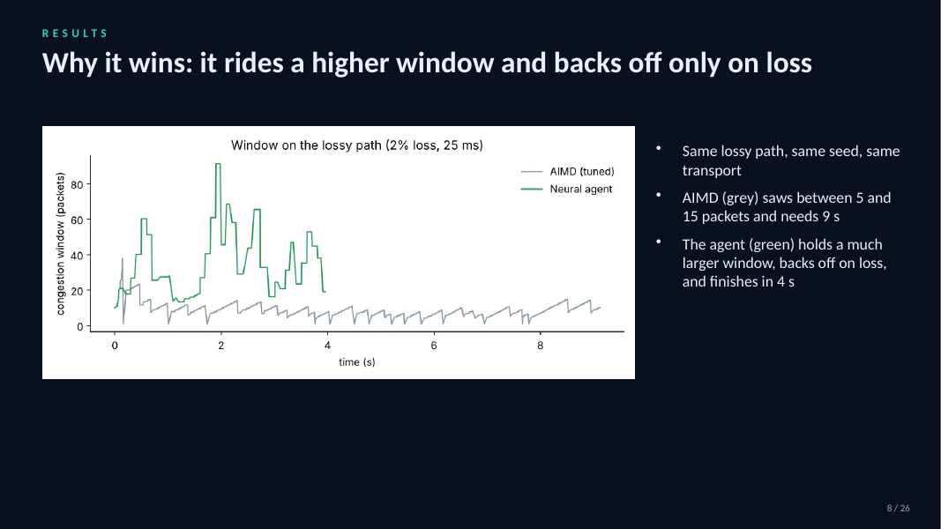
8. Window picture
Time on this slide: 0:40
SAY
Same path, same seed. AIMD saws between 5 and 15 packets and needs 9 s; the agent holds a much bigger window, backs off on loss, finishes in 4 s.
IF ASKED Why not just a bigger AIMD cap? We tuned it to 128; the agent still wins.

Slide 11
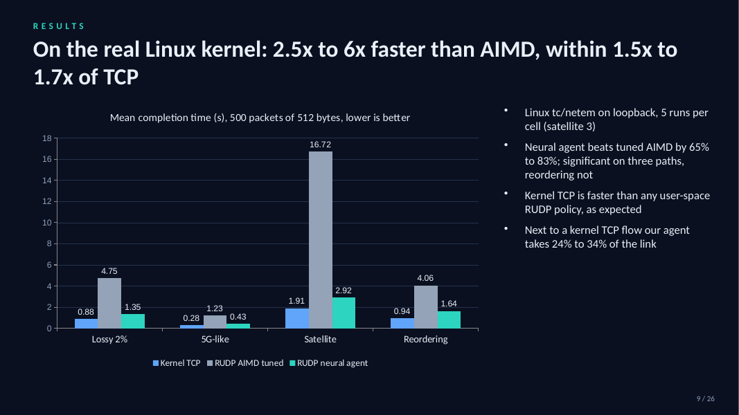
9. Kernel
Time on this slide: 1:00
SAY
Real Linux queues with netem, 500 real 512 byte packets.
Agent beats tuned AIMD by 65 to 83%. Kernel TCP is still faster, as expected.
IF ASKED Why is TCP faster? In-kernel, years of tuning, no user-space overhead.

Slide 12
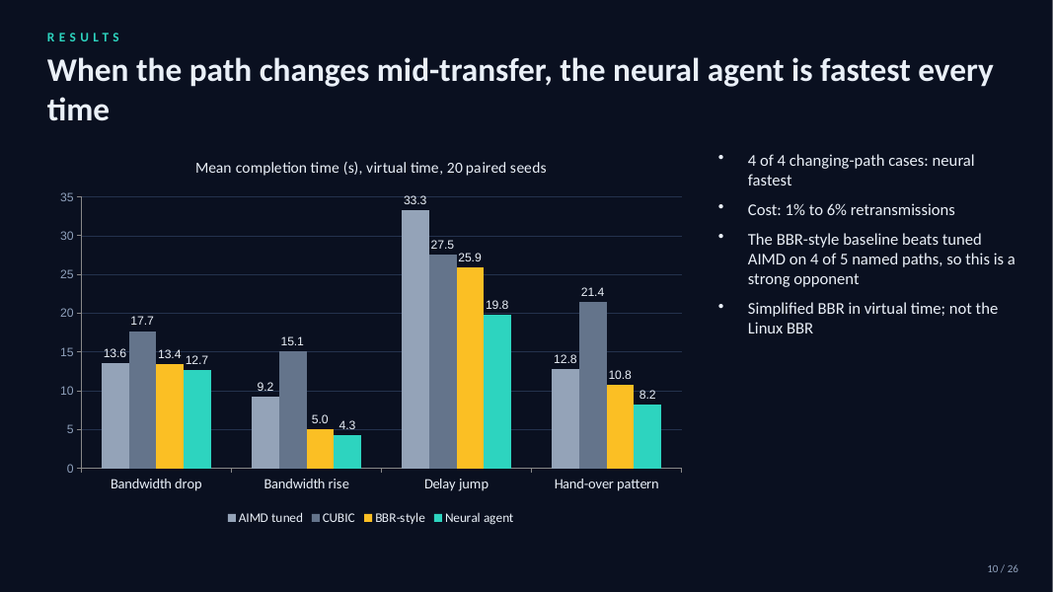
10. Changing paths
Time on this slide: 1:00
SAY
Bandwidth drop, rise, delay jump, hand-over: the agent is fastest in all four.
BBR-style is a strong opponent here and beats AIMD on most.
IF ASKED Is it real BBR? A simplified version in virtual time.

Slide 13
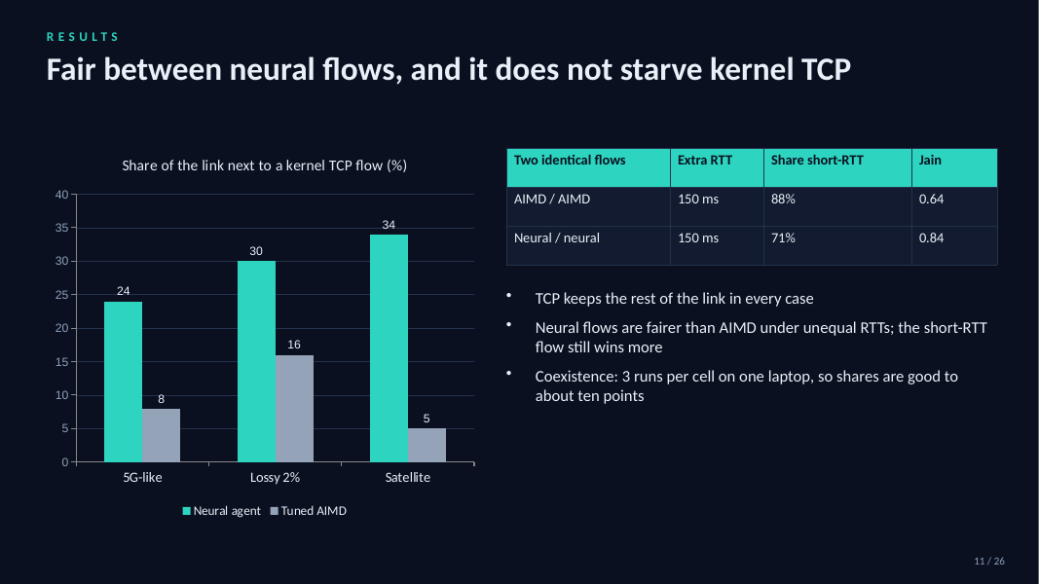
11. Fairness
Time on this slide: 1:00
SAY
Next to a kernel TCP flow the agent takes 24 to 34% and TCP keeps the rest. Jain fairness 0.84 against 0.64 for AIMD with unequal RTTs.
IF ASKED Is it polite? More pushy than AIMD; we have an optional polite mode.

Slide 14
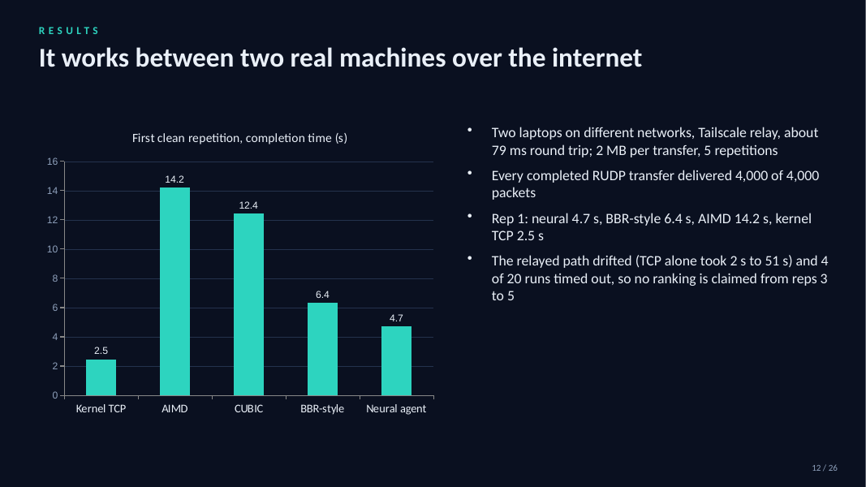
12. Two machines
Time on this slide: 0:45
SAY
Two laptops on different networks over Tailscale, 79 ms RTT. Every completed transfer delivered all 4000 packets; in rep 1 the agent took 4.7 s.
The relay drifted, so no ranking from later reps.
IF ASKED Why only one clean rep? The relayed path drifted; 4 of 20 runs timed out.

Slide 15
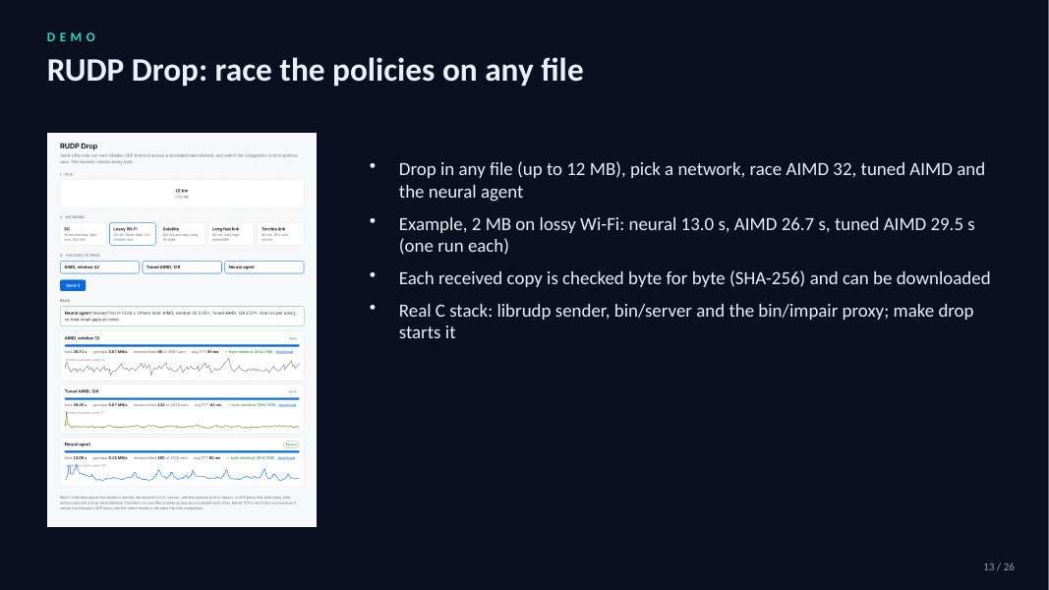
13. REPLIC Drop
Time on this slide: 1:00
SAY
Drop in a file, pick a network, race three policies. Example: 13.0 s neural against 26.7 s AIMD, byte-identical by SHA-256.
IF ASKED Real stack? Yes: C sender, server and impairment proxy.

Slide 16
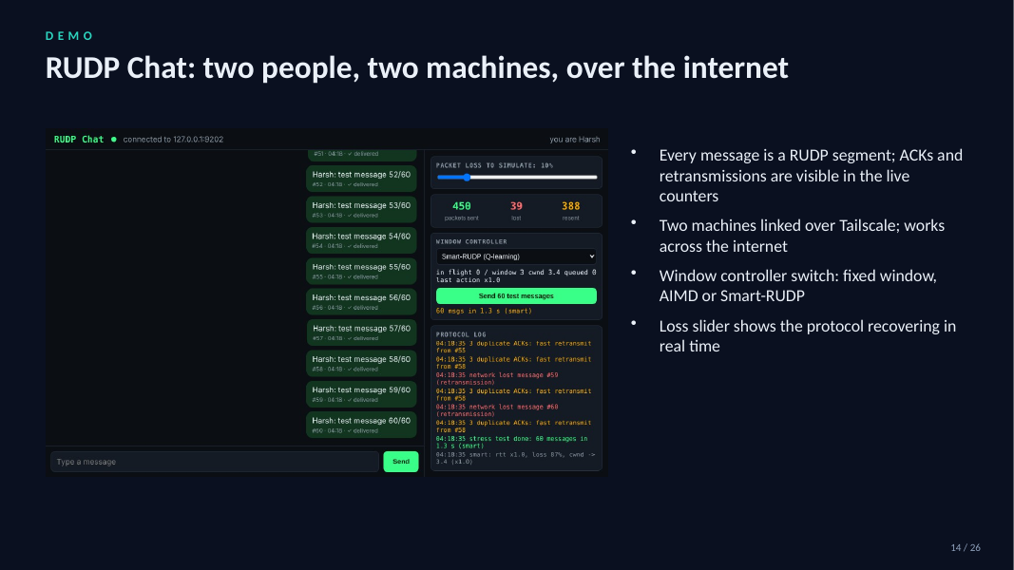
14. Chat
Time on this slide: 1:00
SAY
Chat over REPLIC between two machines. Live counters show ACKs and retransmissions; the loss slider shows recovery.
IF ASKED Does it run on the internet? Yes, linked over Tailscale.

Slide 17
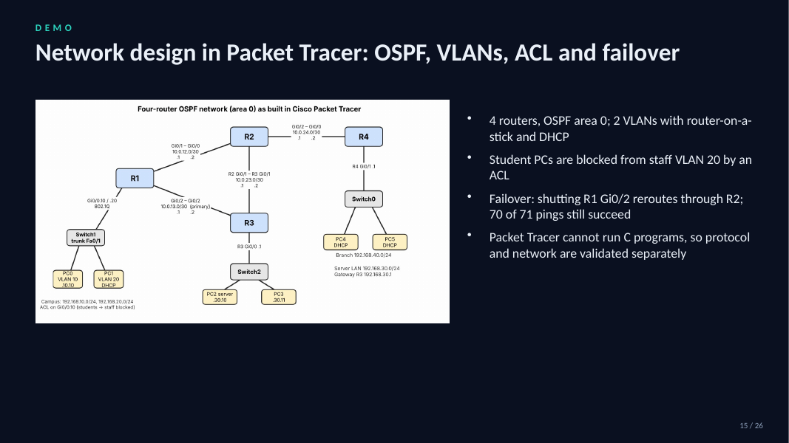
15. Packet Tracer
Time on this slide: 0:50
SAY
Four routers, OSPF area 0, two VLANs, DHCP, an ACL, and failover: shutting R1 Gi0/2 reroutes through R2, 70 of 71 pings succeed.
IF ASKED Why separate from the code? Packet Tracer cannot run C programs.

Slide 18
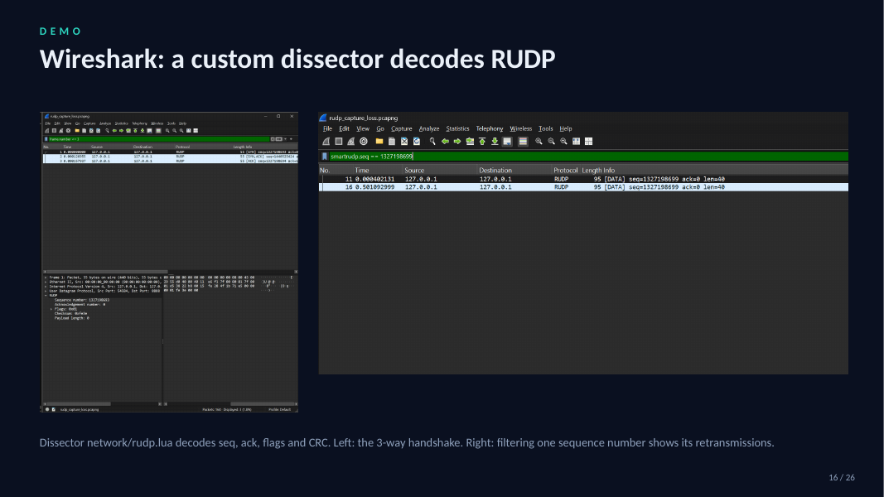
16. Wireshark
Time on this slide: 0:40
SAY
Our Lua dissector decodes seq, ack, flags and CRC. Left, the handshake; right, filtering one sequence number shows retransmissions.
IF ASKED Is it a real capture? Yes, from the running protocol on loopback.

Slide 19
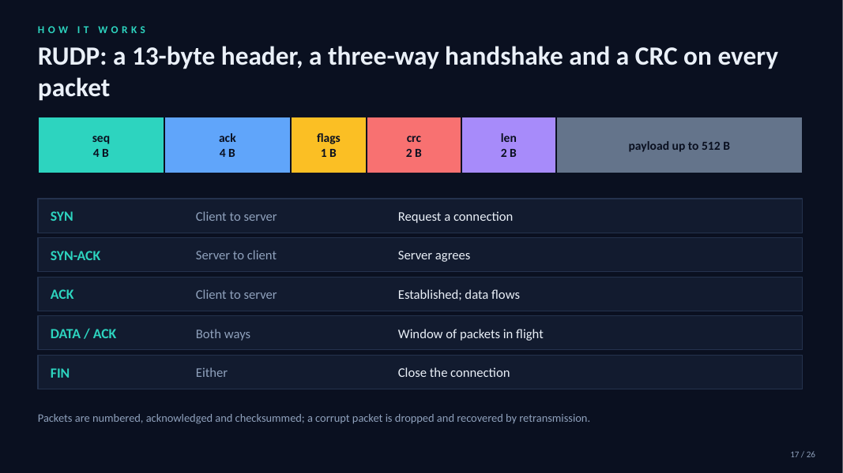
17. Protocol
Time on this slide: 0:50
SAY
13-byte header, three-way handshake, CRC-16 on every packet; corrupt packets are dropped and recovered.
IF ASKED Why CRC-16? A byte-sum accepted corrupt packets; CRC-16 accepted 0 of 333k.

Slide 20
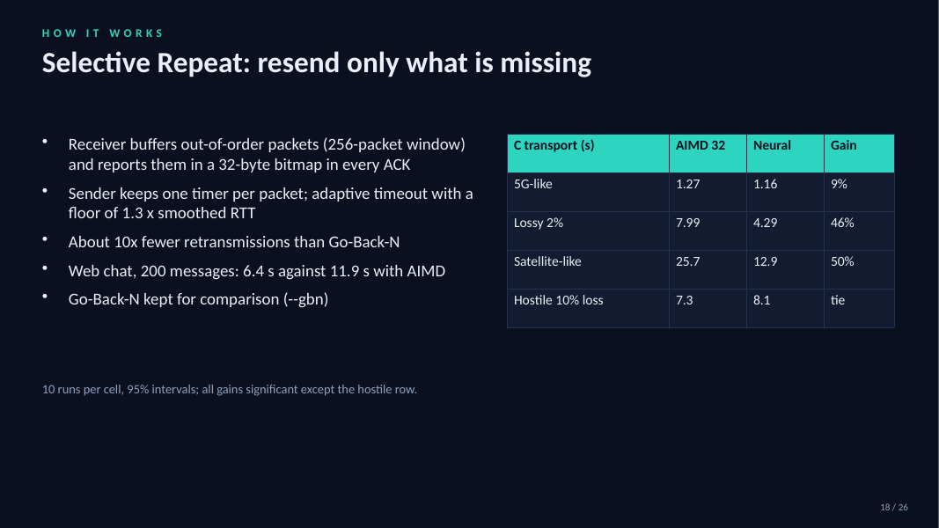
18. Selective Repeat
Time on this slide: 0:50
SAY
Receiver buffers out of order, 32-byte ACK bitmap, one timer per packet, adaptive timeout. About 10x fewer retransmissions than Go-Back-N.
IF ASKED Is the gain significant? All rows yes except hostile 10% loss.

Slide 21
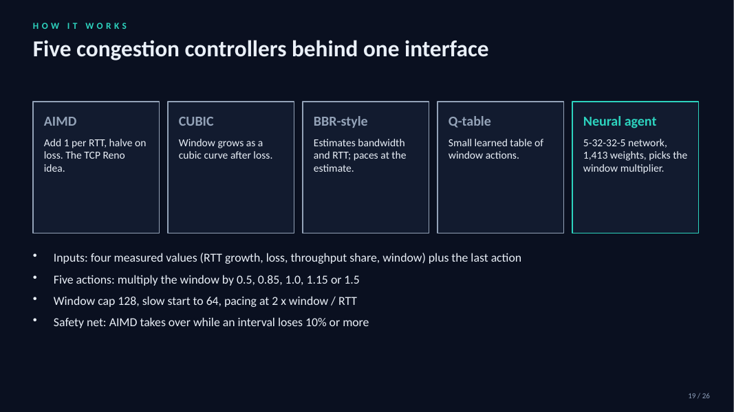
19. Controllers
Time on this slide: 0:50
SAY
Five controllers behind one interface. The neural net is 5-32-32-5 with 1413 weights and five actions from 0.5x to 1.5x.
AIMD takes over when an interval loses 10% or more.
IF ASKED Why hand-over? Without it the agent was 7x slower at 10% loss.

Slide 22
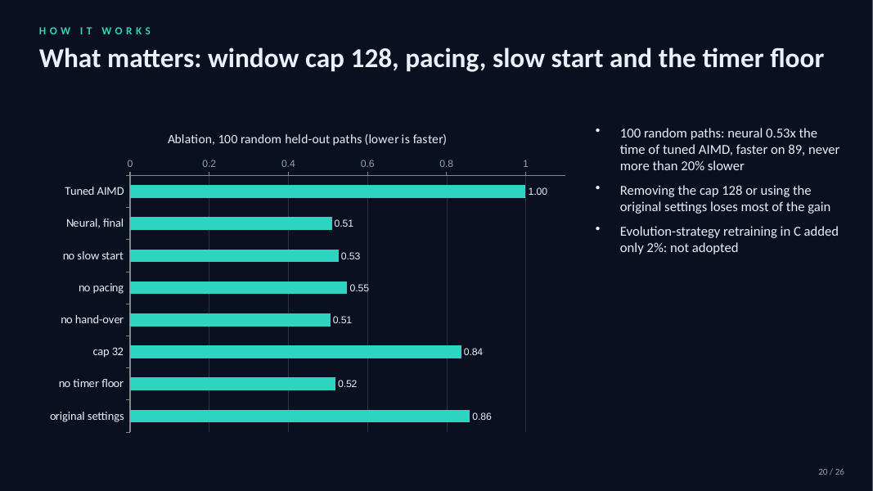
20. Ablation
Time on this slide: 0:50
SAY
On 100 random held-out paths the agent takes 0.53x the time. Cap 128 and original settings matter most.
IF ASKED Did retraining help? Evolution strategy added only 2%, not adopted.

Slide 23
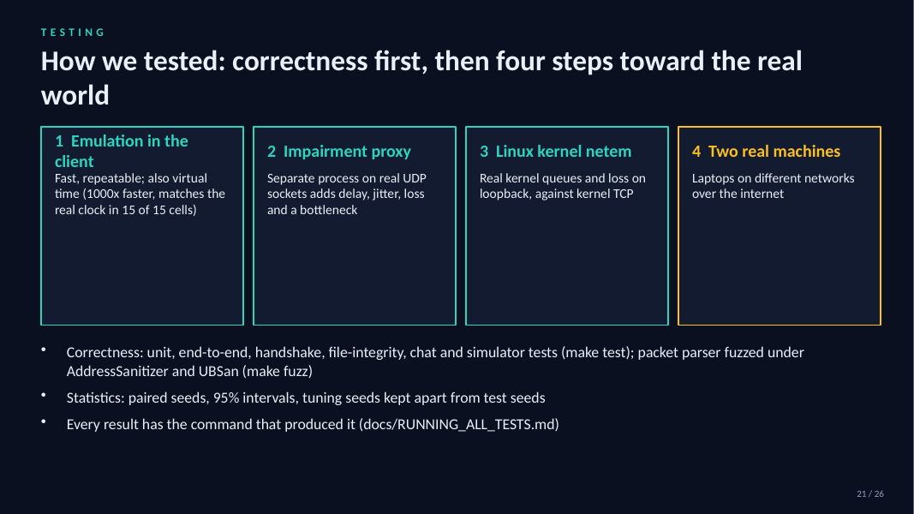
21. How we tested
Time on this slide: 0:40
SAY
Correctness first, then four steps toward the real world: emulation, impairment proxy, kernel netem, two machines.
IF ASKED Where are commands? docs/RUNNING_ALL_TESTS.md.

Slide 24
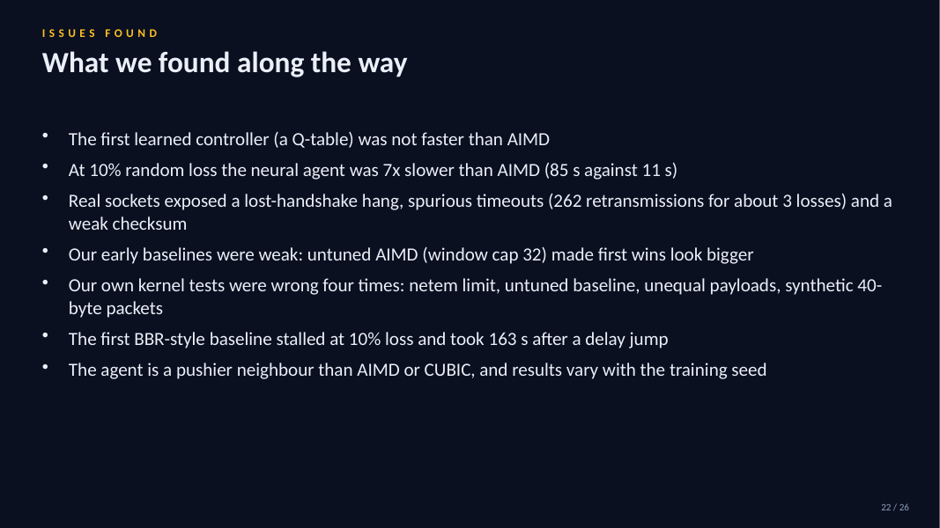
22. Issues
Time on this slide: 0:50
SAY
What went wrong: the Q-table was not faster, 7x slower at 10% loss, socket bugs, weak early baselines, and four mistakes in our own kernel tests.
IF ASKED Were results hidden? No; all are in the report.

Slide 25
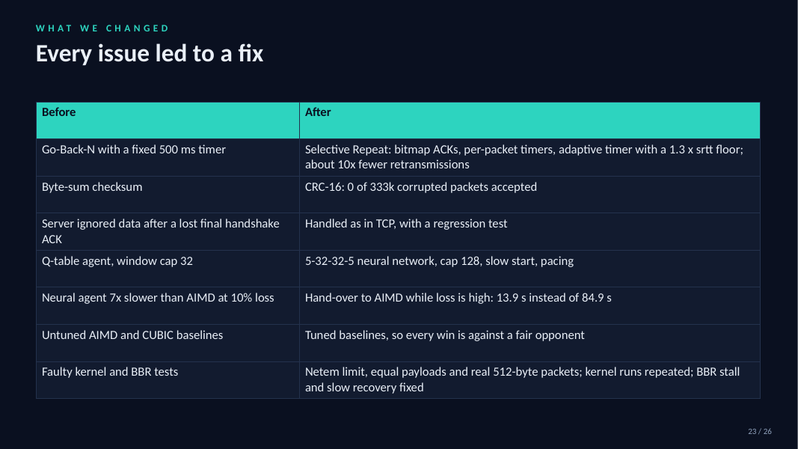
23. Changes
Time on this slide: 1:00
SAY
Each issue led to a fix: Selective Repeat, CRC-16, tuned baselines, neural net with hand-over, corrected kernel tests.
IF ASKED Biggest fix? Hand-over to AIMD: 84.9 s down to 13.9 s at 10% loss.

Slide 26
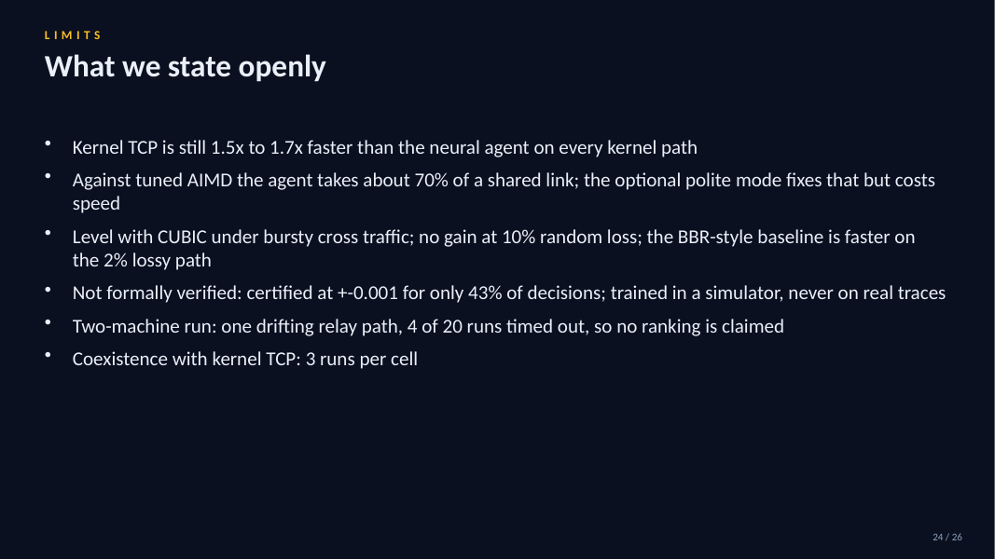
24. Limits
Time on this slide: 0:50
SAY
Kernel TCP is faster; the agent is pushier than AIMD; no formal verification; trained in a simulator; two-machine run is one relayed path.
IF ASKED Future work? Real traces, formal certification, a direct-LAN multi-machine run.

Slide 27
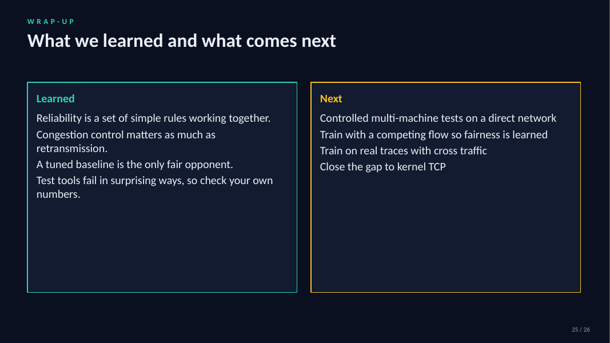
25. Learned
Time on this slide: 0:50
SAY
We learned protocol design, honest evaluation, and that tuned baselines matter. Next: real traces and certification.
IF ASKED What would you do first? A bigger real-network study.

Slide 28

26. Thank you
Time on this slide: 0:15
SAY
Thank you. Code and results are at github.com/Capsturrrr/replic.
IF ASKED Questions.

Slide 29
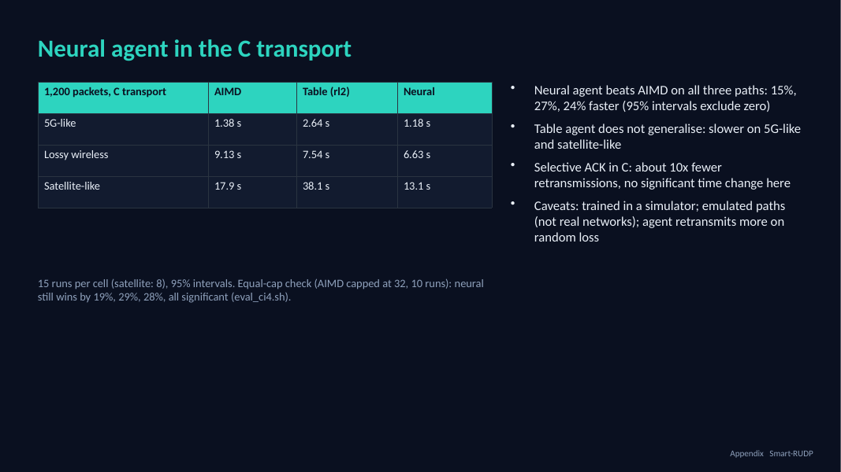
27. Neural agent in the C transport
Time on this slide: 1:00
SAY
We then put the neural agent into the C transport, the same code as Section 8, and tested it on the same three emulated paths with 15 runs each.
AIMD and the agents all start from a window of 10. The neural agent was faster than AIMD on all three: 15 percent on 5G-like, 27 percent on lossy, 24 percent on satellite-like. The intervals exclude zero.
The retrained table did not carry over: it was slower on 5G and satellite. A network generalises to unseen paths where a table does not.
We also added selective acknowledgments to the C code: about ten times fewer retransmissions, but no significant change in completion time on these emulated paths.
We also reran it with AIMD capped at 32 like the agent: the neural agent still wins by 19, 29 and 28 percent, all significant.
IF ASKED Q: So Smart-REPLIC now beats AIMD? A: The neural version does, in the C transport on emulated paths, trained in a simulator; the original table agent in Section 8 did not. Q: Is it fair? A: Same start window; AIMD keeps a cap of 128 while the agents are capped at 32; the agent retransmits more on random loss. Q: Why no gain from SACK? A: Those paths are limited by the bottleneck rate, so extra retransmissions cost little; the simulator, with different paths, showed a large gain.

Slide 30
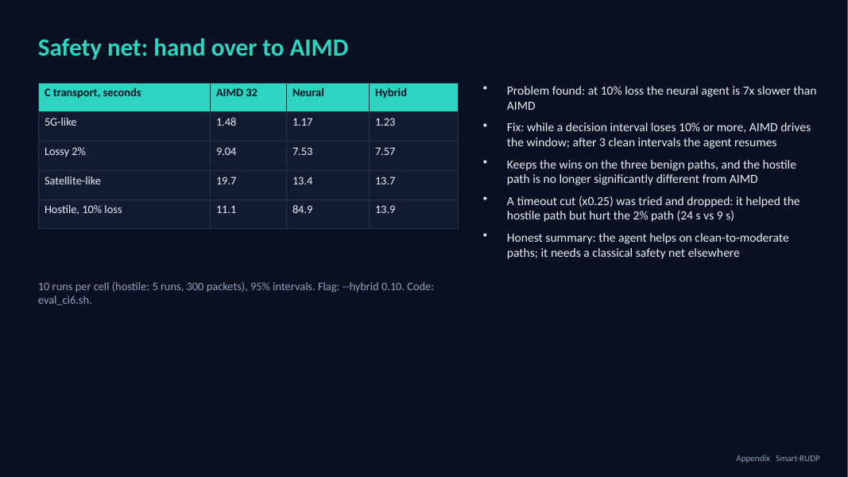
28. Safety net: hand over to AIMD
Time on this slide: 0:50
SAY
While checking our own result we found where the neural agent fails: on a hostile path with 10 percent loss it needed about 85 seconds where AIMD needed 11.
The fix is a hand-over: when a decision interval loses 10 percent or more of its packets, plain AIMD controls the window; after three clean intervals the agent takes over again.
With that, the three benign paths keep the agent's advantage and the hostile path is back near AIMD at about 14 seconds.
We also tried cutting the window on every timeout; it fixed the hostile case but made the 2 percent path much worse, so we dropped it. So the learned agent is useful on clean to moderate paths and needs a classical safety net elsewhere.
IF ASKED Is the hybrid still 'AI'? Yes on clean and moderate paths, where the neural network decides; on heavy loss it deliberately defers to AIMD. It is a rule we added, not something the network learned.

Slide 31
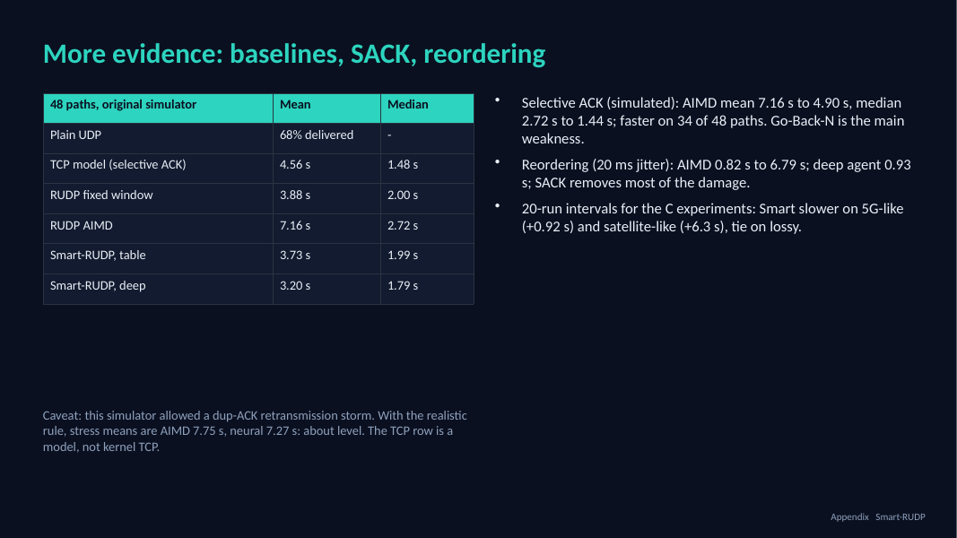
29. More evidence: baselines, SACK, reordering
Time on this slide: 1:00
SAY
The abstract also promised TCP and plain UDP baselines, so we ran them on the same 48 unseen simulated paths.
Plain UDP delivered only 68 percent of the messages, so reliability is needed. Our TCP model, with selective acknowledgments, has the lowest median at 1.48 seconds.
Smart-REPLIC deep is at 3.20 seconds mean and is about even with the TCP model path by path: faster on 22, slower on 23.
The gap to TCP is mostly Go-Back-N. A selective-ack version of our transport cut AIMD from 7.16 to 4.90 seconds in simulation.
Reordering hurts Go-Back-N badly: AIMD goes from 0.82 to 6.79 seconds at 20 milliseconds of jitter. The learned agents cope better and selective ack removes most of the damage.
For the C experiments we repeated 20 runs per mode: Smart-REPLIC is still slower on 5G and satellite and ties on lossy.
Be upfront: our simulator originally allowed a duplicate-ACK retransmission storm that flatters aggressive controllers. With the realistic rule the neural agent is about level with AIMD in simulation (7.27 s against 7.75 s). The C results are the evidence we rely on.
IF ASKED Q: Is the TCP row real TCP? A: No, it is a model with the same window cap; real kernel TCP needs netem on Linux, and we provide the script. Q: Why did you not implement SACK in C? A: Time; the simulation shows it is the biggest win and it is the first item of future work. Q: Is 20 runs enough? A: The intervals exclude zero for 5G and satellite and include zero for lossy. Did you check it is not a simulator artefact? Yes: with the realistic rule the simulated gain mostly disappears, so we lean on the C results, which use that rule and equal window caps.

Slide 32
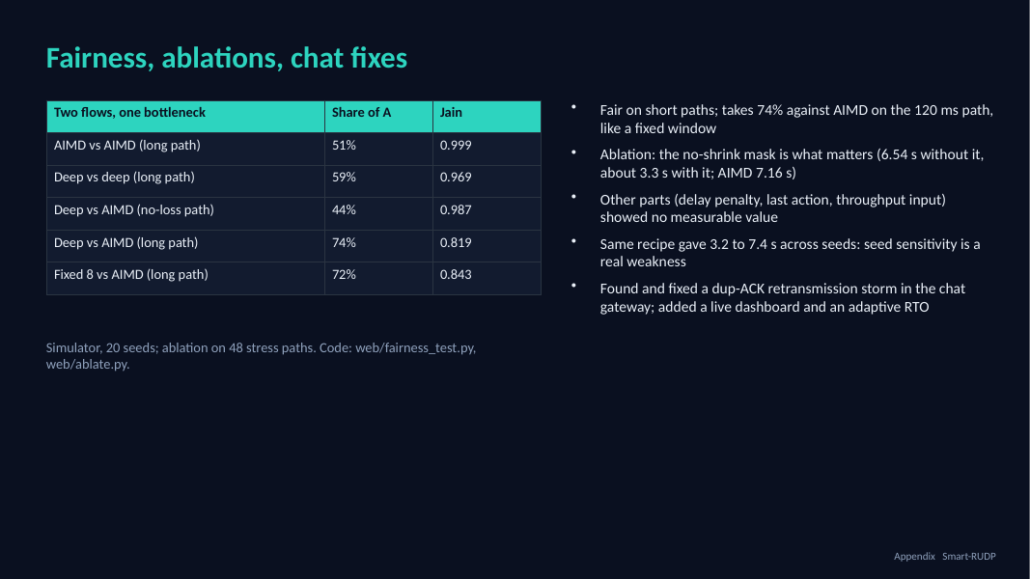
30. Fairness, ablations, chat fixes
Time on this slide: 0:50
SAY
We also tested two things people ask about. Fairness: two flows through one bottleneck. The neural agent is fair against itself and on short paths, but takes 74 percent against AIMD on the long 120 ms path, about like a fixed window.
Ablation: we retrained the agent with one piece removed. Only the no-shrink mask matters; without it the agent is no better than AIMD. The other pieces showed no measurable value.
The same recipe also gave very different results by seed, between 3.2 and 7.4 seconds, so we pick the seed on validation paths.
While building the dashboard we found a retransmission storm in the web gateway and fixed it; there is also an adaptive timeout option now.
IF ASKED Is the agent fair? Mostly, but not on the long path against AIMD (74% share, Jain 0.82). Fairness was only tested in the simulator, not in C.

Slide 33
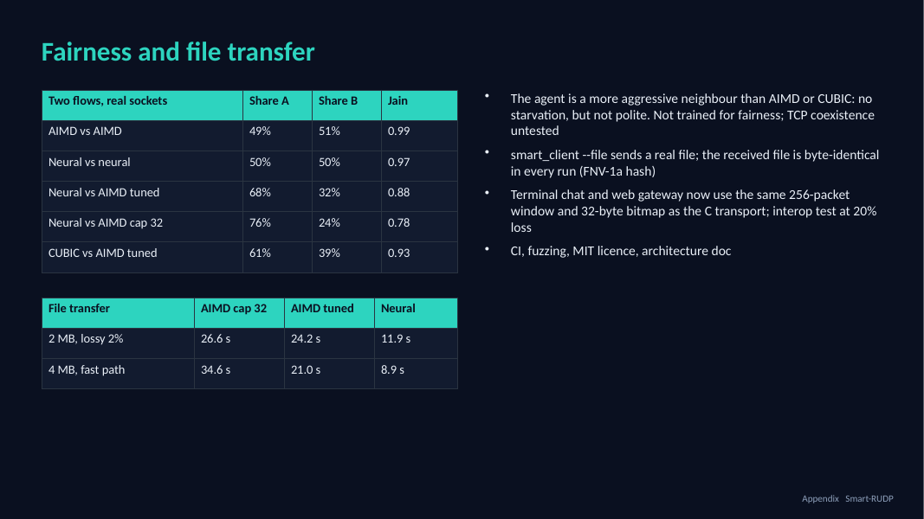
31. Fairness and file transfer
Time on this slide: 0:50
SAY
Fairness on real sockets: two neural flows split the link evenly, and so do two AIMD flows. But against tuned AIMD the neural agent takes 68 percent of the link, and 76 percent against the original AIMD. CUBIC takes 61 percent. So the agent is a more aggressive neighbour. Nothing starves, but it is not polite, and we did not test coexistence with TCP. That is our main limitation.
We also added file transfer: the sender sends a real file and the received file is byte-identical in every run. A 4 megabyte file over the fast path takes 8.9 seconds with the agent against 21 seconds with tuned AIMD.
The chat and web gateway now use the same window and bitmap as the C transport, and there is CI, fuzzing and an architecture document.
IF ASKED Would this be safe to deploy? Not on a shared link yet: it needs fairness-aware training and TCP coexistence tests. For a dedicated path it is a clear win.

Slide 34
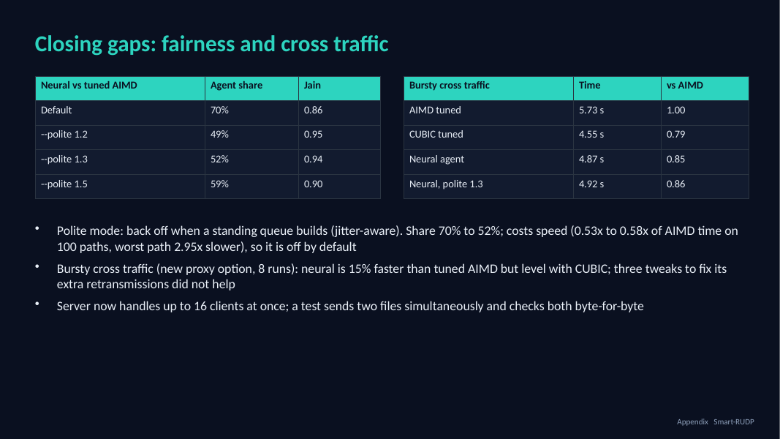
32. Closing gaps: fairness and cross traffic
Time on this slide: 0:50
SAY
We worked on the weaknesses we had listed. For fairness we added an optional polite mode: when a standing queue builds, the agent backs off. Over 8 runs against tuned AIMD it takes 52 percent of the link instead of 70, and the Jain index rises from 0.86 to 0.94. The price is speed: on 100 random paths the average time goes from 0.53 to 0.58 times AIMD's, and the worst path is 2.95 times slower, so it stays off by default.
We also added bursty cross traffic to the test proxy. Here the result is less flattering: the agent is 15 percent faster than tuned AIMD, but level with CUBIC, and it retransmits about three times as often as AIMD. Three tweaks did not fix that, so we report it as a limit. Finally the server now handles up to 16 clients, checked by sending two files at once.
IF ASKED Is polite mode learned? No. It is a hand-made rule on the delay signal. A learned version needs a two-flow training environment, which is future work.

Slide 35
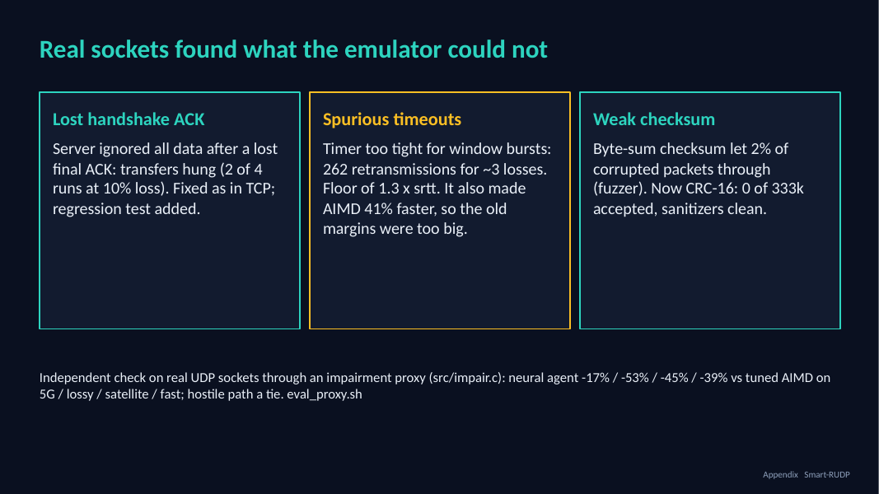
33. Real sockets found what the emulator could not
Time on this slide: 0:50
SAY
The emulator is inside our client, so we also tested through a separate impairment process on real UDP sockets. That found three real defects.
First, if the client's last handshake ACK is lost, the server ignored all following data and the transfer hung. We fixed it the way TCP does and added a regression test. Second, the spurious timeouts I just mentioned. Third, a fuzzer showed our byte-sum checksum let about 2 percent of corrupted packets through, so it is now CRC-16 and the fuzzer accepts none.
On real sockets the neural agent is again fastest on every path: 17, 53, 45 and 39 percent faster than tuned AIMD on 5G, lossy, satellite and fast, and a tie on the hostile path.
IF ASKED Is this a real network? It is real UDP sockets on one machine, with the impairment applied by a separate process. It is not a kernel netem or a multi-machine path; we provide the script for that but had no root access.

Slide 36
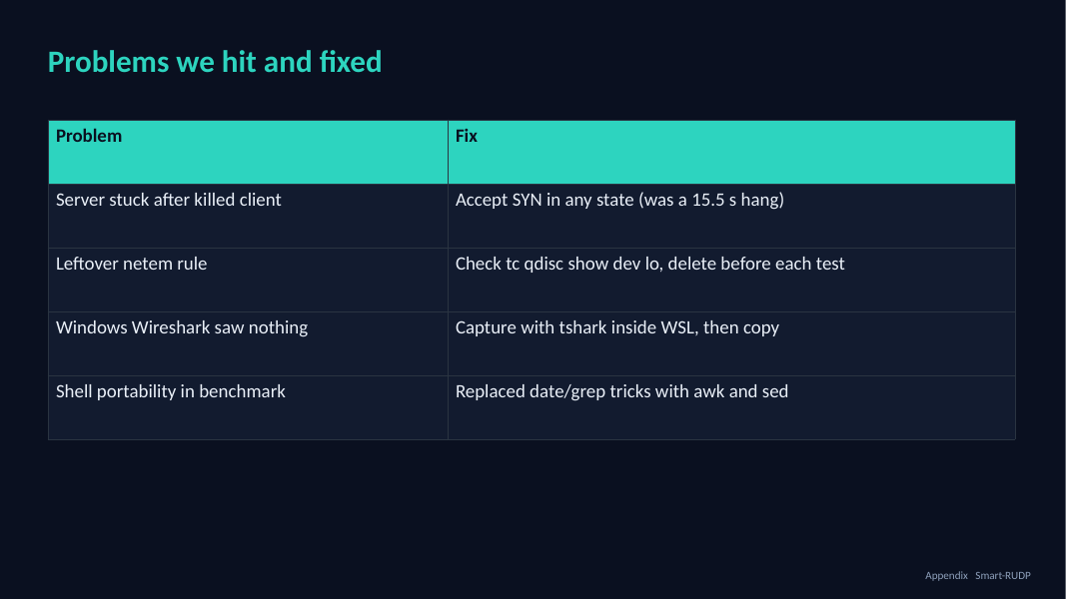
34. Problems we hit and fixed
Time on this slide: 0:40
SAY
Server stuck after a killed client: it hung 15.5 s; fix was to accept SYN in any state.
A leftover netem rule distorted results; we now check tc qdisc before each test.
Windows Wireshark saw nothing: capture inside WSL.
Benchmark script portability: replaced date and grep tricks with awk and sed.
IF ASKED Say these quickly: it shows real debugging, which is what separates a project from a lab.

Slide 37
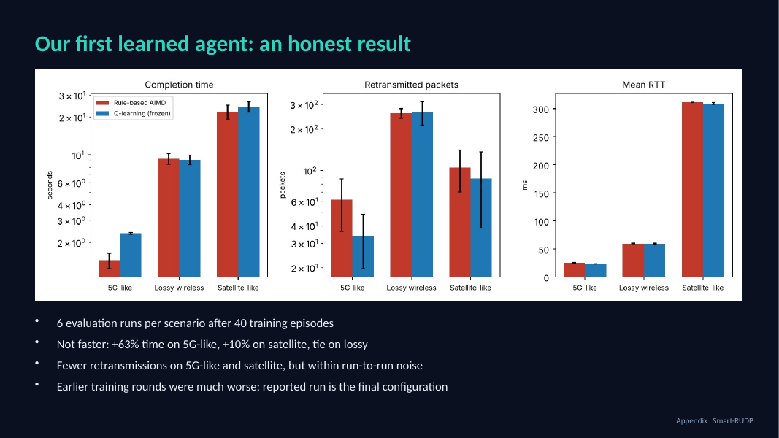
35. Our first learned agent: an honest result
Time on this slide: 0:50
SAY
Be honest: it did not beat AIMD. Plus 63 percent time on 5G-like, plus 10 percent on satellite, a tie on the lossy path.
It used somewhat fewer retransmissions on two paths, within run-to-run noise.
Earlier training rounds were much worse; this is the final configuration. The finding is that a simple learner does not beat a tuned rule.
In the chat, retrained for bursty random-loss traffic, it does beat AIMD on most simulated paths; mention that on slide 19.
IF ASKED Q: Then what was the point? A: The experiment. We tested whether a learned window helps and report the answer, including the negative result.

Slide 38
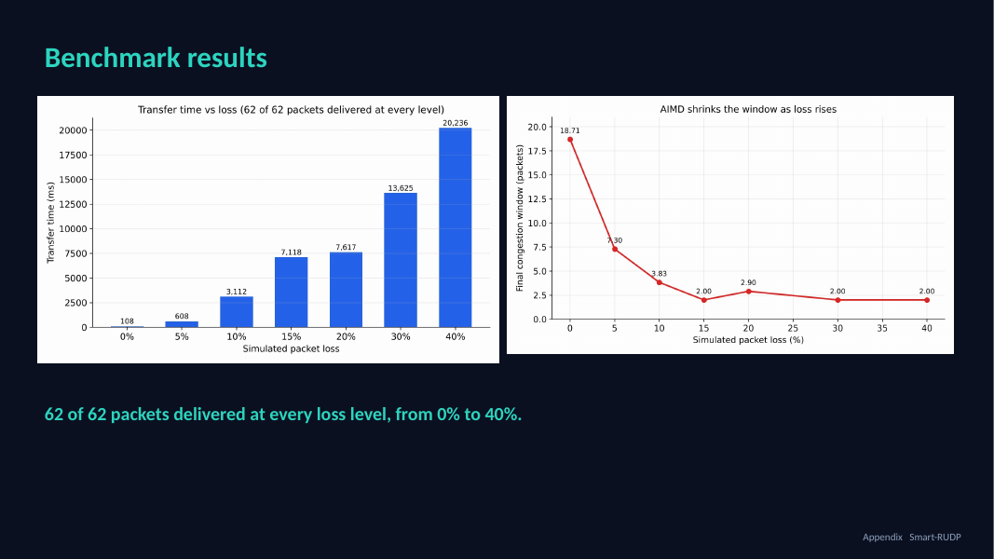
36. Benchmark results
Time on this slide: 0:40
SAY
62 of 62 packets were delivered at every loss level from 0 to 40 percent.
Higher loss costs time and retransmissions, never correctness.
IF ASKED Q: Single runs? A: Yes, the original benchmark ran each level once. Smart-REPLIC evaluation uses 6 runs per scenario.

Slide 39
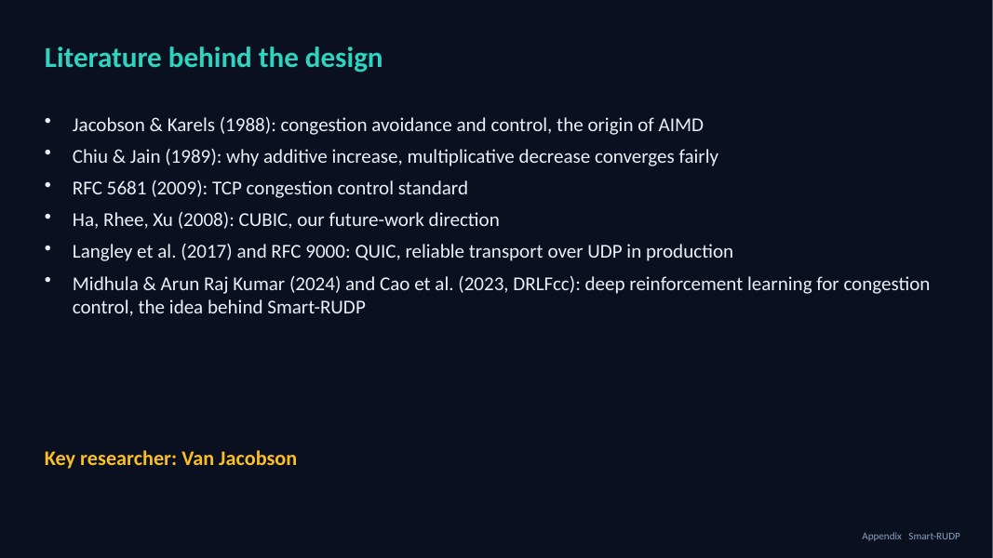
37. Literature behind the design
Time on this slide: 0:30
SAY
Jacobson and Karels 1988 is the origin of AIMD; Chiu and Jain 1989 explains why it converges fairly.
RFC 5681 is the standard; CUBIC is future work; QUIC and RFC 9000 are reliable transport over UDP in production.
The AI part comes from Midhula and Arun Raj Kumar (2024) and Cao et al. (2023, DRLFcc): deep reinforcement learning for congestion control. Smart-REPLIC applies the same idea with a smaller tabular Q-learning agent.
Key researcher: Van Jacobson.
IF ASKED Q: Why AIMD? A: Chiu and Jain show it converges to a fair share. Q: Are those papers deep RL and yours is not? A: Yes; we used a lookup table, which is simpler and inspectable.

Slide 40
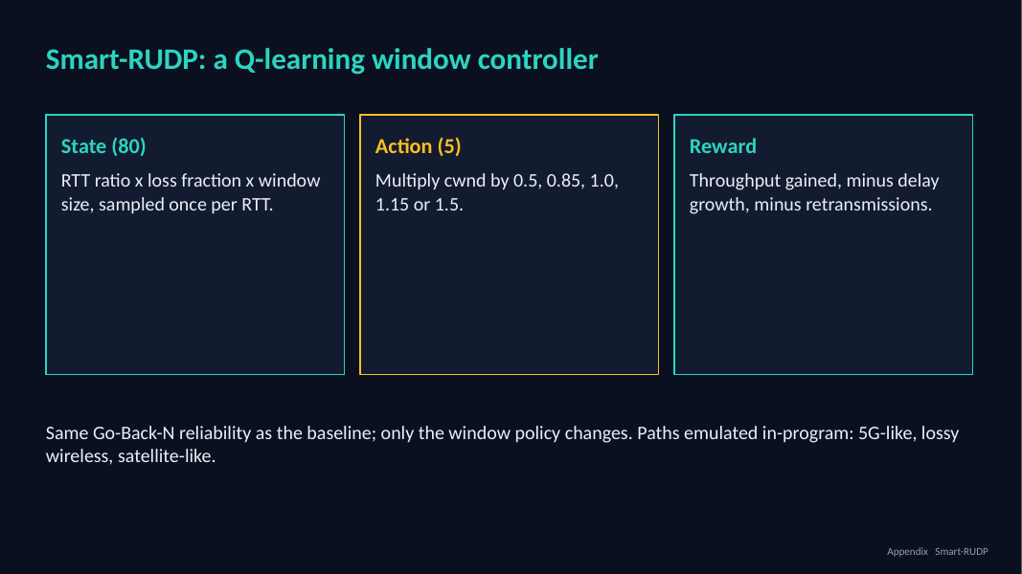
38. Smart-REPLIC: a Q-learning window controller
Time on this slide: 0:50
SAY
Q-learning with 80 states (RTT ratio, loss fraction, window size), sampled once per RTT.
Five actions: multiply the window by 0.5, 0.85, 1.0, 1.15 or 1.5.
Reward: throughput gained, minus delay growth, minus retransmissions. Same Go-Back-N reliability; only the window policy changes. Paths are emulated in the program: 5G-like, lossy wireless, satellite-like.
IF ASKED Q: Is it really learning? A: Yes, 40 training episodes; the learning-curve figure shows it. It is small and tabular with limited training.

Slide 41
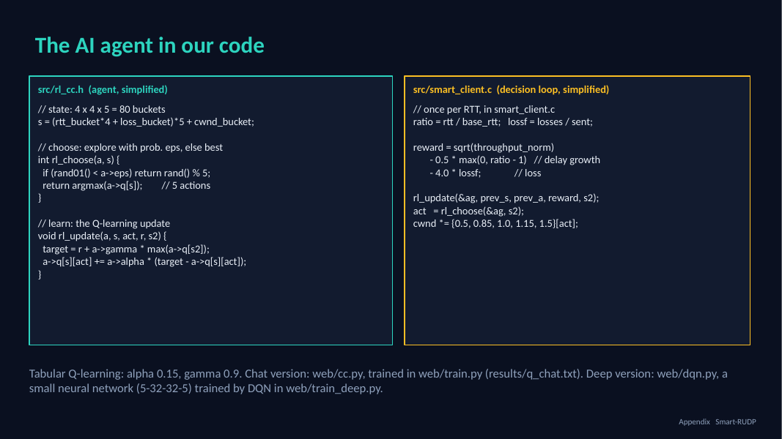
39. The AI agent in our code
Time on this slide: 1:00
SAY
This is the agent itself. Left: rl_cc.h, 73 lines of C. The state is 80 buckets of RTT ratio, loss and window size.
choose picks one of five window multipliers, usually the best, sometimes random so it keeps exploring.
update is the Q-learning rule: move the value of the action we took toward the reward plus the best value of the next state.
Right: the loop in smart_client.c. Once per RTT it computes the reward, throughput minus delay growth minus loss, updates the table, picks the next action and scales the window.
The code on the slide is simplified; the real files are in the repo.
We also built a deep version: web/dqn.py is a small neural network, two hidden layers of 32, trained with DQN in the same simulator. It reads continuous inputs instead of buckets.
IF ASKED Q: Is this deep RL? A: The C agent is tabular. The chat also has a deep agent, a small DQN in numpy (5-32-32-5). Q: Does deep beat the table? A: Modestly: 3.20 s vs 3.73 s mean on 48 unseen paths, faster on 19, slower on 6. Q: Any problem? A: Training is seed-sensitive: 1 of 4 seeds failed, so we select on validation paths. It is simulated and not in the C code. Q: Where is it trained? A: web/train.py for the chat, the smart client trains online for the main experiments; table in results/q_chat.txt.

Slide 42
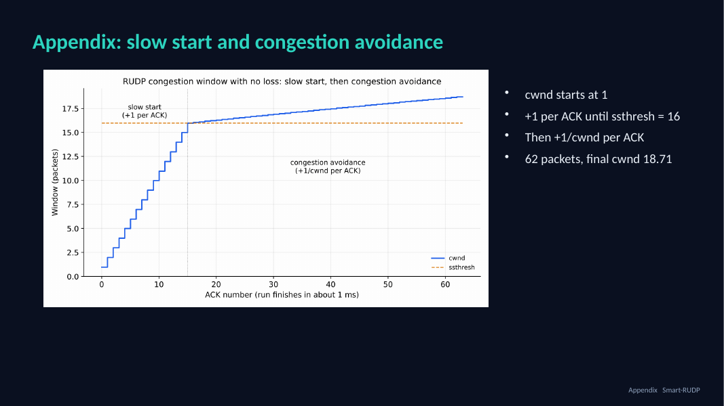
40. Appendix: slow start and congestion avoidance
Time on this slide: -
SAY
Only if asked: the window starts at 1, adds 1 per ACK until the threshold 16, then 1/window per ACK. In the 62-packet run the final window was 18.71.
IF ASKED Use this slide to answer 'show me congestion avoidance'.

Slide 43
Hard questions and short answers (1 of 3)
Is this a lab exercise?
A lab sends datagrams. We built reliability and congestion control on top, measured them, and used them in a real chat and a routed network.
Why not TCP?
TCP is in the kernel and cannot be changed. Building our own makes every mechanism visible. QUIC and HTTP/3 do the same.
Did Smart-REPLIC win?
Yes, in the final C transport against tuned baselines: 15 to 52 percent less time than tuned AIMD on four ordinary paths (real clock, real sockets and 100 random held-out paths agree), a tie on the 10 percent loss path. Against a simplified BBR it wins on the satellite-like and fast paths and loses on the 2 percent lossy path. The first tabular agent did not beat AIMD, and we say so.
Why Go-Back-N?
We started with it because it is simple to build and explain, then replaced it as the default with Selective Repeat: the receiver buffers out-of-order packets and reports them in an ACK bitmap, and the sender resends only what is missing. Go-Back-N stays behind a flag for comparison.
Was it tested between machines?
Yes. Delay, loss and jitter are emulated in our client, in a separate proxy on real UDP sockets, and in virtual time; these agree with each other. We also ran it once on the Linux kernel with tc netem on one laptop: the agent beat tuned AIMD there, but kernel TCP was 1.5 to 1.7 times faster than us. We also made one run between two laptops on different networks over a Tailscale relay: REPLIC delivered every transfer that finished, but the path drifted and four of twenty runs timed out, so we do not rank the policies from it; kernel TCP was 2 to 6 times faster on the clean repetitions.

Slide 44
Hard questions and short answers (2 of 3)
What does Packet Tracer prove?
The network design: OSPF, VLANs, ACL, 70/71 failover. The protocol is validated separately with emulation and Wireshark.
Peer disappears?
Sender keeps retransmitting on timeout. A connection abort after repeated timeouts is not built; it is the fix we would add.
Does the checksum catch errors?
It is CRC-16/CCITT now. The first version was a byte sum and a fuzzer showed 2 percent of corrupted packets got through; with CRC-16 none of 333,000 did. It cannot catch every error pattern, as no 16-bit check can.
Why no handshake in the exported trace?
The export builds synthetic packets. The real tshark capture shows SYN, SYN-ACK, ACK.
Is the baseline fair?
We tuned it: window cap 128 and a high start threshold, plus the same retransmission-timer floor for every policy. We also compare against tuned CUBIC. Tuned AIMD improved a lot, and the agent is still ahead on four paths.

Slide 45
Hard questions and short answers (3 of 3)
Is it fair to other flows?
No, not entirely: against tuned AIMD it takes 68 percent of a shared link, (CUBIC takes 61 percent). Nothing starves. We did not train for fairness. With unequal round-trip times two neural flows are fairer than two AIMD flows (Jain 0.84 against 0.64 at +150 ms). Against a kernel TCP flow on the same link it takes only 24 to 34 percent, so it does not starve TCP (three runs per cell).
How do you know the simulator is right?
The virtual-time mode runs our real C sender code with a simulated receiver and clock. It matched the real-clock runs in all 15 cells, and the real-socket proxy agrees too.
Is Q-learning really learning?
80 states, 5 actions, 40 episodes; the learning-curve figure shows it. Small and tabular, with limited training.
Did you compare with BBR?
Yes, a simplified BBR-style policy, not the Linux one. It beats tuned AIMD on four of five paths, is faster than our agent on the 2 percent lossy path, and slower on the satellite-like and fast paths. Two bugs in our own version were found and fixed.
Can the neural network be trusted?
In practice it is tolerant: noise of 0.2 on its inputs costs at most 12 percent, and a small decision tree gives the same transfer time on four of five paths. It is not formally verified: certification works only at tiny input changes.

