Slide 1
Smart-RUDP
Reliable UDP with learning-based congestion control, in C
Computer Networks | Faculty: Anuradha G
Harshavardhan Mallela 24BAI0274 Rohit Arya 24BCE0819 Shloak Sinha 24BDS0378

Slide 2
The problem
UDP
TCP
Fast and simple, but no guarantees: packets can be lost, duplicated or reordered.
Reliable, but lives inside the OS kernel. Hard to see, hard to change, hard to learn from.
In 1986 the early Internet suffered congestion collapse: throughput fell from 32 Kbps to 40 bps. TCP congestion control was invented to fix it.
Our question: can we rebuild TCP's core ideas ourselves, on top of UDP?
2 / 38 Smart-RUDP

Slide 3
Why we built it
The need
Our answer
Campus users send data to a server across a routed network. TCP is fixed inside the kernel; plain UDP gives no guarantees. Real systems (QUIC, HTTP/3) solve this with reliability built in user space over UDP.
RUDP: a readable, tunable reliable transport over UDP, plus Smart-RUDP, a controller that learns the window from RTT and loss.
Scenario: a student on VLAN 10 uploads a file to the server LAN. The ACL keeps students out of staff VLAN 20. If a core link fails, OSPF reroutes through R2: a longer path and higher RTT that the transport must adapt to.
Validated: protocol tests and Smart-RUDP vs AIMD on emulated paths; network design built and tested in Packet Tracer; traffic analysed in Wireshark.
3 / 38 Smart-RUDP

Slide 4
What we built
Handshake
Reliability
Flow control
Congestion control
SYN, SYN-ACK, ACK before any data flows.
Sequence numbers, ACKs, checksums, timeouts, retransmission.
Go-Back-N sliding window; its size is the congestion window.
AIMD: slow start, avoidance, halve on loss.
About 670 lines of C across 4 source files. Client + server, built in 8 phases, on github.com/Capsturrrr/rudp
4 / 38 Smart-RUDP

Slide 5
The RUDP packet header: 13 bytes
Field | Size | Purpose
seq | 4 B | Packet number
ack | 4 B | Next packet expected
flags | 1 B | SYN / ACK / FIN / DATA
checksum | 2 B | Detects corruption
payload_len | 2 B | Data length (max 512)
Fields packed byte by byte, so compiler struct padding never changes the wire format.
Data packet = 53 bytes on the wire. ACK / handshake = 13 bytes.
5 / 38 Smart-RUDP

Slide 6
Handshake and data flow
1
SYN
Client -> Server
Request a connection
2
SYN-ACK
Client <- Server
Server agrees
3
ACK
Client -> Server
ESTABLISHED, data may flow
4
DATA
Client -> Server
Up to window-size packets in flight
5
ACK
Client <- Server
Cumulative: confirms everything up to N
6
FIN
Client -> Server
Close the connection
Server accepts a new SYN in any state, so a killed client can never leave it stuck.
6 / 38 Smart-RUDP

Slide 7
Reliability: Go-Back-N
Window = cwnd packets in flight (fixed at 4 in Phase 4, then driven by cwnd)
Receiver sends cumulative ACKs
Retransmission timeout: 500 ms
Fast retransmit after 3 duplicate ACKs, no waiting for the timer
Checksum failures are dropped, then recovered by retransmission
Proof
In a netem 20% loss capture we saw 12 timeouts spaced about 500 ms apart.
Result
2,442-byte message reassembled correctly.
7 / 38 Smart-RUDP

Slide 8
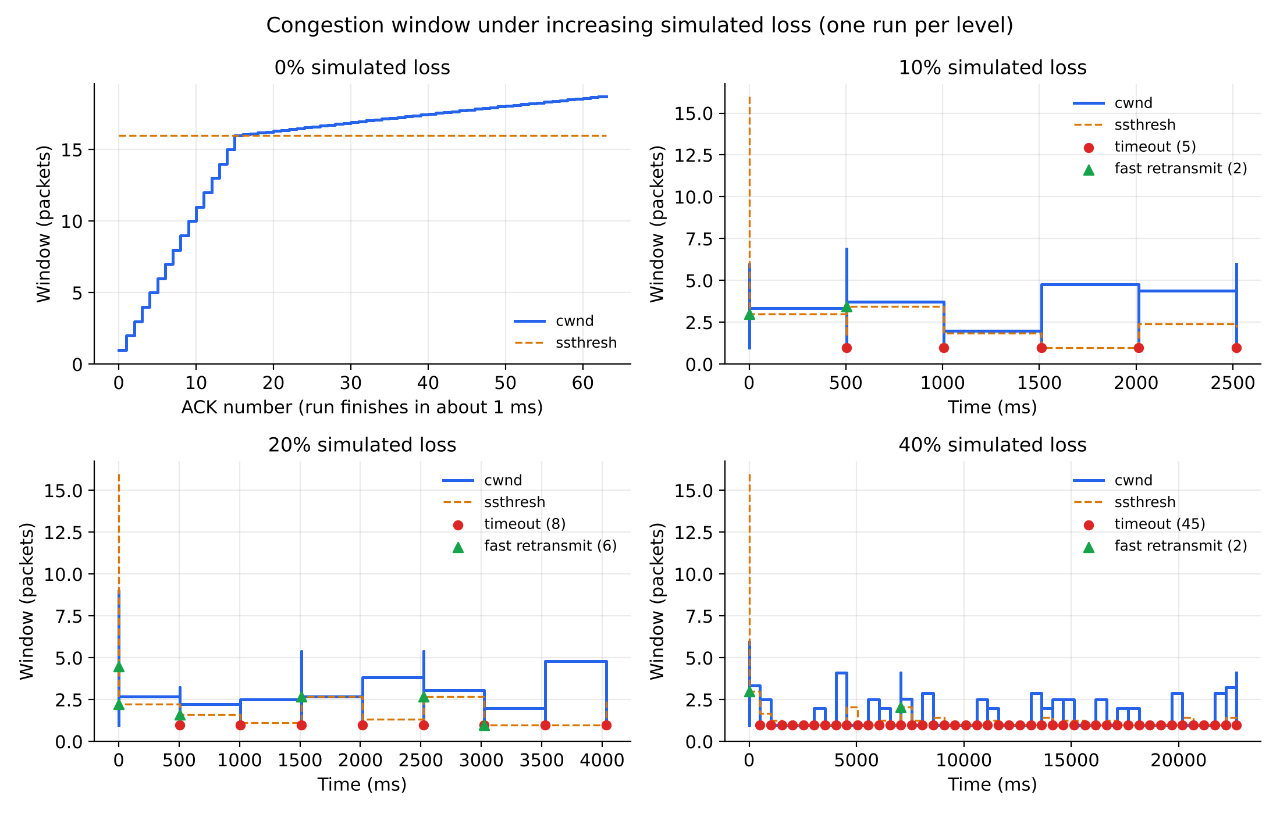
Congestion control: AIMD
Slow start: cwnd +1 per ACK, below ssthresh 16
Avoidance: cwnd + 1/cwnd per ACK
3 dup ACKs: cwnd halves
Timeout: cwnd resets to 1, ssthresh halves
Capped at 32
Fresh runs at 0%, 10%, 20% and 40% simulated loss. Red = timeout, green = fast retransmit.
8 / 38 Smart-RUDP

Slide 9
How we tested
Built-in loss simulator
tc / netem
Wireshark / tshark
Drops packets in code at a set percentage. Used for the benchmark.
Linux kernel injects real loss on loopback. Used to validate behaviour.
Captured in WSL, opened in Windows Wireshark. Confirmed handshake, ACKs, retransmissions.
Wireshark could not see WSL loopback from Windows, so we captured with tshark inside WSL and copied the file across.
9 / 38 Smart-RUDP

Slide 10


Benchmark results
62 of 62 packets delivered at every loss level, from 0% to 40%.
10 / 38 Smart-RUDP

Slide 11
Problems we hit and fixed
Problem | Fix
Server stuck after killed client | Accept SYN in any state (was a 15.5 s hang)
Leftover netem rule | Check tc qdisc show dev lo, delete before each test
Windows Wireshark saw nothing | Capture with tshark inside WSL, then copy
Shell portability in benchmark | Replaced date/grep tricks with awk and sed
11 / 38 Smart-RUDP

Slide 12
Literature behind the design
Jacobson & Karels (1988): congestion avoidance and control, the origin of AIMD
Chiu & Jain (1989): why additive increase, multiplicative decrease converges fairly
RFC 5681 (2009): TCP congestion control standard
Ha, Rhee, Xu (2008): CUBIC, our future-work direction
Langley et al. (2017) and RFC 9000: QUIC, reliable transport over UDP in production
Midhula & Arun Raj Kumar (2024) and Cao et al. (2023, DRLFcc): deep reinforcement learning for congestion control, the idea behind Smart-RUDP
Key researcher: Van Jacobson
12 / 38 Smart-RUDP

Slide 13

Network design: OSPF topology in Packet Tracer
4 routers, OSPF area 0 (R1-R2-R3 triangle, R4 branch)
2 VLANs, router-on-a-stick, DHCP on R1 and R4
Access list: student to staff blocked (verified)
Routes: server LAN metric 2 via R3, branch metric 3 via R2
Failover: shut R1 Gi0/2, 70/71 pings, reroute via R2 (metric 3)
Built and tested in Packet Tracer: OSPF adjacencies, routes, ACL and failover all verified.
13 / 38 Smart-RUDP

Slide 14
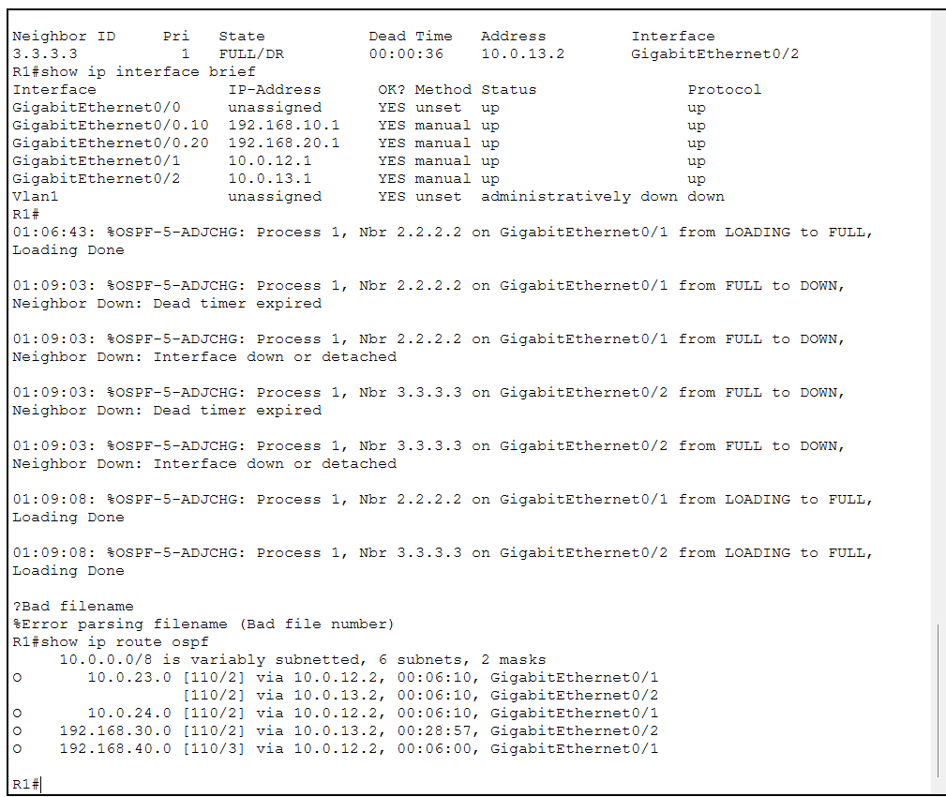
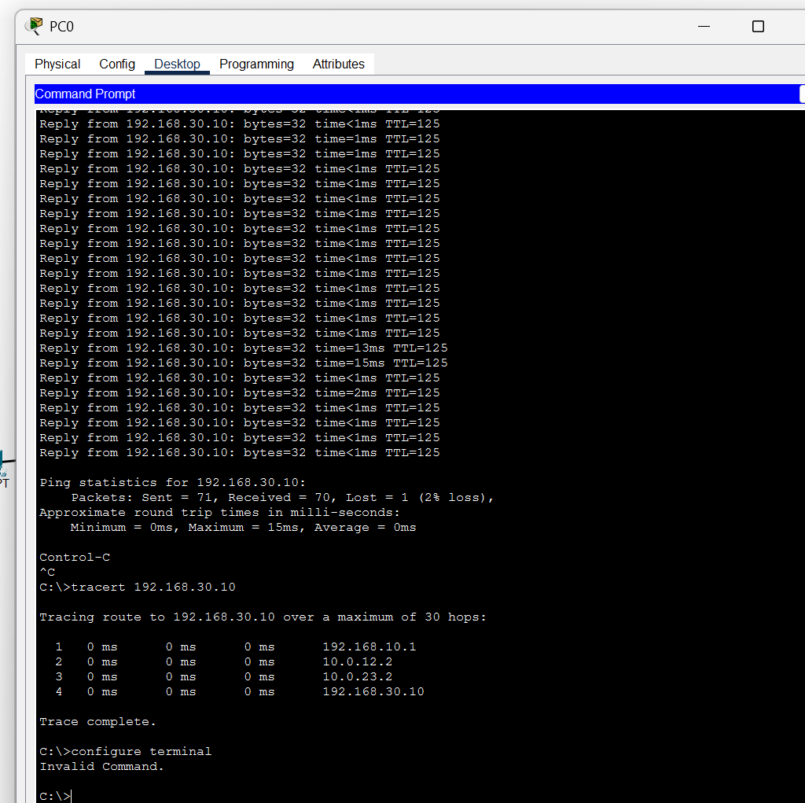
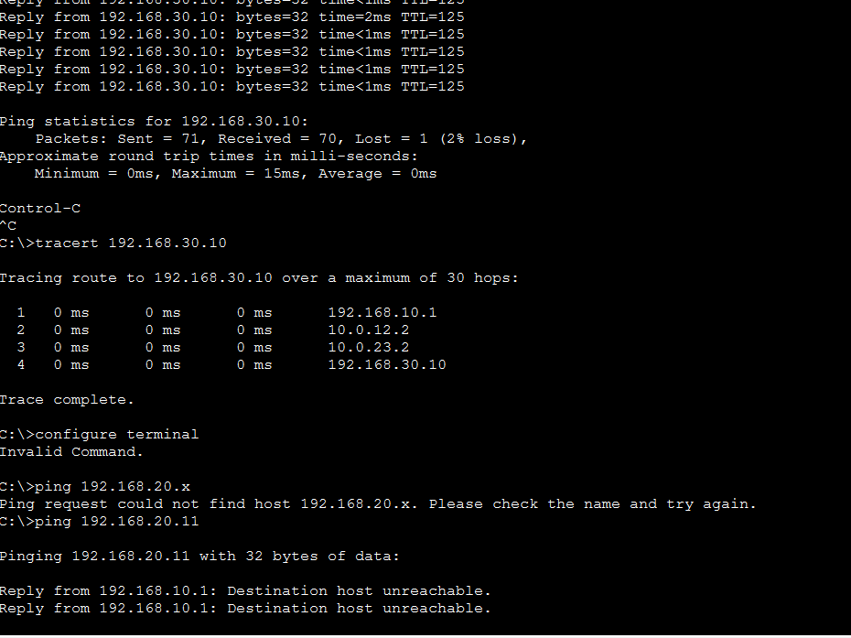
Packet Tracer results: routes, failover, ACL
OSPF routes on R1
Link failure: 70/71 pings, reroute
ACL: student blocked, staff allowed
Server LAN metric 2 via R3, branch LAN metric 3 via R2
Shutting R1 Gi0/2: traffic reroutes via R2, only 1 of 71 pings lost
Student PC gets "destination unreachable" to staff; server still reachable (TTL 126)
14 / 38 Smart-RUDP

Slide 15
Smart-RUDP: a Q-learning window controller
State (80)
Action (5)
Reward
RTT ratio x loss fraction x window size, sampled once per RTT.
Multiply cwnd by 0.5, 0.85, 1.0, 1.15 or 1.5.
Throughput gained, minus delay growth, minus retransmissions.
Same Go-Back-N reliability as the baseline; only the window policy changes. Paths emulated in-program: 5G-like, lossy wireless, satellite-like.
15 / 38 Smart-RUDP

Slide 16
The AI agent in our code
src/rl_cc.h (agent, simplified)
src/smart_client.c (decision loop, simplified)
// state: 4 x 4 x 5 = 80 buckets
s = (rtt_bucket*4 + loss_bucket)*5 + cwnd_bucket;
// choose: explore with prob. eps, else best
int rl_choose(a, s) {
if (rand01() < a->eps) return rand() % 5;
return argmax(a->q[s]); // 5 actions
}
// learn: the Q-learning update
void rl_update(a, s, act, r, s2) {
target = r + a->gamma * max(a->q[s2]);
a->q[s][act] += a->alpha * (target - a->q[s][act]);
}
// once per RTT, in smart_client.c
ratio = rtt / base_rtt; lossf = losses / sent;
reward = sqrt(throughput_norm)
- 0.5 * max(0, ratio - 1) // delay growth
- 4.0 * lossf; // loss
rl_update(&ag, prev_s, prev_a, reward, s2);
act = rl_choose(&ag, s2);
cwnd *= {0.5, 0.85, 1.0, 1.15, 1.5}[act];
Tabular Q-learning: alpha 0.15, gamma 0.9. Chat version: web/cc.py, trained in web/train.py (results/q_chat.txt). Deep version: web/dqn.py, a small neural network (5-32-32-5) trained by DQN in web/train_deep.py.
16 / 38 Smart-RUDP

Slide 17

Smart-RUDP vs AIMD: honest result
6 evaluation runs per scenario after 40 training episodes
Not faster: +63% time on 5G-like, +10% on satellite, tie on lossy
Fewer retransmissions on 5G-like and satellite, but within run-to-run noise
Earlier training rounds were much worse; reported run is the final configuration
17 / 38 Smart-RUDP

Slide 18
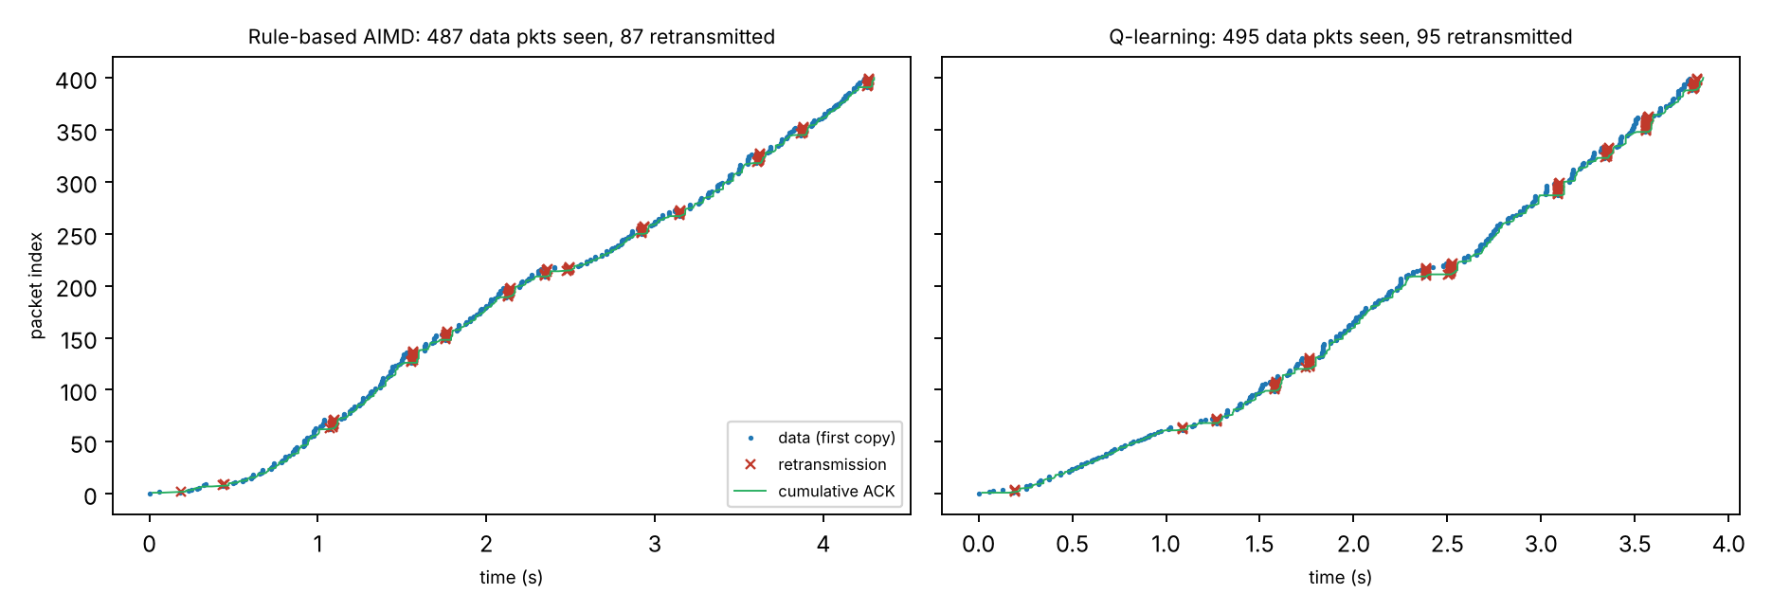
Wireshark: RUDP dissector and traces
rudp.lua decodes seq, ack, flags, checksum, length
Filters: smartrudp.flags.data == 1, smartrudp.seq == N
400 packets, lossy path: 87 (AIMD) and 95 (Smart) repeated data segments seen at the receiver
Trace exported by the program, topology addresses, handshake not included
18 / 38 Smart-RUDP

Slide 19


Wireshark: real capture
Left: SYN, SYN-ACK, ACK decoded by the smartrudp dissector (filter frame.number <= 3)
Right: smartrudp.seq == N shows the same segment sent twice, a retransmission
19 / 38 Smart-RUDP

Slide 20

Demo: RUDP Chat over the internet
Each message is one RUDP segment: numbered, checksummed, ACKed in order
Browser UI via a small gateway; terminal version too
Two machines linked over Tailscale (laptop and phone)
Loss slider: lost messages are resent and still arrive in order
Window controller switch: fixed, AIMD or Smart-RUDP (Q-learning, learns live)
Retrained for the chat: faster than AIMD on 5 of 6 held-out paths, equal on 1 (Table 11)
Stress test, 48 unseen paths: table 3.73 s, deep (DQN) 3.20 s, AIMD 7.16 s
Deep agent is seed-sensitive, so picked on validation paths
20 / 38 Smart-RUDP

Slide 21
More evidence: baselines, SACK, reordering
48 paths, original simulator | Mean | Median
Plain UDP | 68% delivered | -
TCP model (selective ACK) | 4.56 s | 1.48 s
RUDP fixed window | 3.88 s | 2.00 s
RUDP AIMD | 7.16 s | 2.72 s
Smart-RUDP, table | 3.73 s | 1.99 s
Smart-RUDP, deep | 3.20 s | 1.79 s
Selective ACK (simulated): AIMD mean 7.16 s to 4.90 s, median 2.72 s to 1.44 s; faster on 34 of 48 paths. Go-Back-N is the main weakness.
Reordering (20 ms jitter): AIMD 0.82 s to 6.79 s; deep agent 0.93 s; SACK removes most of the damage.
20-run intervals for the C experiments: Smart slower on 5G-like (+0.92 s) and satellite-like (+6.3 s), tie on lossy.
Caveat: this simulator allowed a dup-ACK retransmission storm. With the realistic rule, stress means are AIMD 7.75 s, neural 7.27 s: about level. The TCP row is a model, not kernel TCP.
21 / 38 Smart-RUDP

Slide 22
Neural agent in the C transport
1,200 packets, C transport | AIMD | Table (rl2) | Neural
5G-like | 1.38 s | 2.64 s | 1.18 s
Lossy wireless | 9.13 s | 7.54 s | 6.63 s
Satellite-like | 17.9 s | 38.1 s | 13.1 s
Neural agent beats AIMD on all three paths: 15%, 27%, 24% faster (95% intervals exclude zero)
Table agent does not generalise: slower on 5G-like and satellite-like
Selective ACK in C: about 10x fewer retransmissions, no significant time change here
Caveats: trained in a simulator; emulated paths (not real networks); agent retransmits more on random loss
15 runs per cell (satellite: 8), 95% intervals. Equal-cap check (AIMD capped at 32, 10 runs): neural still wins by 19%, 29%, 28%, all significant (eval_ci4.sh).
22 / 38 Smart-RUDP

Slide 23
Fairness, ablations, chat fixes
Two flows, one bottleneck | Share of A | Jain
AIMD vs AIMD (long path) | 51% | 0.999
Deep vs deep (long path) | 59% | 0.969
Deep vs AIMD (no-loss path) | 44% | 0.987
Deep vs AIMD (long path) | 74% | 0.819
Fixed 8 vs AIMD (long path) | 72% | 0.843
Fair on short paths; takes 74% against AIMD on the 120 ms path, like a fixed window
Ablation: the no-shrink mask is what matters (6.54 s without it, about 3.3 s with it; AIMD 7.16 s)
Other parts (delay penalty, last action, throughput input) showed no measurable value
Same recipe gave 3.2 to 7.4 s across seeds: seed sensitivity is a real weakness
Found and fixed a dup-ACK retransmission storm in the chat gateway; added a live dashboard and an adaptive RTO
Simulator, 20 seeds; ablation on 48 stress paths. Code: web/fairness_test.py, web/ablate.py.
23 / 38 Smart-RUDP

Slide 24
Safety net: hand over to AIMD
C transport, seconds | AIMD 32 | Neural | Hybrid
5G-like | 1.48 | 1.17 | 1.23
Lossy 2% | 9.04 | 7.53 | 7.57
Satellite-like | 19.7 | 13.4 | 13.7
Hostile, 10% loss | 11.1 | 84.9 | 13.9
Problem found: at 10% loss the neural agent is 7x slower than AIMD
Fix: while a decision interval loses 10% or more, AIMD drives the window; after 3 clean intervals the agent resumes
Keeps the wins on the three benign paths, and the hostile path is no longer significantly different from AIMD
A timeout cut (x0.25) was tried and dropped: it helped the hostile path but hurt the 2% path (24 s vs 9 s)
Honest summary: the agent helps on clean-to-moderate paths; it needs a classical safety net elsewhere
10 runs per cell (hostile: 5 runs, 300 packets), 95% intervals. Flag: --hybrid 0.10. Code: eval_ci6.sh.
24 / 38 Smart-RUDP

Slide 25
Selective Repeat is now the default
C transport, seconds | AIMD 32 | Neural | Gain
5G-like | 1.27 | 1.16 | 9%
Lossy 2% | 7.99 | 4.29 | 46%
Satellite-like | 25.7 | 12.9 | 50%
Hostile, 10% loss | 7.3 | 8.1 | tie
Receiver buffers out-of-order packets (64 window) and reports them in a bitmap in every ACK
Sender: one timer per packet; resends only the missing ones
Retransmissions drop about 10x; web chat 200 messages: 6.4 s vs 11.9 s (AIMD)
The neural agent now wins by more, and the 10% loss failure was mostly a Go-Back-N effect
Go-Back-N kept for comparison: --gbn / RUDP_GBN
10 runs per cell (hostile: 5), 95% intervals, all gains significant except the hostile row. Code: eval_ci7.sh.
25 / 38 Smart-RUDP

Slide 26
Final results: tuned baselines, real clock
Path (seconds) | AIMD cap 32 | AIMD tuned | CUBIC tuned | Neural
5G-like | 1.41 | 1.09 | 1.19 | 0.92
Lossy 2% | 7.98 | 7.05 | 13.92 | 3.62
Satellite-like | 17.93 | 11.36 | 8.26 | 5.46
Fast (3,000 pkts) | 14.55 | 8.20 | 6.52 | 3.92
Hostile 10% loss | 7.54 | 8.34 | 12.32 | 8.93
Neural agent fastest on 4 of 5 paths; significantly faster than tuned AIMD on all four: -15%, -49%, -52%, -52%
Faster than tuned CUBIC on lossy (-74%) and satellite (-34%); equal on 5G-like and fast; CUBIC is 2x slower than AIMD at 2% loss
Hostile 10% loss: no significant difference between any two policies
Retransmissions now low (3, 6, 4 packets): the old 262 were spurious timeouts, fixed with a timer floor that AIMD also benefits from
Real clock, real server process, 10 paired runs per path (hostile: 5), 95% intervals. eval_final.sh. Every policy uses the same timer, window cap rules and Selective Repeat.
26 / 38 Smart-RUDP

Slide 27
Real sockets found what the emulator could not
Lost handshake ACK
Spurious timeouts
Weak checksum
Server ignored all data after a lost final ACK: transfers hung (2 of 4 runs at 10% loss). Fixed as in TCP; regression test added.
Timer too tight for window bursts: 262 retransmissions for ~3 losses. Floor of 1.3 x srtt. It also made AIMD 41% faster, so the old margins were too big.
Byte-sum checksum let 2% of corrupted packets through (fuzzer). Now CRC-16: 0 of 333k accepted, sanitizers clean.
Independent check on real UDP sockets through an impairment proxy (src/impair.c): neural agent -17% / -53% / -45% / -39% vs tuned AIMD on 5G / lossy / satellite / fast; hostile path a tie. eval_proxy.sh
27 / 38 Smart-RUDP

Slide 28
A fast, faithful C simulator, and what it showed
--vt 1: the real C sender with a simulated receiver and clock, about 1000x faster; matches the real-clock runs in 15 of 15 cells
100 random held-out paths: neural agent 0.53x the time of tuned AIMD, faster on 89, never >20% slower (tuned CUBIC: slower by >20% on 27)
Biggest factors: window cap 128, pacing, timer floor, slow start
Evolution-strategy retraining in C: +2% only, not adopted
28 / 38 Smart-RUDP

Slide 29
Fairness and file transfer
Two flows, real sockets | Share A | Share B | Jain
AIMD vs AIMD | 49% | 51% | 0.99
Neural vs neural | 50% | 50% | 0.97
Neural vs AIMD tuned | 68% | 32% | 0.88
Neural vs AIMD cap 32 | 76% | 24% | 0.78
CUBIC vs AIMD tuned | 61% | 39% | 0.93
The agent is a more aggressive neighbour than AIMD or CUBIC: no starvation, but not polite. Not trained for fairness; TCP coexistence untested
smart_client --file sends a real file; the received file is byte-identical in every run (FNV-1a hash)
Terminal chat and web gateway now use the same 256-packet window and 32-byte bitmap as the C transport; interop test at 20% loss
CI, fuzzing, MIT licence, architecture doc
File transfer | AIMD cap 32 | AIMD tuned | Neural
2 MB, lossy 2% | 26.6 s | 24.2 s | 11.9 s
4 MB, fast path | 34.6 s | 21.0 s | 8.9 s
29 / 38 Smart-RUDP

Slide 30

Seeing the difference: the window
Same lossy path, same seed, same transport
AIMD (grey) saws between 5 and 15 packets and needs 9 s
The agent (green) rides much higher, backs off on loss, and finishes in 4 s
Regenerate: make figures
30 / 38 Smart-RUDP

Slide 31
Closing gaps: fairness and cross traffic
Neural vs tuned AIMD | Agent share | Jain
Default | 70% | 0.86
--polite 1.2 | 49% | 0.95
--polite 1.3 | 52% | 0.94
--polite 1.5 | 59% | 0.90
Bursty cross traffic | Time | vs AIMD
AIMD tuned | 5.73 s | 1.00
CUBIC tuned | 4.55 s | 0.79
Neural agent | 4.87 s | 0.85
Neural, polite 1.3 | 4.92 s | 0.86
Polite mode: back off when a standing queue builds (jitter-aware). Share 70% to 52%; costs speed (0.53x to 0.58x of AIMD time on 100 paths, worst path 2.95x slower), so it is off by default
Bursty cross traffic (new proxy option, 8 runs): neural is 15% faster than tuned AIMD but level with CUBIC; three tweaks to fix its extra retransmissions did not help
Server now handles up to 16 clients at once; a test sends two files simultaneously and checks both byte-for-byte
31 / 38 Smart-RUDP

Slide 32
Reality check: real kernel (tc/netem)
Path (500 packets) | TCP | AIMD tuned | Neural | vs AIMD
Lossy, 2% loss | 0.88 s | 4.75 s | 1.35 s | -71%
5G-like | 0.28 s | 1.23 s | 0.43 s | -65%
Satellite, 150 ms (3 runs) | 1.91 s | 16.7 s | 2.92 s | -83%
Reordering | 0.94 s | 4.06 s | 1.64 s | -60% (n.s.)
Kernel tc/netem on loopback, 5 runs per cell, 512-byte payloads for TCP, UDP and RUDP
Neural beats tuned AIMD on a real kernel path: 65% to 83% faster, significant on three paths
Kernel TCP is still faster than us everywhere: 1.5x to 1.7x
Sharing a link with kernel TCP: the neural agent takes only 24% to 34% (AIMD 5% to 17%); it does not starve TCP
Our first runs were wrong four times (netem limit; untuned baseline; unequal payloads; synthetic 40-byte packets). Found, fixed, re-run, documented
32 / 38 Smart-RUDP

Slide 33
Research gaps: changing paths and a BBR baseline
Mean time (s) | AIMD tuned | CUBIC | BBR-style | Neural
Bandwidth drop | 13.6 | 17.7 | 13.4 | 12.7
Bandwidth rise | 9.2 | 15.1 | 5.0 | 4.3
Delay jump | 33.3 | 27.5 | 25.9 | 19.8
Hand-over pattern | 12.8 | 21.4 | 10.8 | 8.2
2% lossy path (3,000 pkts) | 19.8 | 53.3 | 8.2 | 9.8
Satellite-like path | 32.8 | 26.6 | 16.8 | 11.2
Paths that change mid-transfer: neural fastest in 4 of 4 cases, at the cost of 1% to 6% retransmissions
A simplified BBR beats tuned AIMD on 4 of 5 paths and is faster than the agent on the 2% lossy path
Two bugs in our own BBR (stall at 10% loss; 163 s after a delay jump) found by these tests and fixed
Virtual time, 20 paired seeds; not the Linux BBR
33 / 38 Smart-RUDP

Slide 34
Research gaps: fairness and trust
Two identical flows | Extra RTT | Share short-RTT | Jain
AIMD / AIMD | 150 ms | 88% | 0.64
Neural / neural | 150 ms | 71% | 0.84
Neural flows are fairer than AIMD under unequal RTTs, but still favour the short-RTT flow (6 pairs per cell)
A depth-5 decision tree matches the network on only 79% of decisions, yet gives the same transfer time on 4 of 5 paths
Noise of 0.2 on the inputs costs at most 12%
Formal interval-bound certification: 43% of decisions at +-0.001, none at +-0.03. It is robust in practice but not proven
Coexistence with kernel TCP: neural takes 24% to 34% of a shared link, so it does not starve TCP (3 runs per cell)
34 / 38 Smart-RUDP

Slide 35
First run between two machines
Time (s) | TCP | AIMD | CUBIC | BBR-style | Neural
Rep 1 (clean) | 2.5 | 14.2 | 12.4 | 6.4 | 4.7
Rep 2 (clean) | 2.0 | 12.0 | - | - | -
Rep 3 | 39.3 | - | 240 | 53 | 71
Rep 4 | 11.4 | 87 | 218 | 69 | 111
Rep 5 | 50.9 | 143 | 167 | 44 | 32
Two laptops, different networks, Tailscale relay (about 79 ms RTT); 2 MB per transfer, 5 repetitions
RUDP works between real machines: every completed run delivered 4,000 of 4,000 packets
The path drifted (TCP alone 2 s to 51 s) and 4 of 20 RUDP runs timed out, so this is a demonstration, not a ranking
Clean reps: kernel TCP 2x to 6x faster; rep 1 the neural agent beat AIMD (4.7 s vs 14.2 s)
Next: repeat on a direct local network with more reps
35 / 38 Smart-RUDP

Slide 36
Learnings and future work
Learned
Next
Reliability is a set of simple rules working together.
Congestion control matters as much as retransmission.
Testing tools fail in surprising ways.
Fairness-aware training, TCP coexistence
Train on real traces with cross traffic
Close the gap to kernel TCP; controlled multi-machine tests
Limits: kernel TCP is 1.5x to 1.7x faster; one noisy two-machine run only; polite mode is a hand-made rule that costs speed; level with CUBIC under bursty cross traffic; no gain at 10% random loss; BBR-style baseline is faster on the 2% lossy path; coexistence with kernel TCP measured with only 3 runs per cell.
36 / 38 Smart-RUDP

Slide 37
Thank you
github.com/Capsturrrr/rudp
Harshavardhan Mallela Rohit Arya Shloak Sinha

Slide 38

Appendix: slow start and congestion avoidance
cwnd starts at 1
+1 per ACK until ssthresh = 16
Then +1/cwnd per ACK
62 packets, final cwnd 18.71
Appendix Smart-RUDP

