Slide 1
Smart-RUDP
Reliable UDP with learning-based congestion control, in C
Computer Networks | Faculty: Anuradha G
Harshavardhan Mallela 24BAI0274 Rohit Arya 24BCE0819 Shloak Sinha 24BDS0378
Notes:
[0:20] Good morning ma'am. We are Harshavardhan, Rohit and Shloak.
Our project is Smart-RUDP: a reliable transport protocol we built in C on top of UDP, plus a controller that learns how fast to send.
If asked: Say the three names and the GitHub link once, then move on.

Slide 2
The problem
UDP
TCP
Fast and simple, but no guarantees: packets can be lost, duplicated or reordered.
Reliable, but lives inside the OS kernel. Hard to see, hard to change, hard to learn from.
In 1986 the early Internet suffered congestion collapse: throughput fell from 32 Kbps to 40 bps. TCP congestion control was invented to fix it.
Our question: can we rebuild TCP's core ideas ourselves, on top of UDP?
2 / 38 Smart-RUDP
Notes:
[0:40] UDP is fast but gives no guarantees: packets can be lost, duplicated or reordered.
TCP is reliable but sits inside the operating system, so you cannot see or change it.
In 1986 the early Internet had congestion collapse: throughput fell from 32 Kbps to 40 bps. TCP's congestion control was invented to fix that.
Our question: can we rebuild TCP's core ideas ourselves, on UDP?
If asked: Q: Why not just use TCP? A: TCP cannot be changed or inspected; building our own makes every mechanism visible. QUIC and HTTP/3 do the same in practice.

Slide 3
Why we built it
The need
Our answer
Campus users send data to a server across a routed network. TCP is fixed inside the kernel; plain UDP gives no guarantees. Real systems (QUIC, HTTP/3) solve this with reliability built in user space over UDP.
RUDP: a readable, tunable reliable transport over UDP, plus Smart-RUDP, a controller that learns the window from RTT and loss.
Scenario: a student on VLAN 10 uploads a file to the server LAN. The ACL keeps students out of staff VLAN 20. If a core link fails, OSPF reroutes through R2: a longer path and higher RTT that the transport must adapt to.
Validated: protocol tests and Smart-RUDP vs AIMD on emulated paths; network design built and tested in Packet Tracer; traffic analysed in Wireshark.
3 / 38 Smart-RUDP
Notes:
[0:50] The need: campus users send data to a server across a routed network. TCP is fixed in the kernel; UDP gives no guarantees.
Our answer: RUDP, a readable and tunable transport, and Smart-RUDP, which learns the window from RTT and loss.
Scenario: a student on VLAN 10 uploads to the server LAN. The ACL keeps students out of staff VLAN 20. If a core link fails, OSPF reroutes through R2: longer path, higher RTT, and the transport must adapt.
If asked: Q: Is this just a lab exercise? A: A lab sends datagrams. We built reliability and congestion control on top, measured them, and used them in an application.

Slide 4
What we built
Handshake
Reliability
Flow control
Congestion control
SYN, SYN-ACK, ACK before any data flows.
Sequence numbers, ACKs, checksums, timeouts, retransmission.
Go-Back-N sliding window; its size is the congestion window.
AIMD: slow start, avoidance, halve on loss.
About 670 lines of C across 4 source files. Client + server, built in 8 phases, on github.com/Capsturrrr/rudp
4 / 38 Smart-RUDP
Notes:
[0:40] Four pieces: handshake, reliability, flow control and congestion control.
About 670 lines of C across four source files, built in eight phases, on GitHub at Capsturrrr/rudp.
If asked: Q: Who did what? A: Agree one answer as a team before you go in.

Slide 5
The RUDP packet header: 13 bytes
Field | Size | Purpose
seq | 4 B | Packet number
ack | 4 B | Next packet expected
flags | 1 B | SYN / ACK / FIN / DATA
checksum | 2 B | Detects corruption
payload_len | 2 B | Data length (max 512)
Fields packed byte by byte, so compiler struct padding never changes the wire format.
Data packet = 53 bytes on the wire. ACK / handshake = 13 bytes.
5 / 38 Smart-RUDP
Notes:
[0:40] 13-byte header: sequence 4, ack 4, flags 1, checksum 2, payload length 2.
Fields are packed byte by byte so compiler padding never changes the wire format.
A data packet is 53 bytes on the wire; ACKs and handshake packets are 13.
If asked: Q: How does the checksum work? A: 16-bit one's-complement sum over header and payload, like UDP/TCP. A corrupted packet fails and is recovered by retransmission.

Slide 6
Handshake and data flow
1
SYN
Client -> Server
Request a connection
2
SYN-ACK
Client <- Server
Server agrees
3
ACK
Client -> Server
ESTABLISHED, data may flow
4
DATA
Client -> Server
Up to window-size packets in flight
5
ACK
Client <- Server
Cumulative: confirms everything up to N
6
FIN
Client -> Server
Close the connection
Server accepts a new SYN in any state, so a killed client can never leave it stuck.
6 / 38 Smart-RUDP
Notes:
[0:50] Three-way handshake: SYN, SYN-ACK, ACK. Then data, up to a window of packets in flight.
ACKs are cumulative: ACK N confirms everything before N. FIN closes the connection.
The server accepts a new SYN in any state, so a killed client can never leave it stuck. That was a real bug we fixed.
If asked: Q: What if the peer disappears? A: Sender keeps retransmitting on timeout. An abort after repeated timeouts is not implemented; it is the fix we would add.

Slide 7
Reliability: Go-Back-N
Window = cwnd packets in flight (fixed at 4 in Phase 4, then driven by cwnd)
Receiver sends cumulative ACKs
Retransmission timeout: 500 ms
Fast retransmit after 3 duplicate ACKs, no waiting for the timer
Checksum failures are dropped, then recovered by retransmission
Proof
In a netem 20% loss capture we saw 12 timeouts spaced about 500 ms apart.
Result
2,442-byte message reassembled correctly.
7 / 38 Smart-RUDP
Notes:
[0:50] The window is the number of packets in flight; it started fixed at 4 and is now driven by the congestion window.
Timeout is 500 ms; fast retransmit triggers after 3 duplicate ACKs, no waiting for the timer.
Proof: in a 20% loss netem capture we saw 12 timeouts about 500 ms apart. Result: the 2,442-byte message reassembled correctly.
If asked: Q: Why Go-Back-N? A: Simpler to build and explain. It wastes bandwidth under loss; Selective Repeat with SACK is our stated future work.

Slide 8
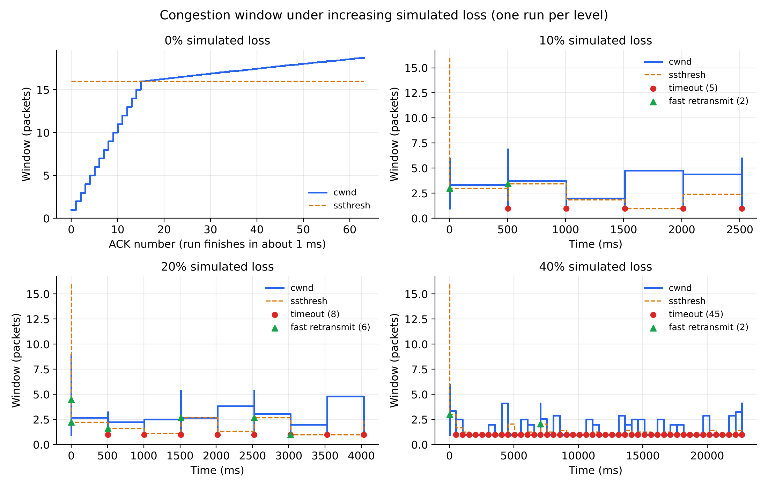
Congestion control: AIMD
Slow start: cwnd +1 per ACK, below ssthresh 16
Avoidance: cwnd + 1/cwnd per ACK
3 dup ACKs: cwnd halves
Timeout: cwnd resets to 1, ssthresh halves
Capped at 32
Fresh runs at 0%, 10%, 20% and 40% simulated loss. Red = timeout, green = fast retransmit.
8 / 38 Smart-RUDP
Notes:
[0:50] Slow start: window grows by one per ACK until the threshold of 16. Then avoidance: plus 1/window per ACK.
Three duplicate ACKs: window halves. A timeout: window resets to 1 and the threshold halves. Cap is 32.
The graph shows fresh runs at 0, 10, 20 and 40 percent loss. Red marks are timeouts, green are fast retransmits.
If asked: Q: Why cap 32 and ssthresh 16? A: The cap stops a lossless run growing without bound; 16 is where doubling switches to linear growth.

Slide 9
How we tested
Built-in loss simulator
tc / netem
Wireshark / tshark
Drops packets in code at a set percentage. Used for the benchmark.
Linux kernel injects real loss on loopback. Used to validate behaviour.
Captured in WSL, opened in Windows Wireshark. Confirmed handshake, ACKs, retransmissions.
Wireshark could not see WSL loopback from Windows, so we captured with tshark inside WSL and copied the file across.
9 / 38 Smart-RUDP
Notes:
[0:40] Three tools: a loss simulator inside the code (used for the benchmark), Linux tc/netem injecting real loss on loopback, and Wireshark/tshark.
Windows Wireshark could not see WSL loopback, so we captured with tshark inside WSL and copied the file across.
If asked: Q: Is the loss real? A: Benchmark and chat loss is simulated in the program. We also captured a real loopback run with tshark and netem loss.

Slide 10


Benchmark results
62 of 62 packets delivered at every loss level, from 0% to 40%.
10 / 38 Smart-RUDP
Notes:
[0:40] 62 of 62 packets were delivered at every loss level from 0 to 40 percent.
Higher loss costs time and retransmissions, never correctness.
If asked: Q: Single runs? A: Yes, the original benchmark ran each level once. Smart-RUDP evaluation uses 6 runs per scenario.

Slide 11
Problems we hit and fixed
Problem | Fix
Server stuck after killed client | Accept SYN in any state (was a 15.5 s hang)
Leftover netem rule | Check tc qdisc show dev lo, delete before each test
Windows Wireshark saw nothing | Capture with tshark inside WSL, then copy
Shell portability in benchmark | Replaced date/grep tricks with awk and sed
11 / 38 Smart-RUDP
Notes:
[0:40] Server stuck after a killed client: it hung 15.5 s; fix was to accept SYN in any state.
A leftover netem rule distorted results; we now check tc qdisc before each test.
Windows Wireshark saw nothing: capture inside WSL.
Benchmark script portability: replaced date and grep tricks with awk and sed.
If asked: Say these quickly: it shows real debugging, which is what separates a project from a lab.

Slide 12
Literature behind the design
Jacobson & Karels (1988): congestion avoidance and control, the origin of AIMD
Chiu & Jain (1989): why additive increase, multiplicative decrease converges fairly
RFC 5681 (2009): TCP congestion control standard
Ha, Rhee, Xu (2008): CUBIC, our future-work direction
Langley et al. (2017) and RFC 9000: QUIC, reliable transport over UDP in production
Midhula & Arun Raj Kumar (2024) and Cao et al. (2023, DRLFcc): deep reinforcement learning for congestion control, the idea behind Smart-RUDP
Key researcher: Van Jacobson
12 / 38 Smart-RUDP
Notes:
[0:30] Jacobson and Karels 1988 is the origin of AIMD; Chiu and Jain 1989 explains why it converges fairly.
RFC 5681 is the standard; CUBIC is future work; QUIC and RFC 9000 are reliable transport over UDP in production.
The AI part comes from Midhula and Arun Raj Kumar (2024) and Cao et al. (2023, DRLFcc): deep reinforcement learning for congestion control. Smart-RUDP applies the same idea with a smaller tabular Q-learning agent.
Key researcher: Van Jacobson.
If asked: Q: Why AIMD? A: Chiu and Jain show it converges to a fair share. Q: Are those papers deep RL and yours is not? A: Yes; we used a lookup table, which is simpler and inspectable.

Slide 13

Network design: OSPF topology in Packet Tracer
4 routers, OSPF area 0 (R1-R2-R3 triangle, R4 branch)
2 VLANs, router-on-a-stick, DHCP on R1 and R4
Access list: student to staff blocked (verified)
Routes: server LAN metric 2 via R3, branch metric 3 via R2
Failover: shut R1 Gi0/2, 70/71 pings, reroute via R2 (metric 3)
Built and tested in Packet Tracer: OSPF adjacencies, routes, ACL and failover all verified.
13 / 38 Smart-RUDP
Notes:
[0:50] Four routers, OSPF area 0: R1, R2, R3 form a triangle and R4 is a branch.
Two VLANs with router-on-a-stick, DHCP on R1 and R4, and an access list blocking student to staff.
Server LAN is metric 2 via R3; branch is metric 3 via R2. Failover: shutting R1 Gi0/2 still gave 70 of 71 pings, rerouted via R2.
If asked: Q: Does RUDP run inside Packet Tracer? A: No, it cannot run C. Packet Tracer validates the network design; protocol is validated on one machine plus Wireshark.

Slide 14
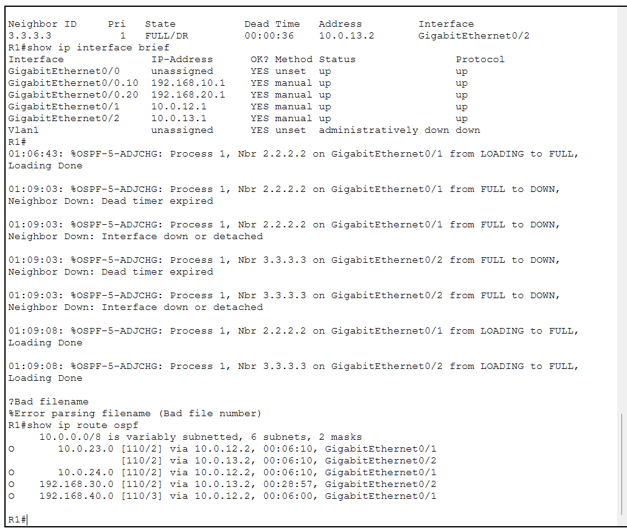
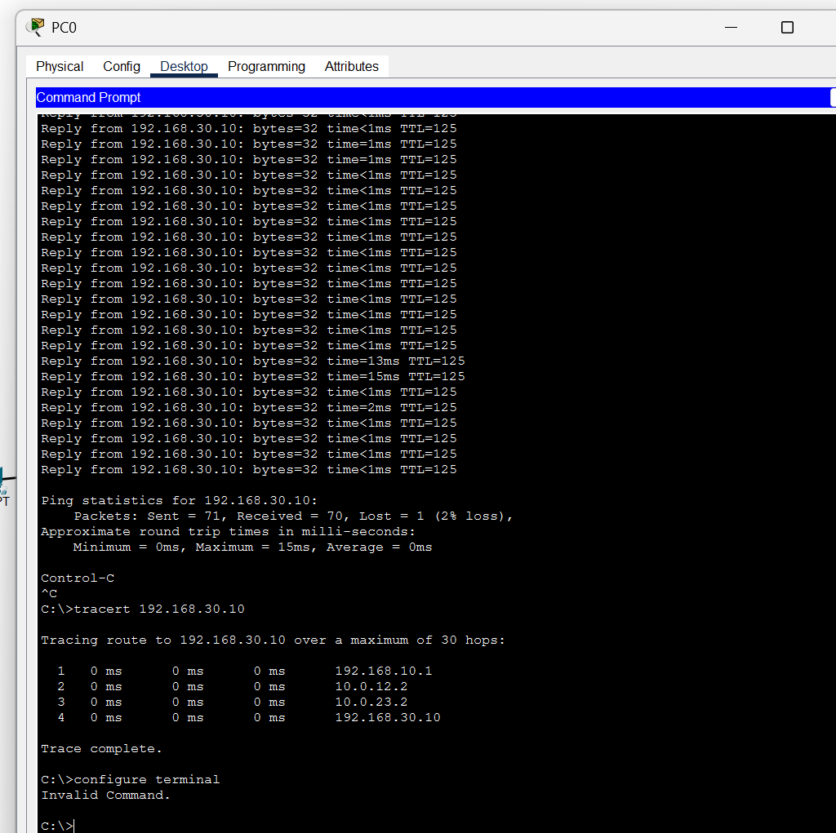
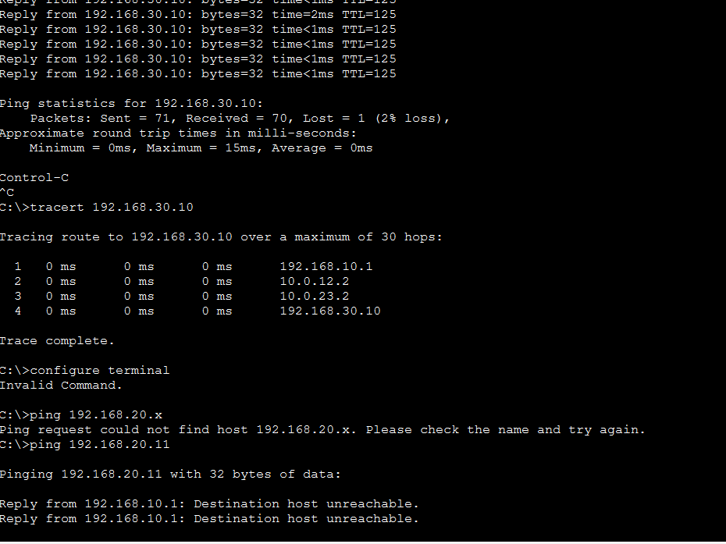
Packet Tracer results: routes, failover, ACL
OSPF routes on R1
Link failure: 70/71 pings, reroute
ACL: student blocked, staff allowed
Server LAN metric 2 via R3, branch LAN metric 3 via R2
Shutting R1 Gi0/2: traffic reroutes via R2, only 1 of 71 pings lost
Student PC gets "destination unreachable" to staff; server still reachable (TTL 126)
14 / 38 Smart-RUDP
Notes:
[0:40] Left: OSPF routes on R1 with the metrics. Middle: the link-failure test, 70 of 71 pings. Right: the ACL, where the student gets destination unreachable to staff but the server is still reachable (TTL 126).
If asked: If asked to show it live: have the .pkt file open and follow Demo_Steps.txt.

Slide 15
Smart-RUDP: a Q-learning window controller
State (80)
Action (5)
Reward
RTT ratio x loss fraction x window size, sampled once per RTT.
Multiply cwnd by 0.5, 0.85, 1.0, 1.15 or 1.5.
Throughput gained, minus delay growth, minus retransmissions.
Same Go-Back-N reliability as the baseline; only the window policy changes. Paths emulated in-program: 5G-like, lossy wireless, satellite-like.
15 / 38 Smart-RUDP
Notes:
[0:50] Q-learning with 80 states (RTT ratio, loss fraction, window size), sampled once per RTT.
Five actions: multiply the window by 0.5, 0.85, 1.0, 1.15 or 1.5.
Reward: throughput gained, minus delay growth, minus retransmissions. Same Go-Back-N reliability; only the window policy changes. Paths are emulated in the program: 5G-like, lossy wireless, satellite-like.
If asked: Q: Is it really learning? A: Yes, 40 training episodes; the learning-curve figure shows it. It is small and tabular with limited training.

Slide 16
The AI agent in our code
src/rl_cc.h (agent, simplified)
src/smart_client.c (decision loop, simplified)
// state: 4 x 4 x 5 = 80 buckets
s = (rtt_bucket*4 + loss_bucket)*5 + cwnd_bucket;
// choose: explore with prob. eps, else best
int rl_choose(a, s) {
if (rand01() < a->eps) return rand() % 5;
return argmax(a->q[s]); // 5 actions
}
// learn: the Q-learning update
void rl_update(a, s, act, r, s2) {
target = r + a->gamma * max(a->q[s2]);
a->q[s][act] += a->alpha * (target - a->q[s][act]);
}
// once per RTT, in smart_client.c
ratio = rtt / base_rtt; lossf = losses / sent;
reward = sqrt(throughput_norm)
- 0.5 * max(0, ratio - 1) // delay growth
- 4.0 * lossf; // loss
rl_update(&ag, prev_s, prev_a, reward, s2);
act = rl_choose(&ag, s2);
cwnd *= {0.5, 0.85, 1.0, 1.15, 1.5}[act];
Tabular Q-learning: alpha 0.15, gamma 0.9. Chat version: web/cc.py, trained in web/train.py (results/q_chat.txt). Deep version: web/dqn.py, a small neural network (5-32-32-5) trained by DQN in web/train_deep.py.
16 / 38 Smart-RUDP
Notes:
[1:00] This is the agent itself. Left: rl_cc.h, 73 lines of C. The state is 80 buckets of RTT ratio, loss and window size.
choose picks one of five window multipliers, usually the best, sometimes random so it keeps exploring.
update is the Q-learning rule: move the value of the action we took toward the reward plus the best value of the next state.
Right: the loop in smart_client.c. Once per RTT it computes the reward, throughput minus delay growth minus loss, updates the table, picks the next action and scales the window.
The code on the slide is simplified; the real files are in the repo.
We also built a deep version: web/dqn.py is a small neural network, two hidden layers of 32, trained with DQN in the same simulator. It reads continuous inputs instead of buckets.
If asked: Q: Is this deep RL? A: The C agent is tabular. The chat also has a deep agent, a small DQN in numpy (5-32-32-5). Q: Does deep beat the table? A: Modestly: 3.20 s vs 3.73 s mean on 48 unseen paths, faster on 19, slower on 6. Q: Any problem? A: Training is seed-sensitive: 1 of 4 seeds failed, so we select on validation paths. It is simulated and not in the C code. Q: Where is it trained? A: web/train.py for the chat, the smart client trains online for the main experiments; table in results/q_chat.txt.

Slide 17

Smart-RUDP vs AIMD: honest result
6 evaluation runs per scenario after 40 training episodes
Not faster: +63% time on 5G-like, +10% on satellite, tie on lossy
Fewer retransmissions on 5G-like and satellite, but within run-to-run noise
Earlier training rounds were much worse; reported run is the final configuration
17 / 38 Smart-RUDP
Notes:
[0:50] Be honest: it did not beat AIMD. Plus 63 percent time on 5G-like, plus 10 percent on satellite, a tie on the lossy path.
It used somewhat fewer retransmissions on two paths, within run-to-run noise.
Earlier training rounds were much worse; this is the final configuration. The finding is that a simple learner does not beat a tuned rule.
In the chat, retrained for bursty random-loss traffic, it does beat AIMD on most simulated paths; mention that on slide 19.
If asked: Q: Then what was the point? A: The experiment. We tested whether a learned window helps and report the answer, including the negative result.

Slide 18
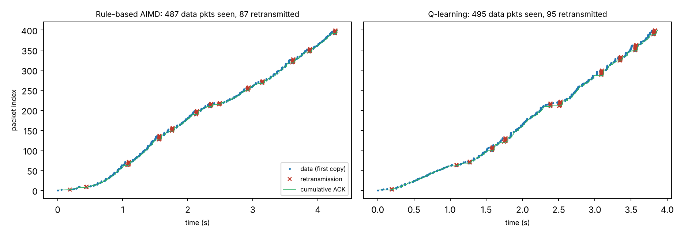
Wireshark: RUDP dissector and traces
rudp.lua decodes seq, ack, flags, checksum, length
Filters: smartrudp.flags.data == 1, smartrudp.seq == N
400 packets, lossy path: 87 (AIMD) and 95 (Smart) repeated data segments seen at the receiver
Trace exported by the program, topology addresses, handshake not included
18 / 38 Smart-RUDP
Notes:
[0:40] We wrote a Lua dissector, named smartrudp, that decodes sequence, ack, flags, checksum and length.
Useful filters: smartrudp.flags.data == 1 and smartrudp.seq == N.
In a 400-packet lossy run the receiver saw 87 (AIMD) and 95 (Smart) repeated data segments.
The program's exported trace uses topology addresses and has no handshake.
If asked: Q: Why no handshake in the export? A: The export builds synthetic packets. The real tshark capture on the next slide shows the handshake.

Slide 19


Wireshark: real capture
Left: SYN, SYN-ACK, ACK decoded by the smartrudp dissector (filter frame.number <= 3)
Right: smartrudp.seq == N shows the same segment sent twice, a retransmission
19 / 38 Smart-RUDP
Notes:
[0:50] Left: the first three packets, SYN, SYN-ACK and ACK, decoded by our dissector (filter frame.number <= 3).
Right: filter smartrudp.seq == N shows the same segment twice, a retransmission.
If asked: If Wireshark is open live: Analyze, Decode As, UDP 8888 = RUDP, then use these two filters.

Slide 20

Demo: RUDP Chat over the internet
Each message is one RUDP segment: numbered, checksummed, ACKed in order
Browser UI via a small gateway; terminal version too
Two machines linked over Tailscale (laptop and phone)
Loss slider: lost messages are resent and still arrive in order
Window controller switch: fixed, AIMD or Smart-RUDP (Q-learning, learns live)
Retrained for the chat: faster than AIMD on 5 of 6 held-out paths, equal on 1 (Table 11)
Stress test, 48 unseen paths: table 3.73 s, deep (DQN) 3.20 s, AIMD 7.16 s
Deep agent is seed-sensitive, so picked on validation paths
20 / 38 Smart-RUDP
Notes:
[1:00] The protocol in use: each message is one numbered, checksummed RUDP segment, ACKed in order.
There is a terminal version and a browser version; two devices were linked over Tailscale, laptop and phone.
Drag the loss slider: lost messages are resent and still arrive in order. The right panel shows sent, lost and resent counts and the log.
There is a controller switch: fixed window, AIMD, or Smart-RUDP. For the chat we retrained Smart-RUDP on simulated paths: it was faster than AIMD on 5 of 6 held-out paths and equal on 1, because AIMD resets to one packet on random loss. Say it is simulated, and that the agent may not shrink the window without a congestion signal. Stress test: 48 random paths the agent never trained on, 3 seeds each. Mean delivery time was 3.73 seconds for Smart-RUDP against 7.16 for AIMD. Smart-RUDP was faster on 27 paths, slower on 5, within 5 percent on 16. So on our data, in simulation, it beats AIMD in the chat setting. There is also a deep neural-network option in the controller dropdown; it gave 3.20 seconds mean on the stress paths against 3.73 for the table.
If asked: Q: Is that a fair win? A: Both start from the same window of 10; held-out paths and seeds; honest limits: simulated, and without the no-shrink rule the agent lost. Q: Did it win in Section 8? A: No, that result stands. Q: Where does it lose? A: Tight bottleneck queues and very high loss; the fixed window of 8 is hard to beat there. A broader-trained agent did worse, so we kept the first.

Slide 21
More evidence: baselines, SACK, reordering
48 paths, original simulator | Mean | Median
Plain UDP | 68% delivered | -
TCP model (selective ACK) | 4.56 s | 1.48 s
RUDP fixed window | 3.88 s | 2.00 s
RUDP AIMD | 7.16 s | 2.72 s
Smart-RUDP, table | 3.73 s | 1.99 s
Smart-RUDP, deep | 3.20 s | 1.79 s
Selective ACK (simulated): AIMD mean 7.16 s to 4.90 s, median 2.72 s to 1.44 s; faster on 34 of 48 paths. Go-Back-N is the main weakness.
Reordering (20 ms jitter): AIMD 0.82 s to 6.79 s; deep agent 0.93 s; SACK removes most of the damage.
20-run intervals for the C experiments: Smart slower on 5G-like (+0.92 s) and satellite-like (+6.3 s), tie on lossy.
Caveat: this simulator allowed a dup-ACK retransmission storm. With the realistic rule, stress means are AIMD 7.75 s, neural 7.27 s: about level. The TCP row is a model, not kernel TCP.
21 / 38 Smart-RUDP
Notes:
[1:00] The abstract also promised TCP and plain UDP baselines, so we ran them on the same 48 unseen simulated paths.
Plain UDP delivered only 68 percent of the messages, so reliability is needed. Our TCP model, with selective acknowledgments, has the lowest median at 1.48 seconds.
Smart-RUDP deep is at 3.20 seconds mean and is about even with the TCP model path by path: faster on 22, slower on 23.
The gap to TCP is mostly Go-Back-N. A selective-ack version of our transport cut AIMD from 7.16 to 4.90 seconds in simulation.
Reordering hurts Go-Back-N badly: AIMD goes from 0.82 to 6.79 seconds at 20 milliseconds of jitter. The learned agents cope better and selective ack removes most of the damage.
For the C experiments we repeated 20 runs per mode: Smart-RUDP is still slower on 5G and satellite and ties on lossy.
Be upfront: our simulator originally allowed a duplicate-ACK retransmission storm that flatters aggressive controllers. With the realistic rule the neural agent is about level with AIMD in simulation (7.27 s against 7.75 s). The C results are the evidence we rely on.
If asked: Q: Is the TCP row real TCP? A: No, it is a model with the same window cap; real kernel TCP needs netem on Linux, and we provide the script. Q: Why did you not implement SACK in C? A: Time; the simulation shows it is the biggest win and it is the first item of future work. Q: Is 20 runs enough? A: The intervals exclude zero for 5G and satellite and include zero for lossy. Did you check it is not a simulator artefact? Yes: with the realistic rule the simulated gain mostly disappears, so we lean on the C results, which use that rule and equal window caps.

Slide 22
Neural agent in the C transport
1,200 packets, C transport | AIMD | Table (rl2) | Neural
5G-like | 1.38 s | 2.64 s | 1.18 s
Lossy wireless | 9.13 s | 7.54 s | 6.63 s
Satellite-like | 17.9 s | 38.1 s | 13.1 s
Neural agent beats AIMD on all three paths: 15%, 27%, 24% faster (95% intervals exclude zero)
Table agent does not generalise: slower on 5G-like and satellite-like
Selective ACK in C: about 10x fewer retransmissions, no significant time change here
Caveats: trained in a simulator; emulated paths (not real networks); agent retransmits more on random loss
15 runs per cell (satellite: 8), 95% intervals. Equal-cap check (AIMD capped at 32, 10 runs): neural still wins by 19%, 29%, 28%, all significant (eval_ci4.sh).
22 / 38 Smart-RUDP
Notes:
[1:00] We then put the neural agent into the C transport, the same code as Section 8, and tested it on the same three emulated paths with 15 runs each.
AIMD and the agents all start from a window of 10. The neural agent was faster than AIMD on all three: 15 percent on 5G-like, 27 percent on lossy, 24 percent on satellite-like. The intervals exclude zero.
The retrained table did not carry over: it was slower on 5G and satellite. A network generalises to unseen paths where a table does not.
We also added selective acknowledgments to the C code: about ten times fewer retransmissions, but no significant change in completion time on these emulated paths.
We also reran it with AIMD capped at 32 like the agent: the neural agent still wins by 19, 29 and 28 percent, all significant.
If asked: Q: So Smart-RUDP now beats AIMD? A: The neural version does, in the C transport on emulated paths, trained in a simulator; the original table agent in Section 8 did not. Q: Is it fair? A: Same start window; AIMD keeps a cap of 128 while the agents are capped at 32; the agent retransmits more on random loss. Q: Why no gain from SACK? A: Those paths are limited by the bottleneck rate, so extra retransmissions cost little; the simulator, with different paths, showed a large gain.

Slide 23
Fairness, ablations, chat fixes
Two flows, one bottleneck | Share of A | Jain
AIMD vs AIMD (long path) | 51% | 0.999
Deep vs deep (long path) | 59% | 0.969
Deep vs AIMD (no-loss path) | 44% | 0.987
Deep vs AIMD (long path) | 74% | 0.819
Fixed 8 vs AIMD (long path) | 72% | 0.843
Fair on short paths; takes 74% against AIMD on the 120 ms path, like a fixed window
Ablation: the no-shrink mask is what matters (6.54 s without it, about 3.3 s with it; AIMD 7.16 s)
Other parts (delay penalty, last action, throughput input) showed no measurable value
Same recipe gave 3.2 to 7.4 s across seeds: seed sensitivity is a real weakness
Found and fixed a dup-ACK retransmission storm in the chat gateway; added a live dashboard and an adaptive RTO
Simulator, 20 seeds; ablation on 48 stress paths. Code: web/fairness_test.py, web/ablate.py.
23 / 38 Smart-RUDP
Notes:
[0:50] We also tested two things people ask about. Fairness: two flows through one bottleneck. The neural agent is fair against itself and on short paths, but takes 74 percent against AIMD on the long 120 ms path, about like a fixed window.
Ablation: we retrained the agent with one piece removed. Only the no-shrink mask matters; without it the agent is no better than AIMD. The other pieces showed no measurable value.
The same recipe also gave very different results by seed, between 3.2 and 7.4 seconds, so we pick the seed on validation paths.
While building the dashboard we found a retransmission storm in the web gateway and fixed it; there is also an adaptive timeout option now.
If asked: Is the agent fair? Mostly, but not on the long path against AIMD (74% share, Jain 0.82). Fairness was only tested in the simulator, not in C.

Slide 24
Safety net: hand over to AIMD
C transport, seconds | AIMD 32 | Neural | Hybrid
5G-like | 1.48 | 1.17 | 1.23
Lossy 2% | 9.04 | 7.53 | 7.57
Satellite-like | 19.7 | 13.4 | 13.7
Hostile, 10% loss | 11.1 | 84.9 | 13.9
Problem found: at 10% loss the neural agent is 7x slower than AIMD
Fix: while a decision interval loses 10% or more, AIMD drives the window; after 3 clean intervals the agent resumes
Keeps the wins on the three benign paths, and the hostile path is no longer significantly different from AIMD
A timeout cut (x0.25) was tried and dropped: it helped the hostile path but hurt the 2% path (24 s vs 9 s)
Honest summary: the agent helps on clean-to-moderate paths; it needs a classical safety net elsewhere
10 runs per cell (hostile: 5 runs, 300 packets), 95% intervals. Flag: --hybrid 0.10. Code: eval_ci6.sh.
24 / 38 Smart-RUDP
Notes:
[0:50] While checking our own result we found where the neural agent fails: on a hostile path with 10 percent loss it needed about 85 seconds where AIMD needed 11.
The fix is a hand-over: when a decision interval loses 10 percent or more of its packets, plain AIMD controls the window; after three clean intervals the agent takes over again.
With that, the three benign paths keep the agent's advantage and the hostile path is back near AIMD at about 14 seconds.
We also tried cutting the window on every timeout; it fixed the hostile case but made the 2 percent path much worse, so we dropped it. So the learned agent is useful on clean to moderate paths and needs a classical safety net elsewhere.
If asked: Is the hybrid still 'AI'? Yes on clean and moderate paths, where the neural network decides; on heavy loss it deliberately defers to AIMD. It is a rule we added, not something the network learned.

Slide 25
Selective Repeat is now the default
C transport, seconds | AIMD 32 | Neural | Gain
5G-like | 1.27 | 1.16 | 9%
Lossy 2% | 7.99 | 4.29 | 46%
Satellite-like | 25.7 | 12.9 | 50%
Hostile, 10% loss | 7.3 | 8.1 | tie
Receiver buffers out-of-order packets (64 window) and reports them in a bitmap in every ACK
Sender: one timer per packet; resends only the missing ones
Retransmissions drop about 10x; web chat 200 messages: 6.4 s vs 11.9 s (AIMD)
The neural agent now wins by more, and the 10% loss failure was mostly a Go-Back-N effect
Go-Back-N kept for comparison: --gbn / RUDP_GBN
10 runs per cell (hostile: 5), 95% intervals, all gains significant except the hostile row. Code: eval_ci7.sh.
25 / 38 Smart-RUDP
Notes:
[0:50] We swapped Go-Back-N for Selective Repeat as the default. The receiver now keeps out-of-order packets and tells the sender exactly which ones it holds in a bitmap inside every ACK; the sender has one timer per packet and resends only what is missing.
The result: about ten times fewer retransmissions, and the neural agent's lead over AIMD grows to 46 percent on the lossy path and 50 percent on the satellite path.
The 10 percent loss failure we found earlier was mostly a Go-Back-N effect: with Selective Repeat the agent ties AIMD there.
Go-Back-N is still in the code behind a flag, and the earlier tables in the report were measured with it and are labelled that way.
If asked: Is it textbook Selective Repeat? Nearly: per-packet timers and a buffering receiver, but we use a cumulative ACK plus a 64-bit bitmap instead of one ACK per packet, and the window is capped at 60.

Slide 26
Final results: tuned baselines, real clock
Path (seconds) | AIMD cap 32 | AIMD tuned | CUBIC tuned | Neural
5G-like | 1.41 | 1.09 | 1.19 | 0.92
Lossy 2% | 7.98 | 7.05 | 13.92 | 3.62
Satellite-like | 17.93 | 11.36 | 8.26 | 5.46
Fast (3,000 pkts) | 14.55 | 8.20 | 6.52 | 3.92
Hostile 10% loss | 7.54 | 8.34 | 12.32 | 8.93
Neural agent fastest on 4 of 5 paths; significantly faster than tuned AIMD on all four: -15%, -49%, -52%, -52%
Faster than tuned CUBIC on lossy (-74%) and satellite (-34%); equal on 5G-like and fast; CUBIC is 2x slower than AIMD at 2% loss
Hostile 10% loss: no significant difference between any two policies
Retransmissions now low (3, 6, 4 packets): the old 262 were spurious timeouts, fixed with a timer floor that AIMD also benefits from
Real clock, real server process, 10 paired runs per path (hostile: 5), 95% intervals. eval_final.sh. Every policy uses the same timer, window cap rules and Selective Repeat.
26 / 38 Smart-RUDP
Notes:
[1:00] This is the final comparison. Everything runs in the C transport with Selective Repeat, a real clock and a real server process. We compare four policies: the original AIMD with a window cap of 32, AIMD tuned with a cap of 128, tuned CUBIC, and the neural agent with its final settings.
The neural agent is fastest on four of the five paths and significantly faster than tuned AIMD on all four: 15 percent on the 5G-like path, 49 percent on lossy, and 52 percent on the satellite-like and fast paths. It beats CUBIC significantly on lossy and satellite. On the hostile 10 percent loss path nothing is significantly different.
One correction we want to be upfront about: earlier we reported bigger margins and 262 retransmissions on the fast path. That came from a timer that fired too early. Fixing it helped AIMD even more than the agent, so these numbers are the honest ones.
If asked: Why did the margin shrink? A retransmission timer defect was hurting AIMD more than the agent. We found it by tracing the retransmissions, fixed it for every policy, and re-ran everything. Without the fix AIMD is 41 percent slower on random paths.

Slide 27
Real sockets found what the emulator could not
Lost handshake ACK
Spurious timeouts
Weak checksum
Server ignored all data after a lost final ACK: transfers hung (2 of 4 runs at 10% loss). Fixed as in TCP; regression test added.
Timer too tight for window bursts: 262 retransmissions for ~3 losses. Floor of 1.3 x srtt. It also made AIMD 41% faster, so the old margins were too big.
Byte-sum checksum let 2% of corrupted packets through (fuzzer). Now CRC-16: 0 of 333k accepted, sanitizers clean.
Independent check on real UDP sockets through an impairment proxy (src/impair.c): neural agent -17% / -53% / -45% / -39% vs tuned AIMD on 5G / lossy / satellite / fast; hostile path a tie. eval_proxy.sh
27 / 38 Smart-RUDP
Notes:
[0:50] The emulator is inside our client, so we also tested through a separate impairment process on real UDP sockets. That found three real defects.
First, if the client's last handshake ACK is lost, the server ignored all following data and the transfer hung. We fixed it the way TCP does and added a regression test. Second, the spurious timeouts I just mentioned. Third, a fuzzer showed our byte-sum checksum let about 2 percent of corrupted packets through, so it is now CRC-16 and the fuzzer accepts none.
On real sockets the neural agent is again fastest on every path: 17, 53, 45 and 39 percent faster than tuned AIMD on 5G, lossy, satellite and fast, and a tie on the hostile path.
If asked: Is this a real network? It is real UDP sockets on one machine, with the impairment applied by a separate process. It is not a kernel netem or a multi-machine path; we provide the script for that but had no root access.

Slide 28
A fast, faithful C simulator, and what it showed
--vt 1: the real C sender with a simulated receiver and clock, about 1000x faster; matches the real-clock runs in 15 of 15 cells
100 random held-out paths: neural agent 0.53x the time of tuned AIMD, faster on 89, never >20% slower (tuned CUBIC: slower by >20% on 27)
Biggest factors: window cap 128, pacing, timer floor, slow start
Evolution-strategy retraining in C: +2% only, not adopted
28 / 38 Smart-RUDP
Notes:
[1:00] Our old simulator was in Python and never matched the C code exactly. So we added a virtual-time mode to the C sender itself: same code, simulated receiver and clock, about a thousand times faster. It reproduces the real-clock results in all 15 calibration cells.
That let us test on 100 random paths that we never tuned on. The neural agent needs 0.53 times the time of tuned AIMD, is faster on 89 paths and never more than 20 percent slower. Tuned CUBIC is slower by more than 20 percent on 27 paths.
The ablation shows which parts matter: the window cap of 128 most, then pacing, the timer floor and slow start. We also tried evolution-strategy retraining directly in the C sender and it only gave 2 percent, so we did not adopt it.
If asked: Is the test set separate from tuning? Yes. Slow-start and hand-over settings were chosen on a different set of random paths; the 100 test paths were used only for the reported numbers.

Slide 29
Fairness and file transfer
Two flows, real sockets | Share A | Share B | Jain
AIMD vs AIMD | 49% | 51% | 0.99
Neural vs neural | 50% | 50% | 0.97
Neural vs AIMD tuned | 68% | 32% | 0.88
Neural vs AIMD cap 32 | 76% | 24% | 0.78
CUBIC vs AIMD tuned | 61% | 39% | 0.93
The agent is a more aggressive neighbour than AIMD or CUBIC: no starvation, but not polite. Not trained for fairness; TCP coexistence untested
smart_client --file sends a real file; the received file is byte-identical in every run (FNV-1a hash)
Terminal chat and web gateway now use the same 256-packet window and 32-byte bitmap as the C transport; interop test at 20% loss
CI, fuzzing, MIT licence, architecture doc
File transfer | AIMD cap 32 | AIMD tuned | Neural
2 MB, lossy 2% | 26.6 s | 24.2 s | 11.9 s
4 MB, fast path | 34.6 s | 21.0 s | 8.9 s
29 / 38 Smart-RUDP
Notes:
[0:50] Fairness on real sockets: two neural flows split the link evenly, and so do two AIMD flows. But against tuned AIMD the neural agent takes 68 percent of the link, and 76 percent against the original AIMD. CUBIC takes 61 percent. So the agent is a more aggressive neighbour. Nothing starves, but it is not polite, and we did not test coexistence with TCP. That is our main limitation.
We also added file transfer: the sender sends a real file and the received file is byte-identical in every run. A 4 megabyte file over the fast path takes 8.9 seconds with the agent against 21 seconds with tuned AIMD.
The chat and web gateway now use the same window and bitmap as the C transport, and there is CI, fuzzing and an architecture document.
If asked: Would this be safe to deploy? Not on a shared link yet: it needs fairness-aware training and TCP coexistence tests. For a dedicated path it is a clear win.

Slide 30

Seeing the difference: the window
Same lossy path, same seed, same transport
AIMD (grey) saws between 5 and 15 packets and needs 9 s
The agent (green) rides much higher, backs off on loss, and finishes in 4 s
Regenerate: make figures
30 / 38 Smart-RUDP
Notes:
[0:40] This is the congestion window on the lossy path, same seed for both. AIMD, in grey, climbs one packet per round trip and halves on every loss, so it never gets above about 15 packets and takes nine seconds. The neural agent, in green, runs much higher, backs off when it sees loss or queueing delay, and finishes in four seconds. The figure comes from our virtual-time sender and can be regenerated with make figures.
If asked: Why does the agent's window jump around so much? It picks one of five multipliers about once per round trip, so it moves in steps; that is the cost of a learned policy with a coarse action set.

Slide 31
Closing gaps: fairness and cross traffic
Neural vs tuned AIMD | Agent share | Jain
Default | 70% | 0.86
--polite 1.2 | 49% | 0.95
--polite 1.3 | 52% | 0.94
--polite 1.5 | 59% | 0.90
Bursty cross traffic | Time | vs AIMD
AIMD tuned | 5.73 s | 1.00
CUBIC tuned | 4.55 s | 0.79
Neural agent | 4.87 s | 0.85
Neural, polite 1.3 | 4.92 s | 0.86
Polite mode: back off when a standing queue builds (jitter-aware). Share 70% to 52%; costs speed (0.53x to 0.58x of AIMD time on 100 paths, worst path 2.95x slower), so it is off by default
Bursty cross traffic (new proxy option, 8 runs): neural is 15% faster than tuned AIMD but level with CUBIC; three tweaks to fix its extra retransmissions did not help
Server now handles up to 16 clients at once; a test sends two files simultaneously and checks both byte-for-byte
31 / 38 Smart-RUDP
Notes:
[0:50] We worked on the weaknesses we had listed. For fairness we added an optional polite mode: when a standing queue builds, the agent backs off. Over 8 runs against tuned AIMD it takes 52 percent of the link instead of 70, and the Jain index rises from 0.86 to 0.94. The price is speed: on 100 random paths the average time goes from 0.53 to 0.58 times AIMD's, and the worst path is 2.95 times slower, so it stays off by default.
We also added bursty cross traffic to the test proxy. Here the result is less flattering: the agent is 15 percent faster than tuned AIMD, but level with CUBIC, and it retransmits about three times as often as AIMD. Three tweaks did not fix that, so we report it as a limit. Finally the server now handles up to 16 clients, checked by sending two files at once.
If asked: Is polite mode learned? No. It is a hand-made rule on the delay signal. A learned version needs a two-flow training environment, which is future work.

Slide 32
Reality check: real kernel (tc/netem)
Path (500 packets) | TCP | AIMD tuned | Neural | vs AIMD
Lossy, 2% loss | 0.88 s | 4.75 s | 1.35 s | -71%
5G-like | 0.28 s | 1.23 s | 0.43 s | -65%
Satellite, 150 ms (3 runs) | 1.91 s | 16.7 s | 2.92 s | -83%
Reordering | 0.94 s | 4.06 s | 1.64 s | -60% (n.s.)
Kernel tc/netem on loopback, 5 runs per cell, 512-byte payloads for TCP, UDP and RUDP
Neural beats tuned AIMD on a real kernel path: 65% to 83% faster, significant on three paths
Kernel TCP is still faster than us everywhere: 1.5x to 1.7x
Sharing a link with kernel TCP: the neural agent takes only 24% to 34% (AIMD 5% to 17%); it does not starve TCP
Our first runs were wrong four times (netem limit; untuned baseline; unequal payloads; synthetic 40-byte packets). Found, fixed, re-run, documented
32 / 38 Smart-RUDP
Notes:
[1:00] Until now our real-socket tests ran through our own proxy. We repeated them on the Linux kernel itself, using tc netem, with kernel TCP in the same table.
Against tuned AIMD the neural agent is 71 percent faster on the lossy path, 65 percent on the 5G-like path and 83 percent on the satellite path, all significant. On the reordering path it is 60 percent faster but that is not significant.
Kernel TCP is still faster than our agent on every path, by one and a half to one and seven tenths. We are not claiming to beat TCP.
We also put a kernel TCP flow and one RUDP flow on the same link. The neural agent takes 24 to 34 percent of it, so it does not starve TCP; tuned AIMD gets only 5 to 17 percent.
Our first runs were wrong four times: the netem queue limit counted packets in flight, the baseline was untuned, the payload sizes differed, and finally RUDP was sending 40-byte synthetic packets. We found each one, fixed it, re-ran everything and documented it.
If asked: Q: Does it beat TCP? A: No. It beats our AIMD baselines on a real kernel path; mature kernel TCP is faster, by 1.5x to 1.7x. Q: Does it starve TCP? A: No, it takes 24 to 34 percent of a shared link (3 runs per cell, one laptop). Q: Why were the first runs wrong? A: four separate mistakes, the last being 40-byte synthetic packets against 512-byte TCP payloads; all fixed and re-run.

Slide 33
Research gaps: changing paths and a BBR baseline
Mean time (s) | AIMD tuned | CUBIC | BBR-style | Neural
Bandwidth drop | 13.6 | 17.7 | 13.4 | 12.7
Bandwidth rise | 9.2 | 15.1 | 5.0 | 4.3
Delay jump | 33.3 | 27.5 | 25.9 | 19.8
Hand-over pattern | 12.8 | 21.4 | 10.8 | 8.2
2% lossy path (3,000 pkts) | 19.8 | 53.3 | 8.2 | 9.8
Satellite-like path | 32.8 | 26.6 | 16.8 | 11.2
Paths that change mid-transfer: neural fastest in 4 of 4 cases, at the cost of 1% to 6% retransmissions
A simplified BBR beats tuned AIMD on 4 of 5 paths and is faster than the agent on the 2% lossy path
Two bugs in our own BBR (stall at 10% loss; 163 s after a delay jump) found by these tests and fixed
Virtual time, 20 paired seeds; not the Linux BBR
33 / 38 Smart-RUDP
Notes:
[1:00] Two more research gaps we tested.
First, paths that change during a transfer: we added a --dyn option so bandwidth and delay change mid-run.
The neural agent was fastest in all four cases, 6 to 53 percent faster than tuned AIMD, but it retransmits 1 to 6 percent of packets.
Second, a stronger baseline: a simplified BBR.
It beats tuned AIMD on four of five paths and is actually faster than our agent on the 2 percent lossy path, 8.2 seconds against 9.8.
Be honest that our BBR is a simplification and that two bugs in it were found and fixed by these tests.
If asked: Is your BBR the real one? No: a simplified version with no ProbeRTT and no BBRv3 loss response; the comparison is against a BBR-style policy.

Slide 34
Research gaps: fairness and trust
Two identical flows | Extra RTT | Share short-RTT | Jain
AIMD / AIMD | 150 ms | 88% | 0.64
Neural / neural | 150 ms | 71% | 0.84
Neural flows are fairer than AIMD under unequal RTTs, but still favour the short-RTT flow (6 pairs per cell)
A depth-5 decision tree matches the network on only 79% of decisions, yet gives the same transfer time on 4 of 5 paths
Noise of 0.2 on the inputs costs at most 12%
Formal interval-bound certification: 43% of decisions at +-0.001, none at +-0.03. It is robust in practice but not proven
Coexistence with kernel TCP: neural takes 24% to 34% of a shared link, so it does not starve TCP (3 runs per cell)
34 / 38 Smart-RUDP
Notes:
[1:00] Fairness and trust.
Two neural flows with unequal round-trip times share the link more evenly than two AIMD flows, Jain 0.84 against 0.64 at 150 ms extra RTT, but still favour the short-RTT flow; six pairs per cell so only the largest gap is clear.
A small decision tree agrees with the network on only 79 percent of decisions but gives the same transfer time on four of five paths.
Noise on the inputs costs at most 12 percent.
Formal certification only works at tiny perturbations, so the agent is robust in practice but not proven.
Kernel TCP coexistence is measured: the neural agent takes 24 to 34 percent of a shared link, so it does not starve TCP, with only three runs per cell.
If asked: Did you test against kernel TCP? Yes, on kernel netem: the neural agent took 24 to 34 percent of a shared link, three runs per cell on one laptop.

Slide 35
First run between two machines
Time (s) | TCP | AIMD | CUBIC | BBR-style | Neural
Rep 1 (clean) | 2.5 | 14.2 | 12.4 | 6.4 | 4.7
Rep 2 (clean) | 2.0 | 12.0 | - | - | -
Rep 3 | 39.3 | - | 240 | 53 | 71
Rep 4 | 11.4 | 87 | 218 | 69 | 111
Rep 5 | 50.9 | 143 | 167 | 44 | 32
Two laptops, different networks, Tailscale relay (about 79 ms RTT); 2 MB per transfer, 5 repetitions
RUDP works between real machines: every completed run delivered 4,000 of 4,000 packets
The path drifted (TCP alone 2 s to 51 s) and 4 of 20 RUDP runs timed out, so this is a demonstration, not a ranking
Clean reps: kernel TCP 2x to 6x faster; rep 1 the neural agent beat AIMD (4.7 s vs 14.2 s)
Next: repeat on a direct local network with more reps
35 / 38 Smart-RUDP
Notes:
[0:45] Until now every test ran on one computer. We ran the sender on one laptop and the receiver on another, on different networks, joined by Tailscale. It could not connect directly, so traffic went through a relay, about 79 milliseconds round trip.
RUDP works between real machines: every transfer that finished delivered all 4,000 packets, with all four policies.
Be honest about the numbers: the path drifted, kernel TCP alone took anywhere from 2 to 51 seconds, and 4 of 20 RUDP runs timed out, so this is a demonstration and not a ranking. On the two clean repetitions kernel TCP was 2 to 6 times faster, and in repetition 1 the neural agent beat tuned AIMD, 4.7 against 14.2 seconds.
If asked: Why not a better test? The other laptop was a one-time setup over the internet; the next step is a direct local network with more repetitions.

Slide 36
Learnings and future work
Learned
Next
Reliability is a set of simple rules working together.
Congestion control matters as much as retransmission.
Testing tools fail in surprising ways.
Fairness-aware training, TCP coexistence
Train on real traces with cross traffic
Close the gap to kernel TCP; controlled multi-machine tests
Limits: kernel TCP is 1.5x to 1.7x faster; one noisy two-machine run only; polite mode is a hand-made rule that costs speed; level with CUBIC under bursty cross traffic; no gain at 10% random loss; BBR-style baseline is faster on the 2% lossy path; coexistence with kernel TCP measured with only 3 runs per cell.
36 / 38 Smart-RUDP
Notes:
[0:50] What we learned: reliability is a set of simple rules working together, congestion control matters as much as retransmission, and tests tell you things about your own results that you do not want to hear.
Our limits: only one noisy two-machine run, the agent is not a polite neighbour, there is no gain at 10 percent random loss, and the tabular agent did not beat AIMD.
Next: fairness-aware training with TCP coexistence, training on real traces, and controlled multi-machine tests.
If asked: What would you do first? Run the netem script on a Linux machine for kernel TCP and RUDP on the same path, then add a competing flow to the training.

Slide 37
Thank you
github.com/Capsturrrr/rudp
Harshavardhan Mallela Rohit Arya Shloak Sinha
Notes:
[0:15] Thank you. The code, report and captures are at github.com/Capsturrrr/rudp. Happy to take questions.
If asked: Pause and smile; hand over to questions.

Slide 38

Appendix: slow start and congestion avoidance
cwnd starts at 1
+1 per ACK until ssthresh = 16
Then +1/cwnd per ACK
62 packets, final cwnd 18.71
Appendix Smart-RUDP
Notes:
[-] Only if asked: the window starts at 1, adds 1 per ACK until the threshold 16, then 1/window per ACK. In the 62-packet run the final window was 18.71.
If asked: Use this slide to answer 'show me congestion avoidance'.

