Slide 1
Smart-RUDP
Reliable UDP with learning-based congestion control, in C
Computer Networks | Faculty: Anuradha G
Harshavardhan Mallela 24BAI0274 Rohit Arya 24BCE0819 Shloak Sinha 24BDS0378
Notes:
SAY (0:20):
- Good morning ma'am. We are Harshavardhan, Rohit and Shloak.
- Our project is Smart-RUDP: a reliable transport protocol we built in C on top of UDP, plus a controller that learns how fast to send.
IF ASKED: Say the three names and the GitHub link once, then move on.

Slide 2
The problem
UDP
TCP
Fast and simple, but no guarantees: packets can be lost, duplicated or reordered.
Reliable, but lives inside the OS kernel. Hard to see, hard to change, hard to learn from.
In 1986 the early Internet suffered congestion collapse: throughput fell from 32 Kbps to 40 bps. TCP congestion control was invented to fix it.
Our question: can we rebuild TCP's core ideas ourselves, on top of UDP?
2 / 21 Smart-RUDP
Notes:
SAY (0:40):
- UDP is fast but gives no guarantees: packets can be lost, duplicated or reordered.
- TCP is reliable but sits inside the operating system, so you cannot see or change it.
- In 1986 the early Internet had congestion collapse: throughput fell from 32 Kbps to 40 bps. TCP's congestion control was invented to fix that.
- Our question: can we rebuild TCP's core ideas ourselves, on UDP?
IF ASKED: Q: Why not just use TCP? A: TCP cannot be changed or inspected; building our own makes every mechanism visible. QUIC and HTTP/3 do the same in practice.

Slide 3
Why we built it
The need
Our answer
Campus users send data to a server across a routed network. TCP is fixed inside the kernel; plain UDP gives no guarantees. Real systems (QUIC, HTTP/3) solve this with reliability built in user space over UDP.
RUDP: a readable, tunable reliable transport over UDP, plus Smart-RUDP, a controller that learns the window from RTT and loss.
Scenario: a student on VLAN 10 uploads a file to the server LAN. The ACL keeps students out of staff VLAN 20. If a core link fails, OSPF reroutes through R2: a longer path and higher RTT that the transport must adapt to.
Validated: protocol tests and Smart-RUDP vs AIMD on emulated paths; network design built and tested in Packet Tracer; traffic analysed in Wireshark.
3 / 21 Smart-RUDP
Notes:
SAY (0:50):
- The need: campus users send data to a server across a routed network. TCP is fixed in the kernel; UDP gives no guarantees.
- Our answer: RUDP, a readable and tunable transport, and Smart-RUDP, which learns the window from RTT and loss.
- Scenario: a student on VLAN 10 uploads to the server LAN. The ACL keeps students out of staff VLAN 20. If a core link fails, OSPF reroutes through R2: longer path, higher RTT, and the transport must adapt.
IF ASKED: Q: Is this just a lab exercise? A: A lab sends datagrams. We built reliability and congestion control on top, measured them, and used them in an application.

Slide 4
What we built
Handshake
Reliability
Flow control
Congestion control
SYN, SYN-ACK, ACK before any data flows.
Sequence numbers, ACKs, checksums, timeouts, retransmission.
Go-Back-N sliding window; its size is the congestion window.
AIMD: slow start, avoidance, halve on loss.
About 670 lines of C across 4 source files. Client + server, built in 8 phases, on github.com/Capsturrrr/rudp
4 / 21 Smart-RUDP
Notes:
SAY (0:40):
- Four pieces: handshake, reliability, flow control and congestion control.
- About 670 lines of C across four source files, built in eight phases, on GitHub at Capsturrrr/rudp.
IF ASKED: Q: Who did what? A: Agree one answer as a team before you go in.

Slide 5
The RUDP packet header: 13 bytes
Field | Size | Purpose
seq | 4 B | Packet number
ack | 4 B | Next packet expected
flags | 1 B | SYN / ACK / FIN / DATA
checksum | 2 B | Detects corruption
payload_len | 2 B | Data length (max 512)
Fields packed byte by byte, so compiler struct padding never changes the wire format.
Data packet = 53 bytes on the wire. ACK / handshake = 13 bytes.
5 / 21 Smart-RUDP
Notes:
SAY (0:40):
- 13-byte header: sequence 4, ack 4, flags 1, checksum 2, payload length 2.
- Fields are packed byte by byte so compiler padding never changes the wire format.
- A data packet is 53 bytes on the wire; ACKs and handshake packets are 13.
IF ASKED: Q: How does the checksum work? A: 16-bit one's-complement sum over header and payload, like UDP/TCP. A corrupted packet fails and is recovered by retransmission.

Slide 6
Handshake and data flow
1
SYN
Client -> Server
Request a connection
2
SYN-ACK
Client <- Server
Server agrees
3
ACK
Client -> Server
ESTABLISHED, data may flow
4
DATA
Client -> Server
Up to window-size packets in flight
5
ACK
Client <- Server
Cumulative: confirms everything up to N
6
FIN
Client -> Server
Close the connection
Server accepts a new SYN in any state, so a killed client can never leave it stuck.
6 / 21 Smart-RUDP
Notes:
SAY (0:50):
- Three-way handshake: SYN, SYN-ACK, ACK. Then data, up to a window of packets in flight.
- ACKs are cumulative: ACK N confirms everything before N. FIN closes the connection.
- The server accepts a new SYN in any state, so a killed client can never leave it stuck. That was a real bug we fixed.
IF ASKED: Q: What if the peer disappears? A: Sender keeps retransmitting on timeout. An abort after repeated timeouts is not implemented; it is the fix we would add.

Slide 7
Reliability: Go-Back-N
Window = cwnd packets in flight (fixed at 4 in Phase 4, then driven by cwnd)
Receiver sends cumulative ACKs
Retransmission timeout: 500 ms
Fast retransmit after 3 duplicate ACKs, no waiting for the timer
Checksum failures are dropped, then recovered by retransmission
Proof
In a netem 20% loss capture we saw 12 timeouts spaced about 500 ms apart.
Result
2,442-byte message reassembled correctly.
7 / 21 Smart-RUDP
Notes:
SAY (0:50):
- The window is the number of packets in flight; it started fixed at 4 and is now driven by the congestion window.
- Timeout is 500 ms; fast retransmit triggers after 3 duplicate ACKs, no waiting for the timer.
- Proof: in a 20% loss netem capture we saw 12 timeouts about 500 ms apart. Result: the 2,442-byte message reassembled correctly.
IF ASKED: Q: Why Go-Back-N? A: Simpler to build and explain. It wastes bandwidth under loss; Selective Repeat with SACK is our stated future work.

Slide 8
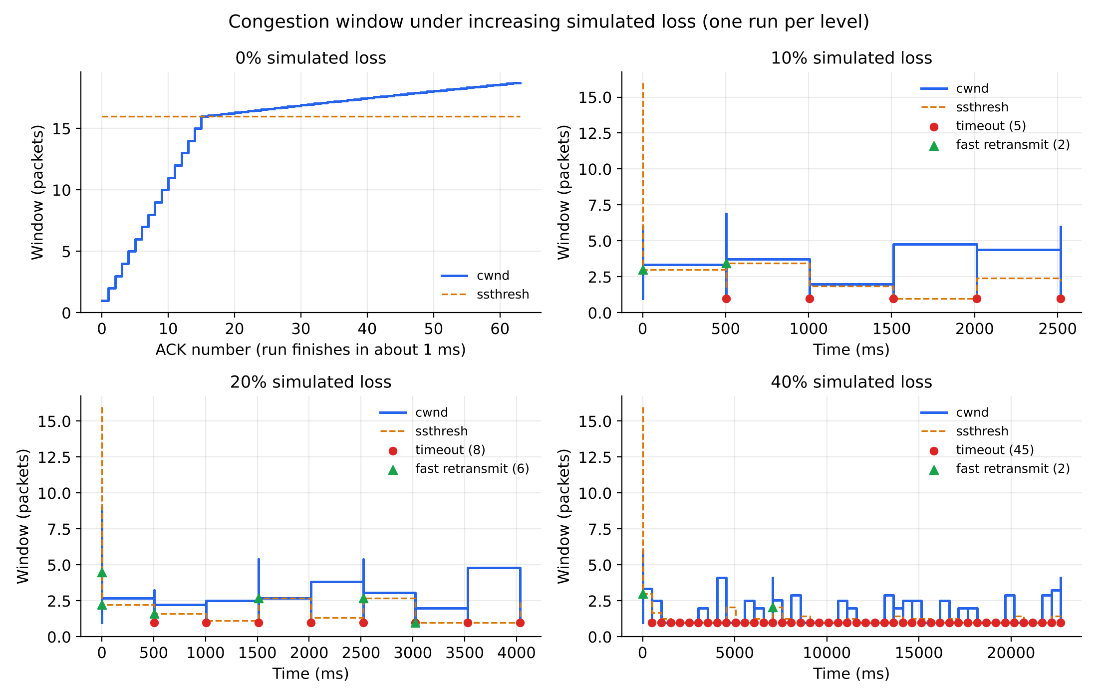
Congestion control: AIMD
Slow start: cwnd +1 per ACK, below ssthresh 16
Avoidance: cwnd + 1/cwnd per ACK
3 dup ACKs: cwnd halves
Timeout: cwnd resets to 1, ssthresh halves
Capped at 32
Fresh runs at 0%, 10%, 20% and 40% simulated loss. Red = timeout, green = fast retransmit.
8 / 21 Smart-RUDP
Notes:
SAY (0:50):
- Slow start: window grows by one per ACK until the threshold of 16. Then avoidance: plus 1/window per ACK.
- Three duplicate ACKs: window halves. A timeout: window resets to 1 and the threshold halves. Cap is 32.
- The graph shows fresh runs at 0, 10, 20 and 40 percent loss. Red marks are timeouts, green are fast retransmits.
IF ASKED: Q: Why cap 32 and ssthresh 16? A: The cap stops a lossless run growing without bound; 16 is where doubling switches to linear growth.

Slide 9
How we tested
Built-in loss simulator
tc / netem
Wireshark / tshark
Drops packets in code at a set percentage. Used for the benchmark.
Linux kernel injects real loss on loopback. Used to validate behaviour.
Captured in WSL, opened in Windows Wireshark. Confirmed handshake, ACKs, retransmissions.
Wireshark could not see WSL loopback from Windows, so we captured with tshark inside WSL and copied the file across.
9 / 21 Smart-RUDP
Notes:
SAY (0:40):
- Three tools: a loss simulator inside the code (used for the benchmark), Linux tc/netem injecting real loss on loopback, and Wireshark/tshark.
- Windows Wireshark could not see WSL loopback, so we captured with tshark inside WSL and copied the file across.
IF ASKED: Q: Is the loss real? A: Benchmark and chat loss is simulated in the program. We also captured a real loopback run with tshark and netem loss.

Slide 10
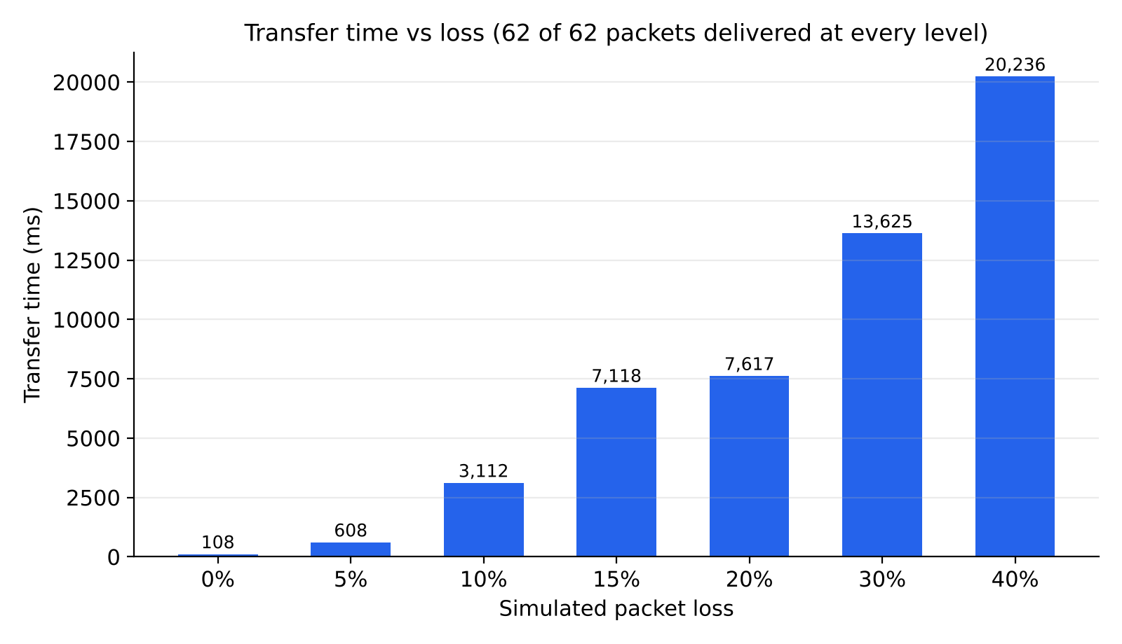
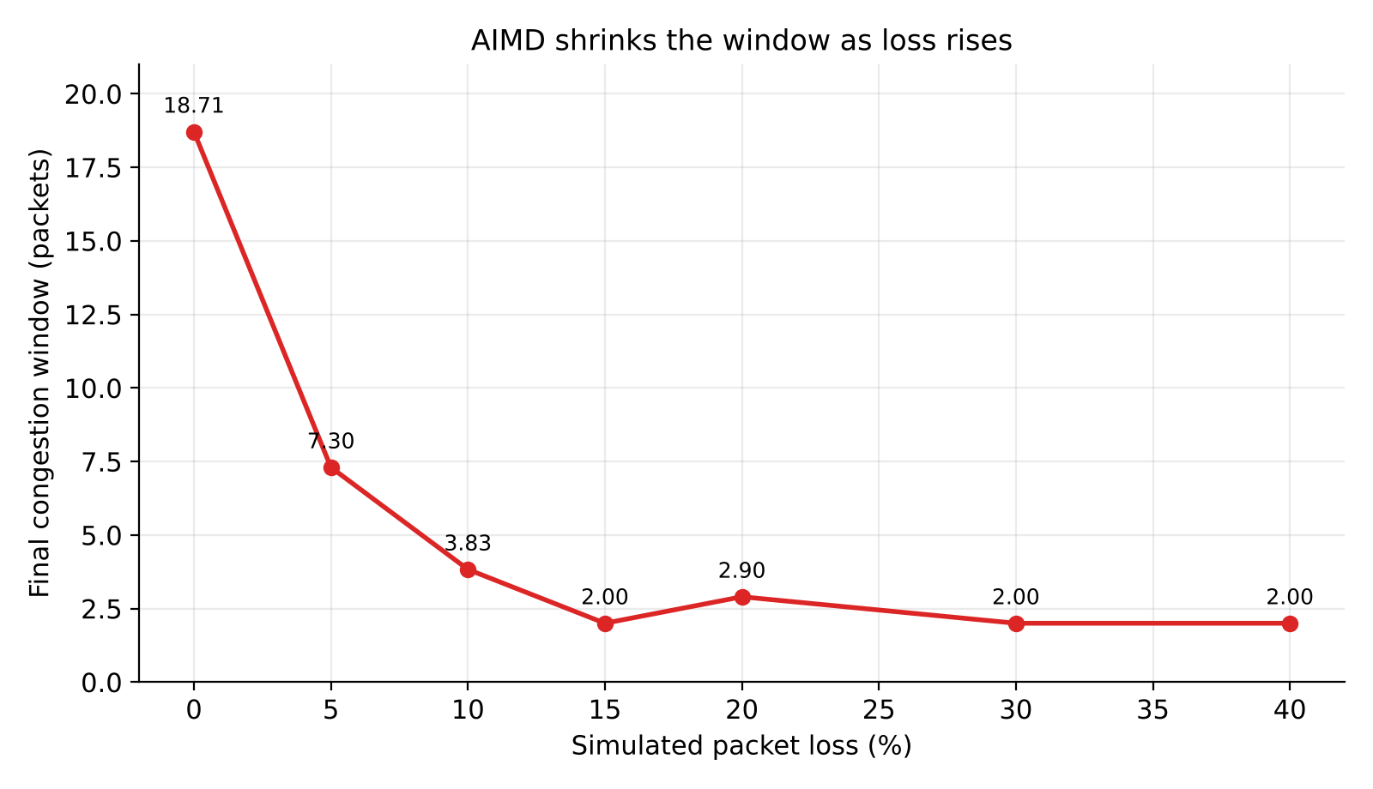
Benchmark results
62 of 62 packets delivered at every loss level, from 0% to 40%.
10 / 21 Smart-RUDP
Notes:
SAY (0:40):
- 62 of 62 packets were delivered at every loss level from 0 to 40 percent.
- Higher loss costs time and retransmissions, never correctness.
IF ASKED: Q: Single runs? A: Yes, the original benchmark ran each level once. Smart-RUDP evaluation uses 6 runs per scenario.

Slide 11
Problems we hit and fixed
Problem | Fix
Server stuck after killed client | Accept SYN in any state (was a 15.5 s hang)
Leftover netem rule | Check tc qdisc show dev lo, delete before each test
Windows Wireshark saw nothing | Capture with tshark inside WSL, then copy
Shell portability in benchmark | Replaced date/grep tricks with awk and sed
11 / 21 Smart-RUDP
Notes:
SAY (0:40):
- Server stuck after a killed client: it hung 15.5 s; fix was to accept SYN in any state.
- A leftover netem rule distorted results; we now check tc qdisc before each test.
- Windows Wireshark saw nothing: capture inside WSL.
- Benchmark script portability: replaced date and grep tricks with awk and sed.
IF ASKED: Say these quickly: it shows real debugging, which is what separates a project from a lab.

Slide 12
Literature behind the design
Jacobson & Karels (1988): congestion avoidance and control, the origin of AIMD
Chiu & Jain (1989): why additive increase, multiplicative decrease converges fairly
RFC 5681 (2009): TCP congestion control standard
Ha, Rhee, Xu (2008): CUBIC, our future-work direction
Langley et al. (2017) and RFC 9000: QUIC, reliable transport over UDP in production
Midhula & Arun Raj Kumar (2024) and Cao et al. (2023, DRLFcc): deep reinforcement learning for congestion control, the idea behind Smart-RUDP
Key researcher: Van Jacobson
12 / 21 Smart-RUDP
Notes:
SAY (0:30):
- Jacobson and Karels 1988 is the origin of AIMD; Chiu and Jain 1989 explains why it converges fairly.
- RFC 5681 is the standard; CUBIC is future work; QUIC and RFC 9000 are reliable transport over UDP in production.
- The AI part comes from Midhula and Arun Raj Kumar (2024) and Cao et al. (2023, DRLFcc): deep reinforcement learning for congestion control. Smart-RUDP applies the same idea with a smaller tabular Q-learning agent.
- Key researcher: Van Jacobson.
IF ASKED: Q: Why AIMD? A: Chiu and Jain show it converges to a fair share. Q: Are those papers deep RL and yours is not? A: Yes; we used a lookup table, which is simpler and inspectable.

Slide 13
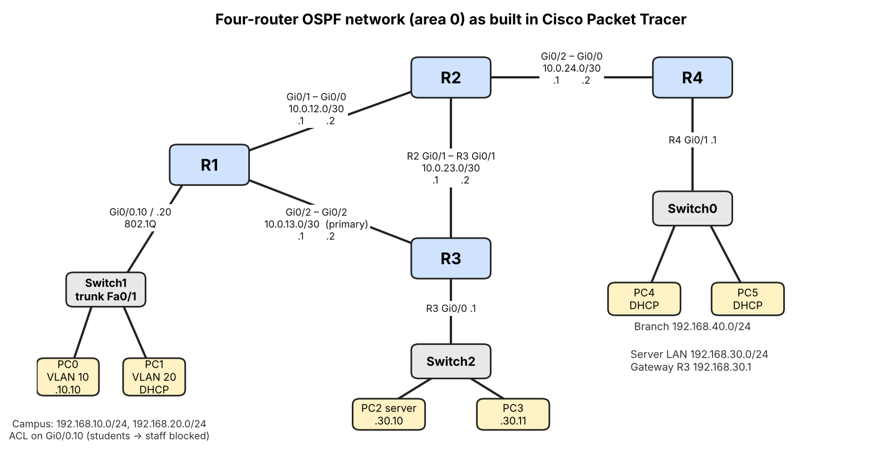
Network design: OSPF topology in Packet Tracer
4 routers, OSPF area 0 (R1-R2-R3 triangle, R4 branch)
2 VLANs, router-on-a-stick, DHCP on R1 and R4
Access list: student to staff blocked (verified)
Routes: server LAN metric 2 via R3, branch metric 3 via R2
Failover: shut R1 Gi0/2, 70/71 pings, reroute via R2 (metric 3)
Built and tested in Packet Tracer: OSPF adjacencies, routes, ACL and failover all verified.
13 / 21 Smart-RUDP
Notes:
SAY (0:50):
- Four routers, OSPF area 0: R1, R2, R3 form a triangle and R4 is a branch.
- Two VLANs with router-on-a-stick, DHCP on R1 and R4, and an access list blocking student to staff.
- Server LAN is metric 2 via R3; branch is metric 3 via R2. Failover: shutting R1 Gi0/2 still gave 70 of 71 pings, rerouted via R2.
IF ASKED: Q: Does RUDP run inside Packet Tracer? A: No, it cannot run C. Packet Tracer validates the network design; protocol is validated on one machine plus Wireshark.

Slide 14
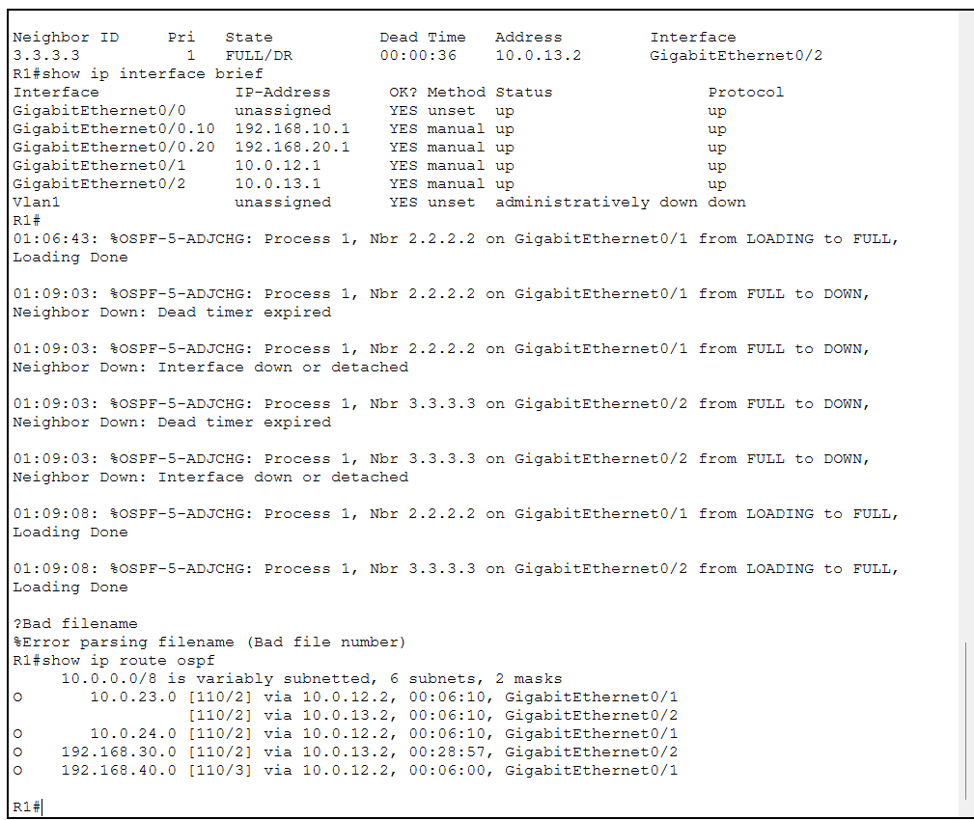
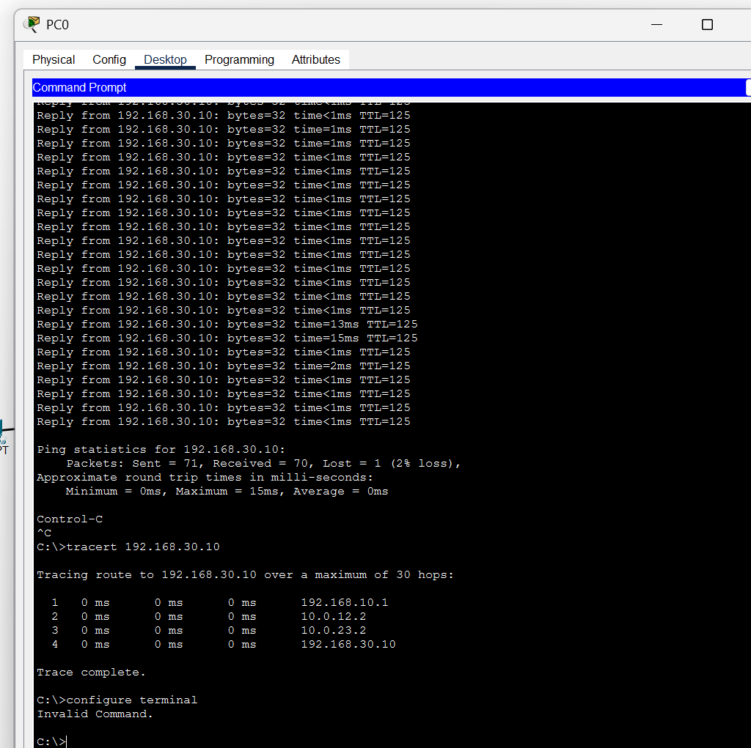
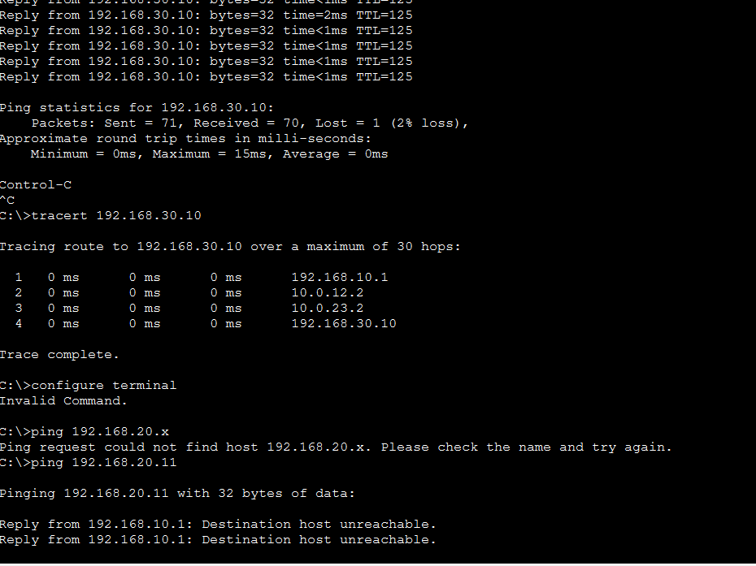
Packet Tracer results: routes, failover, ACL
OSPF routes on R1
Link failure: 70/71 pings, reroute
ACL: student blocked, staff allowed
Server LAN metric 2 via R3, branch LAN metric 3 via R2
Shutting R1 Gi0/2: traffic reroutes via R2, only 1 of 71 pings lost
Student PC gets "destination unreachable" to staff; server still reachable (TTL 126)
14 / 21 Smart-RUDP
Notes:
SAY (0:40):
- Left: OSPF routes on R1 with the metrics. Middle: the link-failure test, 70 of 71 pings. Right: the ACL, where the student gets destination unreachable to staff but the server is still reachable (TTL 126).
IF ASKED: If asked to show it live: have the .pkt file open and follow Demo_Steps.txt.

Slide 15
Smart-RUDP: a Q-learning window controller
State (80)
Action (5)
Reward
RTT ratio x loss fraction x window size, sampled once per RTT.
Multiply cwnd by 0.5, 0.85, 1.0, 1.15 or 1.5.
Throughput gained, minus delay growth, minus retransmissions.
Same Go-Back-N reliability as the baseline; only the window policy changes. Paths emulated in-program: 5G-like, lossy wireless, satellite-like.
15 / 21 Smart-RUDP
Notes:
SAY (0:50):
- Q-learning with 80 states (RTT ratio, loss fraction, window size), sampled once per RTT.
- Five actions: multiply the window by 0.5, 0.85, 1.0, 1.15 or 1.5.
- Reward: throughput gained, minus delay growth, minus retransmissions. Same Go-Back-N reliability; only the window policy changes. Paths are emulated in the program: 5G-like, lossy wireless, satellite-like.
IF ASKED: Q: Is it really learning? A: Yes, 40 training episodes; the learning-curve figure shows it. It is small and tabular with limited training.

Slide 16
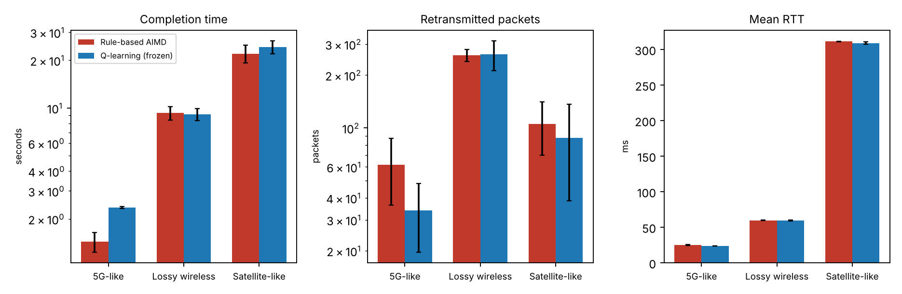
Smart-RUDP vs AIMD: honest result
6 evaluation runs per scenario after 40 training episodes
Not faster: +63% time on 5G-like, +10% on satellite, tie on lossy
Fewer retransmissions on 5G-like and satellite, but within run-to-run noise
Earlier training rounds were much worse; reported run is the final configuration
16 / 21 Smart-RUDP
Notes:
SAY (0:50):
- Be honest: it did not beat AIMD. Plus 63 percent time on 5G-like, plus 10 percent on satellite, a tie on the lossy path.
- It used somewhat fewer retransmissions on two paths, within run-to-run noise.
- Earlier training rounds were much worse; this is the final configuration. The finding is that a simple learner does not beat a tuned rule.
IF ASKED: Q: Then what was the point? A: The experiment. We tested whether a learned window helps and report the answer, including the negative result.

Slide 17
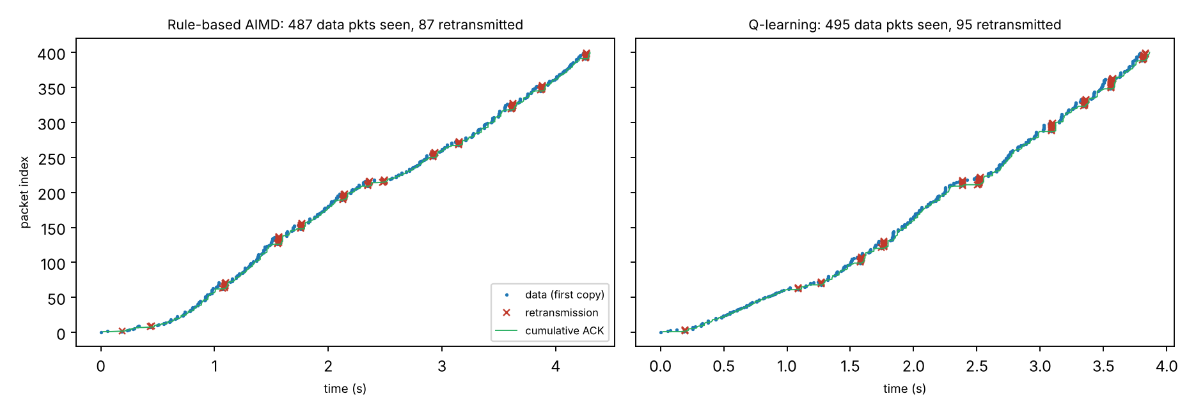
Wireshark: RUDP dissector and traces
rudp.lua decodes seq, ack, flags, checksum, length
Filters: smartrudp.flags.data == 1, smartrudp.seq == N
400 packets, lossy path: 87 (AIMD) and 95 (Smart) repeated data segments seen at the receiver
Trace exported by the program, topology addresses, handshake not included
17 / 21 Smart-RUDP
Notes:
SAY (0:40):
- We wrote a Lua dissector, named smartrudp, that decodes sequence, ack, flags, checksum and length.
- Useful filters: smartrudp.flags.data == 1 and smartrudp.seq == N.
- In a 400-packet lossy run the receiver saw 87 (AIMD) and 95 (Smart) repeated data segments.
- The program's exported trace uses topology addresses and has no handshake.
IF ASKED: Q: Why no handshake in the export? A: The export builds synthetic packets. The real tshark capture on the next slide shows the handshake.

Slide 18
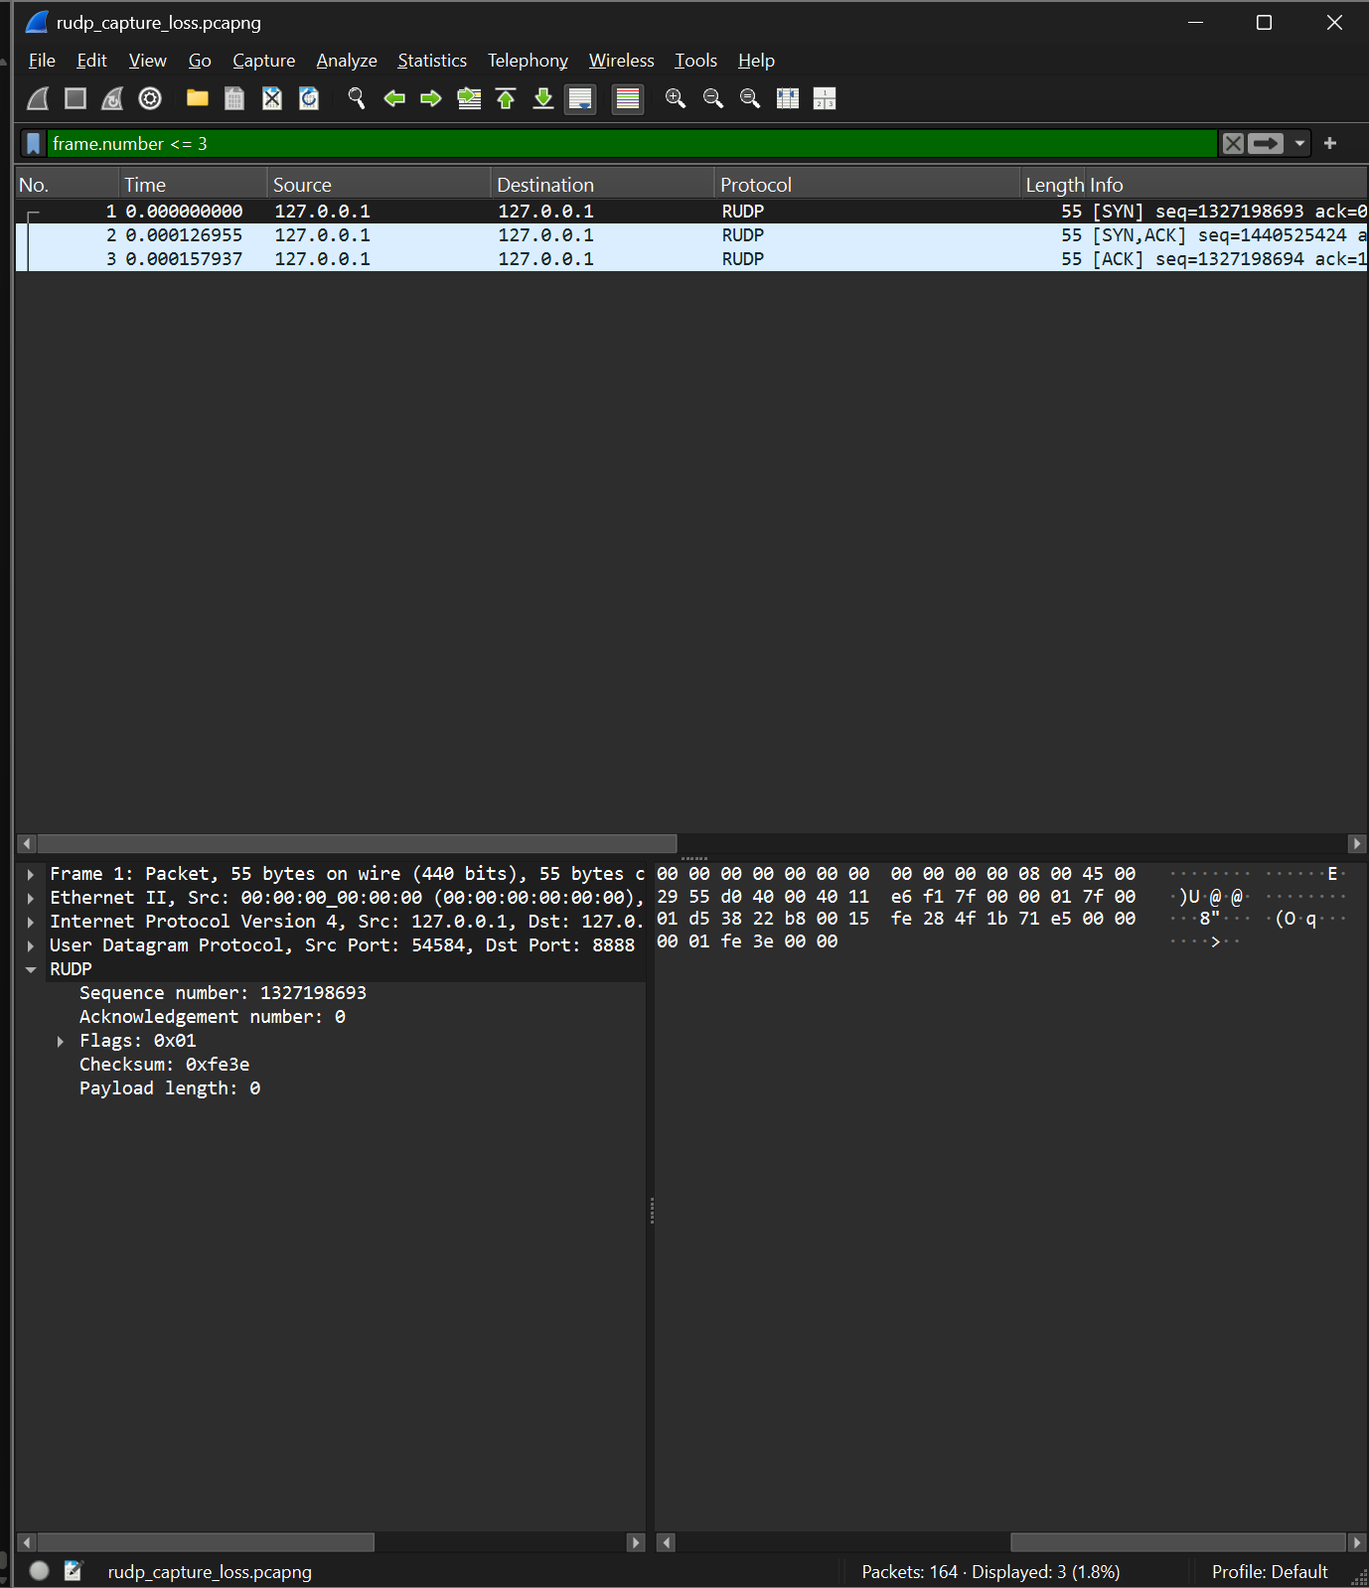
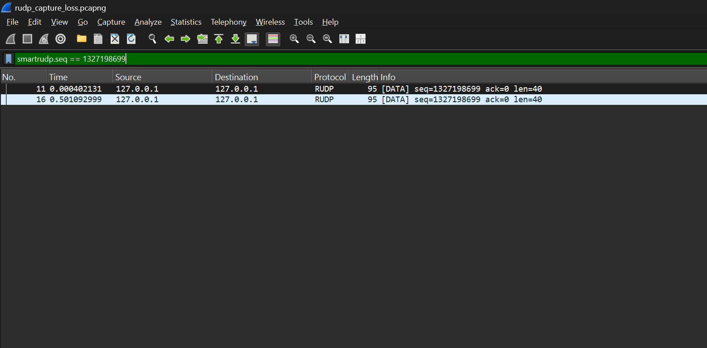
Wireshark: real capture
Left: SYN, SYN-ACK, ACK decoded by the smartrudp dissector (filter frame.number <= 3)
Right: smartrudp.seq == N shows the same segment sent twice, a retransmission
18 / 21 Smart-RUDP
Notes:
SAY (0:50):
- Left: the first three packets, SYN, SYN-ACK and ACK, decoded by our dissector (filter frame.number <= 3).
- Right: filter smartrudp.seq == N shows the same segment twice, a retransmission.
IF ASKED: If Wireshark is open live: Analyze, Decode As, UDP 8888 = RUDP, then use these two filters.

Slide 19
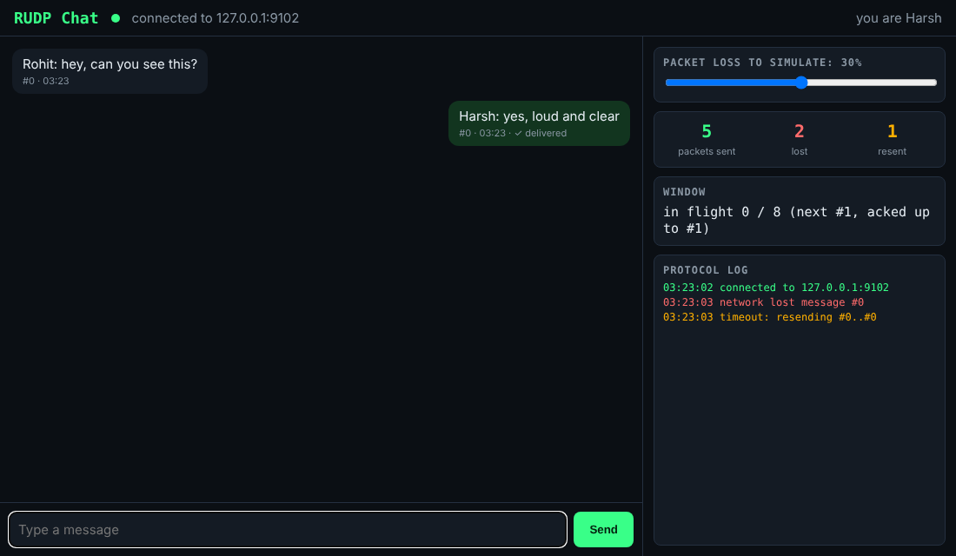
Demo: RUDP Chat over the internet
Each message is one RUDP segment: numbered, checksummed, ACKed in order
Browser UI via a small gateway; terminal version too
Two machines linked over Tailscale (laptop and phone)
Loss slider: lost messages are resent and still arrive in order
Uses a fixed window of 8, not the Smart-RUDP controller
19 / 21 Smart-RUDP
Notes:
SAY (1:00):
- The protocol in use: each message is one numbered, checksummed RUDP segment, ACKed in order.
- There is a terminal version and a browser version; two devices were linked over Tailscale, laptop and phone.
- Drag the loss slider: lost messages are resent and still arrive in order. The right panel shows sent, lost and resent counts and the log.
- It uses a fixed window of 8, not the Smart-RUDP controller.
IF ASKED: Q: Is it secure? A: No encryption or accounts; it is a demo of reliability, not a product.

Slide 20
Learnings and future work
Learned
Next
Reliability is a set of simple rules working together.
Congestion control matters as much as retransmission.
Testing tools fail in surprising ways.
Selective Repeat / SACK
A stronger learning agent
Kernel netem and real multi-machine tests
Run RUDP across a real multi-machine network
Limits: Go-Back-N wastes bandwidth; emulated (not kernel) paths; Smart-RUDP did not beat AIMD.
20 / 21 Smart-RUDP
Notes:
SAY (0:50):
- Learned: reliability is a set of simple rules working together; congestion control matters as much as retransmission; testing tools fail in surprising ways.
- Next: Selective Repeat with SACK, a stronger learning agent, adaptive timeout, and tests on a real multi-machine network.
- Name the limits before she does: Go-Back-N, loopback-only protocol tests, Smart-RUDP not beating AIMD.
IF ASKED: End on the limits and the fix order: SACK, adaptive timeout, real-network tests.

Slide 21
Thank you
github.com/Capsturrrr/rudp
Harshavardhan Mallela Rohit Arya Shloak Sinha
Notes:
SAY (0:15):
- Thank you. The code, report and captures are at github.com/Capsturrrr/rudp. Happy to take questions.
IF ASKED: Pause and smile; hand over to questions.

Slide 22
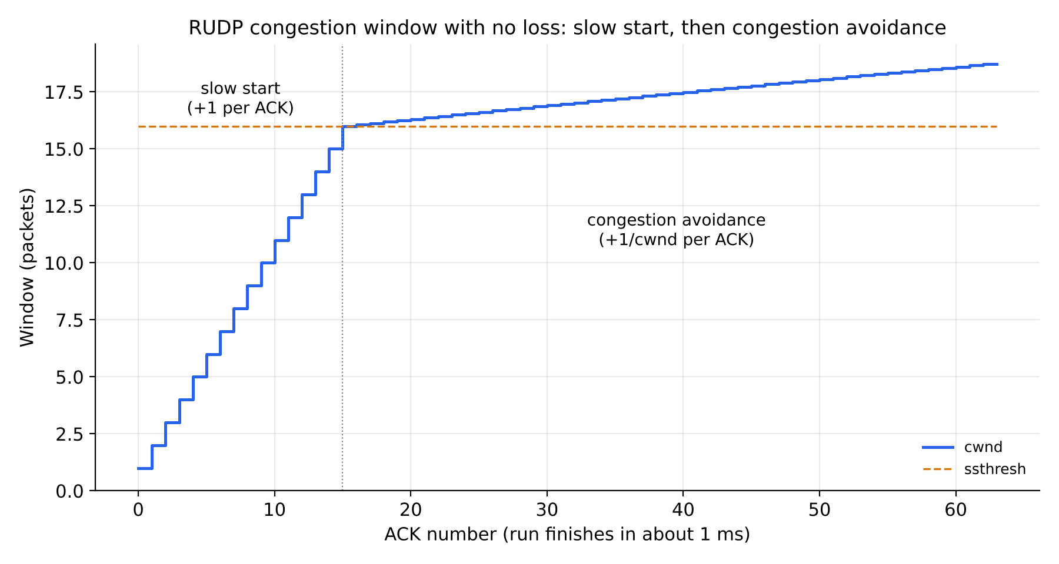
Appendix: slow start and congestion avoidance
cwnd starts at 1
+1 per ACK until ssthresh = 16
Then +1/cwnd per ACK
62 packets, final cwnd 18.71
Appendix Smart-RUDP
Notes:
SAY (-):
- Only if asked: the window starts at 1, adds 1 per ACK until the threshold 16, then 1/window per ACK. In the 62-packet run the final window was 18.71.
IF ASKED: Use this slide to answer 'show me congestion avoidance'.

