Slide 1
Smart-RUDP
Reliable UDP with learning-based congestion control, in C
Computer Networks | Faculty: Anuradha G
Harshavardhan Mallela 24BAI0274 Rohit Arya 24BCE0819 Shloak Sinha 24BDS0378

Slide 2
The problem
UDP
TCP
Fast and simple, but no guarantees: packets can be lost, duplicated or reordered.
Reliable, but lives inside the OS kernel. Hard to see, hard to change, hard to learn from.
In 1986 the early Internet suffered congestion collapse: throughput fell from 32 Kbps to 40 bps. TCP congestion control was invented to fix it.
Our question: can we rebuild TCP's core ideas ourselves, on top of UDP?
2 / 24 Smart-RUDP

Slide 3
Why we built it
The need
Our answer
Campus users send data to a server across a routed network. TCP is fixed inside the kernel; plain UDP gives no guarantees. Real systems (QUIC, HTTP/3) solve this with reliability built in user space over UDP.
RUDP: a readable, tunable reliable transport over UDP, plus Smart-RUDP, a controller that learns the window from RTT and loss.
Scenario: a student on VLAN 10 uploads a file to the server LAN. The ACL keeps students out of staff VLAN 20. If a core link fails, OSPF reroutes through R2: a longer path and higher RTT that the transport must adapt to.
Validated: protocol tests and Smart-RUDP vs AIMD on emulated paths; network design built and tested in Packet Tracer; traffic analysed in Wireshark.
3 / 24 Smart-RUDP

Slide 4
What we built
Handshake
Reliability
Flow control
Congestion control
SYN, SYN-ACK, ACK before any data flows.
Sequence numbers, ACKs, checksums, timeouts, retransmission.
Go-Back-N sliding window; its size is the congestion window.
AIMD: slow start, avoidance, halve on loss.
About 670 lines of C across 4 source files. Client + server, built in 8 phases, on github.com/Capsturrrr/rudp
4 / 24 Smart-RUDP

Slide 5
The RUDP packet header: 13 bytes
Field | Size | Purpose
seq | 4 B | Packet number
ack | 4 B | Next packet expected
flags | 1 B | SYN / ACK / FIN / DATA
checksum | 2 B | Detects corruption
payload_len | 2 B | Data length (max 512)
Fields packed byte by byte, so compiler struct padding never changes the wire format.
Data packet = 53 bytes on the wire. ACK / handshake = 13 bytes.
5 / 24 Smart-RUDP

Slide 6
Handshake and data flow
1
SYN
Client -> Server
Request a connection
2
SYN-ACK
Client <- Server
Server agrees
3
ACK
Client -> Server
ESTABLISHED, data may flow
4
DATA
Client -> Server
Up to window-size packets in flight
5
ACK
Client <- Server
Cumulative: confirms everything up to N
6
FIN
Client -> Server
Close the connection
Server accepts a new SYN in any state, so a killed client can never leave it stuck.
6 / 24 Smart-RUDP

Slide 7
Reliability: Go-Back-N
Window = cwnd packets in flight (fixed at 4 in Phase 4, then driven by cwnd)
Receiver sends cumulative ACKs
Retransmission timeout: 500 ms
Fast retransmit after 3 duplicate ACKs, no waiting for the timer
Checksum failures are dropped, then recovered by retransmission
Proof
In a netem 20% loss capture we saw 12 timeouts spaced about 500 ms apart.
Result
2,442-byte message reassembled correctly.
7 / 24 Smart-RUDP

Slide 8
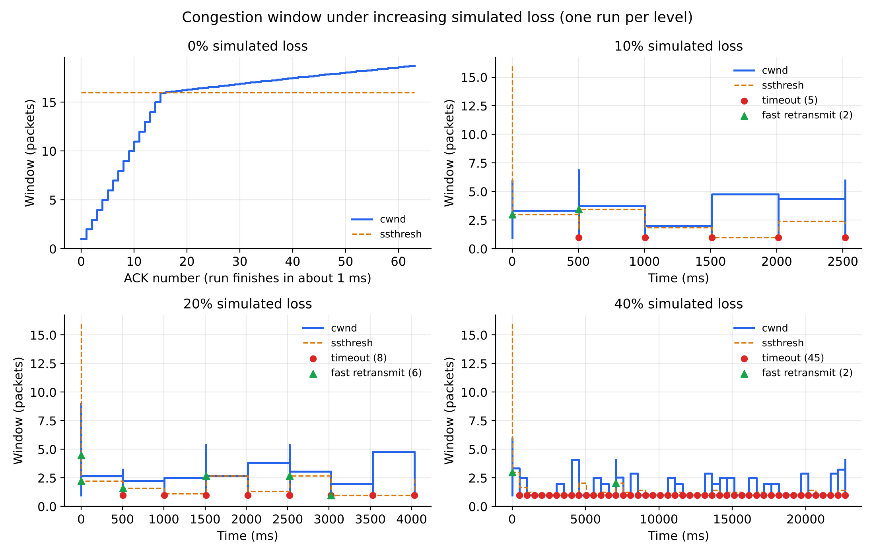
Congestion control: AIMD
Slow start: cwnd +1 per ACK, below ssthresh 16
Avoidance: cwnd + 1/cwnd per ACK
3 dup ACKs: cwnd halves
Timeout: cwnd resets to 1, ssthresh halves
Capped at 32
Fresh runs at 0%, 10%, 20% and 40% simulated loss. Red = timeout, green = fast retransmit.
8 / 24 Smart-RUDP

Slide 9
How we tested
Built-in loss simulator
tc / netem
Wireshark / tshark
Drops packets in code at a set percentage. Used for the benchmark.
Linux kernel injects real loss on loopback. Used to validate behaviour.
Captured in WSL, opened in Windows Wireshark. Confirmed handshake, ACKs, retransmissions.
Wireshark could not see WSL loopback from Windows, so we captured with tshark inside WSL and copied the file across.
9 / 24 Smart-RUDP

Slide 10
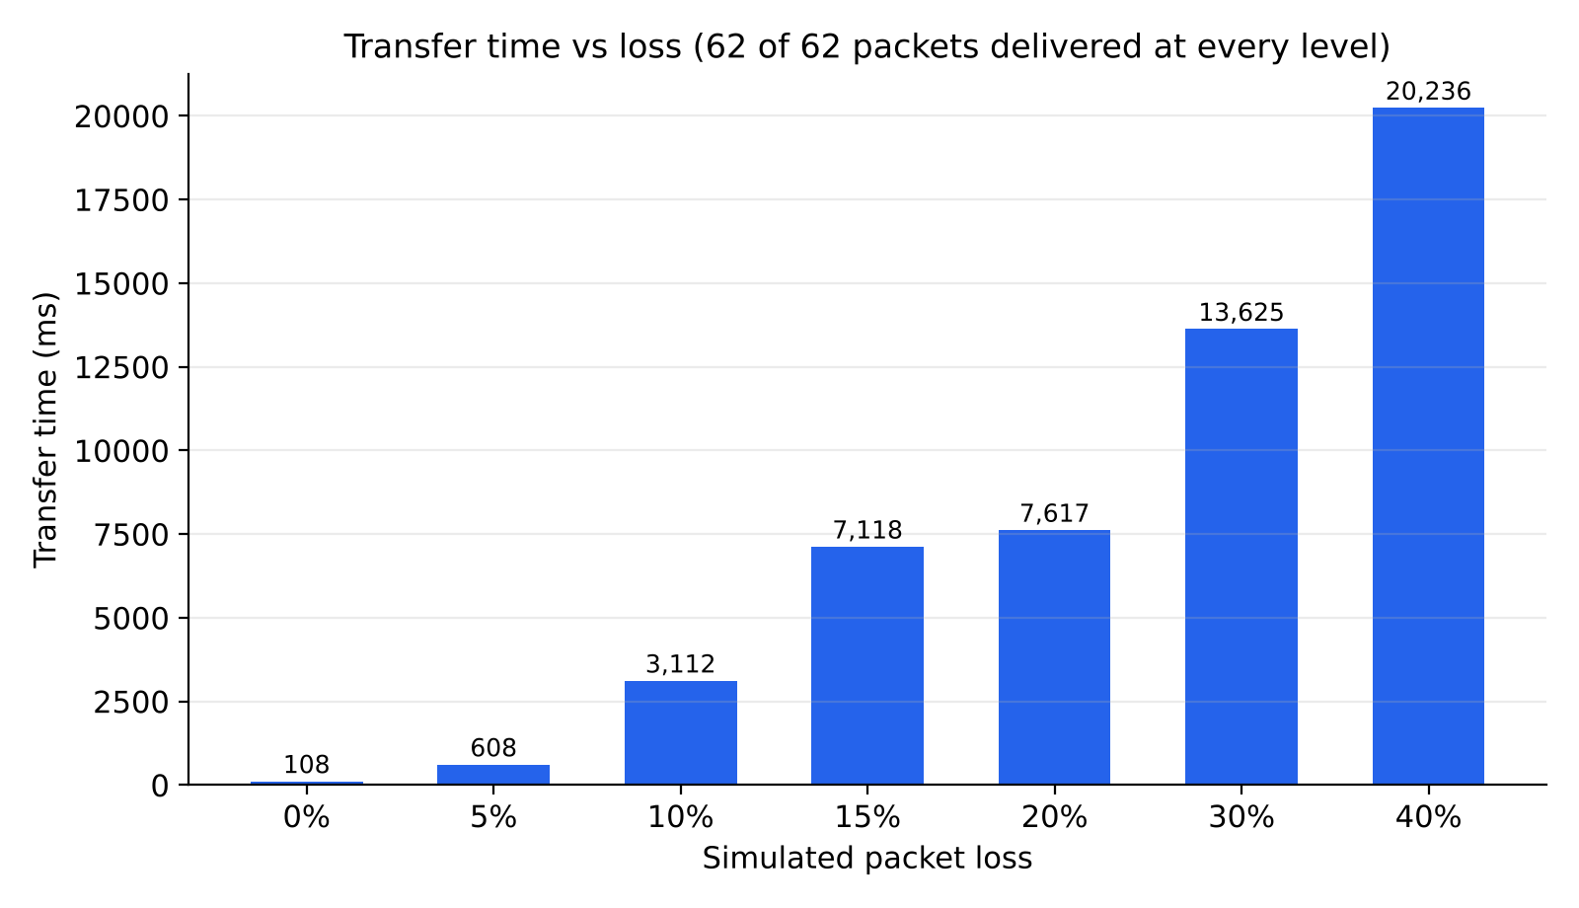
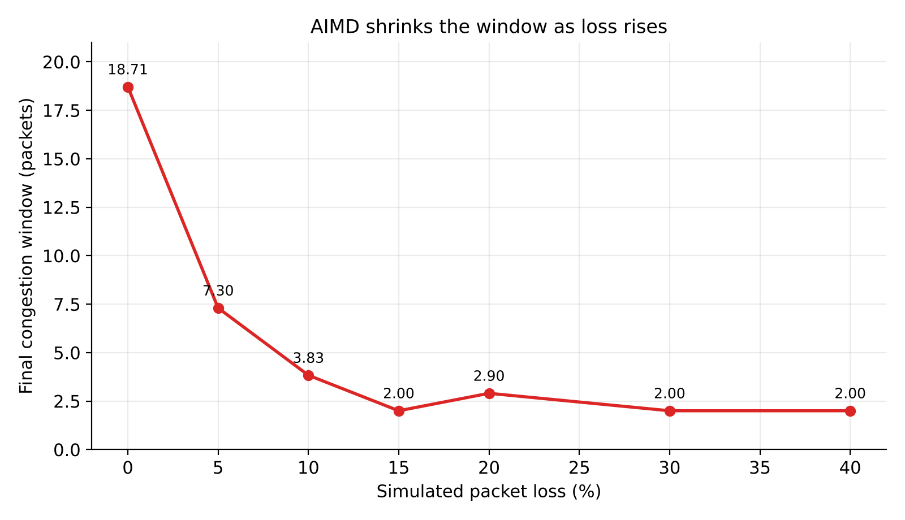
Benchmark results
62 of 62 packets delivered at every loss level, from 0% to 40%.
10 / 24 Smart-RUDP

Slide 11
Problems we hit and fixed
Problem | Fix
Server stuck after killed client | Accept SYN in any state (was a 15.5 s hang)
Leftover netem rule | Check tc qdisc show dev lo, delete before each test
Windows Wireshark saw nothing | Capture with tshark inside WSL, then copy
Shell portability in benchmark | Replaced date/grep tricks with awk and sed
11 / 24 Smart-RUDP

Slide 12
Literature behind the design
Jacobson & Karels (1988): congestion avoidance and control, the origin of AIMD
Chiu & Jain (1989): why additive increase, multiplicative decrease converges fairly
RFC 5681 (2009): TCP congestion control standard
Ha, Rhee, Xu (2008): CUBIC, our future-work direction
Langley et al. (2017) and RFC 9000: QUIC, reliable transport over UDP in production
Midhula & Arun Raj Kumar (2024) and Cao et al. (2023, DRLFcc): deep reinforcement learning for congestion control, the idea behind Smart-RUDP
Key researcher: Van Jacobson
12 / 24 Smart-RUDP

Slide 13
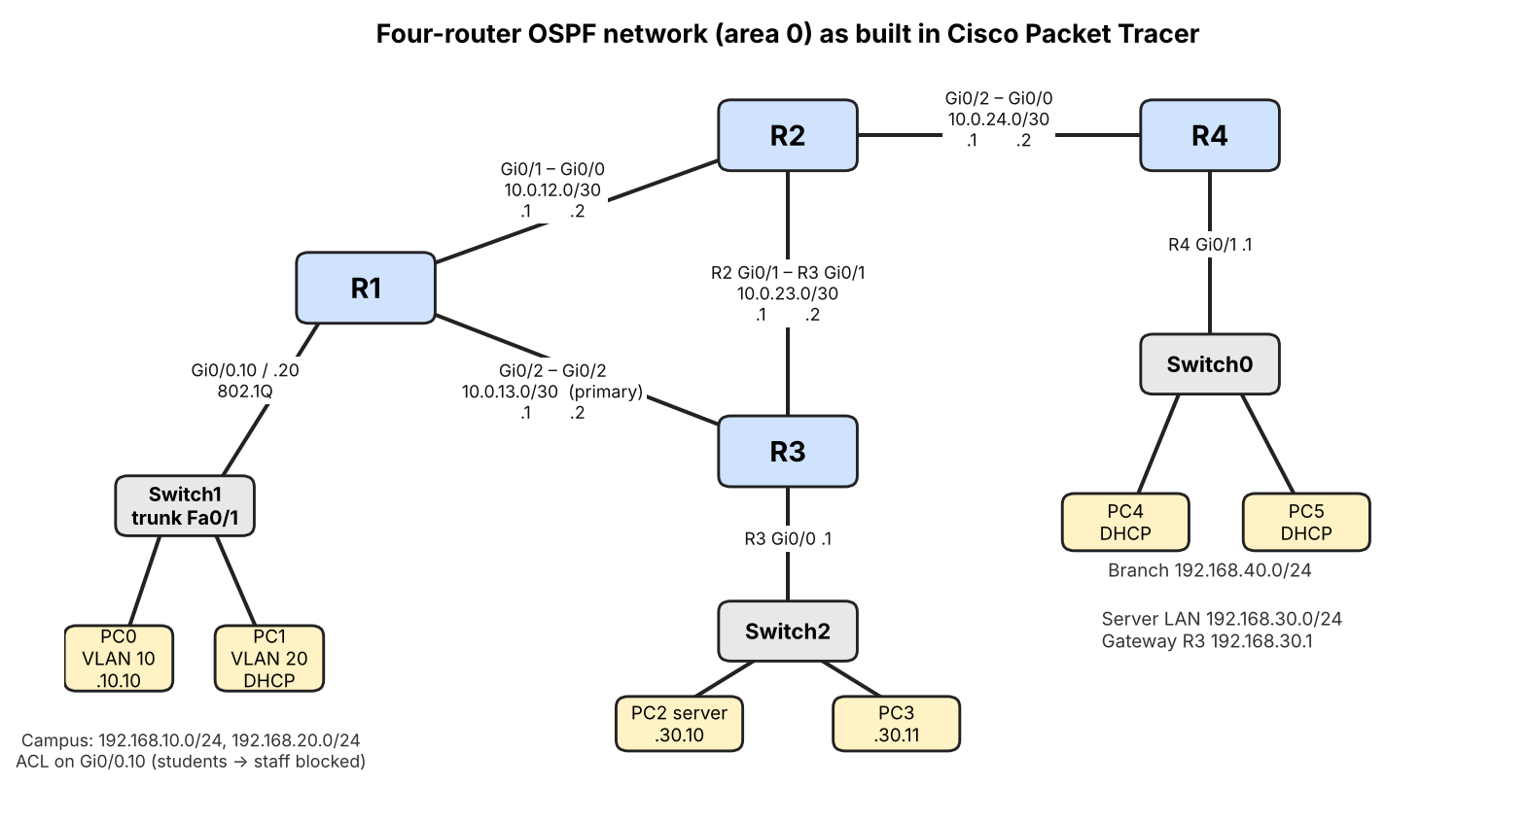
Network design: OSPF topology in Packet Tracer
4 routers, OSPF area 0 (R1-R2-R3 triangle, R4 branch)
2 VLANs, router-on-a-stick, DHCP on R1 and R4
Access list: student to staff blocked (verified)
Routes: server LAN metric 2 via R3, branch metric 3 via R2
Failover: shut R1 Gi0/2, 70/71 pings, reroute via R2 (metric 3)
Built and tested in Packet Tracer: OSPF adjacencies, routes, ACL and failover all verified.
13 / 24 Smart-RUDP

Slide 14
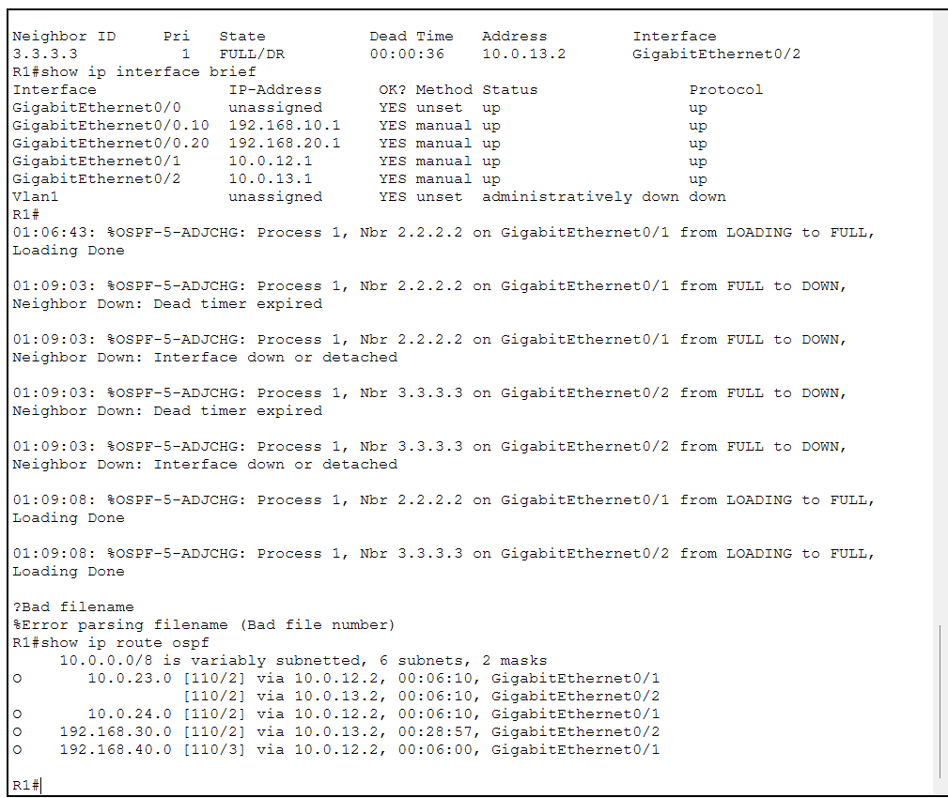
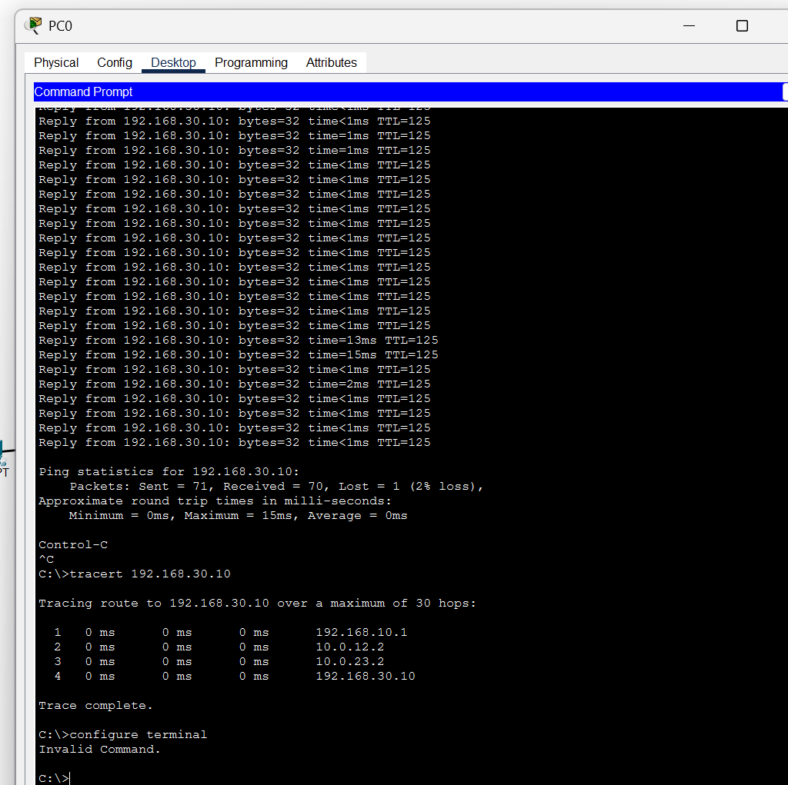
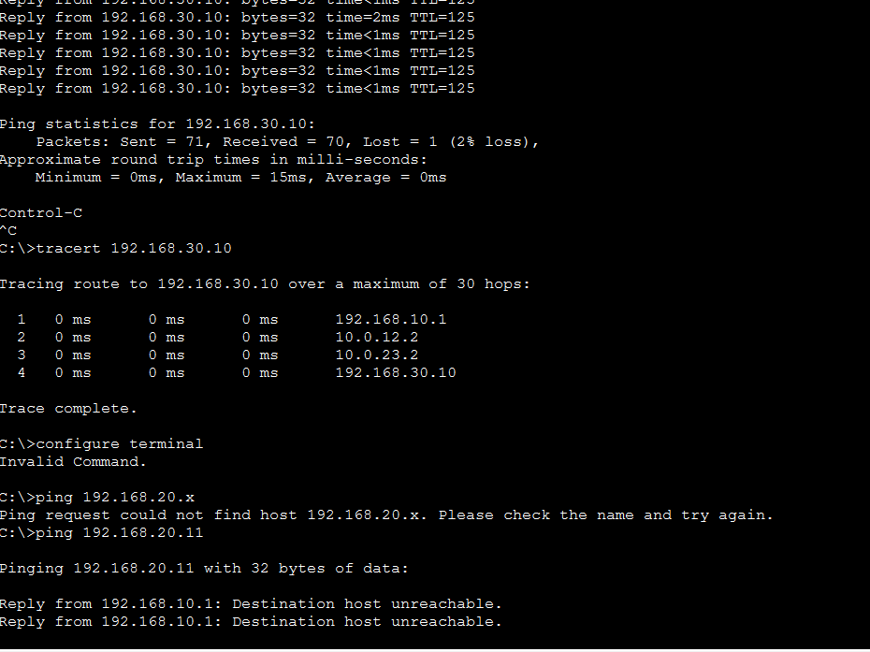
Packet Tracer results: routes, failover, ACL
OSPF routes on R1
Link failure: 70/71 pings, reroute
ACL: student blocked, staff allowed
Server LAN metric 2 via R3, branch LAN metric 3 via R2
Shutting R1 Gi0/2: traffic reroutes via R2, only 1 of 71 pings lost
Student PC gets "destination unreachable" to staff; server still reachable (TTL 126)
14 / 24 Smart-RUDP

Slide 15
Smart-RUDP: a Q-learning window controller
State (80)
Action (5)
Reward
RTT ratio x loss fraction x window size, sampled once per RTT.
Multiply cwnd by 0.5, 0.85, 1.0, 1.15 or 1.5.
Throughput gained, minus delay growth, minus retransmissions.
Same Go-Back-N reliability as the baseline; only the window policy changes. Paths emulated in-program: 5G-like, lossy wireless, satellite-like.
15 / 24 Smart-RUDP

Slide 16
The AI agent in our code
src/rl_cc.h (agent, simplified)
src/smart_client.c (decision loop, simplified)
// state: 4 x 4 x 5 = 80 buckets
s = (rtt_bucket*4 + loss_bucket)*5 + cwnd_bucket;
// choose: explore with prob. eps, else best
int rl_choose(a, s) {
if (rand01() < a->eps) return rand() % 5;
return argmax(a->q[s]); // 5 actions
}
// learn: the Q-learning update
void rl_update(a, s, act, r, s2) {
target = r + a->gamma * max(a->q[s2]);
a->q[s][act] += a->alpha * (target - a->q[s][act]);
}
// once per RTT, in smart_client.c
ratio = rtt / base_rtt; lossf = losses / sent;
reward = sqrt(throughput_norm)
- 0.5 * max(0, ratio - 1) // delay growth
- 4.0 * lossf; // loss
rl_update(&ag, prev_s, prev_a, reward, s2);
act = rl_choose(&ag, s2);
cwnd *= {0.5, 0.85, 1.0, 1.15, 1.5}[act];
Tabular Q-learning: alpha 0.15, gamma 0.9. Chat version: web/cc.py, trained in web/train.py (results/q_chat.txt). Deep version: web/dqn.py, a small neural network (5-32-32-5) trained by DQN in web/train_deep.py.
16 / 24 Smart-RUDP

Slide 17
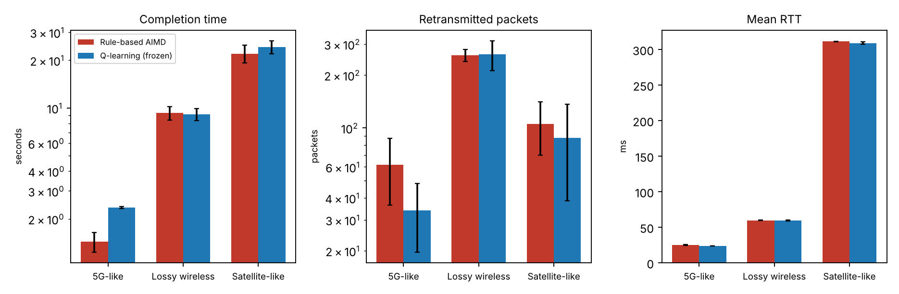
Smart-RUDP vs AIMD: honest result
6 evaluation runs per scenario after 40 training episodes
Not faster: +63% time on 5G-like, +10% on satellite, tie on lossy
Fewer retransmissions on 5G-like and satellite, but within run-to-run noise
Earlier training rounds were much worse; reported run is the final configuration
17 / 24 Smart-RUDP

Slide 18
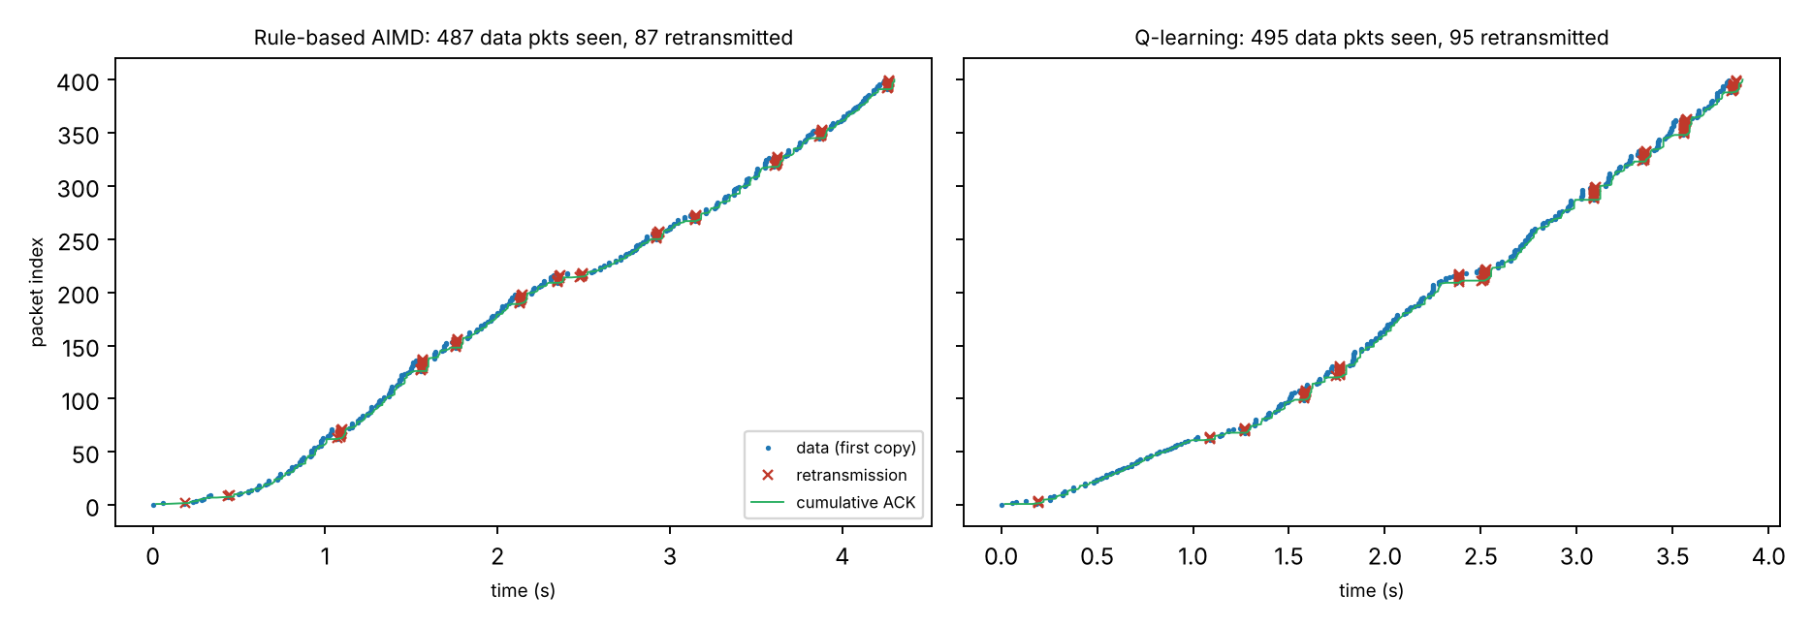
Wireshark: RUDP dissector and traces
rudp.lua decodes seq, ack, flags, checksum, length
Filters: smartrudp.flags.data == 1, smartrudp.seq == N
400 packets, lossy path: 87 (AIMD) and 95 (Smart) repeated data segments seen at the receiver
Trace exported by the program, topology addresses, handshake not included
18 / 24 Smart-RUDP

Slide 19
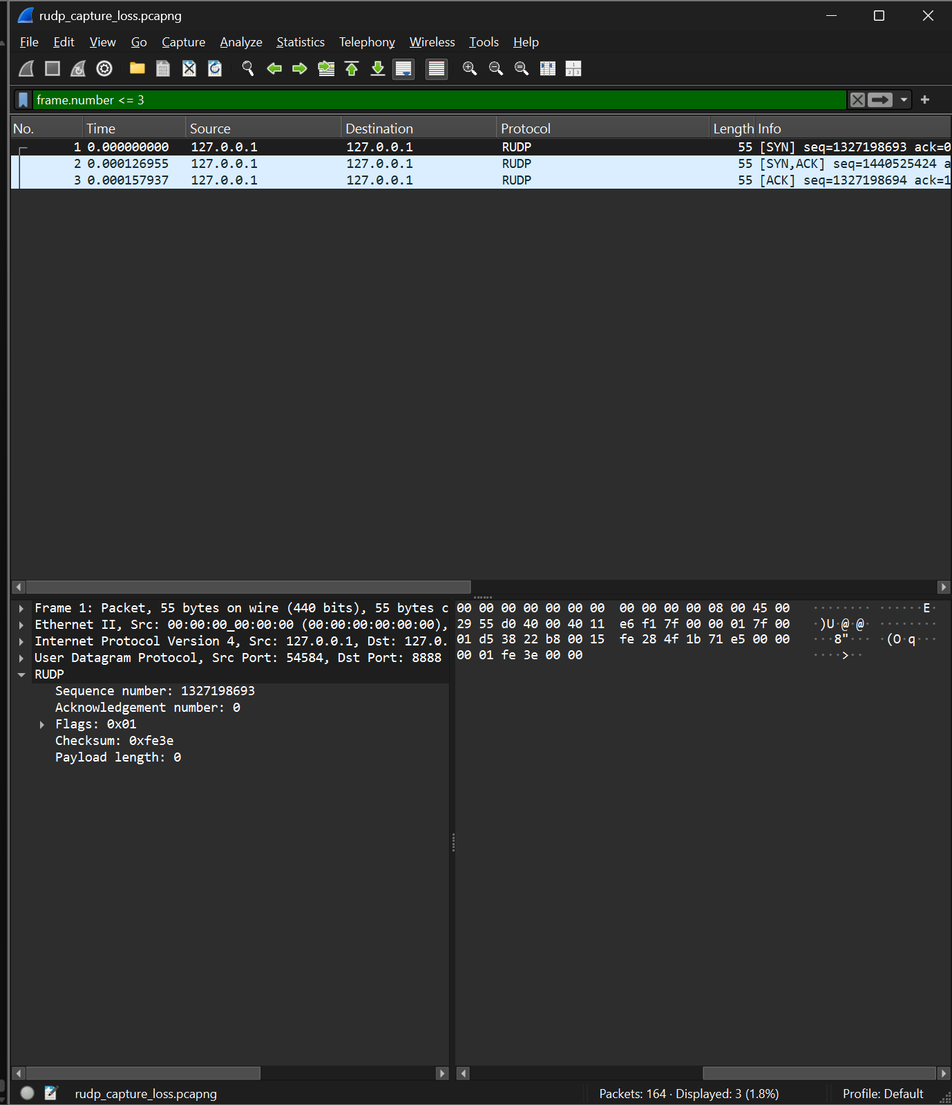
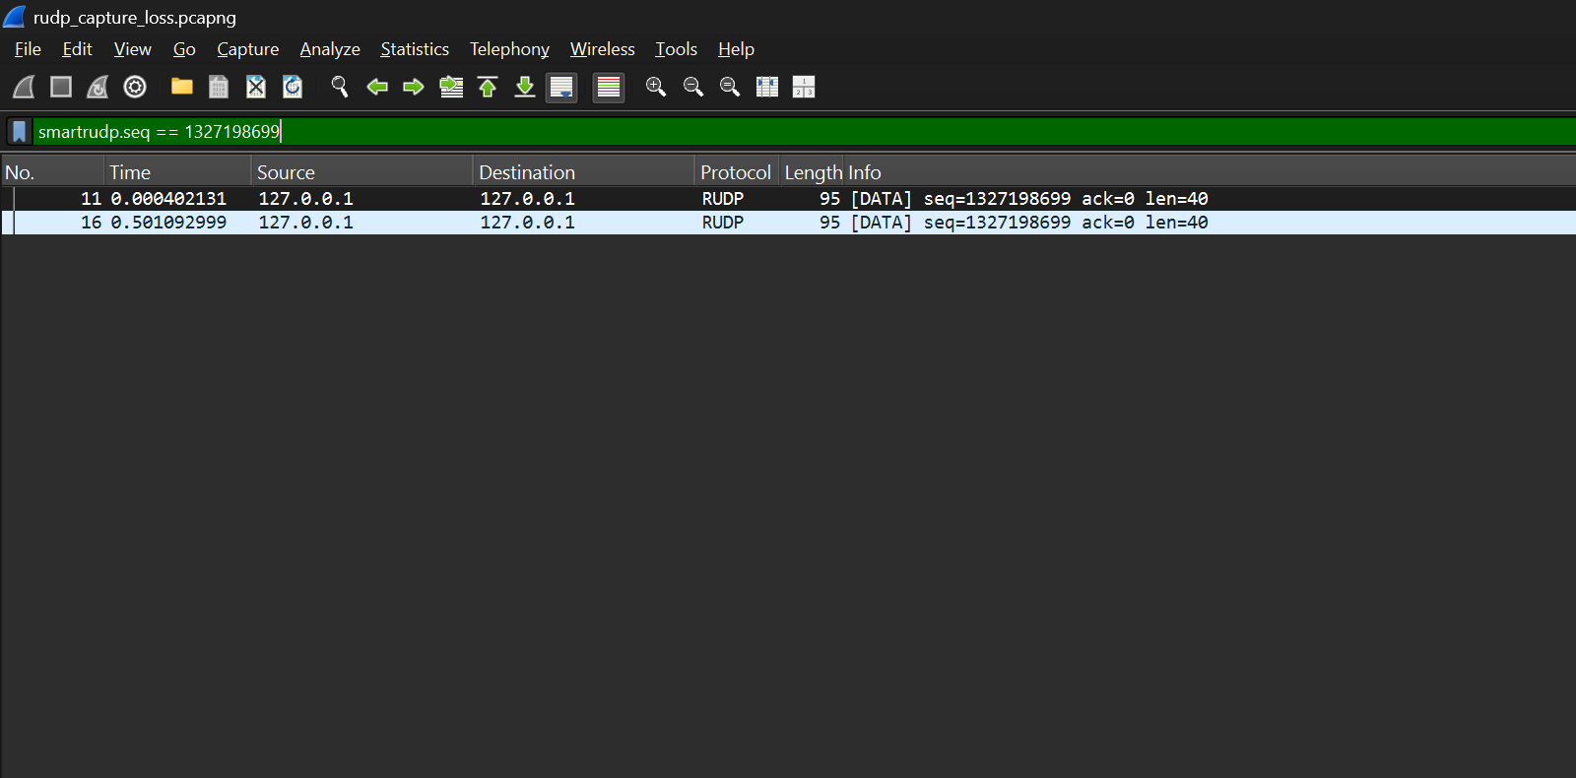
Wireshark: real capture
Left: SYN, SYN-ACK, ACK decoded by the smartrudp dissector (filter frame.number <= 3)
Right: smartrudp.seq == N shows the same segment sent twice, a retransmission
19 / 24 Smart-RUDP

Slide 20
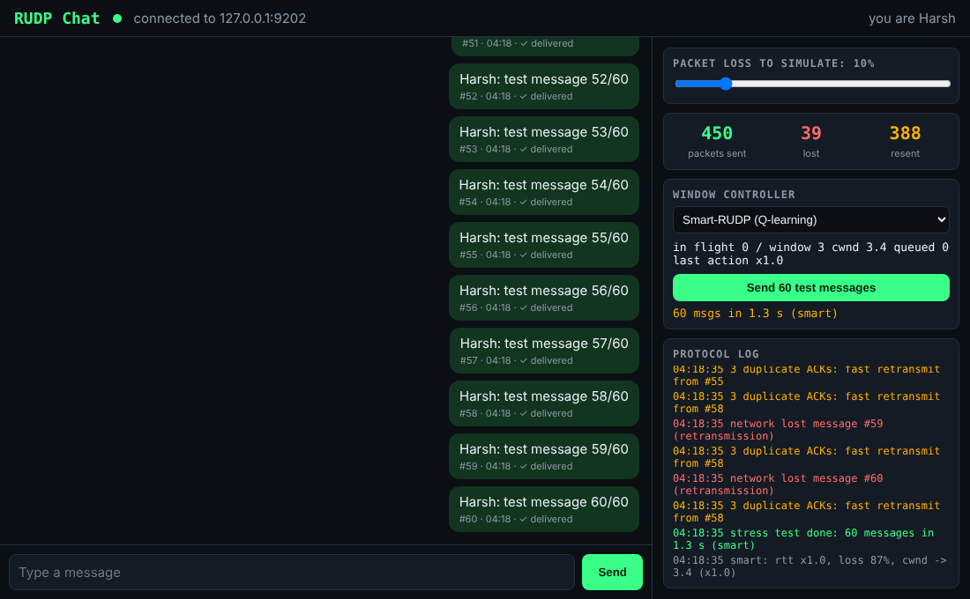
Demo: RUDP Chat over the internet
Each message is one RUDP segment: numbered, checksummed, ACKed in order
Browser UI via a small gateway; terminal version too
Two machines linked over Tailscale (laptop and phone)
Loss slider: lost messages are resent and still arrive in order
Window controller switch: fixed, AIMD or Smart-RUDP (Q-learning, learns live)
Retrained for the chat: faster than AIMD on 5 of 6 held-out paths, equal on 1 (Table 11)
Stress test, 48 unseen paths: table 3.73 s, deep (DQN) 3.20 s, AIMD 7.16 s
Deep agent is seed-sensitive, so picked on validation paths
20 / 24 Smart-RUDP

Slide 21
More evidence: baselines, SACK, reordering
48 unseen paths (simulated) | Mean | Median
Plain UDP | 68% delivered | -
TCP model (selective ACK) | 4.56 s | 1.48 s
RUDP fixed window | 3.88 s | 2.00 s
RUDP AIMD | 7.16 s | 2.72 s
Smart-RUDP, table | 3.73 s | 1.99 s
Smart-RUDP, deep | 3.20 s | 1.79 s
Selective ACK (simulated): AIMD mean 7.16 s to 4.90 s, median 2.72 s to 1.44 s; faster on 34 of 48 paths. Go-Back-N is the main weakness.
Reordering (20 ms jitter): AIMD 0.82 s to 6.79 s; deep agent 0.93 s; SACK removes most of the damage.
20-run intervals for the C experiments: Smart slower on 5G-like (+0.92 s) and satellite-like (+6.3 s), tie on lossy.
The TCP row is a model, not kernel TCP. Real netem numbers need a Linux machine: netem_baselines.sh.
21 / 24 Smart-RUDP

Slide 22
Neural agent in the C transport
1,200 packets, C transport | AIMD | Table (rl2) | Neural
5G-like | 1.38 s | 2.64 s | 1.18 s
Lossy wireless | 9.13 s | 7.54 s | 6.63 s
Satellite-like | 17.9 s | 38.1 s | 13.1 s
Neural agent beats AIMD on all three paths: 15%, 27%, 24% faster (95% intervals exclude zero)
Table agent does not generalise: slower on 5G-like and satellite-like
Selective ACK in C: about 10x fewer retransmissions, no significant time change here
Caveats: trained in a simulator; emulated paths; AIMD cap 128 vs agents 32; agent retransmits more on random loss
15 runs per cell (satellite: 8), 95% confidence intervals. Code: src/deep_cc.h, web/dqn.py, eval_ci2.sh.
22 / 24 Smart-RUDP

Slide 23
Learnings and future work
Learned
Next
Reliability is a set of simple rules working together.
Congestion control matters as much as retransmission.
Testing tools fail in surprising ways.
Train the neural agent in C / on real netem
Selective ACK where throughput limits the path
Kernel netem and real multi-machine tests
Limits: Go-Back-N wastes bandwidth and suffers under reordering; C tests use an emulated path; the tabular agent did not beat AIMD in C.
23 / 24 Smart-RUDP

Slide 24
Thank you
github.com/Capsturrrr/rudp
Harshavardhan Mallela Rohit Arya Shloak Sinha

Slide 25
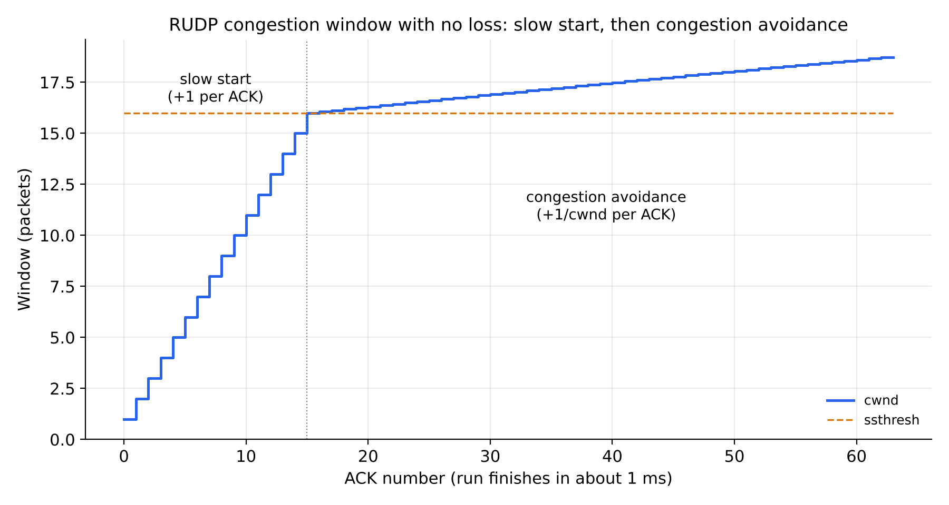
Appendix: slow start and congestion avoidance
cwnd starts at 1
+1 per ACK until ssthresh = 16
Then +1/cwnd per ACK
62 packets, final cwnd 18.71
Appendix Smart-RUDP

