Slide 1
Host guide: Smart-RUDP review
For the presenter only. Each page shows one slide of the real deck, what to say, and the question it is likely to bring.
Computer Networks | Faculty: Anuradha G | 9 Oct 2026

Slide 2
Plan for the session
Total talking time about 15 minutes, then questions.
# | Slide | Time | # | Slide | Time
1 | Title | 0:20 | 12 | Literature | 0:30
2 | The problem | 0:40 | 13 | Network design | 0:50
3 | Why we built it | 0:50 | 14 | Packet Tracer results | 0:40
4 | What we built | 0:40 | 15 | Smart-RUDP design | 0:50
5 | Packet header | 0:40 | 16 | Smart-RUDP result | 0:50
6 | Handshake and data flow | 0:50 | 17 | Wireshark traces | 0:40
7 | Go-Back-N | 0:50 | 18 | Wireshark real capture | 0:50
8 | AIMD | 0:50 | 19 | RUDP Chat demo | 1:00
9 | How we tested | 0:40 | 20 | Learnings and future work | 0:50
10 | Benchmark results | 0:40 | 21 | Thank you | 0:15
11 | Problems fixed | 0:40 | 22 | Appendix: slow start | -
Rules: say the limits before she asks; answer in one or two sentences; if you do not know, say what you would check.

Slide 3
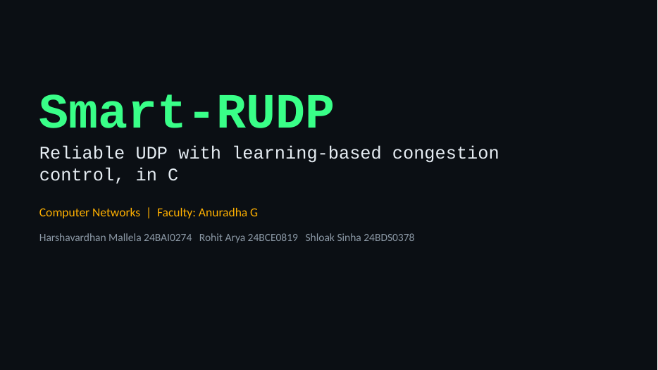
1. Title
Time on this slide: 0:20
SAY
Good morning ma'am. We are Harshavardhan, Rohit and Shloak.
Our project is Smart-RUDP: a reliable transport protocol we built in C on top of UDP, plus a controller that learns how fast to send.
IF ASKED Say the three names and the GitHub link once, then move on.

Slide 4
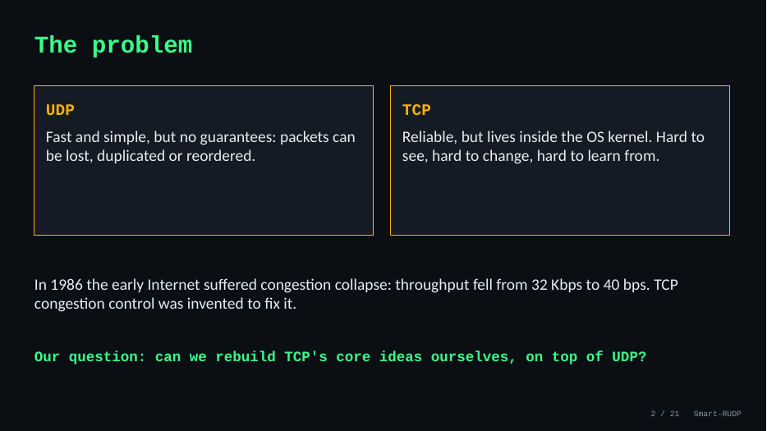
2. The problem
Time on this slide: 0:40
SAY
UDP is fast but gives no guarantees: packets can be lost, duplicated or reordered.
TCP is reliable but sits inside the operating system, so you cannot see or change it.
In 1986 the early Internet had congestion collapse: throughput fell from 32 Kbps to 40 bps. TCP's congestion control was invented to fix that.
Our question: can we rebuild TCP's core ideas ourselves, on UDP?
IF ASKED Q: Why not just use TCP? A: TCP cannot be changed or inspected; building our own makes every mechanism visible. QUIC and HTTP/3 do the same in practice.

Slide 5
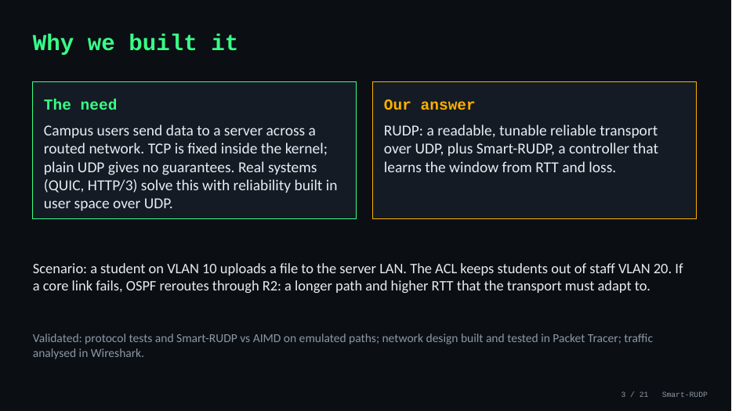
3. Why we built it
Time on this slide: 0:50
SAY
The need: campus users send data to a server across a routed network. TCP is fixed in the kernel; UDP gives no guarantees.
Our answer: RUDP, a readable and tunable transport, and Smart-RUDP, which learns the window from RTT and loss.
Scenario: a student on VLAN 10 uploads to the server LAN. The ACL keeps students out of staff VLAN 20. If a core link fails, OSPF reroutes through R2: longer path, higher RTT, and the transport must adapt.
IF ASKED Q: Is this just a lab exercise? A: A lab sends datagrams. We built reliability and congestion control on top, measured them, and used them in an application.

Slide 6
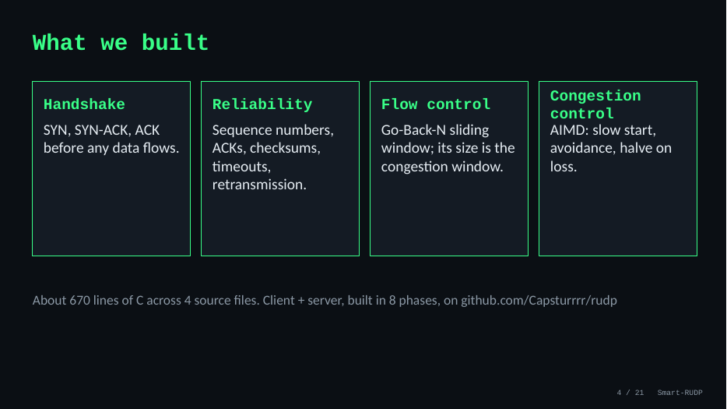
4. What we built
Time on this slide: 0:40
SAY
Four pieces: handshake, reliability, flow control and congestion control.
About 670 lines of C across four source files, built in eight phases, on GitHub at Capsturrrr/rudp.
IF ASKED Q: Who did what? A: Agree one answer as a team before you go in.

Slide 7
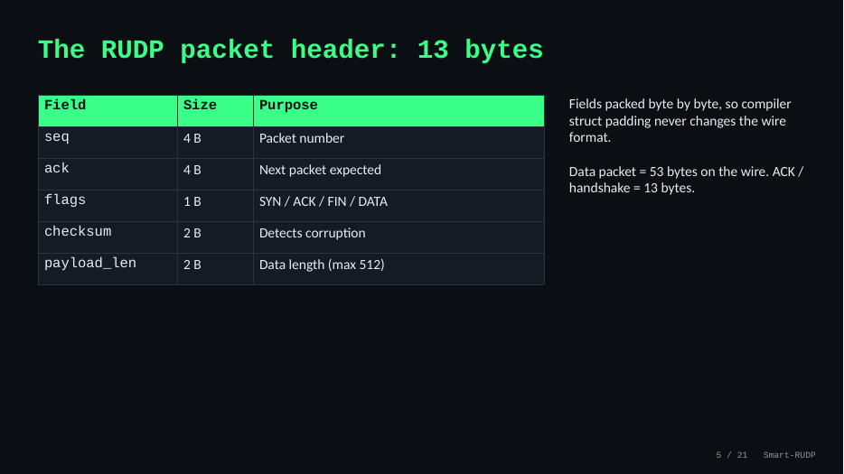
5. Packet header
Time on this slide: 0:40
SAY
13-byte header: sequence 4, ack 4, flags 1, checksum 2, payload length 2.
Fields are packed byte by byte so compiler padding never changes the wire format.
A data packet is 53 bytes on the wire; ACKs and handshake packets are 13.
IF ASKED Q: How does the checksum work? A: 16-bit one's-complement sum over header and payload, like UDP/TCP. A corrupted packet fails and is recovered by retransmission.

Slide 8
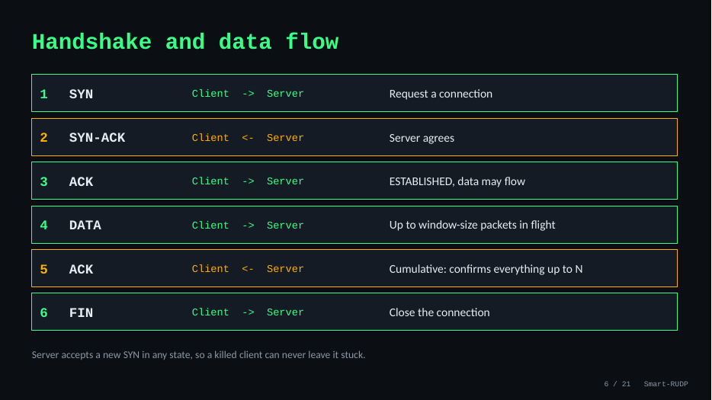
6. Handshake and data flow
Time on this slide: 0:50
SAY
Three-way handshake: SYN, SYN-ACK, ACK. Then data, up to a window of packets in flight.
ACKs are cumulative: ACK N confirms everything before N. FIN closes the connection.
The server accepts a new SYN in any state, so a killed client can never leave it stuck. That was a real bug we fixed.
IF ASKED Q: What if the peer disappears? A: Sender keeps retransmitting on timeout. An abort after repeated timeouts is not implemented; it is the fix we would add.

Slide 9
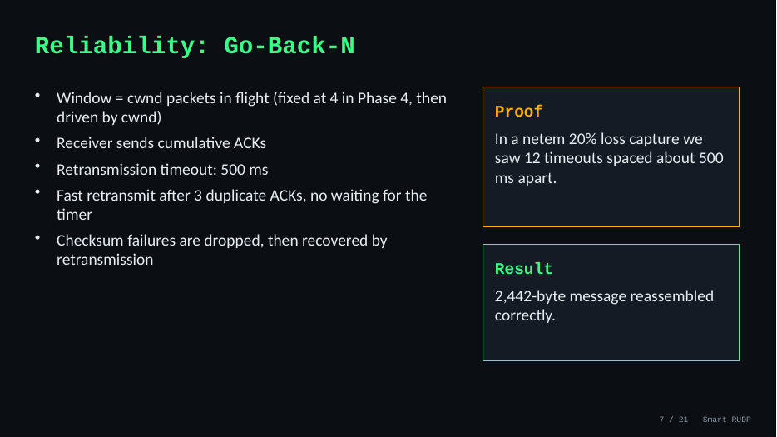
7. Go-Back-N
Time on this slide: 0:50
SAY
The window is the number of packets in flight; it started fixed at 4 and is now driven by the congestion window.
Timeout is 500 ms; fast retransmit triggers after 3 duplicate ACKs, no waiting for the timer.
Proof: in a 20% loss netem capture we saw 12 timeouts about 500 ms apart. Result: the 2,442-byte message reassembled correctly.
IF ASKED Q: Why Go-Back-N? A: Simpler to build and explain. It wastes bandwidth under loss; Selective Repeat with SACK is our stated future work.

Slide 10
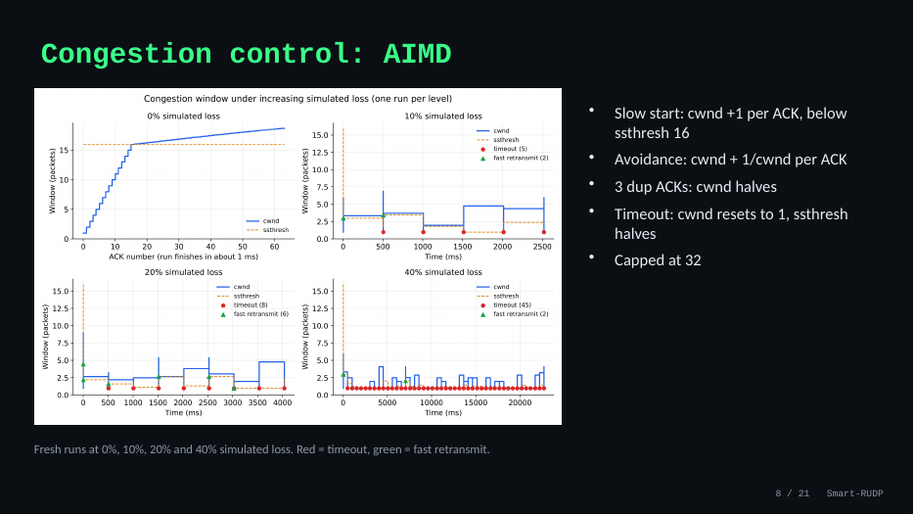
8. AIMD
Time on this slide: 0:50
SAY
Slow start: window grows by one per ACK until the threshold of 16. Then avoidance: plus 1/window per ACK.
Three duplicate ACKs: window halves. A timeout: window resets to 1 and the threshold halves. Cap is 32.
The graph shows fresh runs at 0, 10, 20 and 40 percent loss. Red marks are timeouts, green are fast retransmits.
IF ASKED Q: Why cap 32 and ssthresh 16? A: The cap stops a lossless run growing without bound; 16 is where doubling switches to linear growth.

Slide 11
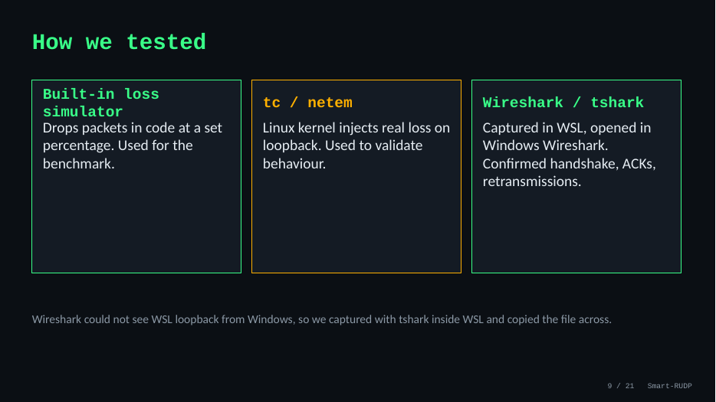
9. How we tested
Time on this slide: 0:40
SAY
Three tools: a loss simulator inside the code (used for the benchmark), Linux tc/netem injecting real loss on loopback, and Wireshark/tshark.
Windows Wireshark could not see WSL loopback, so we captured with tshark inside WSL and copied the file across.
IF ASKED Q: Is the loss real? A: Benchmark and chat loss is simulated in the program. We also captured a real loopback run with tshark and netem loss.

Slide 12
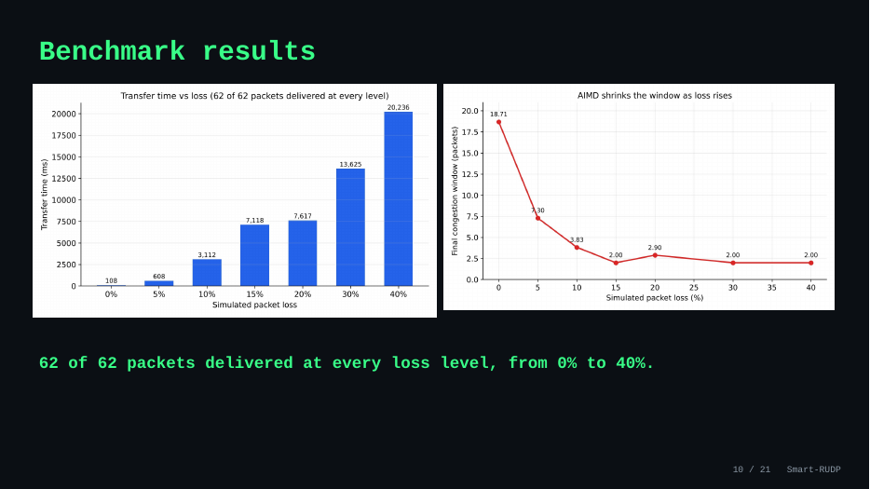
10. Benchmark results
Time on this slide: 0:40
SAY
62 of 62 packets were delivered at every loss level from 0 to 40 percent.
Higher loss costs time and retransmissions, never correctness.
IF ASKED Q: Single runs? A: Yes, the original benchmark ran each level once. Smart-RUDP evaluation uses 6 runs per scenario.

Slide 13
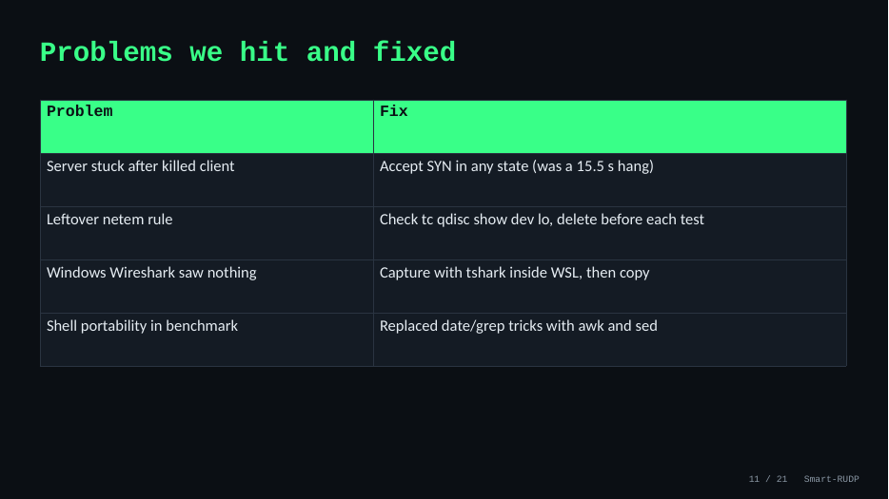
11. Problems fixed
Time on this slide: 0:40
SAY
Server stuck after a killed client: it hung 15.5 s; fix was to accept SYN in any state.
A leftover netem rule distorted results; we now check tc qdisc before each test.
Windows Wireshark saw nothing: capture inside WSL.
Benchmark script portability: replaced date and grep tricks with awk and sed.
IF ASKED Say these quickly: it shows real debugging, which is what separates a project from a lab.

Slide 14
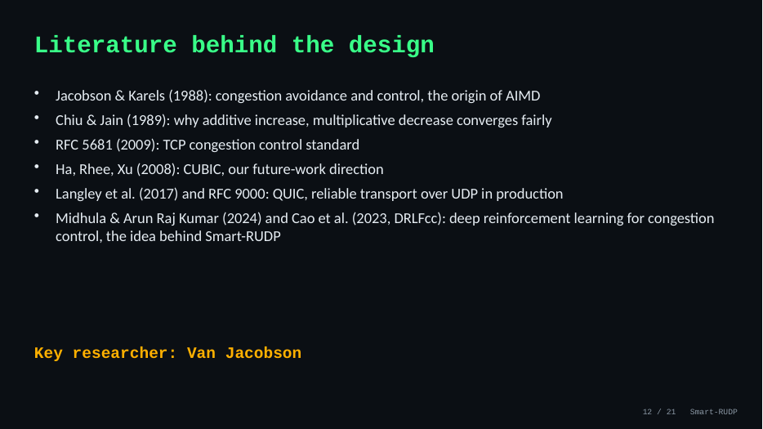
12. Literature
Time on this slide: 0:30
SAY
Jacobson and Karels 1988 is the origin of AIMD; Chiu and Jain 1989 explains why it converges fairly.
RFC 5681 is the standard; CUBIC is future work; QUIC and RFC 9000 are reliable transport over UDP in production.
The AI part comes from Midhula and Arun Raj Kumar (2024) and Cao et al. (2023, DRLFcc): deep reinforcement learning for congestion control. Smart-RUDP applies the same idea with a smaller tabular Q-learning agent.
Key researcher: Van Jacobson.
IF ASKED Q: Why AIMD? A: Chiu and Jain show it converges to a fair share. Q: Are those papers deep RL and yours is not? A: Yes; we used a lookup table, which is simpler and inspectable.

Slide 15
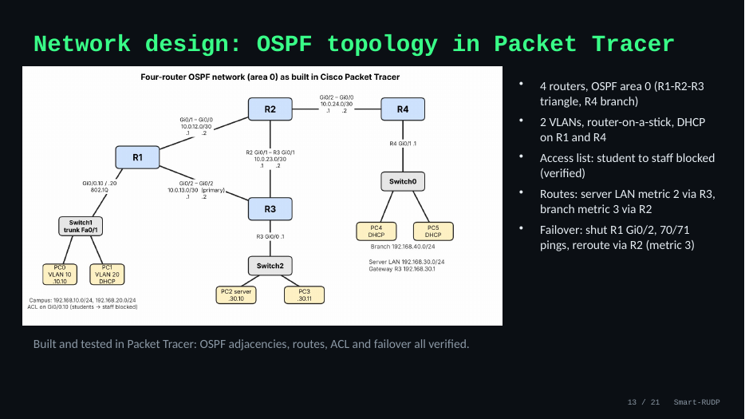
13. Network design
Time on this slide: 0:50
SAY
Four routers, OSPF area 0: R1, R2, R3 form a triangle and R4 is a branch.
Two VLANs with router-on-a-stick, DHCP on R1 and R4, and an access list blocking student to staff.
Server LAN is metric 2 via R3; branch is metric 3 via R2. Failover: shutting R1 Gi0/2 still gave 70 of 71 pings, rerouted via R2.
IF ASKED Q: Does RUDP run inside Packet Tracer? A: No, it cannot run C. Packet Tracer validates the network design; protocol is validated on one machine plus Wireshark.

Slide 16
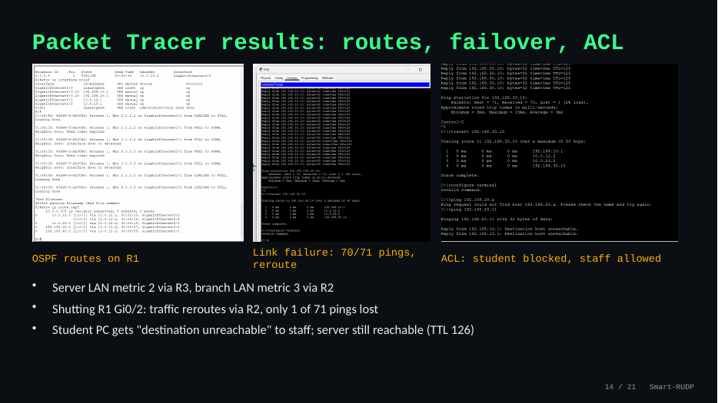
14. Packet Tracer results
Time on this slide: 0:40
SAY
Left: OSPF routes on R1 with the metrics. Middle: the link-failure test, 70 of 71 pings. Right: the ACL, where the student gets destination unreachable to staff but the server is still reachable (TTL 126).
IF ASKED If asked to show it live: have the .pkt file open and follow Demo_Steps.txt.

Slide 17
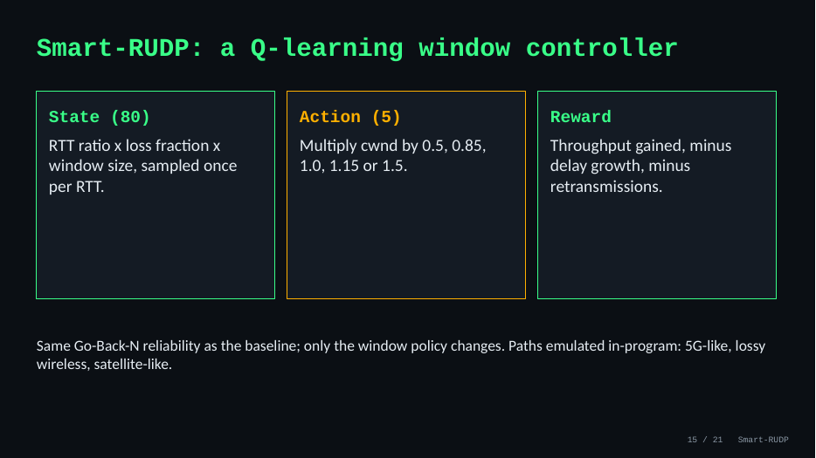
15. Smart-RUDP design
Time on this slide: 0:50
SAY
Q-learning with 80 states (RTT ratio, loss fraction, window size), sampled once per RTT.
Five actions: multiply the window by 0.5, 0.85, 1.0, 1.15 or 1.5.
Reward: throughput gained, minus delay growth, minus retransmissions. Same Go-Back-N reliability; only the window policy changes. Paths are emulated in the program: 5G-like, lossy wireless, satellite-like.
IF ASKED Q: Is it really learning? A: Yes, 40 training episodes; the learning-curve figure shows it. It is small and tabular with limited training.

Slide 18
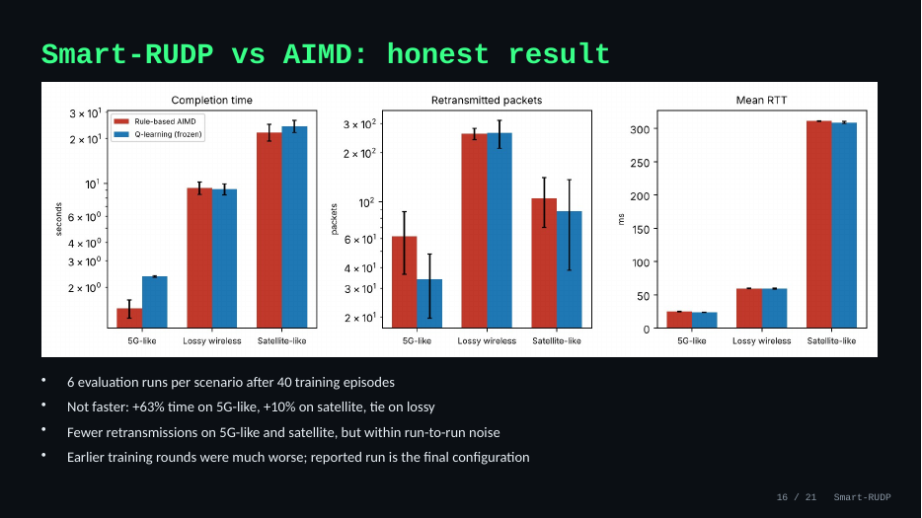
16. Smart-RUDP result
Time on this slide: 0:50
SAY
Be honest: it did not beat AIMD. Plus 63 percent time on 5G-like, plus 10 percent on satellite, a tie on the lossy path.
It used somewhat fewer retransmissions on two paths, within run-to-run noise.
Earlier training rounds were much worse; this is the final configuration. The finding is that a simple learner does not beat a tuned rule.
IF ASKED Q: Then what was the point? A: The experiment. We tested whether a learned window helps and report the answer, including the negative result.

Slide 19
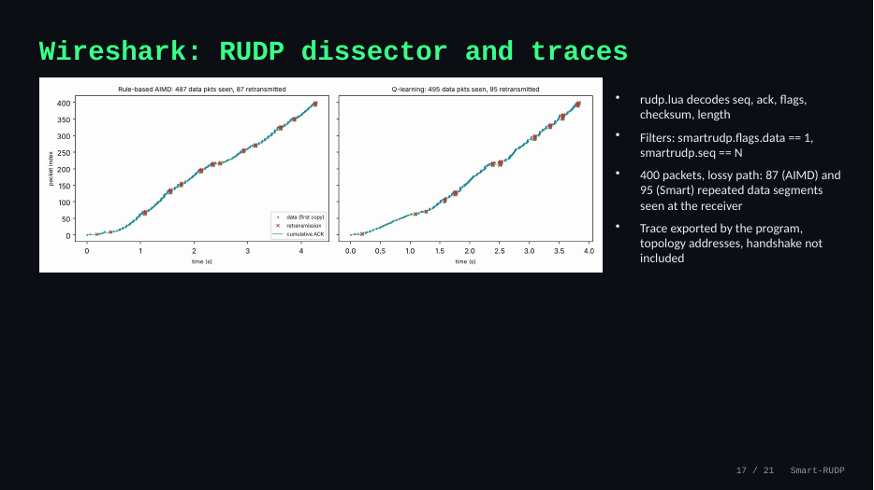
17. Wireshark traces
Time on this slide: 0:40
SAY
We wrote a Lua dissector, named smartrudp, that decodes sequence, ack, flags, checksum and length.
Useful filters: smartrudp.flags.data == 1 and smartrudp.seq == N.
In a 400-packet lossy run the receiver saw 87 (AIMD) and 95 (Smart) repeated data segments.
The program's exported trace uses topology addresses and has no handshake.
IF ASKED Q: Why no handshake in the export? A: The export builds synthetic packets. The real tshark capture on the next slide shows the handshake.

Slide 20
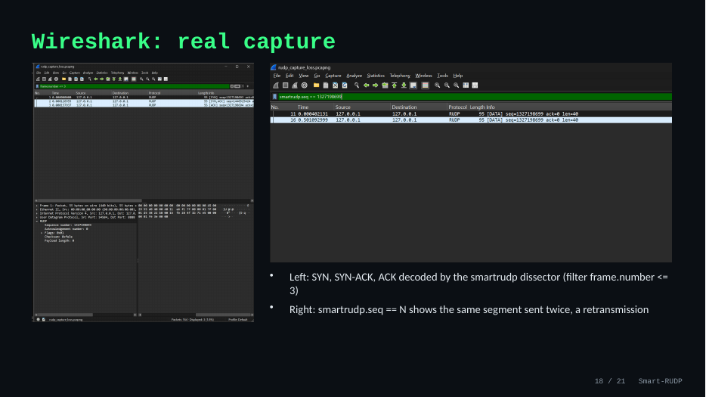
18. Wireshark real capture
Time on this slide: 0:50
SAY
Left: the first three packets, SYN, SYN-ACK and ACK, decoded by our dissector (filter frame.number <= 3).
Right: filter smartrudp.seq == N shows the same segment twice, a retransmission.
IF ASKED If Wireshark is open live: Analyze, Decode As, UDP 8888 = RUDP, then use these two filters.

Slide 21
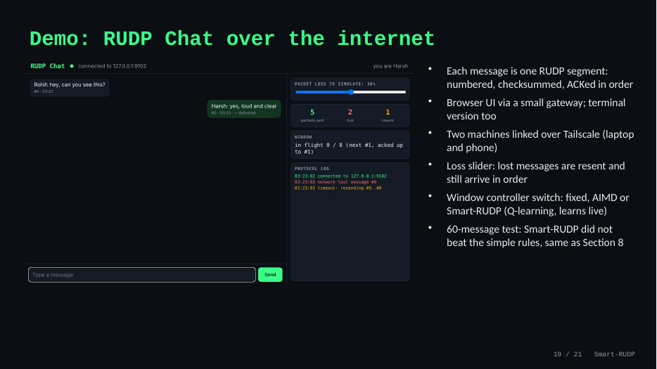
19. RUDP Chat demo
Time on this slide: 1:00
SAY
The protocol in use: each message is one numbered, checksummed RUDP segment, ACKed in order.
There is a terminal version and a browser version; two devices were linked over Tailscale, laptop and phone.
Drag the loss slider: lost messages are resent and still arrive in order. The right panel shows sent, lost and resent counts and the log.
There is a controller switch: fixed window, AIMD, or Smart-RUDP, which loads the trained table and keeps learning live. A 60-message test button times delivery. Honest result: Smart-RUDP did not beat the simple rules here either.
IF ASKED Q: Is it secure? A: No encryption or accounts; it is a demo of reliability, not a product.

Slide 22
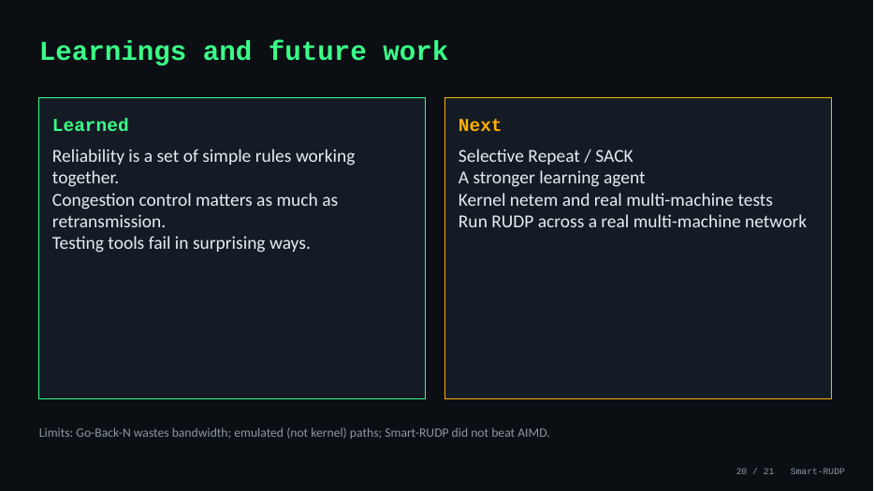
20. Learnings and future work
Time on this slide: 0:50
SAY
Learned: reliability is a set of simple rules working together; congestion control matters as much as retransmission; testing tools fail in surprising ways.
Next: Selective Repeat with SACK, a stronger learning agent, adaptive timeout, and tests on a real multi-machine network.
Name the limits before she does: Go-Back-N, loopback-only protocol tests, Smart-RUDP not beating AIMD.
IF ASKED End on the limits and the fix order: SACK, adaptive timeout, real-network tests.

Slide 23
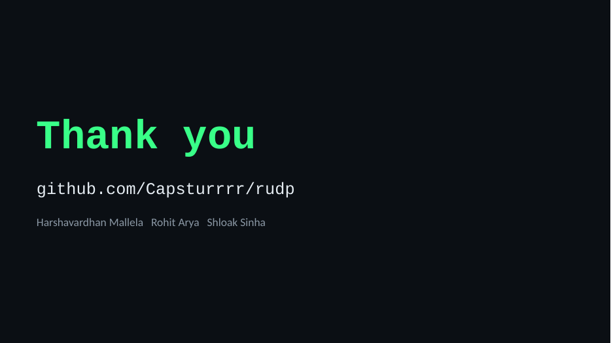
21. Thank you
Time on this slide: 0:15
SAY
Thank you. The code, report and captures are at github.com/Capsturrrr/rudp. Happy to take questions.
IF ASKED Pause and smile; hand over to questions.

Slide 24
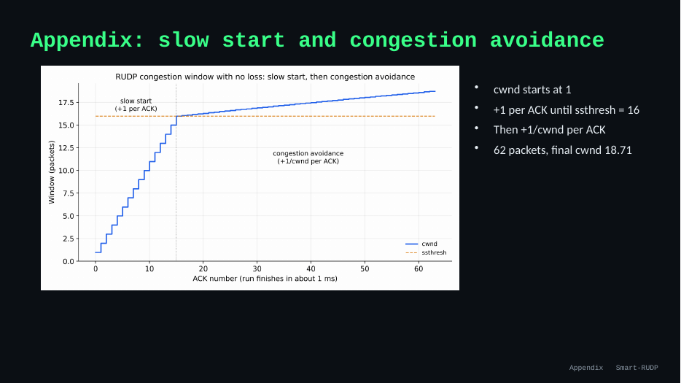
22. Appendix: slow start
Time on this slide: -
SAY
Only if asked: the window starts at 1, adds 1 per ACK until the threshold 16, then 1/window per ACK. In the 62-packet run the final window was 18.71.
IF ASKED Use this slide to answer 'show me congestion avoidance'.

Slide 25
Hard questions and short answers (1 of 2)
Is this a lab exercise?
A lab sends datagrams. We built reliability and congestion control on top, measured them, and used them in a real chat and a routed network.
Why not TCP?
TCP is in the kernel and cannot be changed. Building our own makes every mechanism visible. QUIC and HTTP/3 do the same.
Smart-RUDP did not win. Why include it?
It was the experiment: does a learned window help? We report the answer, including the negative one.
Why Go-Back-N?
Simpler to build and explain. It wastes bandwidth under loss; Selective Repeat with SACK is future work.
Tests ran on one machine?
Yes, with emulated delay, loss and jitter. They do not prove internet performance; the report says so. Chat between laptop and phone is a small real-network check.

Slide 26
Hard questions and short answers (2 of 2)
What does Packet Tracer prove?
The network design: OSPF, VLANs, ACL, 70/71 failover. The protocol is validated separately with emulation and Wireshark.
Peer disappears?
Sender keeps retransmitting on timeout. A connection abort after repeated timeouts is not built; it is the fix we would add.
Does the checksum catch errors?
16-bit one's-complement sum, like UDP/TCP. Corrupted packets fail and are retransmitted. It cannot catch every error pattern.
Why no handshake in the exported trace?
The export builds synthetic packets. The real tshark capture shows SYN, SYN-ACK, ACK.
Is Q-learning really learning?
80 states, 5 actions, 40 episodes; the learning-curve figure shows it. Small and tabular, with limited training.

