Slide 1
Intro to Machine Learning with Python
Objective: Would you like to be able to predict the future?
Machine Learning is a branch of AI that promotes systems decision making by identifying patterns in data with minimal human intervention.
Python is an open source codebase that easily allows you to tap into many open source libraries. This class will focus on scikit-learn, numpy, pandas, scipy, matplotlib, seaborn and a few others.
With this Python learning pod you will be able to identify which algorithms to use to classify your data or run predictive models based on whether you need to do supervised or unsupervised learning.
Karen Pfeifer – For educational purposes only - 2/21/2019

Slide 2
Intro to Machine Learning with Python
Outline: Seven (7) classes with both Activity modules to review in class and guided (or blank template) Experiment modules to run outside of class.
Module 1: Basics
Module 2: Intro to Modeling – Train Test Split, Data Exploration
Module 3: Supervised Learning 1 – Classification and Regression Models
Module 4: Supervised Learning 2 – Decision Trees, Random Forest, GBM, Neural Networks
Module 5: Unsupervised Learning 1 – Preprocessing, PCA, Feature Extraction
Module 6: Unsupervised Learning 2 – Clustering
Module 7: Feature Engineering and Model Comparison
Karen Pfeifer – For educational purposes only - 2/21/2019

Slide 3
Data Scientist
80%
20%
Gather
Prepare
Develop
Score
Someone who uses data to create a model
Uses data to either prove or disprove a hypothesis
80/20 Data Science dilemma - Most data scientists spend 80 percent of their time finding, cleaning, and reorganizing data and only 20 percent of their time on data modeling
The future of Data Science will be broader in scope and will require diversity for success
Karen Pfeifer – For educational purposes only - 2/21/2019

Slide 4
Terms that mean THE SAME THING
Observation = Instance = Data Point = Record = Sample = Entity = Rows
Variable = Attribute = Constructed Variable = Factors = Feature = Columns
Label = Class = Tag = Columns
y = Dependent = Outputs = Target = Class = Response = Predicted Variable
X = Independent = Inputs = Regressor = Covariate = Predictor Variables
Categorical Variables = Nominal/Ordinal Variables = Discrete Variables
Dummy Variable = Indicator Variable = Binary Variable = Boolean Variable = One-Hot Encoding = One-Out-of-N Encoding
Interactions = Products (of Features)
Collinearity = Redundant Variables
Model = Algorithm
Event = Hypothesis
Covariate = Predictor = Regression input
Descriptive Statistics = Fit Statistics
Estimates = Coefficients
Prediction = Forecast
Karen Pfeifer – For educational purposes only - 2/21/2019
Notes:
Categorical Variables = Nominal/Ordinal Variables = Discrete Variables
(E.g., Marvel Superheroes: Black Widow, Thor, Captain Marvel, Black Panther, Captain America, Spider-Man) no order
(E.g., Days of the week: M, Tu, W, Th, etc.) ordered

Slide 5
AI vs Machine Learning vs Deep Learning
Artificial Intelligence
(Ability to learn and reason like humans)
Reasoning
NLP
Planning
Machine Learning
(Ability to learn without explicit programming)
Supervised
Unsupervised
Semi-supervised
Reinforcement
Deep Learning
Karen Pfeifer – For educational purposes only - 2/21/2019
Notes:
Deep learning is a class of machine learning algorithms that use Artificial Neural Networks comprised of multiple layers to progressively extract higher level features from raw input. For example, in image processing, lower layers may identify edges, while higher layer may identify human-meaningful items such as digits/letters or faces. In Deep Learning there is a concept of the input layer, the hidden layer and the output layer. There could be several hidden layers.
Differentiation between supervised, unsupervised, semi-supervised, and reinforcement learning:
Supervised learning is best employed when looking to predict an outcome from the given input on new data, and known data are available for inputs matched to outputs. The input and output pairs allow us to build the model training set. The most common types of problems to solve with supervised learning are classification and regression. The goal is to have the model “generalize” and make accurate predictions.
Unsupervised learning is best used when there is no known output which would generally be used to teach the algorithm the correct answer. When the model is only given input data with no trained output and asked to give output, that is considered unsupervised. There are two main types of unsupervised learning, transformations (such as dimensionality reduction) and clustering (partitioning data into groups of similar items).
Semi-supervised learning has a small amount of labeled test set data but with a large amount of unlabeled data. This is between unsupervised and supervised learning. Unlabeled data, combined with a small amount of labeled data can produce good accuracy improvements over unsupervised models if you can get a little of the data labeled.
Reinforcement learning is differentiated by incorporating a feedback loop by training the model by giving it a positive response for a correct action, and a negative response for an incorrect action based on responses to the environment.
Examples of supervised, unsupervised, semi-supervised, and reinforcement learning:
Supervised: Similarity learning – learns from examples with a similarity function measuring how related two observations are. Good applications could be for recommendation systems where all the labels are known and the model is asked for similar results to the one being queried by the user.
Unsupervised: Autoencoder – a type of artificial neural network – could be used for example if you have a large number of unlabeled molecules where some of them are drugs and others are not and you want to tell for your study which are drugs. Autoencoders are powerful when stacked inside deep neural networks for this type of ML and many other types.
Semi-supervised: Transductive Support Vector Machine (TSVM) model – treats partially labeled data. This can be good for medical diagnosis where you have a training set that has symptoms labeled and then a larger test set where they are unlabeled. Spam email detection, and text classification are also other good examples where TSVM can be helpful.
Reinforcement Learning: Q-learning - this model solves for a stochastic dynamic optimization problem and is best for long-term reward trade-off. A good application for this could be elevator scheduling where the agent is given a number of elevator bank and floor choices and then the reward after error backpropagation is used to train the estimate of Q is how closely it predicts passenger arrival rates through Q-value estimates as output.

Slide 6
AI vs Machine Learning vs Deep Learning
Artificial Intelligence – The simulation of human intelligence processes by machines. These processes include learning, reasoning, and self-correction.
Machine Learning – Use of algorithms and statistical models by computer systems to effectively perform a specific task without using explicit instructions—relying on patterns and inference instead.
Deep Learning - Part of a broader family of machine learning methods based on artificial neural networks (convolutional, recurring, recursive).
Learning can be supervised, semi-supervised or unsupervised. Deep learning is a class of machine learning algorithms that use multiple layers (Neural Networks) to progressively extract higher level features from raw input.
Karen Pfeifer – For educational purposes only - 2/21/2019
Notes:
Deep learning is a class of machine learning algorithms that use Artificial Neural Networks comprised of multiple layers to progressively extract higher level features from raw input. For example, in image processing, lower layers may identify edges, while higher layer may identify human-meaningful items such as digits/letters or faces. In Deep Learning there is a concept of the input layer, the hidden layer and the output layer. There could be several hidden layers.

Slide 7
Modeling Methodology Example
Data Preparation
Data collection and initial transformations
Modeling
Logistic Regression
Comparative Analysis
Conclusions
Scoring & Output Conclusions
Random Forest Classifier
GBM – Gradient Boosting Classifier
Feature Importance / Variable reduction
Comparing models with F1 scores
Data cleansing, imputation and feature engineering
Source access, attribute definition and selection
Plot and Chart Analysis
Classification Reports
Comparing models with prediction scores
Confusion Matrix
Karen Pfeifer – DSS740, confidential – for private student use only 4/23/2019

Slide 8
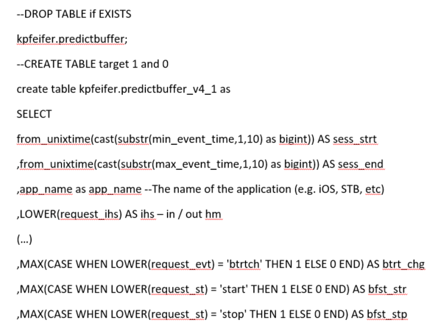
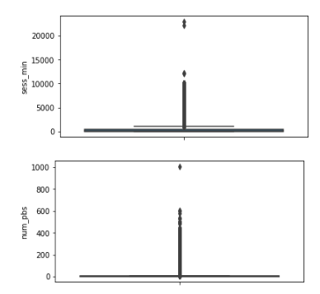
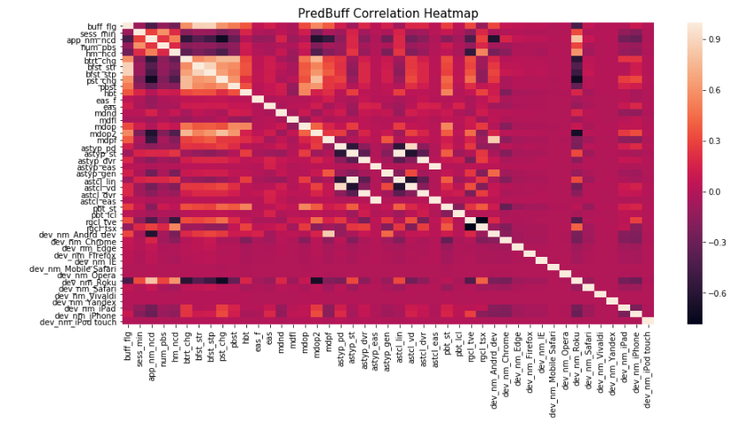
Data Preparation
Collection
Data Selection using SQL
Data Cleansing
Feature Engineering
Isolated object field and one-hot-encoded devices
Import data and review shape, data types
Source selection as first data fusion project
Source selection narrowed to events
Exploration descriptive stats
Null fields replacement
Plotted correlation heatmap
Performed feature selection on high multicollinear variable pairs
Box plots
Rationalized
Merged dataframes
Create ordinal indicators -1, 0, 1
Karen Pfeifer – DSS740, confidential – for private student use only 4/23/2019

Slide 9
Modeling Basics
Gather
Prepare
Develop
Score
80%
20%
Choose your model: Regression vs. Classifier? Supervised vs. Unsupervised vs. Semi-supervised vs. Reinforcement?
Supervised vs Unsupervised
Supervised model examples
Continuous: Linear Regression, Polynomial Regression, Decision Trees, Random Forest, GBMs,
Categorical: KNN, Neural Networks, Logistic Regression, Naïve-Bayes, SVM, Decision Trees, Chi-Squared, LARS, PLS
Unsupervised model examples
Continuous: SVD, DVA, K-means, Hierarchical Clustering
Categorical: Apriori, FP-Growth, Hidden Markov Model
Feature Engineering - Factor Analysis vs Feature Reduction vs Feature Selection
Split train, validation, test (out-of-time)
Hyperparameter tuning
Model Assessment Methods - Confusion Matrix, ROC/AUC, KS, AIC, BIC, ASE, MISC, MSE, RMSE
Scoring & Forecasting
Karen Pfeifer – For educational purposes only - 2/21/2019

Slide 10
Appendix (Additional research topics)

Slide 11









Data Science Tools
Hadoop
Hive
SAS EM
Anaconda
SQL (and all its versions)
Python (and libraries)
R (and libraries)
Spark/pySpark
Scala
Karen Pfeifer – For educational purposes only - 2/21/2019

Slide 12
Discovery
Pod casts
Super Data Science
Data Crunch
Linear Digressions
Partially Derivative
Machine Learning Guide
The AI Podcast
Data Stories – Viz
IBM Analytics Insights
Talk Python To Me
Hadooponomics
Websites
https://www.quora.com (great for articles)
https://www.medium.com (great for articles)
https://stackoverflow.com (great for troubleshooting)
https://www.datasciencecentral.com (great for articles)
https://www.towardsdatascience.com (great for articles)
https://www.kaggle.com (great for learning and data sets)
https://www.python.org (great for learning and troubleshooting)
https://cran.r-project.org (great for learning and troubleshooting)
Karen Pfeifer – For educational purposes only - 2/21/2019

Slide 13
Basic Statistic Concepts
Probability
Mean, Median, Mode
Y independent vs. X dependent
Classification vs. Numbers
p-value, F-Score, t-test, Z-test
Confidence Interval
Alpha levels
Multicollinearity
Heteroskedasticity
Standard deviation
SSE + SSR = SST
ASE Average Squared Error
Null hypothesis 0 vs Hypothesis 1
Karen Pfeifer – For educational purposes only - 2/21/2019

Slide 14
Data Preparation Topics
Nominal, Ordinal, Interval, Ratio
Treatments – Imputation (avg. vs. 0), Transformations to avoid outliers, Discarding (iterative)
Factor Analysis vs Feature Reduction vs Feature Selection
Feature Engineering – Deriving new variables - Indicators (-1,0,1), ordinal (h,m,l) as integer, nominal indexed, one hot encoding
Sampling vs. Census
Classification vs. Numbers
Data vs Metadata
Outlier treatments
Histograms and Negative, Normal, Positive distribution
Box and whisker plot - IQR inter quartile range
Data source and hardening
Karen Pfeifer – For educational purposes only - 2/21/2019

