Slide 1
Q4: How does remote work impact mental health compared to on-site work?
Focusing on the ‘it’ industry

Slide 2
Data Source
I found “Remote Work & Mental Health” on Kaggle to be a very interesting dataset. This dataset has information on gender, industry, mental stress levels and many other insightful details which were a great metric when analyzing on the whole.
Waqi786. (2023). Remote Work and Mental Health [Data set]. Kaggle. https://www.kaggle.com/datasets/waqi786/remote-work-and-mental-health

Slide 3

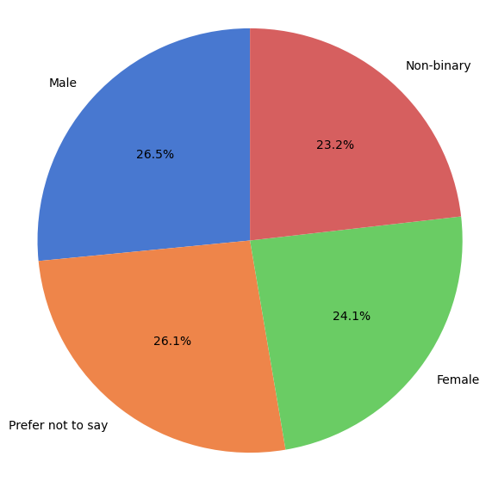
Gender % in the IT industry
This figure shows the percentage of each gender present in the IT industry. Although the numbers do seem relatively equal, we still need to keep in mind that 26% of individuals chose not to disclose.

Slide 4

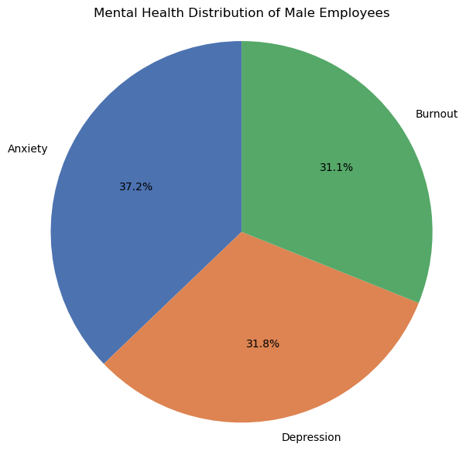
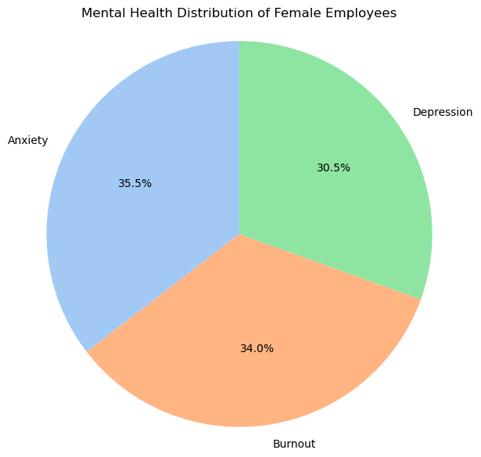
Male vs female mental health
The overall message for the mental health of IT industry males and females is that both experience very similar levels of anxiety, depression and burnout.

Slide 5
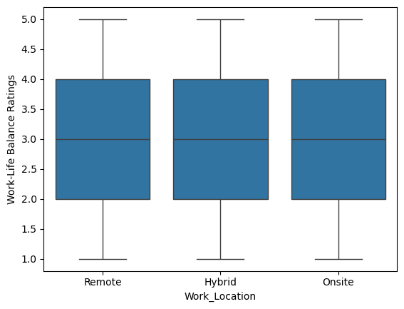
Work-life balance rating
Interestingly the rating for all three work environments is quite similar, I was expecting for the remote environment to allow employees to feel a higher level of work-life balance.

Slide 6
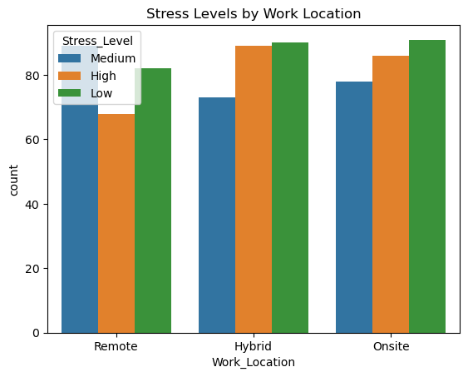
Stress levels by work locations
This graph shows a very clear picture of the hybrid and on-site roles to provide the highest number of responses for low-stress levels but also have a high level of response for high-stress levels.
The takeaway from this graph is that the number of remote workers is lower than the other two work environments which may be leading to the lower counts on this graph.

Slide 7
Analysis
“How does remote work impact mental health compared to on-site work?”
After analyzing the dataset related to mental health and work location I can conclude that the difference between a remote and onsite location contributing to mental health stress is not as notable as I had initially presumed. Although there are factors to consider such as the number of remote workers being less than the number of onsite or hybrid, even then, I do feel that I was expecting a larger variance in numbers which was not the case.

