Slide 1
Q4: How does remote work impact mental health compared to on-site work?
Focusing on the ‘it’ industry

Slide 2
Data Source
I found “Remote Work & Mental Health” on Kaggle to be a very interesting dataset. This dataset has information on gender, industry, mental stress levels and many other insightful details which were a great metric when analyzing on the whole.
Waqi786. (2023). Remote Work and Mental Health [Data set]. Kaggle. https://www.kaggle.com/datasets/waqi786/remote-work-and-mental-health

Slide 3

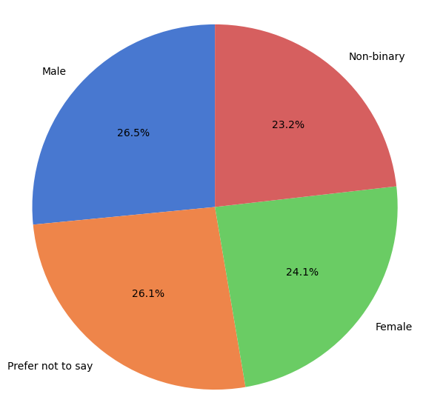
Gender % in the IT industry
This figure shows the percentage of each gender present in the IT industry. Although the numbers do seem relatively equal, we still need to keep in mind that 26% of individuals chose not to disclose.

Slide 4

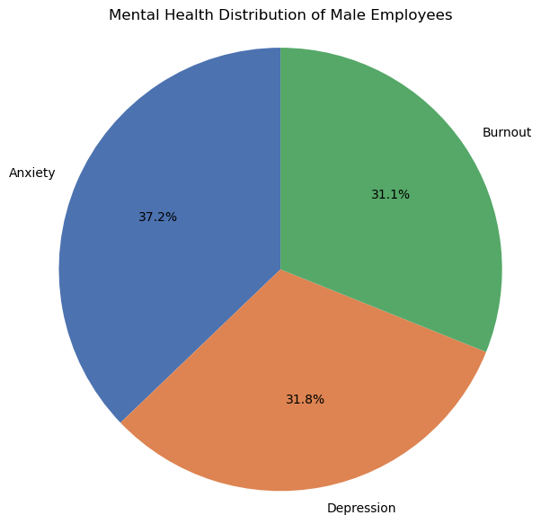
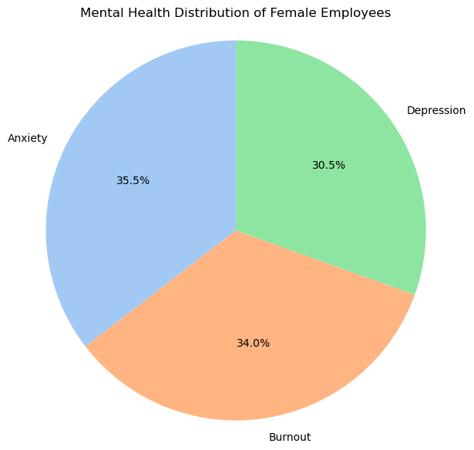
Male vs female mental health
The overall message for the mental health of IT industry males and females is that both experience very similar levels of anxiety, depression and burnout.

Slide 5
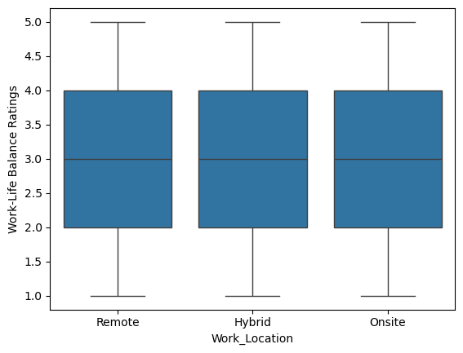
Work-life balance rating
Interestingly the rating for all three work environments is quite similar, I was expecting for the remote environment to allow employees to feel a higher level of work-life balance.

Slide 6
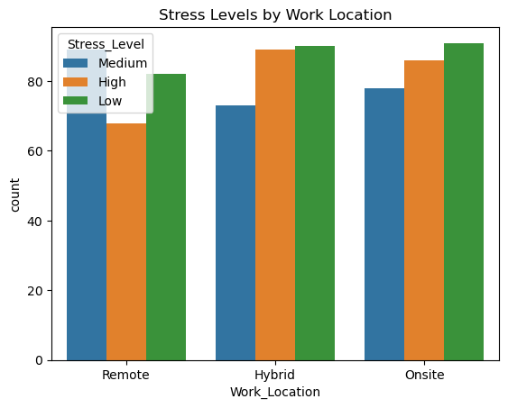
Stress levels by work locations
This graph shows a very clear picture of the hybrid and on-site roles to provide the highest number of responses for low-stress levels but also have a high level of response for high-stress levels.
The takeaway from this graph is that the number of remote workers is lower than the other two work environments which may be leading to the lower counts on this graph.

Slide 7
Analysis
“How does remote work impact mental health compared to on-site work?”
After analyzing the dataset related to mental health and work location I can conclude that the difference between a remote and onsite location contributing to mental health stress is not as notable as I had initially presumed. Although there are factors to consider such as the number of remote workers being less than the number of onsite or hybrid, even then, I do feel that I was expecting a larger variance in numbers which was not the case.

Slide 8
Q2. What is the relationship between physical activity and improved mental health outcomes in tech workers?

Slide 9
DATA SOURCE :
I found the 'Sleep Health and Lifestyle Dataset' on Kaggle to be incredibly insightful. It contains valuable information on various factors such as sleep patterns, lifestyle choices, and demographics. These metrics provide a comprehensive view that is helpful for analyzing sleep health trends and their correlations with lifestyle habits
https://www.kaggle.com/datasets/uom190346a/sleep-health-and-lifestyle-dataset

Slide 10
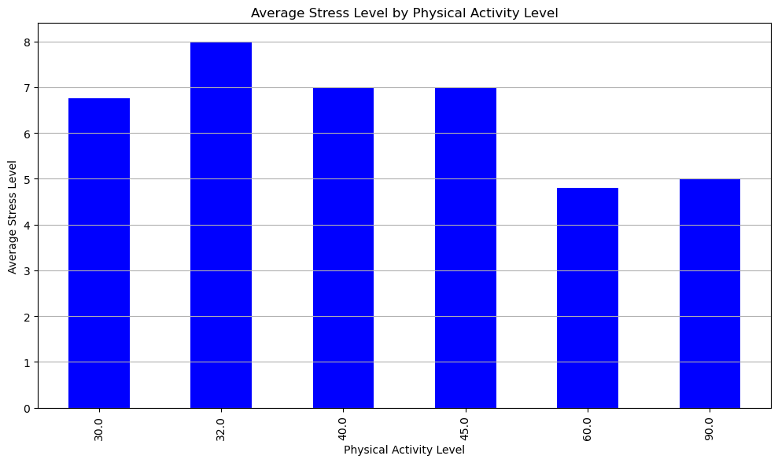
Physical Activity Level vs. Stress Level :
We observed a negative correlation between physical activity levels and stress levels. With the new filtered data, we expect this trend to persist.
For the remaining occupations like Software Engineers and Engineers, their stress levels may show clearer declines with higher physical activity, given that these professions are often sedentary, and physical activity can provide a significant mental health benefit.
Analysis: The relationship between physical activity and stress reduction should remain visible or even more pronounced in the filtered group, confirming that engaging in regular physical activity helps mitigate stress, especially in professions with a sedentary nature like engineering and sales.

Slide 11
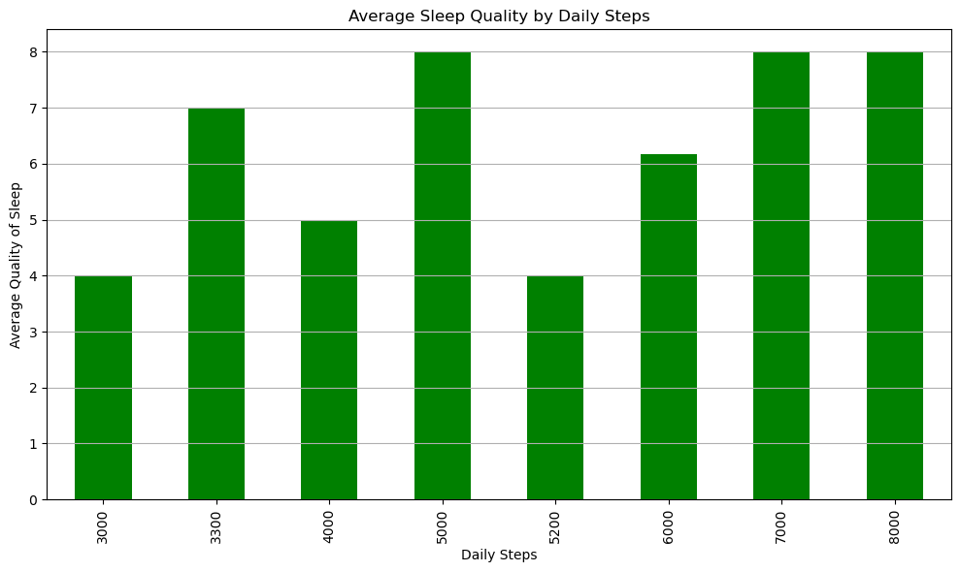
Daily Steps vs. Sleep Quality :
More daily steps were correlated with better sleep quality. After filtering out some occupations, this correlation should still be relevant but might show more consistency across the remaining tech-related professions.
Tech workers like Software Engineers and Engineers, who generally work long hours in front of screens, can benefit from physical activity, particularly in terms of improved sleep. Increased daily steps are likely to contribute to better sleep quality in these roles due to the positive effects of exercise on reducing stress, improving cardiovascular health, and promoting better sleep cycles.
Analysis: With the filtered data, the relationship between daily steps and sleep quality is expected to become clearer. Occupations like software engineering, which are highly sedentary, are more likely to exhibit improvements in sleep quality as their physical activity increases. This reinforces the notion that even light physical activities like walking can significantly improve sleep and, consequently, mental health in tech professions.

Slide 12
ANALYSIS :
Stress Reduction through Activity: Tech workers and those in sedentary roles can benefit greatly from increasing their physical activity levels. The filtered dataset helps focus on these roles, where physical activity may not only improve physical health but also significantly reduce stress.
Better Sleep through Steps: As most of the remaining occupations (software engineers, engineers) involve long hours of sitting, the data shows that adding physical activity (e.g., through walking) has a positive impact on sleep quality. Better sleep leads to improved overall mental health, reduced anxiety, and greater work productivity.
In summary, the filtered dataset supports the same trends but allows for clearer analysis by focusing on tech-related occupations. Increased physical activity continues to demonstrate a strong correlation with lower stress and improved sleep, especially in roles that are predominantly sedentary.

