Slide 1
Heating of the Earth’s surface/atmosphere
Objectives
  The nature of solar radiation
  Surface heat is transferred to the atmosphere
  How the heating effect of solar radiation varies
  Define environment curve and environment lapse rate

Slide 2
Heating of the Earth’s surface/atmosphere
Nature of Solar radiation and its losses
  Energy from the sun is in the form of eletromagnetic wave(radiation) that travels through space in a straight line. No energy lost through passage through space.
  Depleted by absorption, scattering and reflection
  45% of all solar radiation arrives at the surface after depletion by above processes

Slide 3
Heating of the Earth’s surface/atmosphere
In-coming solar radiation; the average percentages of losses are as follows:
Reflection from earth’s surface and cloud top 30 %
Absorption by cloud and water vapour 15 %
Scattering by dust particles 10 %
That leaves an average of 45 % of incoming solar radiation arriving at earth’s surface and absorbed by the land or sea surface.

Slide 4
Heating of the Earth’s surface/atmosphere
Heating of the atmosphere
  Long wave radiation (70%)
  Latent heat transfer (22%)
  Conduction
  Convection (8%)
  Turbulence

Slide 5
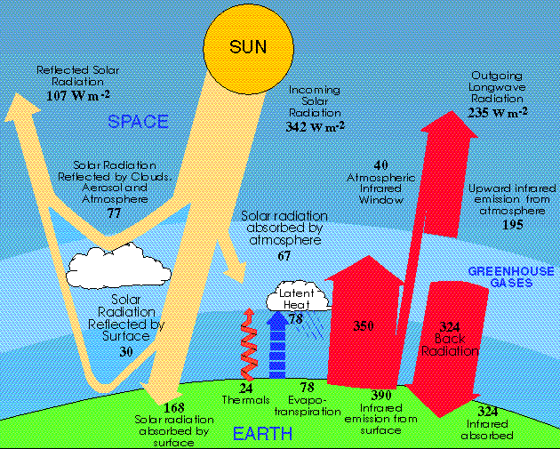
Heating of the Earth’s surface/atmosphere

Slide 6
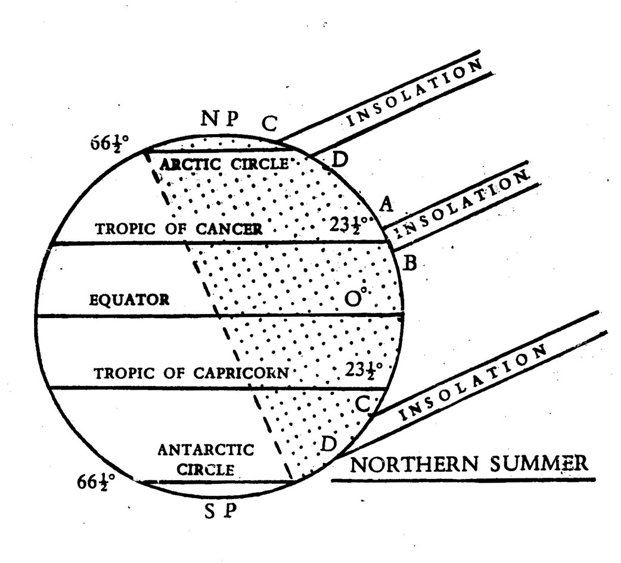
Heating of the solar radiation
Factors that determine temperature of a place:
  Latitude
  Season
  Composition of the atmosphere eg clouds and water vapour.

Slide 7
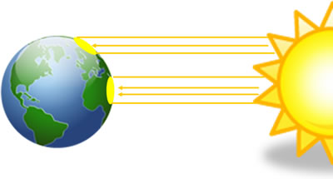
Why does the climate vary over the globe?
Why do we have weather?
Why can’t we predict the weather better?
Here’s how it works
How does the tilt of the earth affect the seasons?
The answers to these questions lie in the unequal distribution and movement of the sun’s energy about the globe. Energy from the sun does not reach all portions of the globe in equal amounts. Time of day, time of year, and latitude all influence the amount of incoming solar energy. The differences in incoming solar radiation across the globe result in heat transport from warmer areas to cooler areas by winds and ocean currents. These currents and patterns, driven by the sun, produce meteorological phenomena, such as cold fronts, thunderstorms, and hurricanes, that we know as weather.
Because the globe is round, the sun’s incoming energy is more concentrated on some portions of the earth than in others. Lower latitudes, near the earth’s equator, receive a greater concentration of incoming energy than higher latitudes. This is because at higher latitudes, the same amount of incoming energy is spread over a larger area of the earth than at lower latitudes.

Slide 8
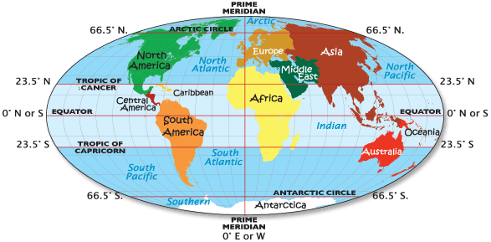
Arctic circle, Equator, Tropic of Cancer & Capricorn

Slide 9
Heating of the Earth’s surface/atmosphere
Questions
  State how solar radiation is depleted as it traverses the atmosphere
  Describe the transference of heat from the earth’s surface to the atmosphere
  Explain how the heating effect of solar radiation varies with latitude of the place, season of the year, and composition of the atmosphere
  Define using your own words ‘environmental lapse rate’

