Slide 1
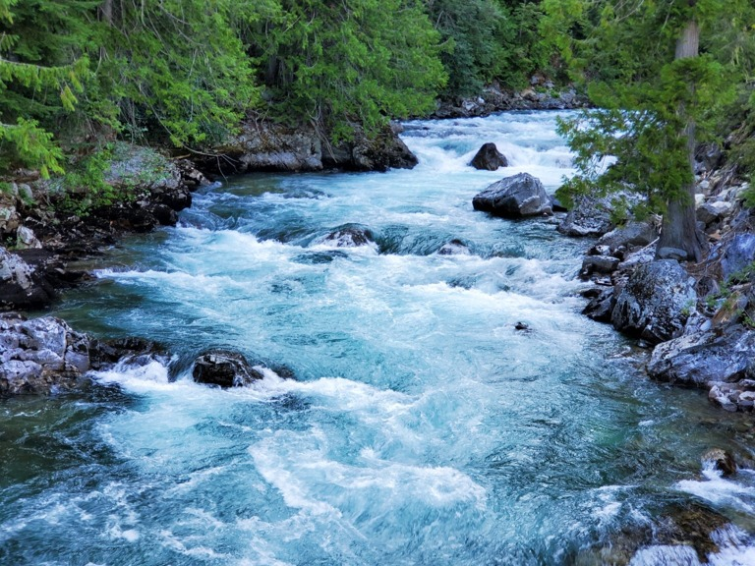
IMPLEMENTATION PROGRESS / 10 NOVEMBER 2026
A still image.
A little controlled motion.
Interactive single-image animation
using flow-field warping
Sayat Mushkin
Yerassyl Myngtay
Amir Ussembayev
ROBT310 · Nazarbayev University · Group 2
STILLFLOW / Single-image animation using flow-field warping
01
Notes:
Introduce all three members by name. State the engineering goal: give a user control over small texture motion in one image. This is a working classical prototype, not a trained generative model. Title image: public-domain NPS photograph, North Cascades National Park Service Complex.

Slide 2
ROBT310 / GROUP 2
From a proposed method to an end-to-end prototype
Scope change, stated explicitly
Now implemented and reviewable
Original proposal: satellite image upscaling.
Interim and current implementation: user-guided
single-image animation.
01 Image upload, mask painting and arrows
02 NumPy flow interpolation and warping
03 Loop preview and GIF export
04 Saved projects, examples and tests
05 Reproducible measurements and figures
Current technical rationale: three inspectable
image-processing algorithms, direct visual
control, and a feasible CPU demonstration.
STILLFLOW / Single-image animation using flow-field warping
02
Notes:
Acknowledge the original proposal and the change. The slide explains the current technical rationale; the team must supply the true historical reason and approval status. Do not pretend those were confirmed. The interim was design-only. Demonstrate implemented work now. React was replaced by plain Canvas/JavaScript to keep setup small; the planned FastAPI/NumPy engine is retained.

Slide 3
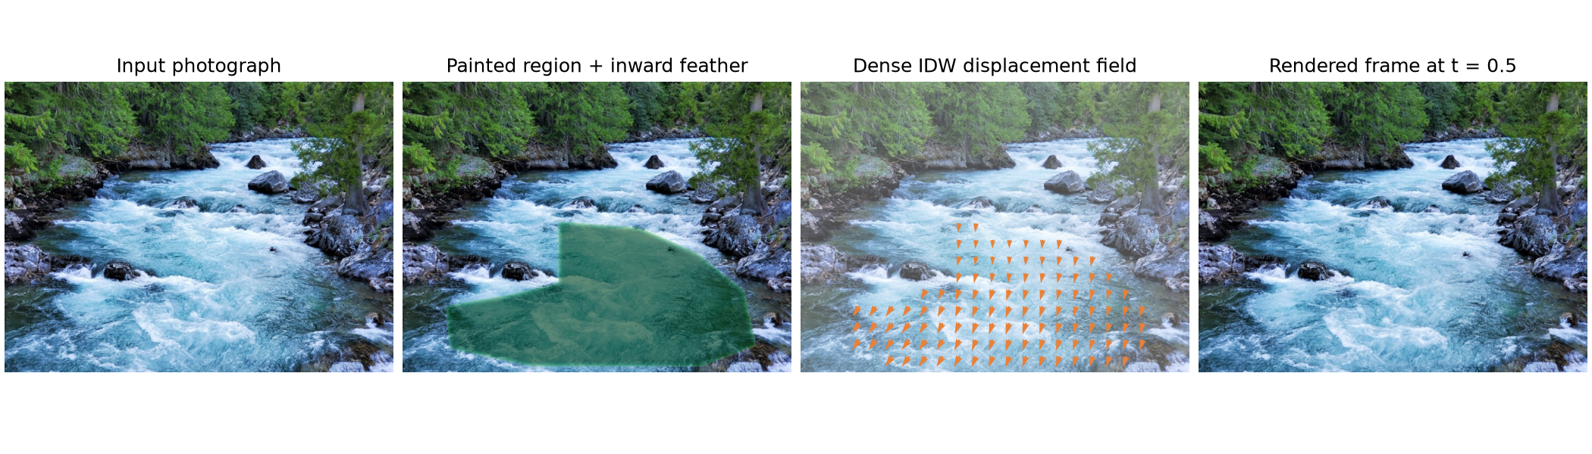
ROBT310 / GROUP 2
The whole pipeline is visible
01
Sparse arrows → dense flow
02
Inverse warp + bilinear sample
03
Cross-fade + mask composite
Pillow handles file I/O and GIF encoding. NumPy implements the field, sampling, feathering and frame synthesis.
STILLFLOW / Single-image animation using flow-field warping
03
Notes:
Walk left to right through the actual input, mask, dense field, and rendered frame. The arrows represent total displacement over a cycle. White controls in the browser are sparse inputs; the dense field is computed, not hand-drawn. No OpenCV remap or optical-flow call is hidden in the code.

Slide 4
ROBT310 / GROUP 2
From a few arrows to moving pixels
1 / Regularized inverse-distance weighting
2 / Backward mapping + bilinear sampling
wᵢ(x) = 1 / (‖x − pᵢ‖² + ε²)
D(x) = Σ wᵢ(x) aᵢ / Σ wᵢ(x)
Aₜ(x) = sample(I, x − tD(x))
Four neighboring source pixels are blended by
fractional x/y distances. Every destination pixel
receives a value.
Nearby arrows have more influence.
ε = 12 pixels prevents singularities.
Zero-motion anchors are soft constraints.
The mask gives exact static protection.
Clamped borders avoid invalid reads, but can
stretch edge textures.
Background: Shepard (1968); Wolberg, Digital Image Warping (1990), inverse mapping and reconstruction.
STILLFLOW / Single-image animation using flow-field warping
04
Notes:
Use the simple example of an arrow dx=8: at half-cycle the output samples four pixels to the left, so the visible feature moves right. Explain regularization means an arrow is not an exact interpolation constraint when other arrows are present. Bilinear sampling is tested against hand-computed weights and affine ramps.

Slide 5
ROBT310 / GROUP 2
Make the loop continuous, and keep the background still
Bₜ(x) = sample(I, x − (t−1)D(x))
s = clip((t−1+r)/r, 0, 1)
α = 3s² − 2s³
Cₜ = (1−α)Aₜ + αBₜ
C₀ = C₁ = I
Continuous-time endpoint
equality
Render t = 0 … (N−1)/N; do not
duplicate the endpoint.
Inward feathering keeps every
unpainted RGB pixel unchanged.
Cross-fading can still ghost.
Fₜ = I + M(Cₜ − I)
M = min(M₀, GaussianBlur(M₀))
STILLFLOW / Single-image animation using flow-field warping
05
Notes:
The second warp is displaced in the opposite phase and takes over near the end. Smoothstep has zero slope at each end of the blending window. Endpoint equality is a mathematical property, while the last-to-first GIF step is measured separately. Explain that inward feathering was chosen to stop blur from leaking animation outside the painted region.

Slide 6
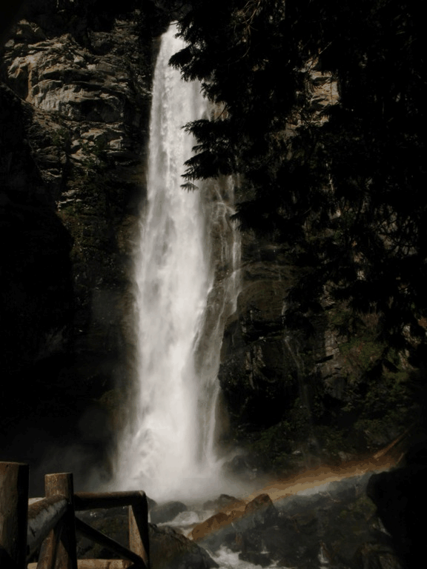
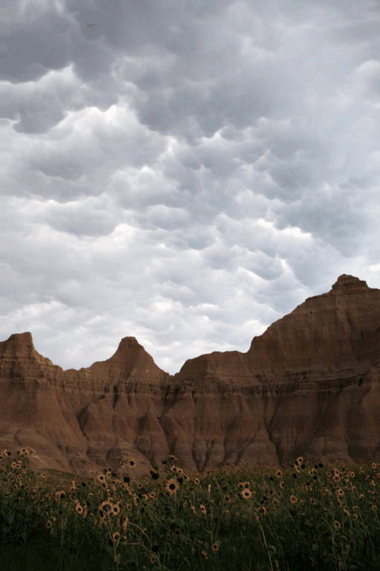
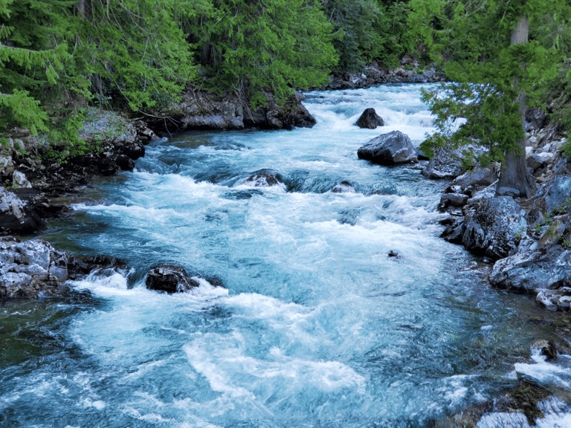
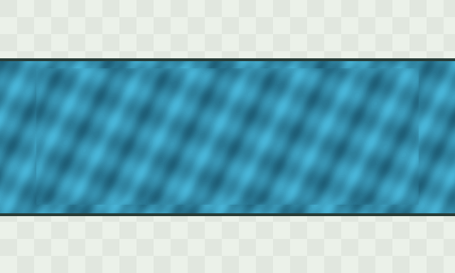
ROBT310 / GROUP 2
Rendered frames from four reproducible cases
River rapids
Waterfall
Cloud drift
Procedural test
External public-domain NPS photographs; project-created masks and arrows. Original procedural data is also included.
STILLFLOW / Single-image animation using flow-field warping
06
Notes:
These slides show still photographs; show the actual animation in the browser or the bundled MP4/GIF files. Credit NPS Staff / North Cascades for river and waterfall; NPS/Cathy Bell for clouds. Do not call these student-shot photographs. The procedural scene is project-generated and supports controlled testing.

Slide 7
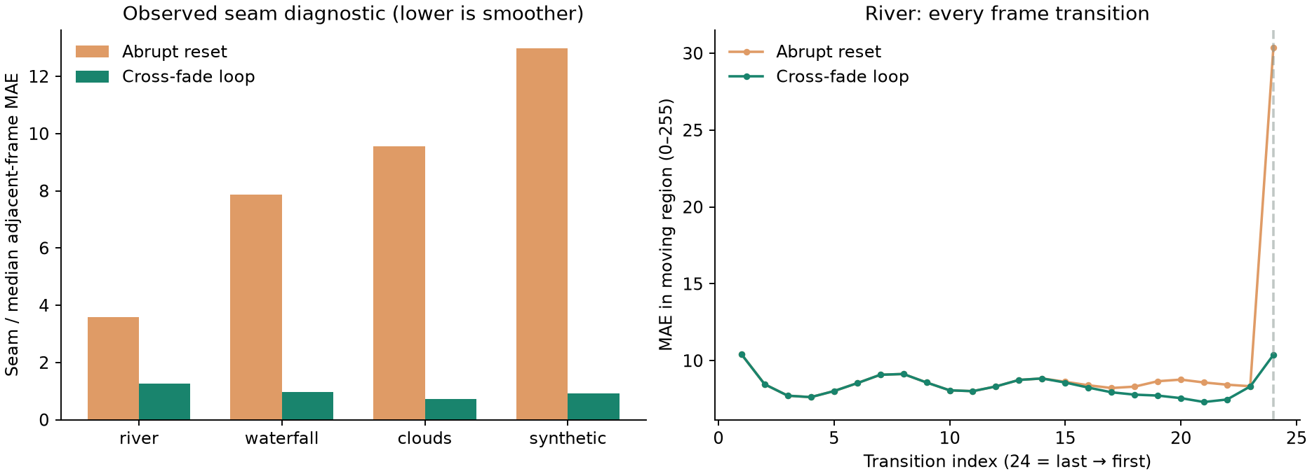
ROBT310 / GROUP 2
Ablation: the loop boundary is measurably less abrupt
CASE
RESET SEAM
LOOP SEAM
STATIC ERROR
River
3.59×
1.26×
0
Waterfall
7.88×
0.96×
0
Clouds
9.55×
0.72×
0
Synthetic
12.97×
0.91×
0
STILLFLOW / Single-image animation using flow-field warping
07
Notes:
All values are produced by scripts/evaluate.py. Seam ratio is the last-to-first moving-region MAE divided by the median adjacent-frame MAE. A lower ratio means a less exceptional seam, not more physical realism. Point to the right-hand plot: it shows all transitions so cross-fade artifacts are not hidden by a single seam metric. No-feather and doubled-motion runs are also saved.

Slide 8
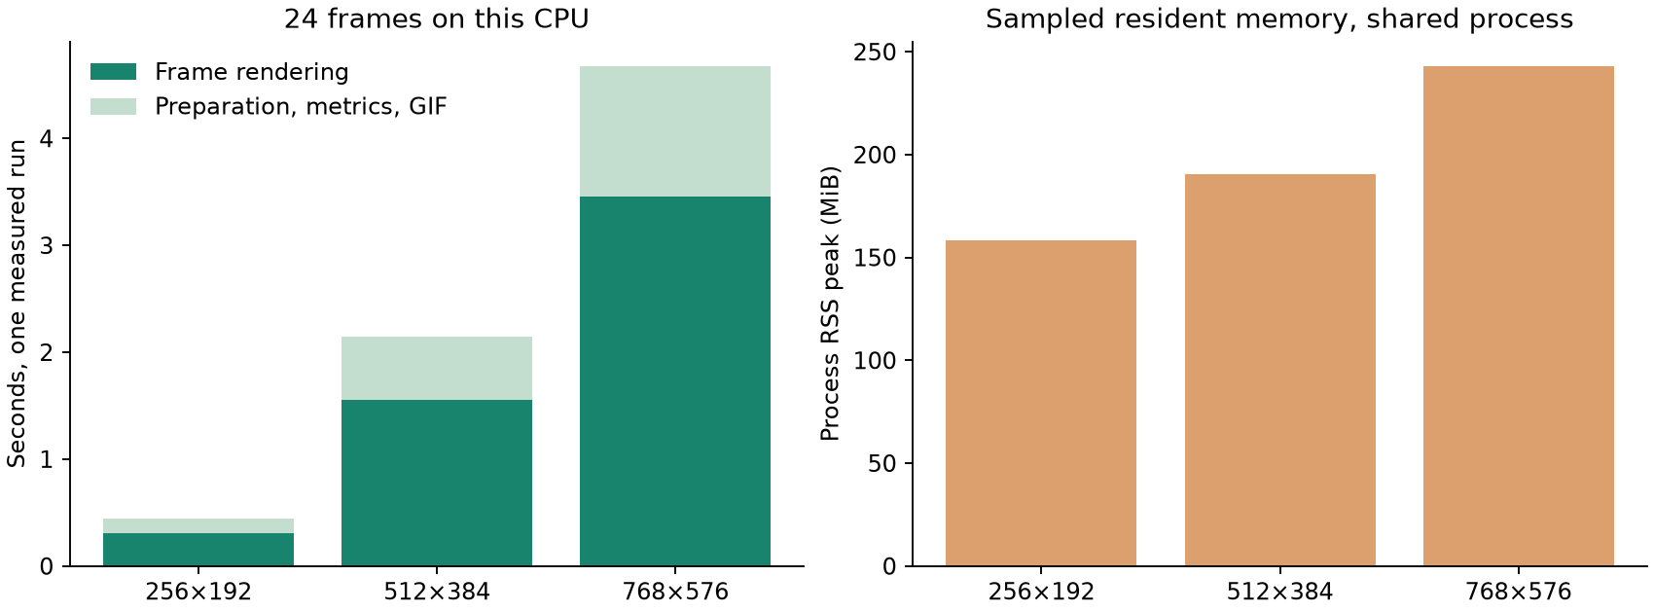
ROBT310 / GROUP 2
42 automated tests pass; CPU cost is measured
Correctness checks
Known IDW weights
Bilinear interpolation
Translation direction
Static-pixel invariance
Loop endpoint equality
GIF timing and palette
Upload / render validation
Single-run measurements on the recorded machine. Memory is sampled process RSS, including libraries and retained frames.
STILLFLOW / Single-image animation using flow-field warping
08
Notes:
These are measured prototype costs, not a claim about all computers. Read the exact 768-side timing from the chart, and explain the difference between frame rendering and GIF encoding. The browser workflow was also exercised: editing, save/restore, actual download, upload, and responsive layout. Core complexity is O(PK+NP); this implementation retains N frames, so total memory is O(NP).

Slide 9
ROBT310 / GROUP 2
What works, what remains limited
Demonstrated
Current limitations
Next practical work
End-to-end user control
Deterministic NumPy algorithms
Repeatable examples and metrics
Exact unpainted-pixel preservation
Ghosting during cross-fades
Stretching for large displacements
No occlusion reconstruction
No physical motion estimation
Add team-captured photographs
Refine masks near rocks / edges
Compare smaller motion settings
Confirm roles and scope rationale
The deliverable is a controllable classical prototype; no new animation theory or human study is claimed.
STILLFLOW / Single-image animation using flow-field warping
09
Notes:
Be explicit about the limits. The source photos are external; original analytic data does not replace an own-photo collection if the instructor requires it. Ask the team to add genuine contributions and short biographies for the final report. Disclose AI coding assistance according to course requirements, and be ready to explain and modify the code.

Slide 10
ROBT310 / GROUP 2
Live demonstration: image → annotations → loop
01 Open the River rapids example
02 Render, then compare with Original
03 Edit a short arrow or erase a boundary
04 Toggle loop blending for the baseline
05 Download GIF and save the project
Offline fallback
results/demo_river.mp4
results/gifs/river_full.gif
results/gifs/river_no_blend.gif
github.com/Capta7nBlack/robt310-stillflow
STILLFLOW / Single-image animation using flow-field warping
10
Notes:
Keep this slide while demonstrating. Start the server before class with start.bat, and keep the browser tab open. If the server or display fails, play the MP4 or GIF files locally. The final public repository should be verified before sharing. Explain the source can run without an online hosting service.

Slide 11
APPENDIX / METHOD BACKGROUND
References and source credits
[1] Le et al. (2023). Animating Still Natural Images Using Warping. ACM TOMM 19(1), article 4. DOI: 10.1145/3511894.
[2] Shepard (1968). A two-dimensional interpolation function for irregularly-spaced data. ACM National Conference, pp. 517–524.
DOI: 10.1145/800186.810616.
[3] Wolberg (1990). Digital Image Warping. IEEE Computer Society Press. §3.1.2 inverse mapping; §5.4.2 linear reconstruction.
[4] Heckbert (1989). Fundamentals of Texture Mapping and Image Warping. UC Berkeley technical report UCB/CSD-89-516.
[5] Photographs: NPS Staff / North Cascades National Park Service Complex; NPS / Cathy Bell. Individual public-domain asset
pages are recorded in examples/sources.json.
STILLFLOW / Single-image animation using flow-field warping
11
Notes:
Le et al. provide motivation, but use more sophisticated preserve-curve warping. Do not call our IDW implementation a reproduction. Wolberg is an actual textbook reference for the fundamentals. All web references and provenance links are in docs/METHOD.md and examples/sources.json.

