Slide 1

NAVOIY PILOT
60-SONIYALIK SCAN
MedTwin
AI Diagnostic &
Triage Network
Bitta smartfon. Bir daqiqa. To‘g‘ri bemor — to‘g‘ri mutaxassisga.
Screening
Digital Twin
Dispatch
Hackathon MVP · Rural Healthcare

Slide 2
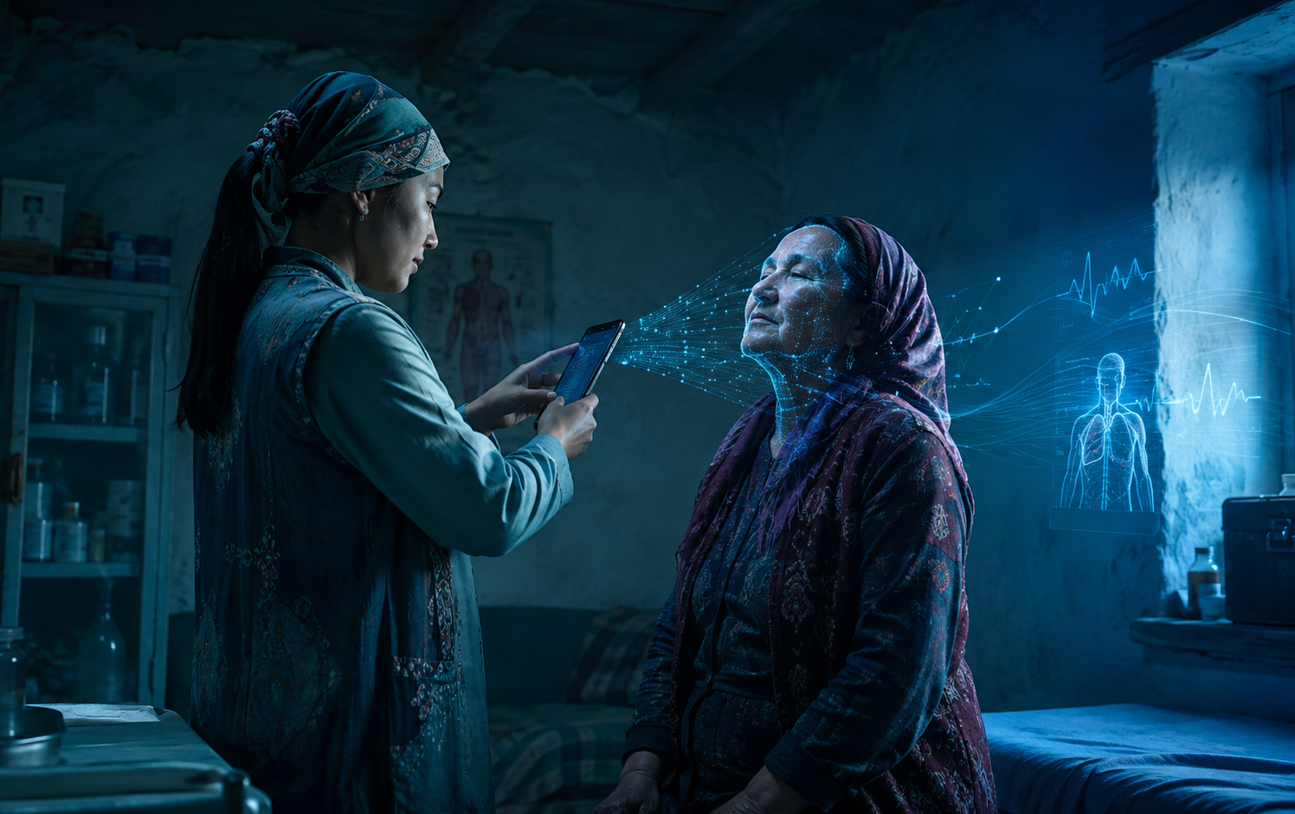
01 — MUAMMO
Chekka hududlarda yordam kechikadi
Muammo telemedicine emas — muammo shoshilinch bemorni tez ajratib olish.
Mutaxassis yetishmaydi
01
Kardiolog, nevrolog, onkolog va diagnostika qurilmalari har doim joyida emas.
Shoshilinch holat noaniq
02
Qaysi bemor bugun mutaxassisga borishi kerakligini tez ajratish qiyin.
Strukturali ma’lumot yo‘q
Natija
03
Bemor → mutaxassis yo‘q → yordam kechikadi
Shifokor ko‘rganda bemor tarixi, signal sifati va risk darajasi tartiblanmagan.
MedTwin kechikish zanjirini “scan → triage → dispatch” bilan qisqartiradi.
MedTwin · AI Diagnostic & Triage Network
02 / 10

Slide 3
02 — YECHIM
Bir daqiqalik klinik yo‘naltirish oqimi
Smartfon signallari Digital Twin’ga aylanadi, AI riskni ajratadi, tizim klinikaga yo‘naltiradi.
BEMOR
MA’LUMOT
2
QAROR
YECHIM
1
3
4
60s Scan
Digital Twin
AI Triage
Doctor / Clinic
Alomatlar + kamera + mikrofon
Signal sifati + raqamli profil
GREEN / YELLOW / RED risk
Klinik brief + dispatch
Shifokorni almashtirmaydi. Tashxis qo‘ymaydi. Klinik qarorni tezlashtiradi.
Demo xavfsizligi: sintetik bemorlar, lokal preprocessing, klinik xavfsizlik protokoli.
MedTwin · AI Diagnostic & Triage Network
03 / 10

Slide 4
03 — MVP DEMO
60 soniya ichida ko‘rinadigan mahsulot
Hakamlar slayddan emas, real oqimdan eslab qolishi kerak: scan, signal, risk, dispatch.
01
Alomatlar
KIRISH
02
Yuz & nafas
KAMERA
MedTwin
Scan
Hozirgi belgilarni tanlash
Yuz simmetriyasi + nafas ritmi
60s
03
Puls · PPG
PPG
04
Nutq vazifasi
MIKROFON
Barmoq orqali kamera PPG signali
Ovoz faolligi va audio sifati
Symptoms
Face & breath
Camera PPG
Sifat + Twin
Clinical brief + triage risk + dispatch queue
05
NATIJA
Output
Speech task
O‘lchovlar Digital Twin’ga yoziladi
Quality gate
MedTwin · AI Diagnostic & Triage Network
04 / 10

Slide 5
04 — WOW FUNCTION
Digital Twin + dori xavfsizligi
AI bemorning profili asosida dorilarni rangli risk bilan solishtiradi: safe, not recommended, dangerous.
PATIENT DIGITAL TWIN
TREATMENT COMPARISON
Amoxicillin
SAFE
RECOMMENDED
Mos keladi: allergiya yo‘q, asosiy vitallar barqaror
Ibuprofen
NOT RECOMMENDED
Caution
Qon bosimi yuqori: shifokor tekshiruvi kerak
Pulse
BP
Drug X
DANGEROUS
Avoid
96
150/95
Kontraindikatsiya: bemor profili bilan mos emas
SpO₂
Risk
93%
YELLOW
Triage + safety advisor, prescription emas: shifokor yakuniy qaror beradi.
MedTwin · AI Diagnostic & Triage Network
05 / 10

Slide 6

05 — CONTROL TOWER
Navoiy uchun real-time dispatch
Qishloqdan kelgan risklar xaritada ko‘rinadi — yuqori xavfli bemor navbatda yo‘qolmaydi.
GREEN
Routine
YELLOW
Follow-up
RED
Urgent
Uchquduq Station → MedTwin Cloud → Navoiy Control Tower → Mutaxassis
MedTwin · AI Diagnostic & Triage Network
06 / 10

Slide 7
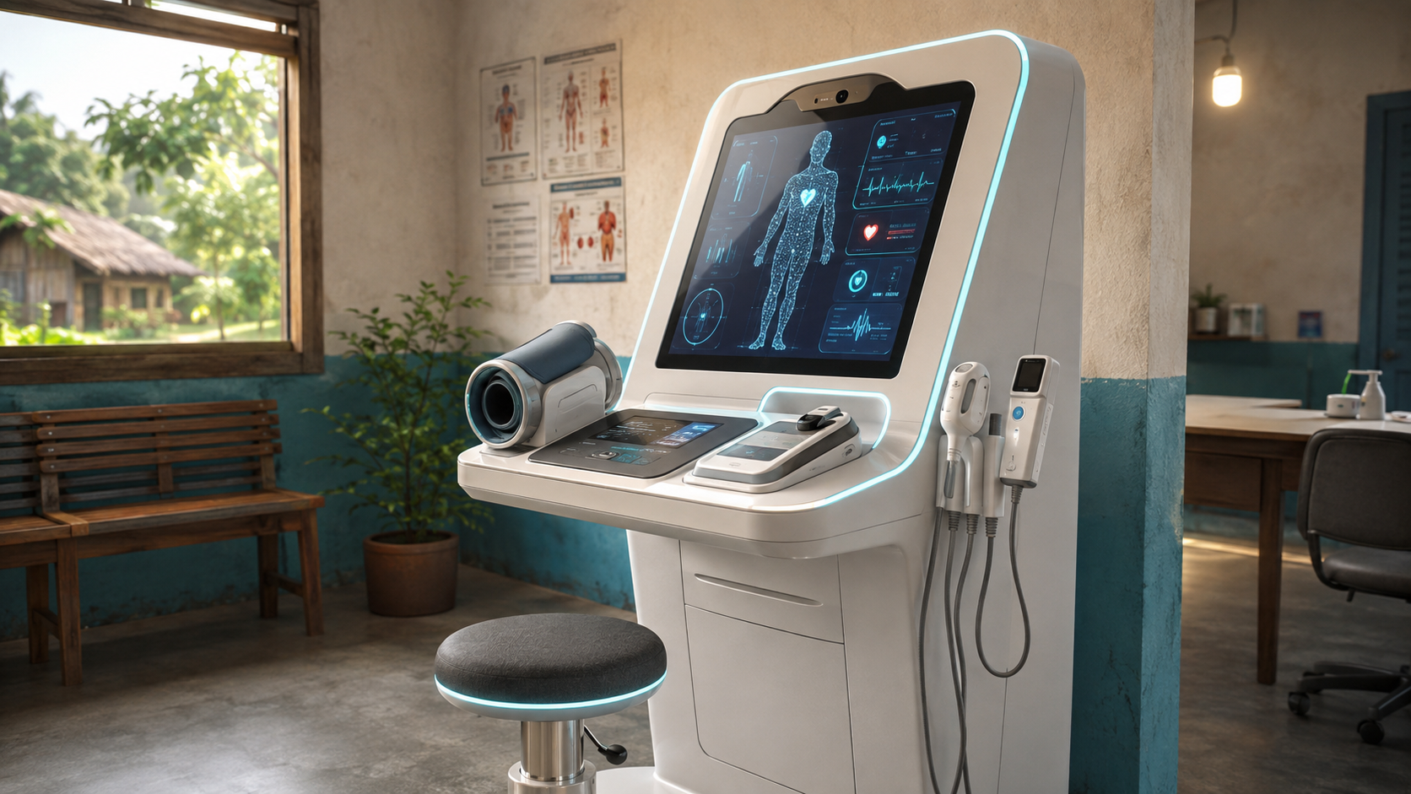
06 — HEALTH STATION
Har qishloqqa “AI tibbiy bankomat”
Shifokor yetishmaydigan joyda asosiy diagnostika infratuzilmasi turadi, mutaxassis esa masofadan ulanadi.
EKG
Yurak
BP
Qon bosimi
SpO₂
Kislorod
TEMP
Harorat
BMI
Vazn
RR
Nafas
POC
Opsiya
1
Walk in
2
Auto scan
3
Twin update
4
AI triage
5
Control Tower
Har qishloqqa shifokor qo‘yish o‘rniga — har qishloqqa standartlashtirilgan screening nuqtasi.
MedTwin · AI Diagnostic & Triage Network
07 / 10

Slide 8
07 — RAQOBAT
MedTwin oddiy chatbot emas
Bizning farq: signal + twin + triage + dispatch + clinic brief bitta oqimda.
Capability
MedTwin
Telemedicine
Chatbot
Health scan app
Smartphone health scan
✓
—
—
✓
Digital Health Twin
✓
—
—
—
AI triage
✓
—
—
—
Remote doctor brief
✓
~
—
—
Mobile clinic dispatch
✓
—
—
—
Offline / low-bandwidth mode
✓
—
—
~
Moat: rural workflow, not generic health advice
MedTwin · AI Diagnostic & Triage Network
08 / 10

Slide 9
08 — BOZOR + MODEL
Pilotdan platformaga
Navoiyda boshlaymiz, qishloq birlamchi tibbiy xizmatini o‘lchanadigan screening tarmog‘iga aylantiramiz.
37.5M
49%
~1.03M
20 000 so‘m
O‘zbekiston aholisi
qishloq aholisi ≈ 18.4M
Navoiy viloyati pilot bozori
a’zo / oy · B2B SaaS
REVENUE LADDER
WHO PAYS
1 000
10 000
50 000
Davlat sog‘liqni saqlash tizimi · klinikalar · mobil klinika operatorlari · sug‘urta kompaniyalari
20 mln / oy
200 mln / oy
1 mlrd / oy
Qo‘shimcha: device kit, deployment, support va hududiy dashboard.
Model demo hisob-kitoblarga asoslangan; pilotda klinik va operatsion KPIlar validatsiya qilinadi.
MedTwin · AI Diagnostic & Triage Network
09 / 10

Slide 10
09 — PILOT PLAN
90 kunda isbotlanadigan natija
Hackathon’dan keyingi maqsad: 1–2 tuman, 1 000+ screening, klinik xavfsizlik validatsiyasi.
Bugun
0–3 oy
6–12 oy
3 yil
Hackathon MVP
Pilot
Scale
Platform
Scan, 3D Twin, AI triage, Navoiy map, dispatch
1–2 tuman, patronaj hamshiralar, 1 000+ screening
10 000+ screening, mobile clinic integration
O‘zbekiston rural health intelligence network
PILOT KPI
ASK
• 1 000+ screening / 90 days
• RED/YELLOW → clinician escalation
• Clinical brief for every high-risk case
• Safety + signal quality validation
Pilot hududi + klinik hamkor + real field test
Maqsad: qishloq bemorini navbatda yo‘qotmaslik.
MedTwin
AI Diagnostic & Triage Network
MedTwin · AI Diagnostic & Triage Network
10 / 11

Slide 11

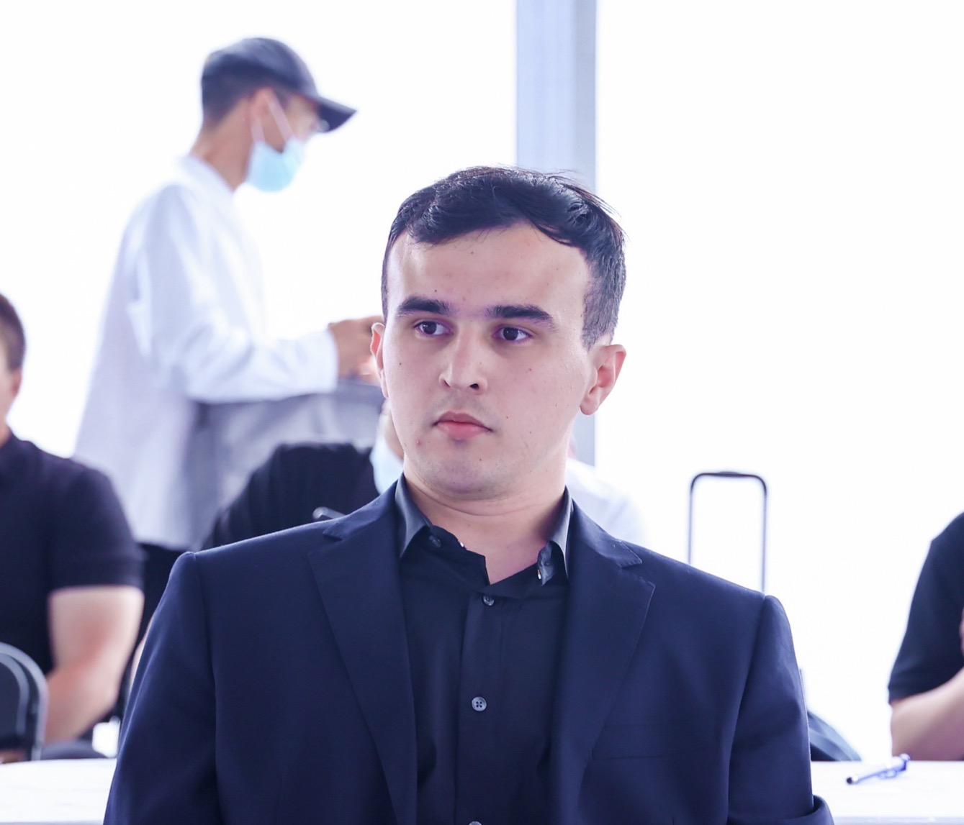
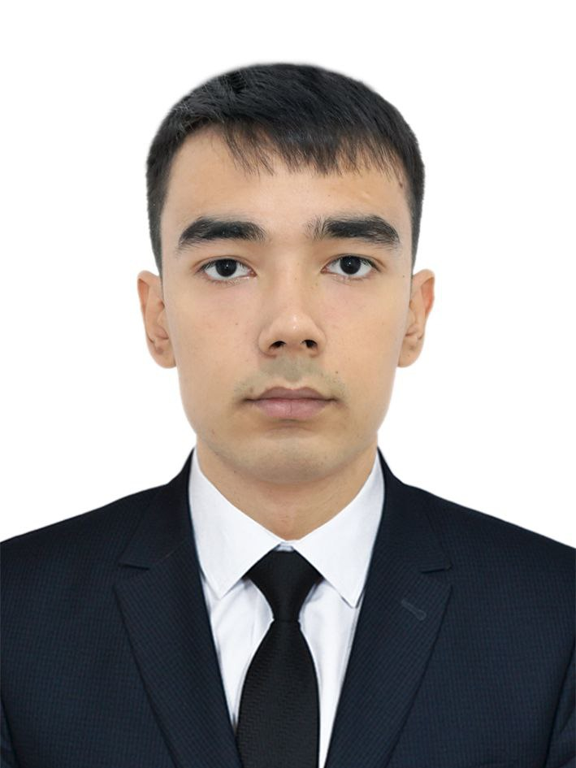
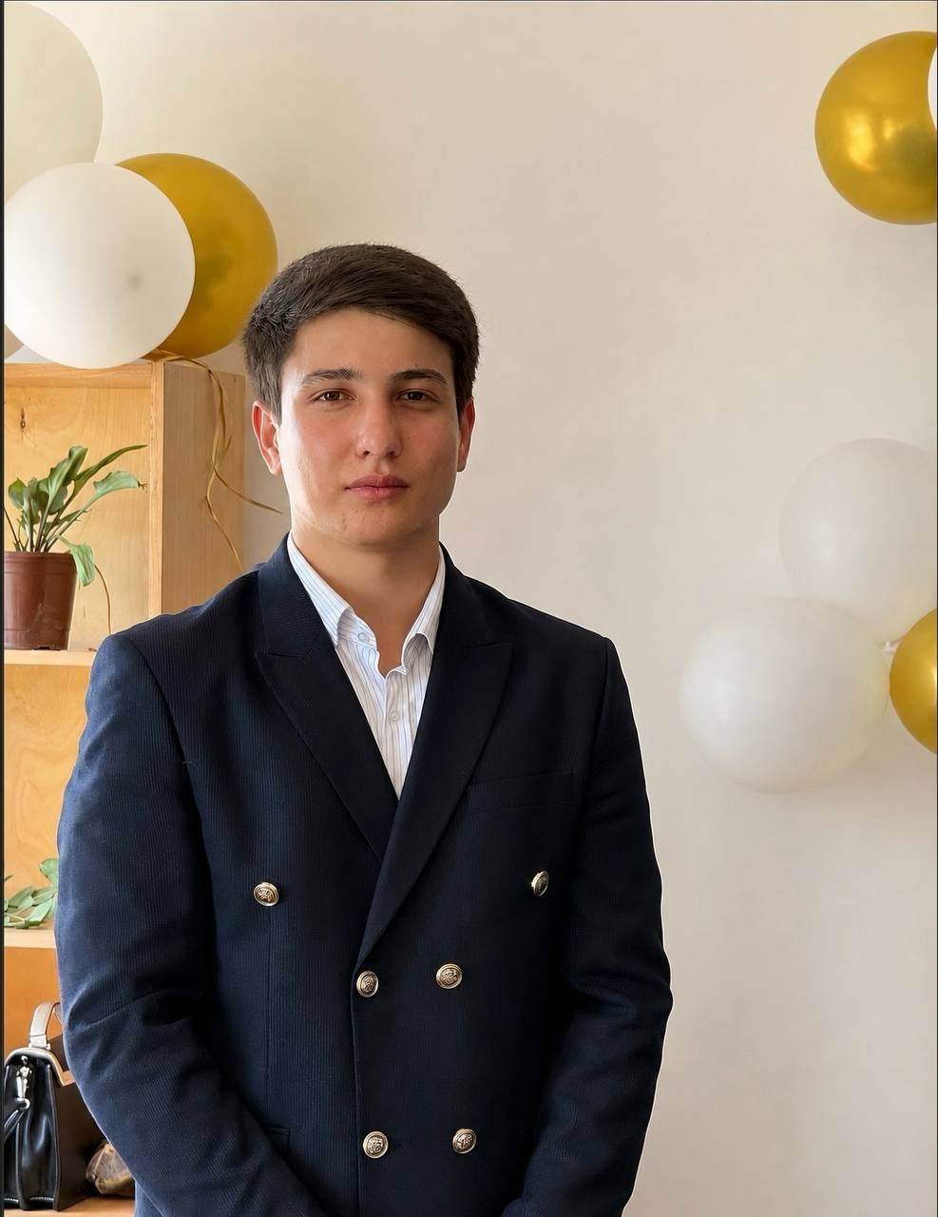
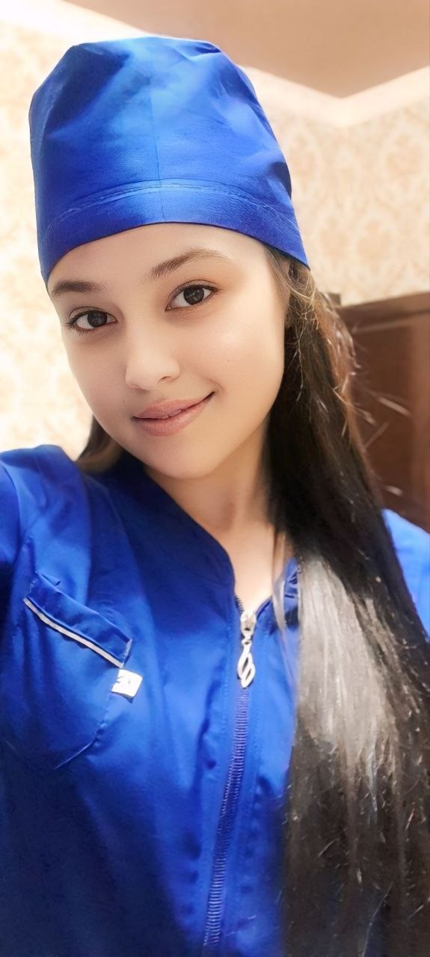
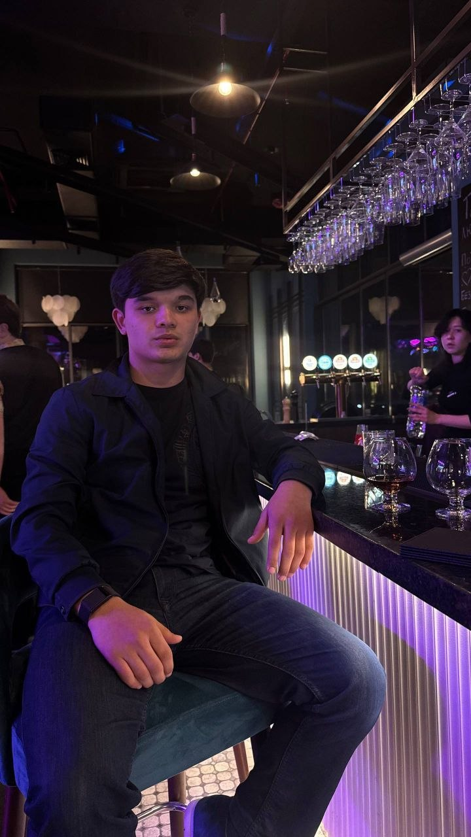
11 — TEAM
BUILT TO PILOT
Jamoa: klinik xavfsizlik + AI product + pilot execution
TEAM OPERATING SYSTEM
Hackathon MVP faqat demo emas — real Navoiy pilotiga chiqish uchun kerakli rollar bir jamoada yig‘ilgan.
Sardorbek Sirojov
CEO / Product Lead
Mahsulot strategiyasi · investor pitch · pilot vision
Sardor Soliyev
AI / Backend Engineer
Triage logic · API · data pipeline · model infrastructure
Muhammadjon Kenjayev
Frontend / 3D Engineer
Scan UI · Digital Twin · map dispatch interface
Shahnozabonu Sirojova
Medical Advisor
Klinik xavfsizlik · triage protokollari · patient risk review
Abdulaziz Zaripov
Business / Pilot Manager
Hamkorliklar · tuman pilotlari · field operations
Edge: product tezligi + klinik ehtiyotkorlik + joyida pilot hamkorliklari
Bir jamoa: screening mahsuloti → AI triage → clinic dispatch → field pilot.
MedTwin · AI Diagnostic & Triage Network
11 / 11

Slide 12

Hackathon’dan keyingi qadam: real pilot uchun hamkorlar qidirmoqdamiz
Bizda MVP bor. Endi bizga Navoiyda real screening oqimini ishga tushirish uchun klinik, hududiy va strategik hamkorlar kerak.
01
Pilot partnerlar
1–2 tuman, oilaviy poliklinika yoki mobil klinika tarmog‘i bilan 1 000+ screening pilotini boshlash.
02
Klinik xavfsizlik
Shifokorlar va medical advisorlar bilan triage protokollari, klinik brief va yo‘naltirish oqimini validatsiya qilish.
03
Qurilma & infra
Health Station, PPG / vitals qurilmalari, bulut yoki hududiy server, internet va deployment support.
04
Grant / investor / ecosystem
CSR, grant, accelerator yoki strategik investorlar bilan MVP’dan pilot va kengayish bosqichiga o‘tish.
Biz nimani olib kelamiz
• Ishlayotgan MVP
• Rural health use case
• O‘lchanadigan pilot KPI
• Premium product vision
Agar siz klinika, tuman pilot operatori, sog‘liqni saqlash tashkiloti, device provider yoki investor bo‘lsangiz — MedTwin bilan pilot quraylik.
MedTwin · AI Diagnostic & Triage Network
12 / 12

