Slide 1
第五章 微分中值定理及其应用
第一节 微分中值定理
一、罗尔定理
二、拉格朗日中值定理
三、柯西中值定理
重点与难点：中值定理的理解与应用

Slide 2
一、罗尔定理
1. 函数极值与费尔马定理
定义
注：极值点必在区间内部，区间内的最值点必是极值点.
费尔马 ( Fermat, 1601—1665,法国 )

Slide 3
证法

Slide 5
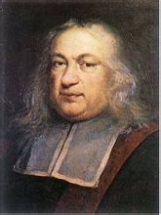
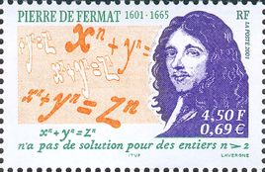
费尔马 (Fermat), 1601—1665, 法国

Slide 6
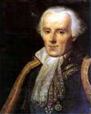
2.罗尔定理
例如,
罗尔 (Rolle， 1652--1719，法国 )

Slide 7
几何解释:

Slide 8
证

Slide 9
注记:若罗尔定理的三个条件中有一个不满足,其结论可能不成立.
例如,
又例如,

Slide 10
例1
证
由介值定理
即为方程的小于1的正实根.
矛盾,

Slide 11
例2
证

Slide 14
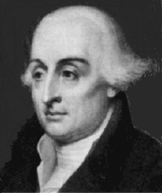
二、拉格朗日 ( Lagrange ) 中值定理
拉格朗日, Lagrange, 1736—1813 , 法国

Slide 15
几何解释:
证
分析:
弦AB方程为

Slide 16
作辅助函数
拉格朗日中值公式
注意: 拉格朗日公式精确地表达了函数在一个区间上的增量与函数在这区间内某点处的导数之间的关系.

Slide 17
拉格朗日中值公式又称有限增量公式.
微分中值定理
拉格朗日中值定理又称有限增量定理.

Slide 18
推论1
推论2

Slide 19
例4
证
练习:

Slide 20
例5
证
由上式得
练习:

Slide 21
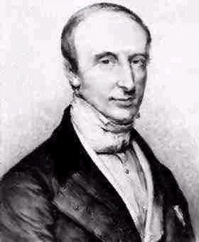
三、柯西 ( Cauchy ) 中值定理
柯西, Cauchy, 1789--1857, 法国

Slide 22
几何解释:
证1
作辅助函数

Slide 24
证2

Slide 26
例6
证
分析:
结论可变形为

Slide 27
例7
证

Slide 28
例8
证

Slide 29
练习
证
原式得证.

Slide 30
四、小结
罗尔定理、拉格朗日中值定理及柯西中值定理之间的关系；
Rolle
定理
Lagrange
中值定理
Cauchy
中值定理
注意定理成立的条件；
注意利用中值定理证明等式与不等式的步骤.

Slide 31
作 业
P181: 1, 2, 4, 5, 7, 8(单), 9, 15, 17, 18, 20.

Slide 32
思考题
试举例说明拉格朗日中值定理的条件缺一不可.

Slide 33
思考题解答
不满足在闭区间上连续的条件；
且
不满足在开区间内可微的条件；
以上两个都可说明问题.

Slide 34

Joseph-Louis Lagrange
Lagrange, along with Euler and the Bernoullis, developed the calculus of variations for dealing with mechanics. He was responsible for laying the groundwork for a different way of writing down Newton's Equations of Motion. This is what has been called Lagrangian Mechanics. It accomplishes the same thing that Newton's Equations provide - the path followed by all the bodies studied in a problem - but the form of the equations is actually better because the form does not change when the coordinate system used to describe a problem changes. Lagrangian Mechanics have been widely used to solve many mechanical problems.

Slide 35

Cauchy, Augustin Louis
Augustin Louis Cauchy, b. Aug. 21, 1789, d. May 23, 1857, was a French mathematician and mathematical physicist who proved (1811) that the angles of a convex Polyhedron(多面体) are determined by its. Numerous terms (术语) in mathematics bear his name, for example, the Cauchy integral theorem, in the theory of complex functions, and the Cauchy-Kovalevskaya existence theorem for the solution of partial differential equations. Cauchy was the first to make a careful study of the conditions for convergence of infinite series(级数). His texts Cours d'analyse (Course on Analysis, 1821) and the 4-volume Exercises d'analyse et de physique mathematique (Exercises in Analysis and in Mathematical Physics, 1840-47) were highly influential.

Slide 36
Paris was a difficult place to live in when Augustin-Louis Cauchy was a young child due to the political events surrounding the French Revolution. When he was four years old his father, fearing for his life in Paris, moved his family to Arcueil. There things were hard and he wrote in a letter:- We never have more than a half pound of bread - and sometimes not even that. This we supplement with the little supply of hard crackers and rice that we are allotted. They soon returned to Paris and Cauchy's father was active in the education of young Augustin-Louis. Laplace and Lagrange were visitors at the Cauchy family home and Lagrange in particular seems to have taken an interest in young Cauchy's mathematical education. Lagrange advised Cauchy's father that his son should obtain a good grounding in languages before starting a serious study of mathematics. In 1802 Augustin-Louis entered the Ecole Centrale du Panthéon where he spent two years studying classical languages.

