Slide 1

SYNSERA Mini Project /BCS554/ 5th Sem
STUDENT NAME [WITH UNIVERSITY ROLL NO]:
1. Akshansh Shekhar(2300320100022)
2. Ayush Goyal(2300320100060)
3. Ayush Kumar Singh(2300320100061)
SUPERVISOR NAME:
Dr. Shanu Sharma

Slide 2
ABSTRACT
Synsera is a full-stack web application designed to help teams, startups, and college clubs monitor productivity and well-being.
Team members submit regular check-ins describing their current tasks, blockers, and feelings.
Using Natural Language Processing (NLP), the system analyzes sentiment, detects burnout risk, and provides insights and suggestions to team leads.
This data-driven approach enhances team performance, morale, and communication efficiency.

Slide 3
OBJECTIVE/PROBLEM STATEMENT
Build an AI-based platform for regular team check-ins and productivity tracking.
Use NLP to analyze text inputs and derive sentiment scores.
Predict burnout or productivity drops using trend analysis.
Generate insights and suggestions for managers to improve engagement.
Encourage transparency and open communication in teams.

Slide 4
LITERATURE REVIEW
Sentiment Analysis Using AI & NLP
Sentiment Analysis identifies emotions and opinions from textual data using AI techniques.
It helps organizations understand public perception and user feedback efficiently.
Text Understanding & Emotion Detection
Natural Language Processing (NLP) techniques analyze text structure and meaning.
Models classify sentiments as positive, negative, or neutral.
Machine Learning–Based Sentiment Classification
Algorithms like Naïve Bayes, SVM, and Logistic Regression learn patterns from labeled data.
Deep Learning for Contextual Analysis
Neural networks such as CNN and LSTM capture context and word relationships.
These models handle long sentences and complex expressions better.
Applications of Sentiment Analysis
Used in product reviews, social media monitoring, customer feedback, and brand analysis.
Helps businesses make data-driven decisions based on user emotions.

Slide 5
Proposed Methodology :
Requirement Analysis: Identify the goal of sentiment classification (positive, negative, neutral) and the type of textual data such as reviews, tweets, or feedback.
System Design: Design the system architecture with modules for text preprocessing, feature extraction, sentiment classification, and result visualization.
Data Collection: Gather datasets of employees.
Model Development: Train machine learning model for sentiment prediction.
Integration: Integrate the trained model into a web or desktop application with a simple and interactive user interface.
Testing: Validate accuracy of recommendations and usability through pilot testing.
Deployment: Launch the application on a scalable cloud platform.
Evaluation & Improvement: Collect user feedback and refine models continuously.

Slide 6
Tools and Technologies Used:
Frontend: TypeScript, React
Backend: Node.js / Flask (API-based communication)
Database: MySQL
AI & ML: Python (NLP libraries such as NLTK, spaCy, scikit-learn)
Text Processing: Tokenization, lemmatization, stop-word removal
Sentiment Classification Models: Naive Bayes, Logistic Regression
Version Control: Git & GitHub
Testing: PyTest / Jest / Manual Testing

Slide 7
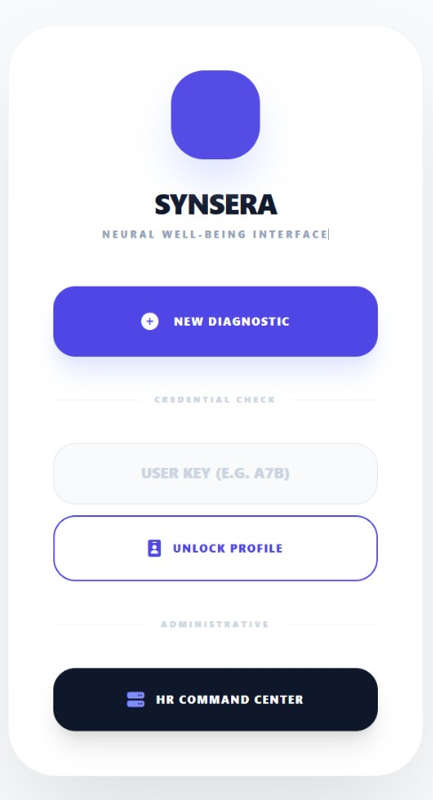
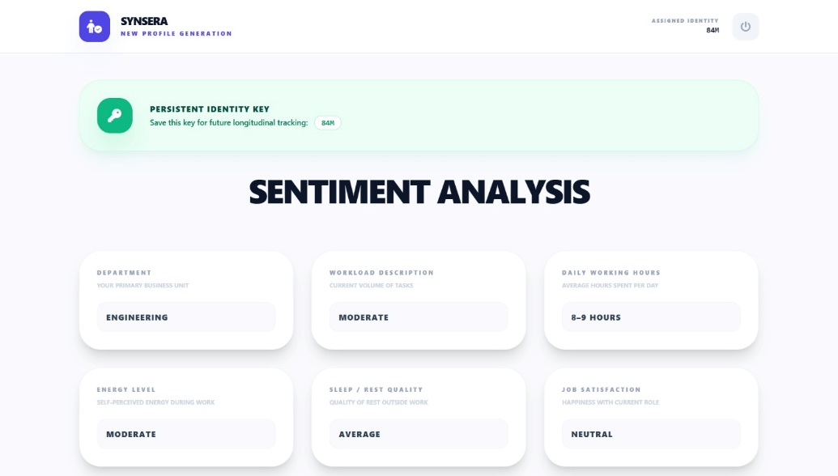
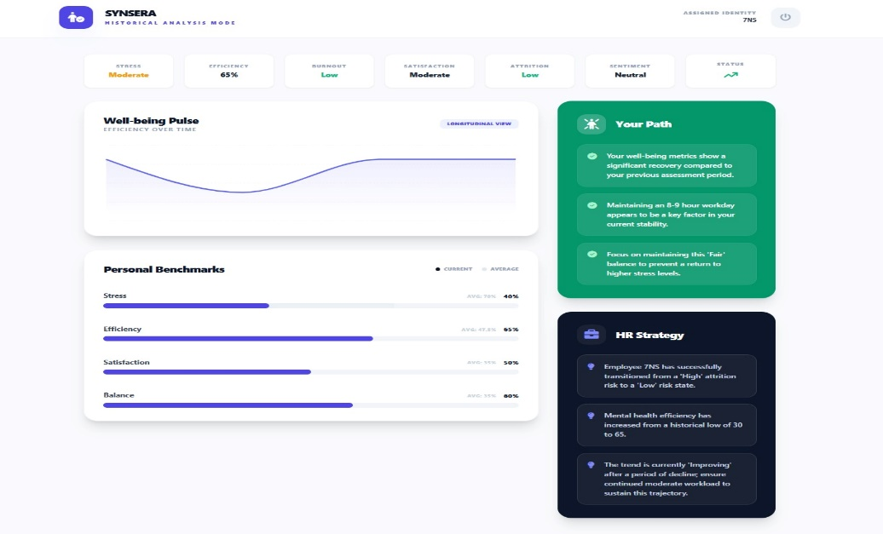
Implementation

Slide 8
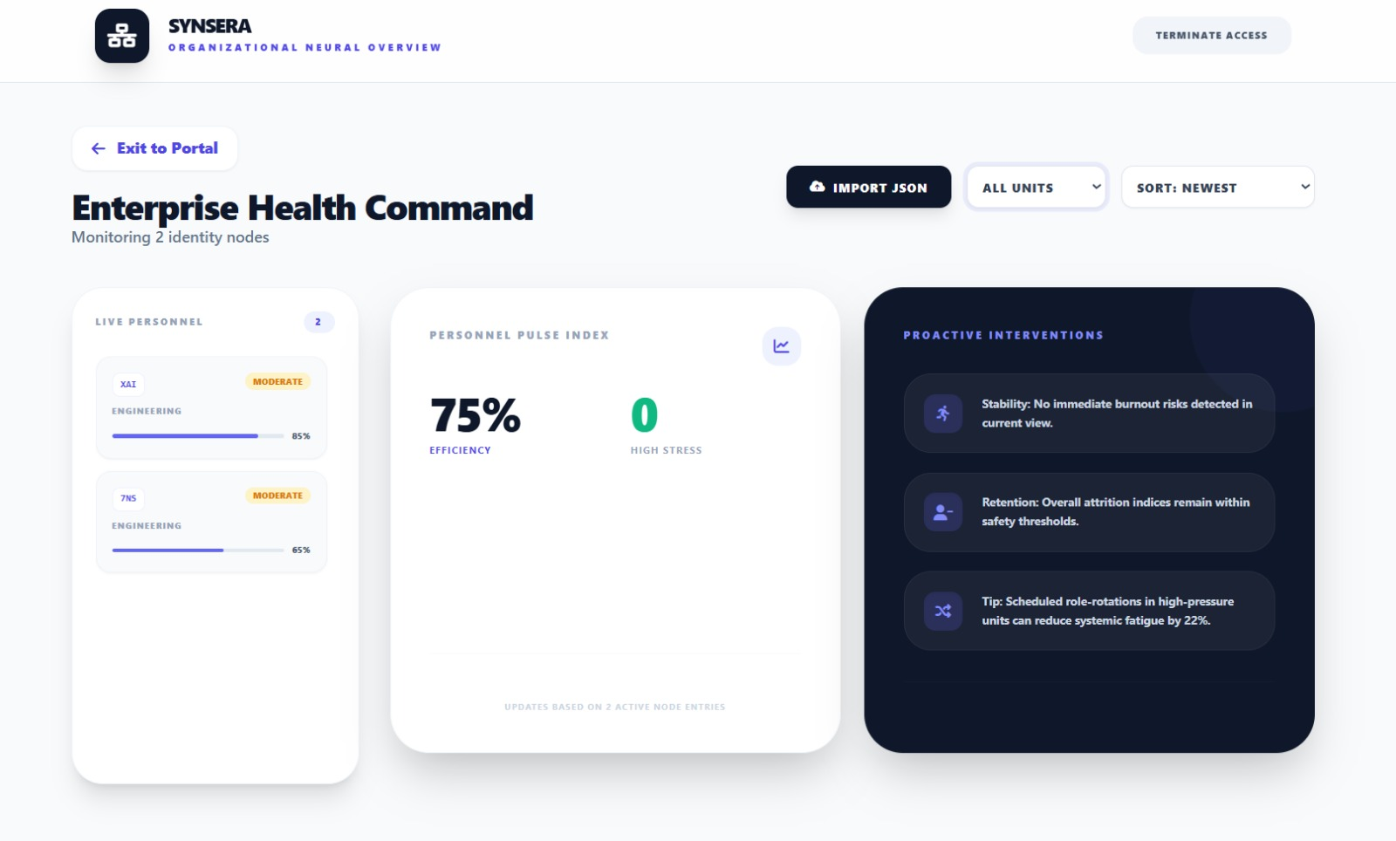
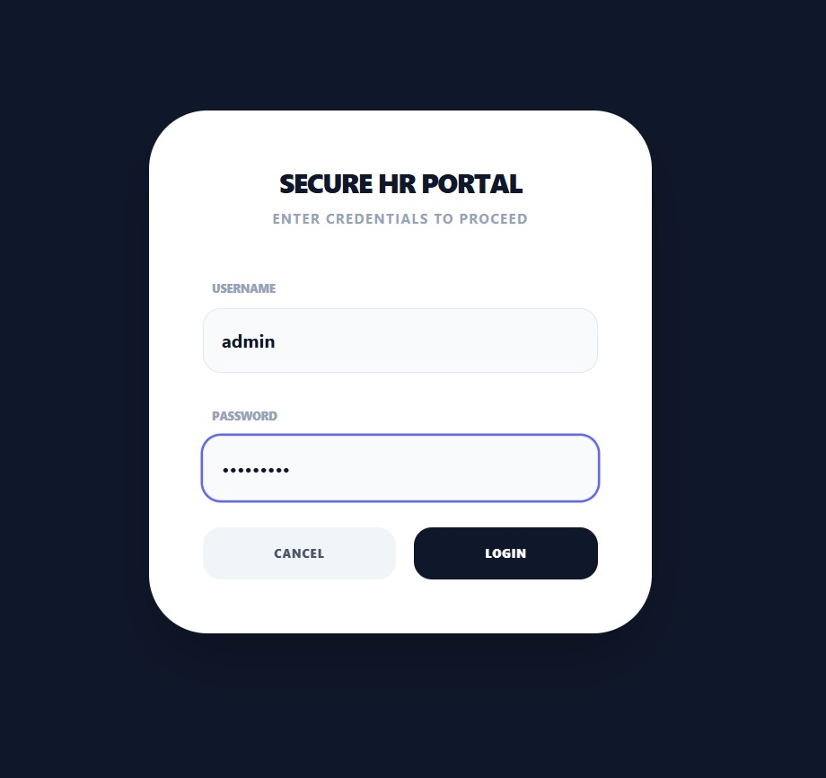
Implementation

Slide 9
RESULTS
Employees:
Submit check-ins, moods, and blockers.
Team Leads:
Receive AI-based summaries and insights.
HR Teams:
Track organization-wide morale and engagement.
Startups / Clubs:
Use aggregated analytics to improve coordination and satisfaction.

Slide 10
CONCLUSION AND FUTURE SCOPE
Synsera offers an innovative AI-based approach to improve workplace well-being and efficiency. By merging sentiment analytics with productivity tracking, it ensures balanced team management.
In future we can work by introducing features like:
Integration with third-party communication tools (Slack, Teams, Trello)..
Voice-based emotional tone detection.
Gamified wellness tracking system.
Advanced predictive analytics for team performance forecasting.

Slide 11
REFERENCES
Hugging Face. (2025). Transformers: State-of-the-Art Natural Language Processing - https://huggingface.co/transformers
Kaggle. (2025). Employee Burnout Prediction Dataset. https://www.kaggle.com/datasets
spaCy. (2025). Industrial-Strength NLP in Python - https://spacy.io
MIT Sloan Management Review. (2023). AI and the Future of Work: Using Analytics to Understand Employee Well-being. https://sloanreview.mit.edu

Slide 12
THANK YOU

