Slide 1
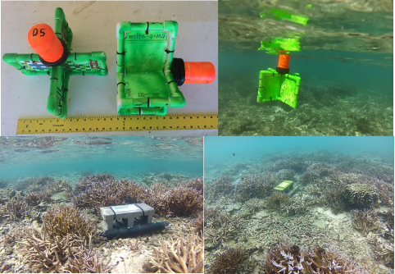
LOW RESOLUTION

Slide 2
