Slide 1
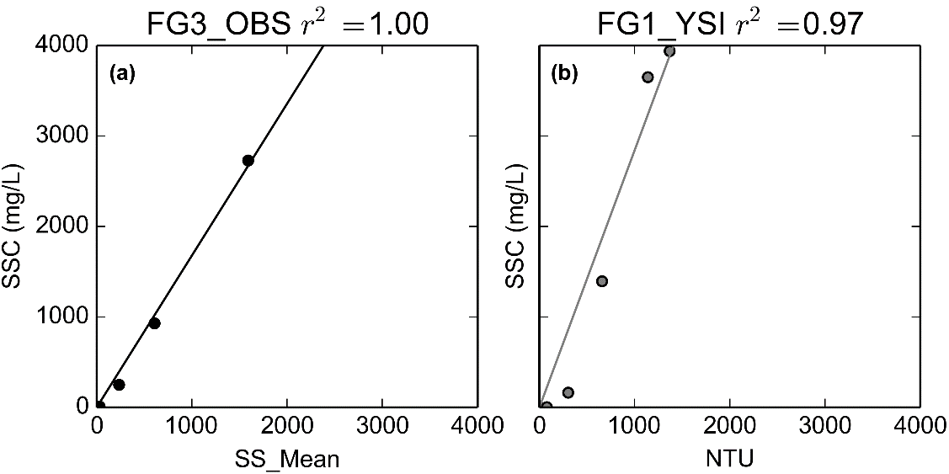
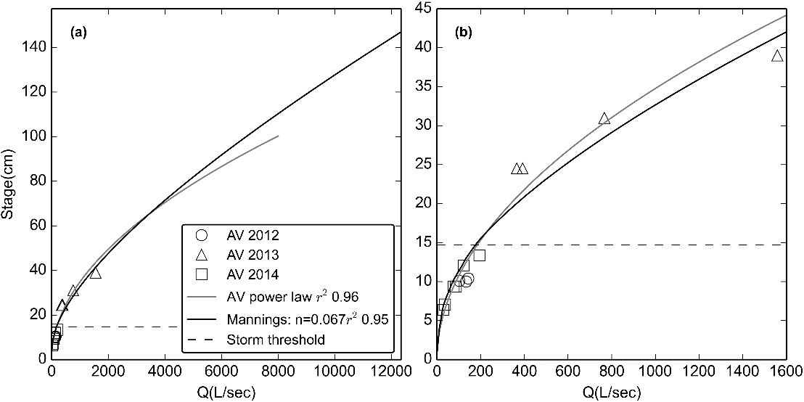
SSY = Q x SSC
PT pressure – Barometric Pressure = Water pressure
SSC = a x Turbidity + b
Water pressure x Density of water = Stream stage
Q = a x Stream Stage + b

