Slide 1
diY
team Trifecta
Do It YourSelf
d
i
Y
Unified Digital System : Building a Centralized Platform for Essential Services and Everyday Utilities
Domain - Web Development
Team :
Anant Sharma (Team Lead), Abhay Aditya R S, Vipul Suthar

Slide 2
diY
Abstract
The DIY Platform addresses this by centralizing information and guidance into a single, user-friendly web application that empowers individuals to independently complete tasks with clarity, speed, and confidence.

Slide 3
diY
Problem Statement
Accessing essential services like legal documents, financial tools, and educational resources often requires navigating multiple complex and disconnected platforms. This fragmentation creates confusion, inefficiency, and barriers to access—especially for users unfamiliar with bureaucratic processes.

Slide 4
diY
Novelty & Uniqueness
The DIY Platform is a comprehensive web application that centralizes access to key services across government, finance, education, travel, and lifestyle sectors. It provides:
Step-by-step guidance for processes like ID applications, tax filing, and certifications
Curated information and eligibility criteria for each service
Verified redirection links to official portals
A clean, intuitive interface for seamless navigation across sectors
This empowers users to complete tasks independently—without needing to search across multiple platforms.

Slide 5
diY
Tech Stack
Frontend : HTML, CSS, Vanilla JS, Bootstrap
Design : Canva
Version Control : Git & GitHub
APIs : External Redirection to Official Sites
Hosting : Vercel

Slide 6
diY
Existing System v/s Proposed System
Currently, individuals rely on an existing system of multiple, fragmented government and third-party sites for information. The content is often unclear, filled with bureaucratic jargon, and requires high effort to navigate. This results in a user experience that is frequently confusing, frustrating, and not optimized for mobile devices. Many of these sites also require logins just to view information.
Our proposed system, the DIY platform, directly contrasts this by providing a single, centralized source of information. The content is intentionally simple, jargon-free, and presented in point-based instructions, requiring low effort from the user to find what they need. The user experience is clean, modern, intuitive, and fully responsive. Most importantly, our platform provides immediate and open access with no login required, serving as a universal guide that simplifies the path to many different official portals.

Slide 7
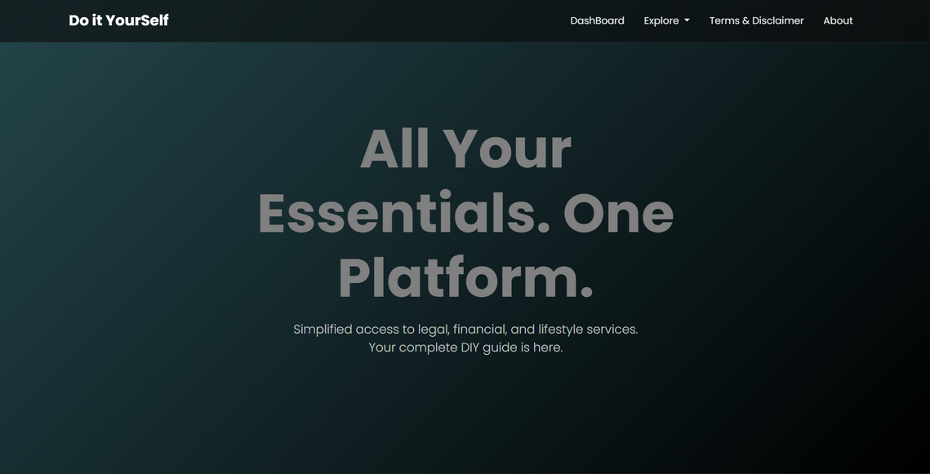
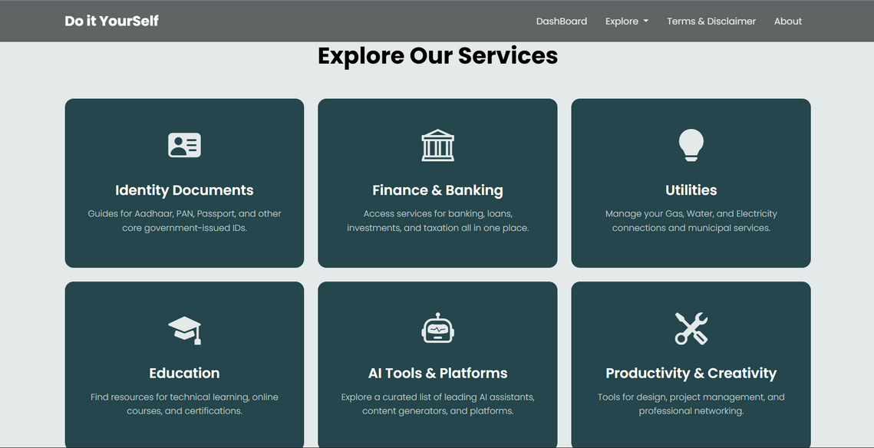
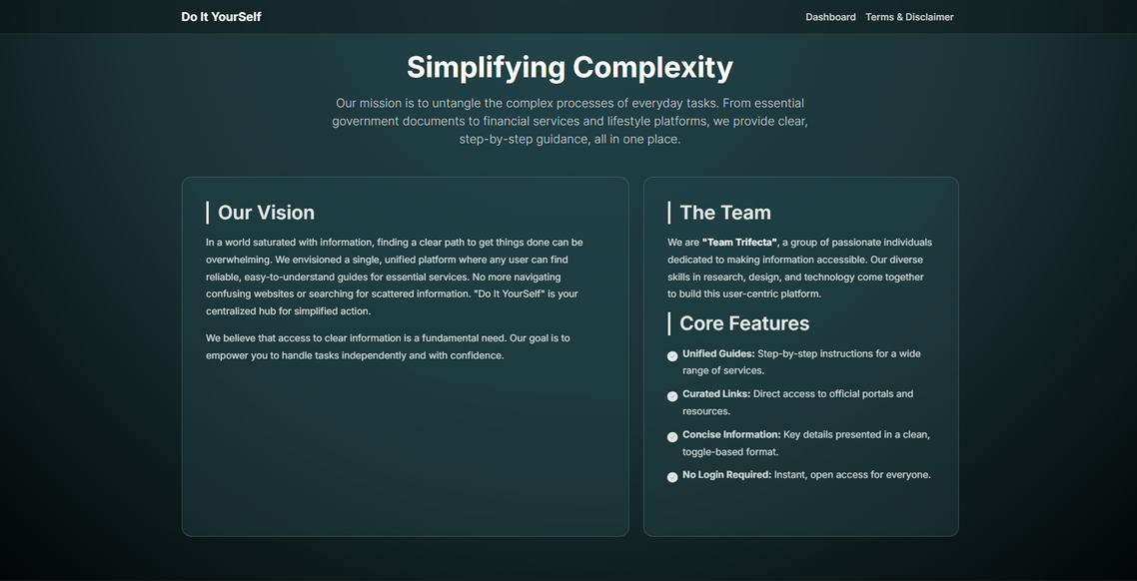
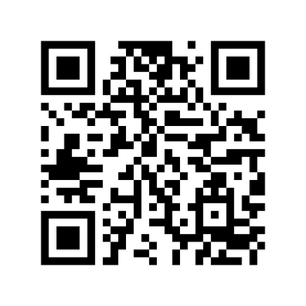
Our Project :
diY
Check out live !

