Slide 1

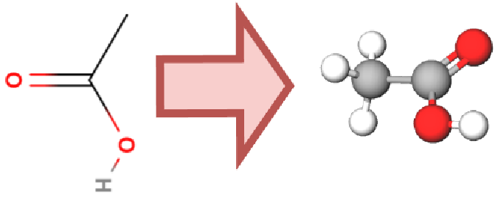
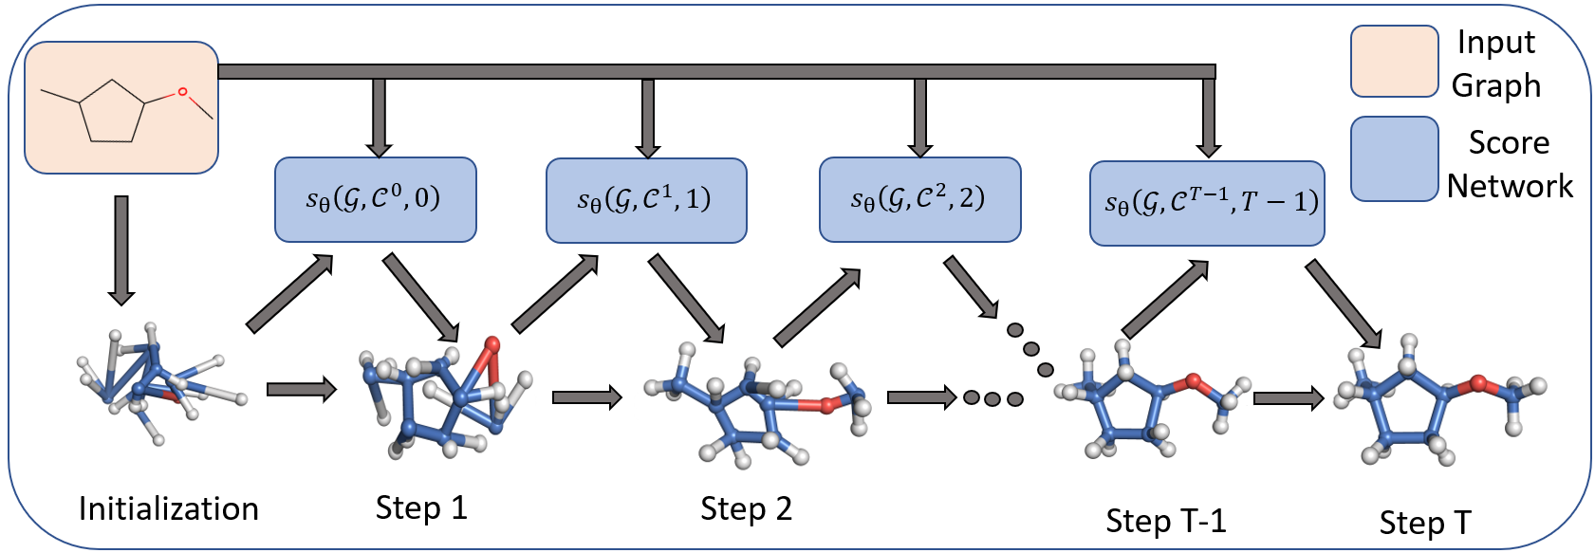
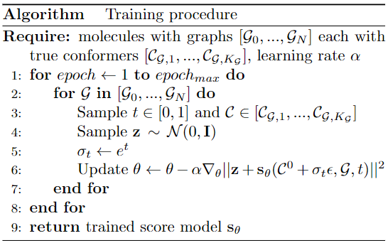
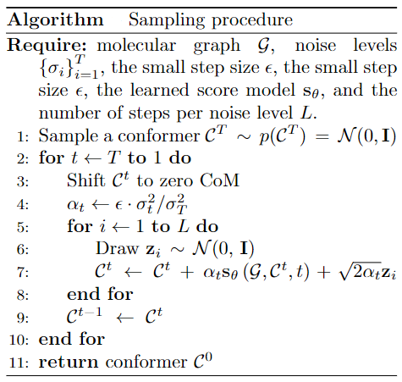
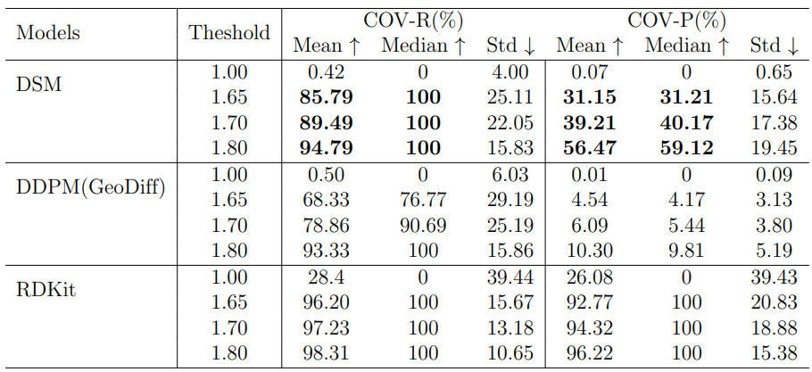
VIETNAM NATIONAL UNIVERSITY UNIVERSITY OF TECHNOLOGY FACULTY OF COMPUTER SCIENCE AND ENGINEERING CAPSTONE PROJECT REPORT
Group : Drug Discovery - AI4Science
Student : Dang Cao Cuong
Student ID : 1952598
Diffusion Model for Conformer Generation
QR CODE
Instructor: Assoc. Prof Quan Thanh Tho, PhD
Introduction
Hình ảnh
The problem we are trying to solve is conformer generation. A conformer is a 3D structure of a molecule and conformer generation is the process of predicting or generating the three-dimensional structure of molecules given their graph, including graph structure, node type, and edge type. Graph structure is the connectivity between nodes of a molecule. Node types and edge types are labeled based on the types of atoms and bonds in a molecule. For example, the image on the left shows that a conformer of the acetic acid molecule is formed given its graph.
Problem Statement/Challenges
Molecule conformer generation is an important task in several scientific fields, such as bioinformatics, pharmacology, material discovery, etc. In drug discovery, conformers of the molecule can be generated by computational means. These procedures, however, are accurate but time-consuming when dealing with large molecular graphs. In addition, machine learning (ML) methods also have difficulty in finding a suitable GNN architecture for spatiotemporal data commonly used to model 3D structures of molecules in space. As a result, techniques for building 3D structures which have stable, fast sampling procedures, and be able to generate diverse, accurate conformers are critical.
Research Method
We aim to use an ML method to learn the probability distribution of conformers given their graphs and then sample from that distribution to obtain possible conformers. To explore the conformer distribution, we propose a score-based diffusion model (SDM) which utilizes the score-based function to approximate small trajectories mapping from a tractable distribution, such as a Gaussian distribution, to the distribution of conformers. The advantage of this method over previous diffusion methods such as the Denoising Diffusion Probabilistic Model (DDPM) is that the mapping trajectories are smaller, so it is easier for GNN to enhance their representational (discriminative) power and learn the trajectories efficiently. The baselines we use for evaluation are GeoDiff and RDKit which are two current machine learning and biocomputational SOTA methods respectively.
System Architecture
The input to our system is a graph of the molecule and the outputs of the system are possible conformers. The core of our system is a graph neural network (GNN) that approximates the score-based function of the molecular coordinates at time t. Initially, the system samples the coordinates of the atoms in the molecule according to a Gaussian probability distribution and then discretizes the diffusion process to map those random coordinates to coordinates that follow the probability distribution of conformers. At each time t, the GNN receives the conformer at time t, the graph of the molecule, and the time when the model is used, and returns the score value to update the conformer. After T steps, a complete conformer is generated. This process is repeated many times to generate possible conformers.
Hình ảnh
Figure: Generation procedure of the system via Langevin dynamics.
Diffusion
Results
Mô tả
Conclusion
The DSM method gives better results than the DDPM method used in GeoDiff in terms of both metrics, COV-R and COV-P. In terms of mean, the DSM method gives about 25% better results on the COV-R metric and 6.8 times better on the COV-P metric with a threshold of 1.65. Although RDKit biocomputational method has slightly better results than DSM, in practice RDKit method skips 5/200 conformers due to failure to generate a conformer. In brief, the proposed method is the most appropriate one for tasks in the drug discovery industry such as creating a large number of conformers which requires fast, stable, diverse, and accurate conformer generation.
Table: The results of conformer generation when applying RDKit, DSM, and DDPM with thresholds of 1.0, 1.65, 1.7 and 1.8

