Slide 1
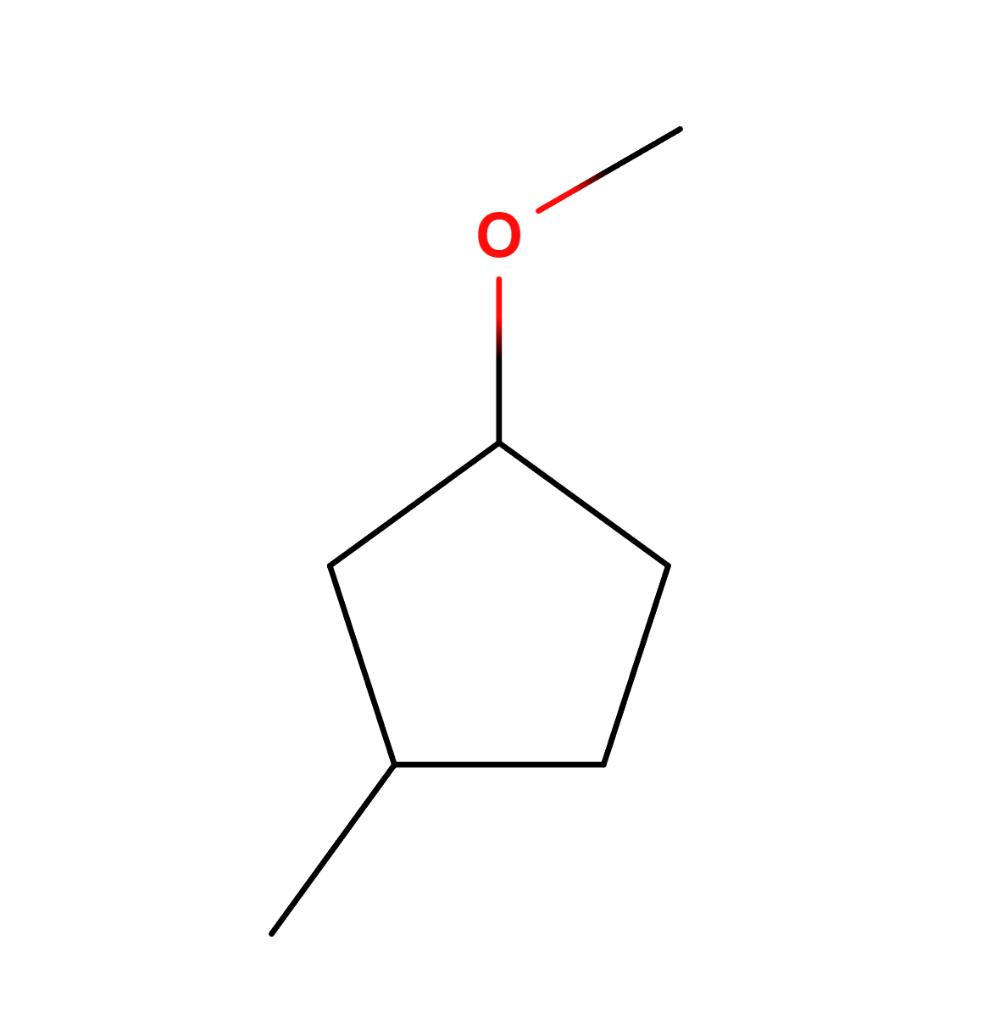
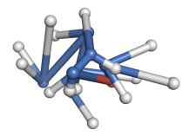
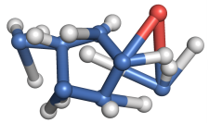
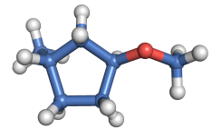
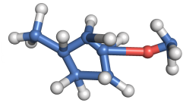
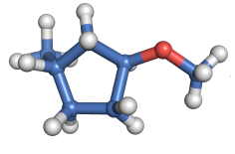




Input Graph
Score Network
$$s_{θ}\left(𝒢,𝒞^{0},0\right)$$
$$s_{θ}\left(𝒢,𝒞^{1},1\right)$$
$$s_{θ}\left(𝒢,𝒞^{2},2\right)$$
$$s_{θ}\left(𝒢,𝒞^{T−1},T−1\right)$$
Initialization
Step 1
Step 2
Step T-1
Step T

