Slide 1
Conditional Random Fields: Probabilistic Models for Segmenting and Labeling Sequence Data
John Lafferty
Andrew McCallum
Fernando Pereira

Slide 2
Goal: Sequence segmentation and labeling
Computational biology
Computational linguistics
Computer science

Slide 3
Overview
Generative models
Conditional models
Label bias problem
Conditional random fields
Experiments

Slide 4
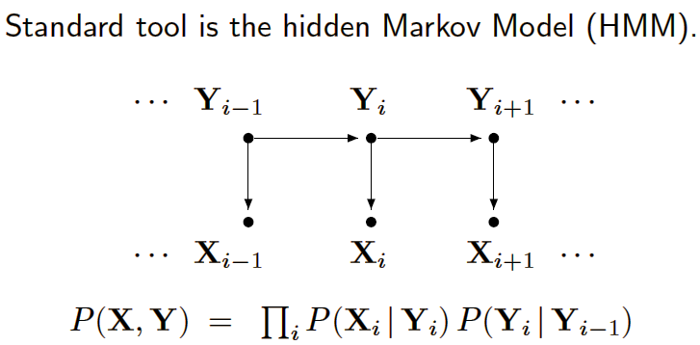
Generative Models
HMMs and stochastic grammars
Assign a joint probability to paired observation and label sequences
Parameters are trained to maximize joint likelihood of training examples

Slide 5
Generative Models
Need to enumerate all possible observation sequences
To ensure tractability of inference problem, must make strong independence assumptions (i.e., conditional independence given labels)

Slide 6
Conditional models
Specify probabilities of label sequences given an observation sequence
Does not expend modeling effort on the observations which are fixed at test time
Conditional probability can dependent on arbitrary, non-independent features of the observation sequence

Slide 7
Example: MEMMs
Maximum entropy Markov models
Each source state has an exponential model that takes the observation feature as input and outputs a distribution over possible next states
Weakness: Label bias problem

Slide 8
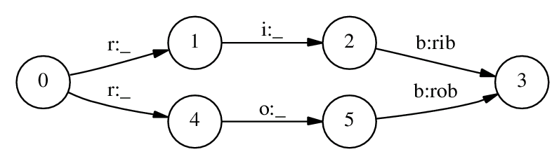
Label Bias Problem
Per-state normalization of transition scores implies “conservation of score mass”
Bias towards states with fewer outgoing transitions
State with single outgoing transition effectively ignores observation

Slide 9
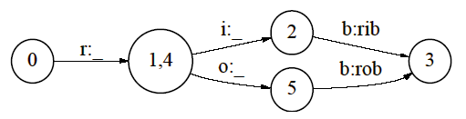
Solving Label Bias
Collapse states, and delay branching until get a discriminating observation
  Not always possible or may lead to combinatorial explosion

Slide 10
Solving Label Bias (cont’d)
Start with fully-connected model and let training procedure figure out a good structure
  Precludes use of prior structure knowledge

Slide 11
Overview
Generative models
Conditional models
Label bias problem
Conditional random fields
Experiments

Slide 12
Conditional Random Fields
Undirected graph (random field)
Construct conditional model p(Y|X)
Does not explicitly model marginal p(X)
Assumption: graph is fixed
  Paper concerns itself with chain graphs and sequences

Slide 13
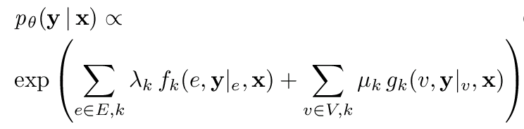
CRFs: Distribution
weights
features

Slide 14
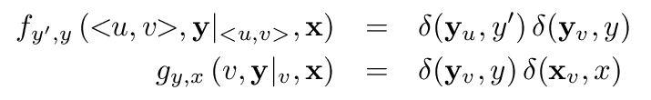
CRFs: Example Features
Corresponding parameters λ and μ similar to the (logarithms of the) HMM parameters p(y’|y) and p(x|y)

Slide 15
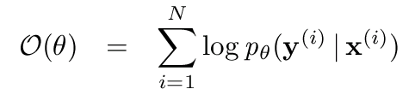
CRFs: Parameter Estimation
Maximize log-likelihood objective function
Paper uses iterative scaling to find optimal parameter vector

Slide 16
Overview
Generative models
Conditional models
Label bias problem
Conditional random fields
Experiments

Slide 17
Experiment 1: Modeling Label Bias
Generate data from simple HMM that encodes noisy version of network
Each state emits designated symbol with prob. 29/32
2,000 training and 500 test samples
MEMM error: 42%; CRF error: 4.6%

Slide 18
Experiment 2: More synthetic data
Five labels: a – e
26 observation values: A – Z
Generate data from a mixed-order HMM
Randomly generate model
For each model, generate sample of 1,000 sequences of length 25

Slide 19
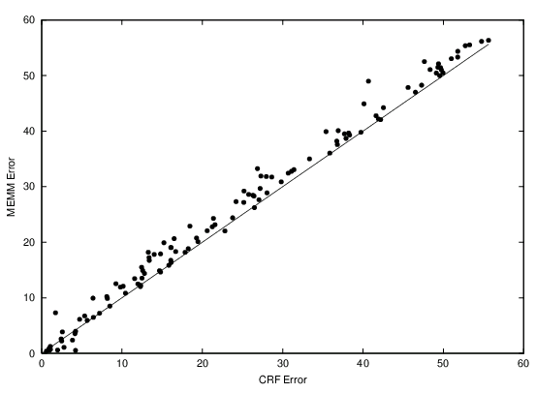
MEMM vs. CRF

Slide 20
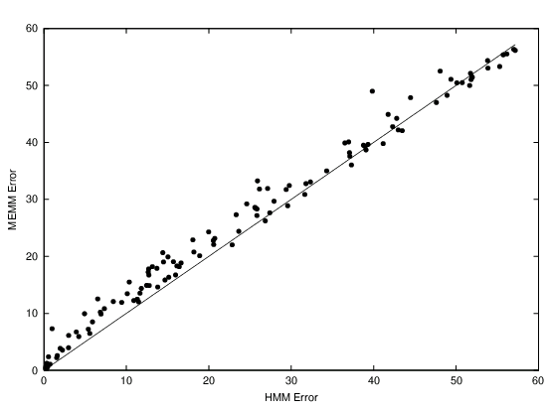
MEMM vs. HMM

Slide 21
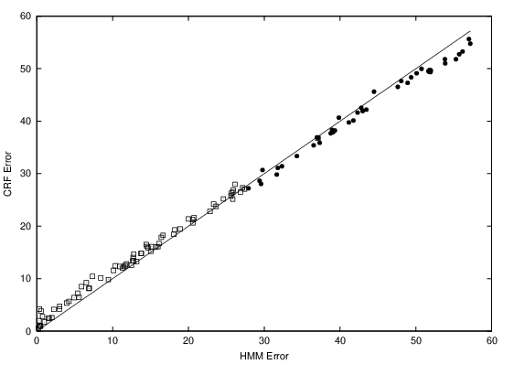
CRF vs. HMM

Slide 22
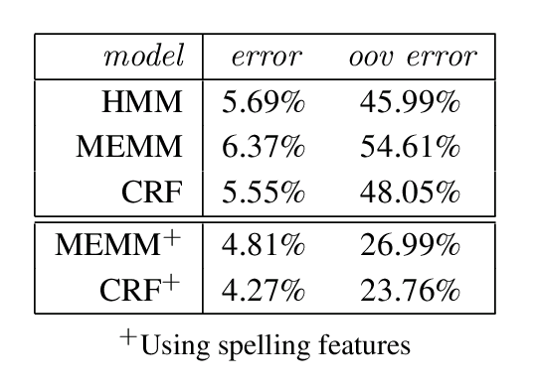
Experiment 3: Part-of-speech Tagging
Each word to be labeled with one of 45 syntactic tags.
50%-50% train-test split
out-of-vocabulary (oov) words: not observed in the training set

Slide 23
Part-of-speech Tagging
Second set of experiments: add small set of orthographic features (whether word is capitalized, whether word ends in –ing, -ogy, -ed, -s, -ly …)
Overall error rate reduced by 25% and oov error reduced by around 50%

Slide 24
Part-of-speech Tagging
Usually start training with zero parameter vector (corresponds to uniform distribution)
Use optimal MEMM parameter vector as starting point for training corresponding CRF
MEMM⁺ trained to convergence in around 100 iterations; CRF⁺ took additional 1,000 iterations
When starting from uniform distribution, CRF⁺ had not converged after 2,000 iterations

Slide 25
Further Aspects of CRFs
Automatic feature selection
  Start from feature-generating rules and evaluate the benefit of the generated features automatically on data

Slide 26
Conclusions
CRFs do not suffer from the label bias problem!
Parameter estimation guaranteed to find the global optimum
Limitation: Slow convergence of the training algorithm

