Slide 1
Autoencoders
Lecture slides for Chapter 14 of Deep Learning
www.deeplearningbook.org
Ian Goodfellow
2016-09-30

Slide 2
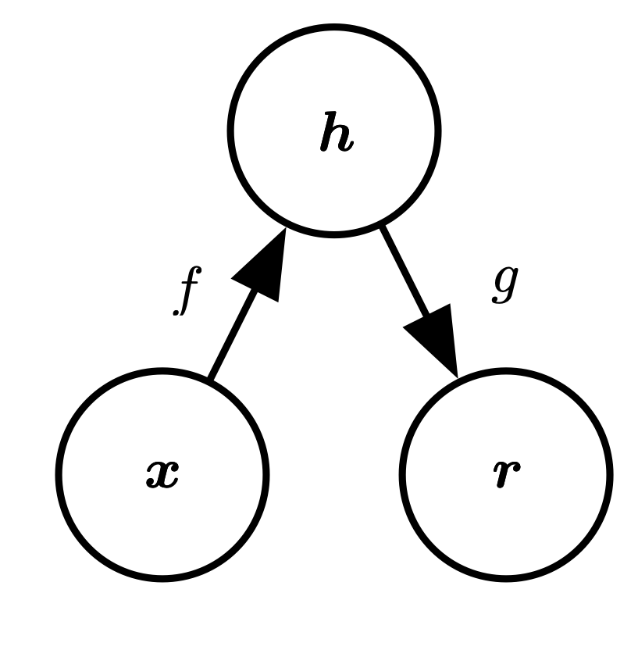
Structure of an Autoencoder
Hidden layer (code)
Input
Reconstruction
Figure 14.1

Slide 3
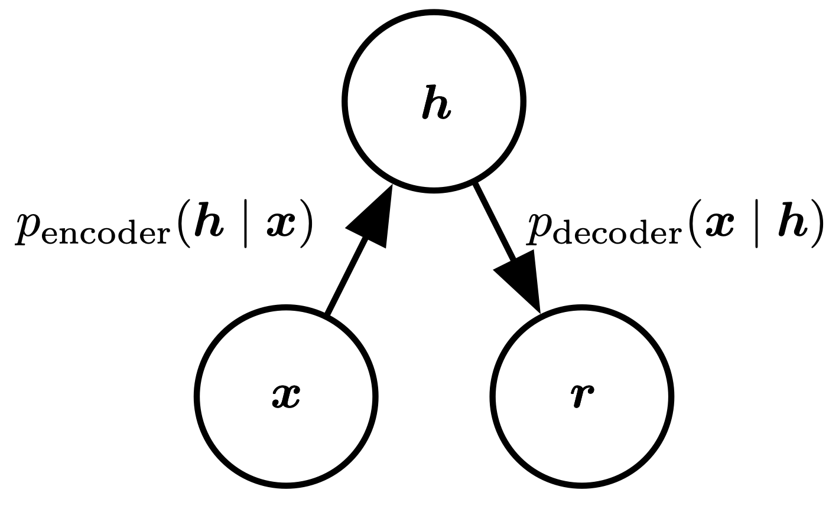
Stochastic Autoencoders
Figure 14.2

Slide 4
Avoiding Trivial Identity
Undercomplete autoencoders
  h has lower dimension than x
  f or g has low capacity (e.g., linear g)
  Must discard some information in h
Overcomplete autoencoders
  h has higher dimension than x
  Must be regularized

Slide 5
Regularized Autoencoders
Sparse autoencoders
Denoising autoencoders
Autoencoders with dropout on the hidden layer
Contractive autoencoders

Slide 6
Sparse Autoencoders
Limit capacity of autoencoder by adding a term to the cost function penalizing the code for being larger
Special case of variational autoencoder
  Probabilistic model
  Laplace prior corresponds to L1 sparsity penalty
  Dirac variational posterior

Slide 7
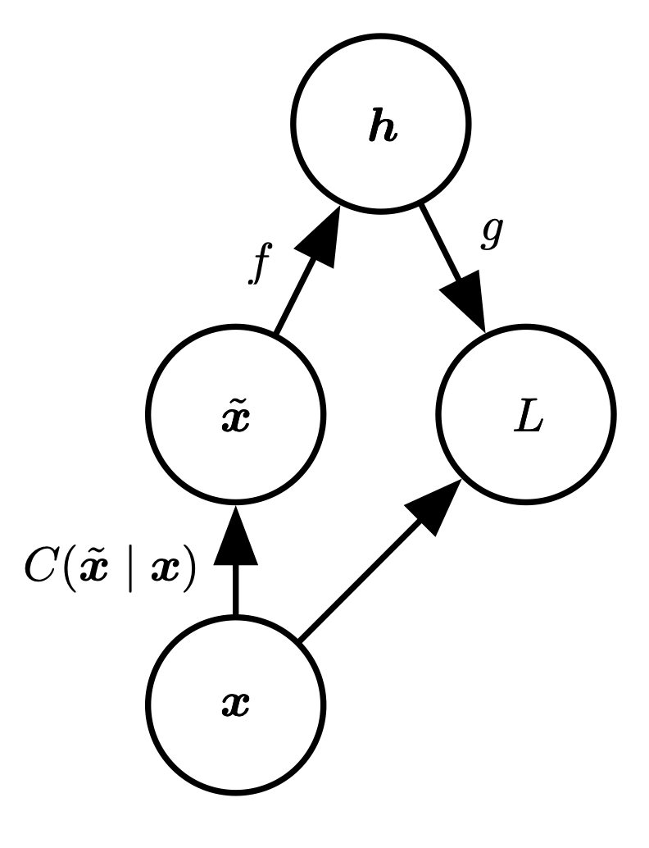
Denoising Autoencoder
C: corruption process
(introduce noise)
Figure 14.3

Slide 8
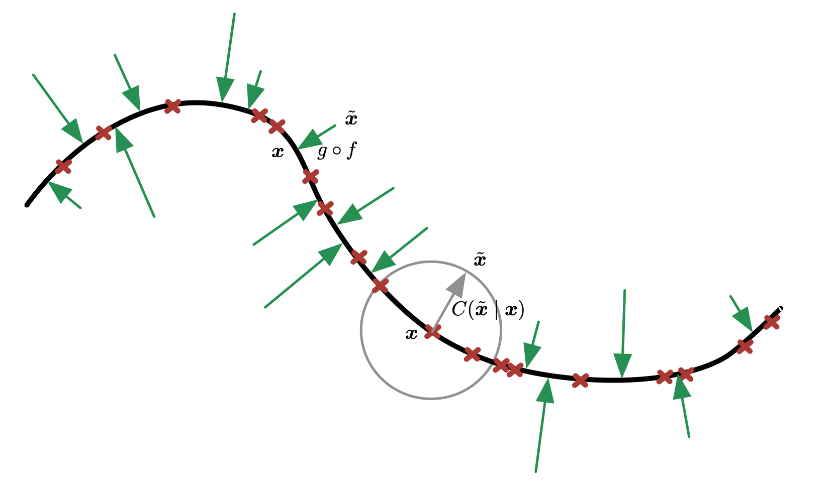
Denoising Autoencoders Learn a Manifold
Figure 14.4

Slide 9
Score Matching
Score:
Fit a density model by matching score of model to score of data
Some denoising autoencoders are equivalent to score matching applied to some density models

Slide 10
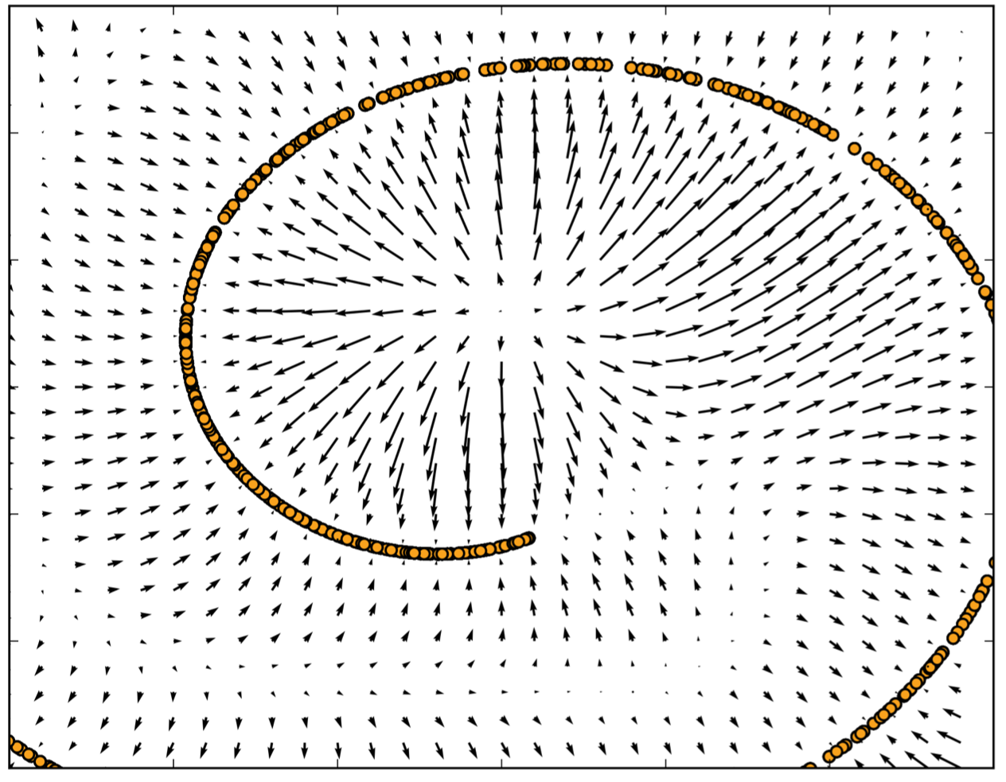
Vector Field Learned by a Denoising Autoencoder
Figure 14.5

Slide 11
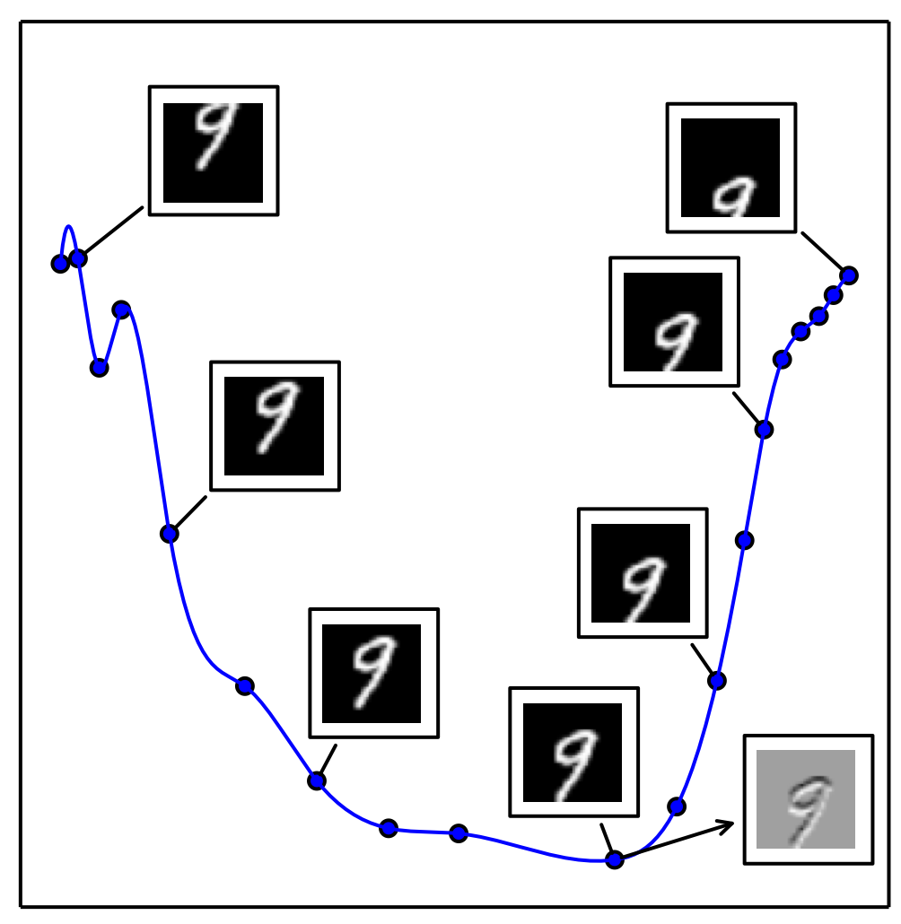
Tangent Hyperplane of a Manifold
Figure 14.6

Slide 12
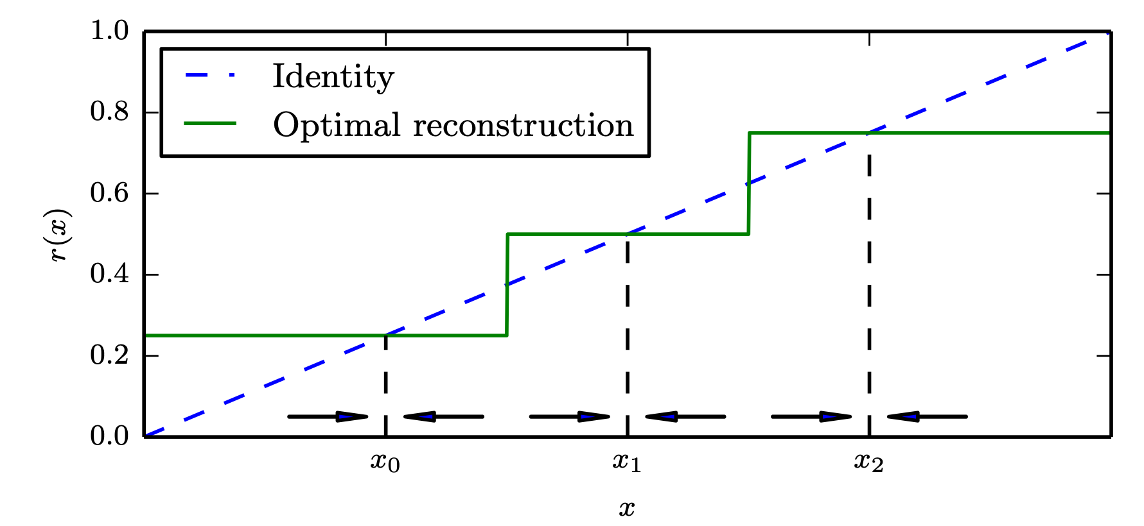
Learning a Collection of 0-D Manifolds by Resisting Perturbation
Figure 14.7

Slide 13
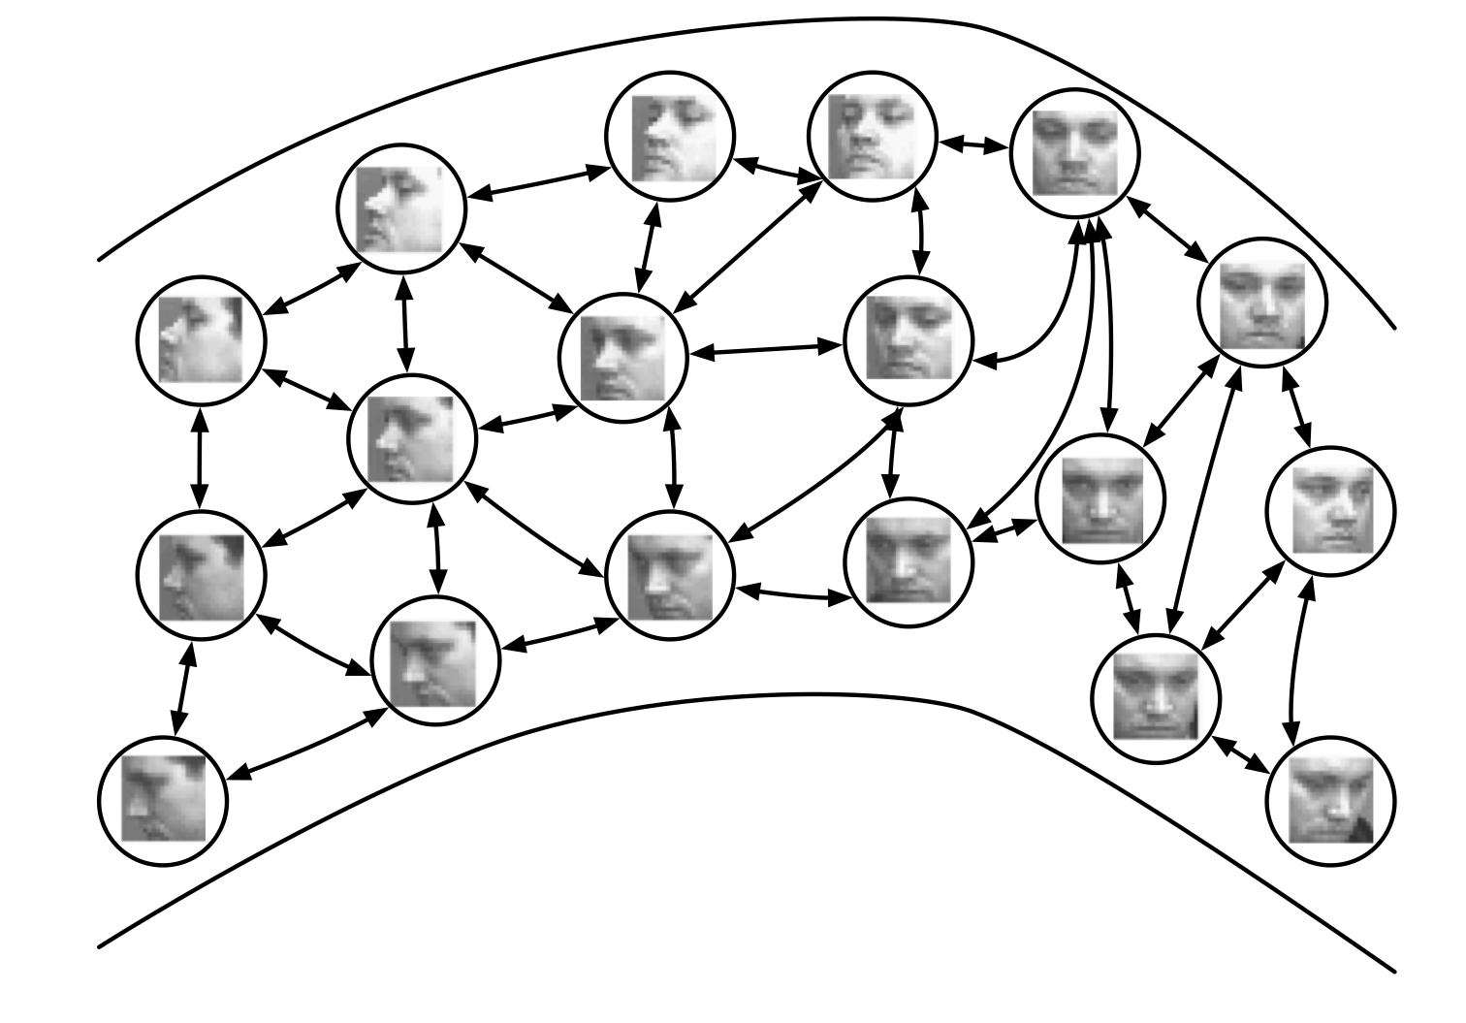
Non-Parametric Manifold Learning with Nearest-Neighbor Graphs
Figure 14.8

Slide 14
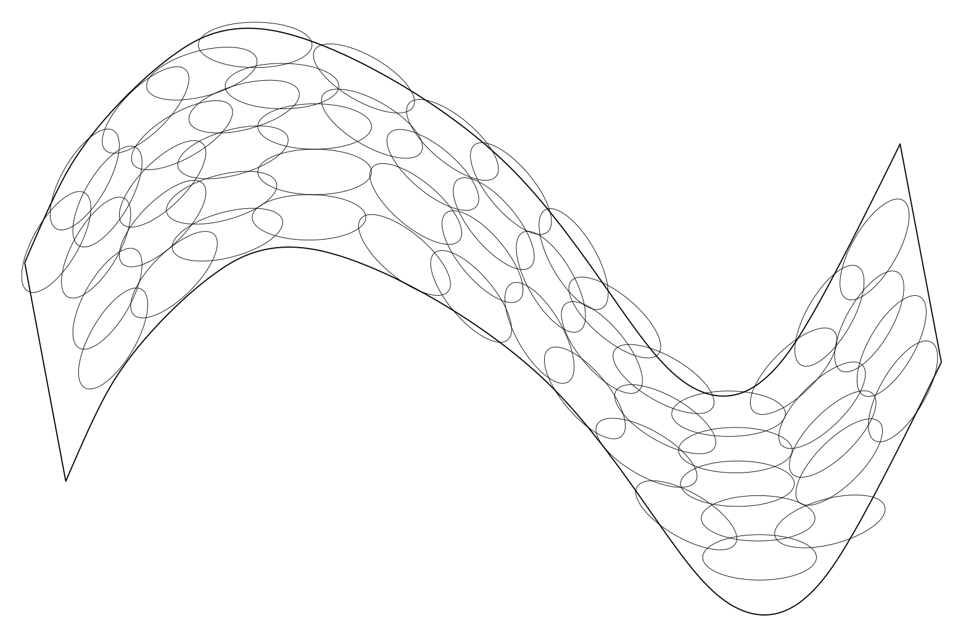
Tiling a Manifold with Local Coordinate Systems
Figure 14.9

Slide 15
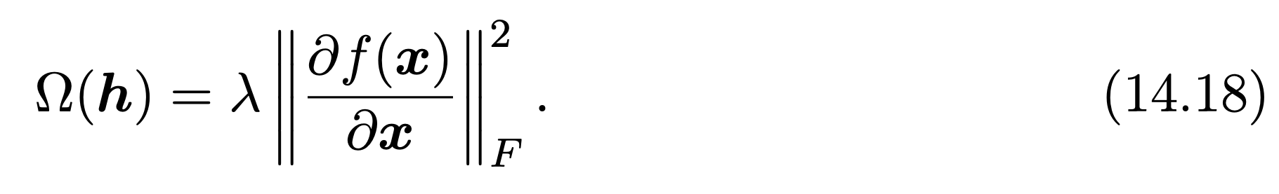
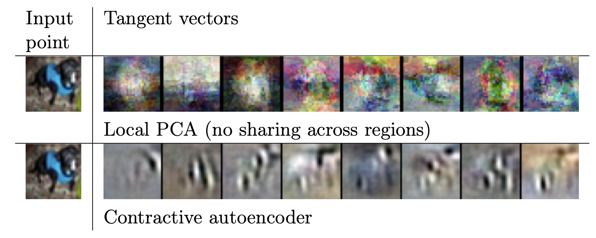
Contractive Autoencoders
Figure 14.10

