Slide 1

Mental Health in Tech
Final Project

Slide 2



Content
1. Intro
2. Problem Statement
3. Business Use-Case
4. EDA
5. Models
6. Key-Features
7. Summary

Slide 3




Introduction
With over 1200 responses, the 2014 Mental Health in Tech Survey was the largest survey done on mental health in the tech industry. The dataset measures attitudes towards mental health and frequency of mental health disorders in the tech workplace.
Source: https://osmihelp.org/research

Slide 4

Problem Statements
1. Create a model that can predict if an employee in the tech-industry would seek out mental-health treatment.
2. Identify the key-features for the predictions.

Slide 5


Business Use-Case
Almost 86% of employees report improved work performance and lower rates of absenteeism after receiving treatment for depression and anxiety.
Employers can increase the ability to retain valuable employees by providing access to mental health benefits.
The models developed here can provide companies with a tool to better understand the mental-health challenges.
Finding cost-cutting methods by removing the need for employees to seek expensive treatments
Source: Journal of Occupational and Environmental Medicine: April 2018 - Volume 60 - Issue 4 - p 322-330, doi: 10.1097/JOM.0000000000001271

Slide 6
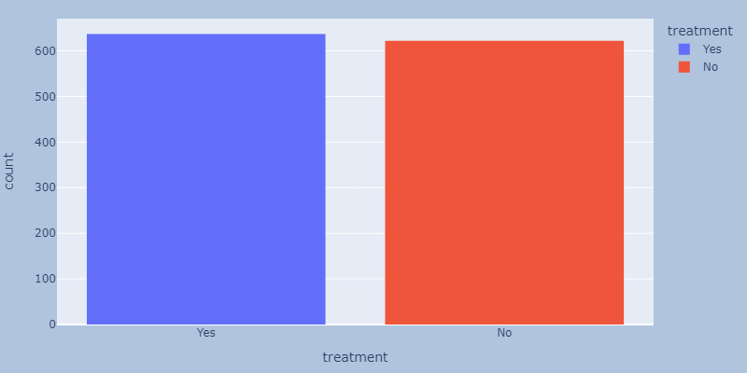
EDA
Have tech-industry employees sought out treatment for a mental health condition?
Almost half of the datasets respondents are seeking treatment. This is a significant ratio.
Treatment is our Dependent Variable

Slide 7
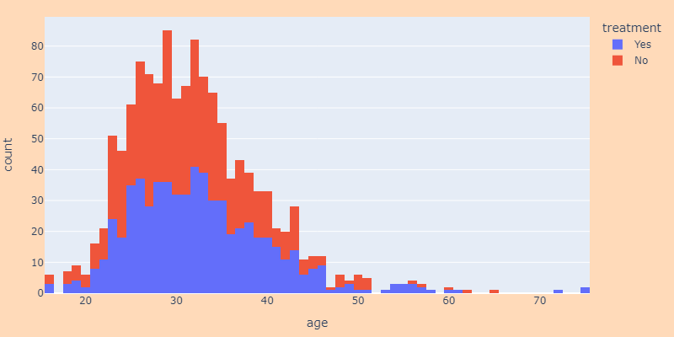
Age
What ages get/do not get treatment?
Most people seeking/and not-seeking mental-health treatment are within the age-range of 25 to 35.
This imbalance is most likely due to the fact that most employees are in that age group.
It does not reveal anything related to age and its propensity to mental-health.

Slide 8
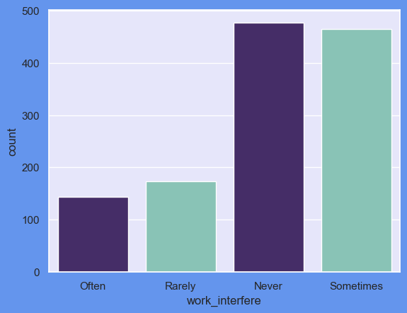
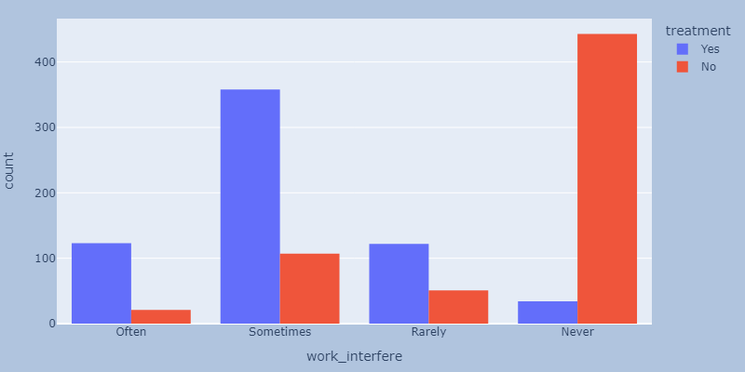
Interference
Does your mental-health cause an interference with your work?
Around 62% of participants have noted that they experience interference at work
The "never" interferes-with-work still contains a number of people that want to get treatment
If it interferes, most choose treatment

Slide 9
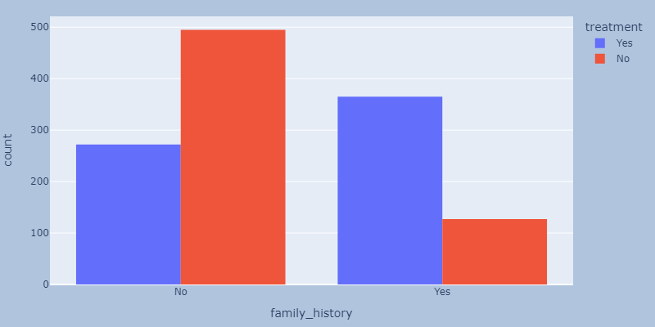
Family-History
Does the employee have a family-history of mental illness?
No: 767
Yes: 492
People who have family history of mental illness are more likely to seek treatment.
Family history is very likely to be an important feature in predicting the choice for treatment.

Slide 10
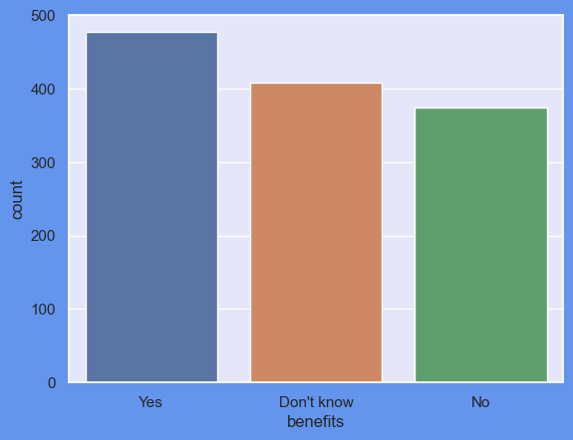
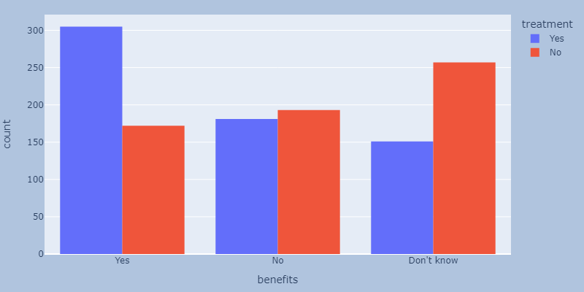
Work Benefits
Does the company you work for provide mental health benefits?
38% of the respondents stated that their company provides them with benefits
Those who responded with "No", 48% of them sought out mental health treatment.
Those who responded with "Yes", 64% of them said that they were seeking treatment
Employer resources are utilized to a larger extent

Slide 11
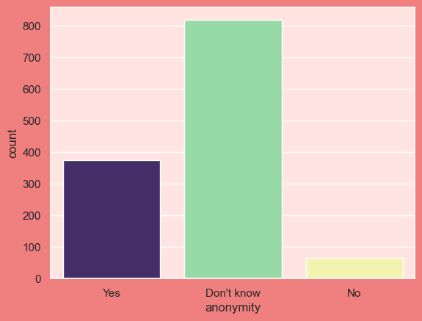
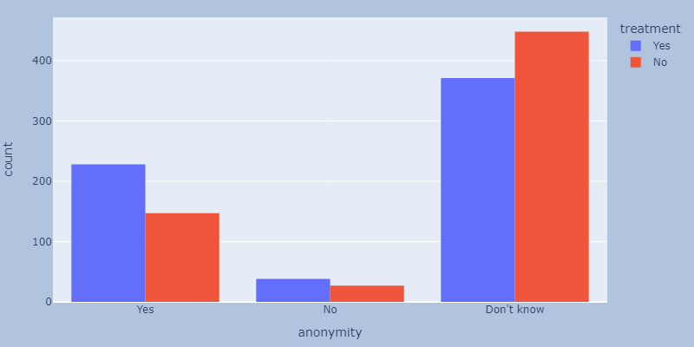
Anonymity
Is your anonymity protected if you choose to take advantage of mental health benefits?
The majority of people do not know if their anonymity is protected. Needs to be addressed.
Respondents with "Yes" show an increased rate of seeking out treatment.
Only 65 respondents said "No". This is a good sign.

Slide 12
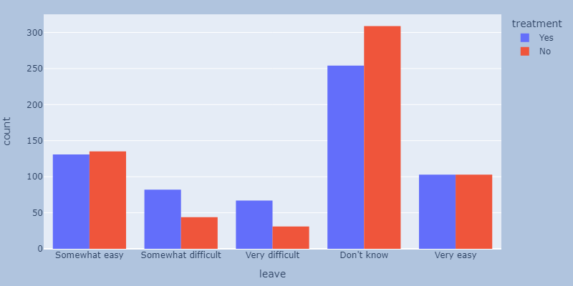
Medical Leave
How easy is it for you to take medical leave for a mental health condition?
Don't know: 563
Somewhat easy: 266
Very easy: 206
Somewhat difficult: 126
Very difficult: 98
This is interesting, because it shows 2 things
I did not expect.
The ratio of treatment-seekers to no-treatment, for those who find it easy to take medical leave, is almost exactly even.
Those who find it difficult to seek medical leave, are more likely to seek treatment. Are those factors related?

Slide 13
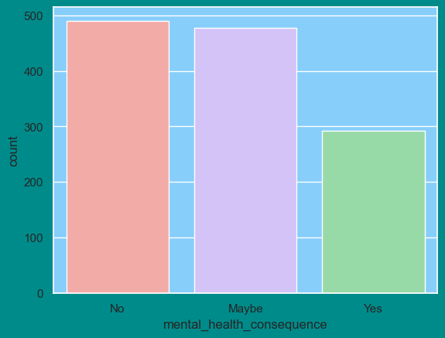
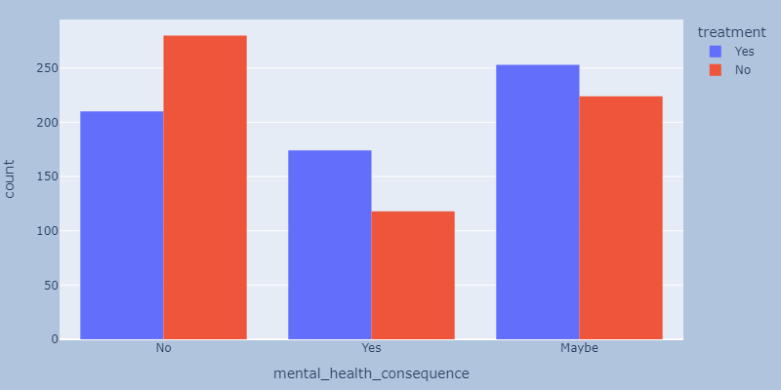
Employer Consequences
Do you think that discussing a mental health issue with your
employer would have negative consequences?
Up to 61% of respondents feel as though sharing their mental-health issues could have negative consequences
The groups who fear repercussions, the majority does seek out treatment
The majority of those who fear no negative consequences, do not seek out treatment
Are those factors related?

Slide 14
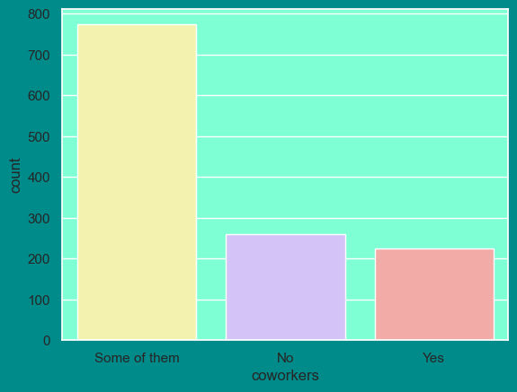
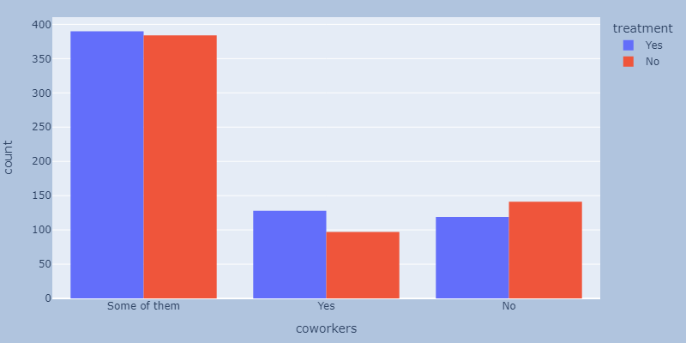
Coworker Trust
Would you be willing to discuss a mental health issue with your coworkers?
Most people ("Some of them" + " Yes" = 79%) would be willing to discuss mental health issues with their coworkers.
In those groups, the majority also seeks out treatment.
Interestingly, for those who feel they have no coworkers to talk to, the majority do not seek out treatment.
This could be due to the perceived social acceptance of mental health issues at work.

Slide 15
Models
Random Forest Classifier
Average Train Accuracy: 0.82
Logistical Regression
Average Train Accuracy: 0.84
KNN-Classifier
Average Train Accuracy: 0.72
Average Test Accuracy: 0.73
Cohen Kappa Score: 0.59
Average Test Accuracy: 0.77
Cohen Kappa Score: 0.60
Winner!
Average Test Accuracy: 0.66
Cohen Kappa Score: 0.42

Slide 16
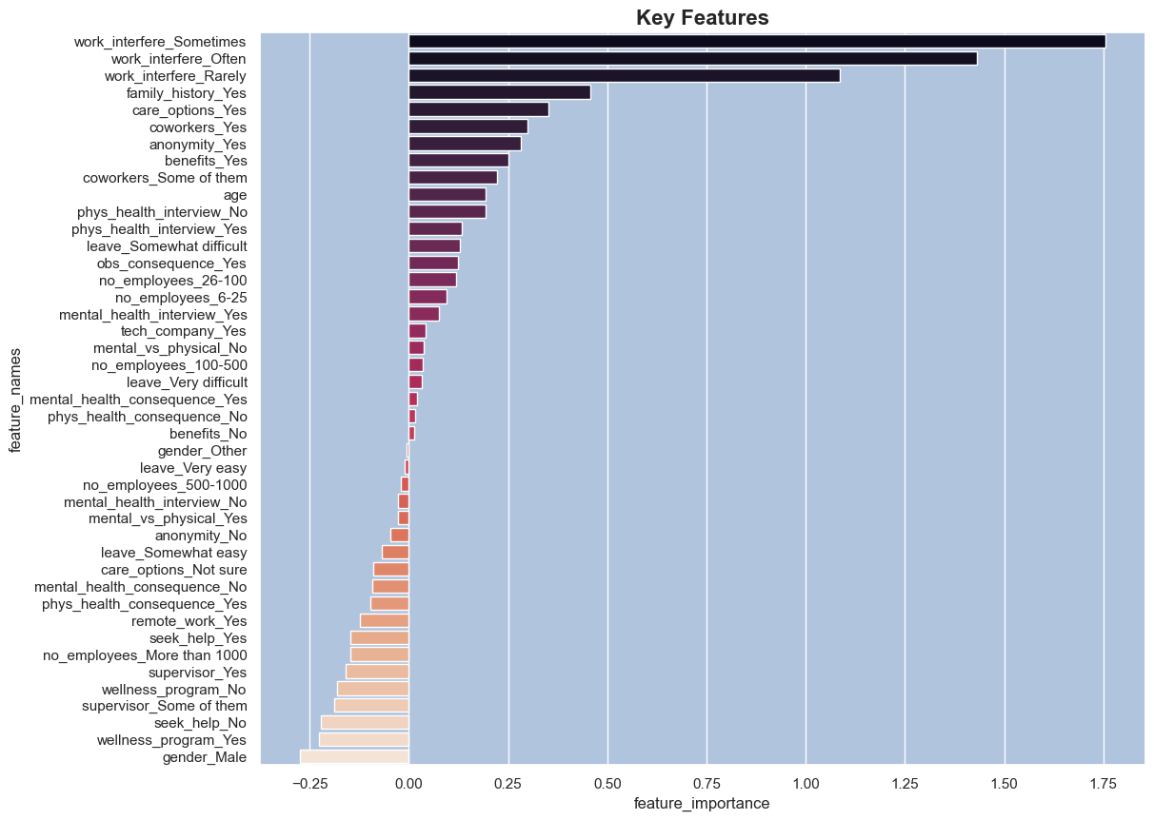
Key-Features
Interference with work is by a large margin the dominant feature …in predicting treatment
Family History, Care Options follow
Talking to coworkers
Anonymity in seeking help
Company benefits related to mental-health
The remaining features appear to be less influential features

Slide 17

Summary
At the job, work benefits, coworker trust and anonymity play an important role in allowing comfortable access to treatment
Difficult medical leaves and fear of consequences from the employer actually show an increased need to employee treatment
Work interference is the largest contributor in predicting whether an employee would seek out treatment
Providing an environment to seek help, free of judgement and negative consequences appears to have a positive impact on employees mental health.

Slide 18
Thank You
Jusef Khayal
jusefkhayal@gmail.com
https://github.com/CaptainDaedalus/FinalProject

