Slide 1

Phishing Awareness Protecting Yourself Online
Stay Safe from Cyber Threats
Muhammad Dilawar Akram
(Cyber Security Intern @ CodeAlpha)

Slide 2

What is Phishing?
• A cybercrime that uses disguised emails, websites, or messages
• Goal: Trick individuals into revealing sensitive information
• Can lead to identity theft, financial loss, and data breaches
• Constantly evolving and becoming more sophisticated

Slide 3
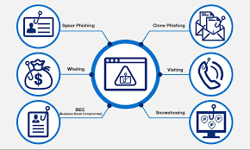
Types of Phishing Attacks
1. Email Phishing
2. Spear Phishing
3. Whaling
4. Smishing (SMS Phishing)
5. Vishing (Voice Phishing)
6. Clone Phishing

Slide 4
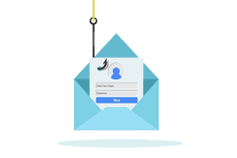
Recognizing Phishing Emails
Urgent or threatening language
Suspicious sender email address
Generic greetings
Requests for sensitive information
Unexpected attachments
Spelling and grammatical errors

Slide 5
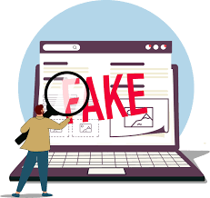
Identifying Fake Websites
Check the URL for misspellings or suspicious domains
Look for 'https://' and the padlock icon
Be wary of pop-up windows asking for credentials
Verify the website's legitimacy through official channels
Use bookmarks for frequently visited sites

Slide 6

Social Engineering Tactics
Impersonation of authority figures
Creating a sense of urgency
Exploiting fear or curiosity
Offering something too good to be true
Pretexting (creating a fabricated scenario)

Slide 7

Best Practices to Avoid Phishing
Be skeptical of unsolicited messages
Don't click on suspicious links or download attachments
Use strong, unique passwords and enable 2FA
Keep software and systems updated
Educate yourself and stay informed about new threats
Report suspected phishing attempts

Slide 8
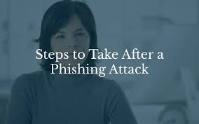
What to Do If You're a Victim
Change
Change passwords immediately
Contact
Contact your bank or credit card company
Monitor
Monitor your accounts for suspicious activity
Report
Report the incident to IT or security team
File
File a report with law enforcement if necessary

Slide 9
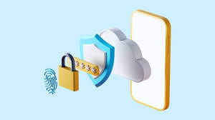
Stay Vigilant, Stay Safe
• Phishing is a serious threat, but awareness is key
• Trust your instincts and verify before acting
• Protect yourself, your data, and your organization
• Remember: If in doubt, reach out to IT support

Slide 10

Thank You

