Slide 1


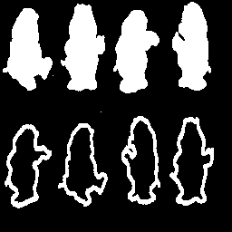
“penn256” image
skeleton?
“bear” image

Slide 2
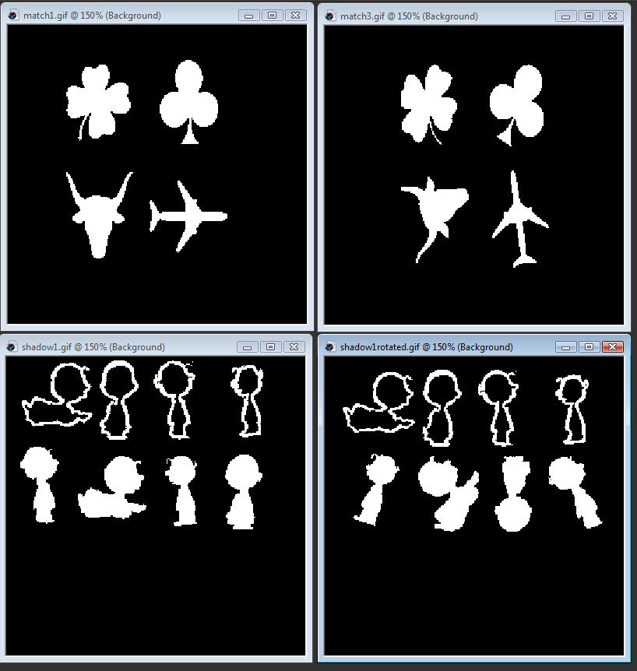
Image “match1”
Minimum
Bounding
Rectangle (MBR) or
Bounding box
Make 4 separate images!

Slide 3
Analysis Sub-Image for the “spade”
Little bigger than MBR? (local knowledge)
Make all sub-images the “same” size?

Slide 4
Image “match3”
Won’t have “perfect” matches with “match1”?

Slide 5
Image “shadow1”
Solid
object

