Slide 1
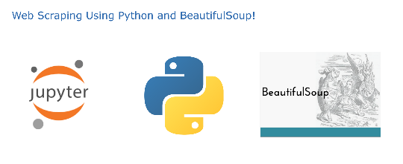








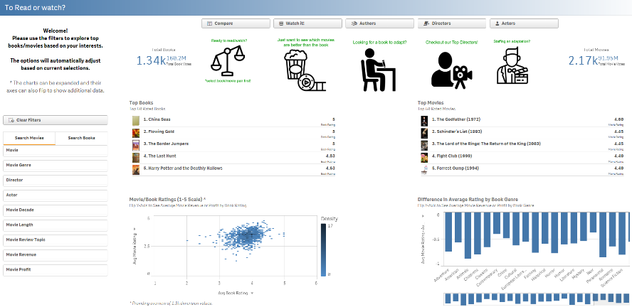




Book-Movie Pairs
(2,262 rows)
Scraped Pairing List
Book
(1339 rows)
LDA Algorithm
Book Topics
(19,433 rows)
Book Genre
(3583 rows)
Book Review Topics
(1,173,776 rows)
Scraped Reviews + REST API
Book Reviews
(228,222 rows)
Qlik Sense Dashboard
Book 1-gram
(7,817,583 rows)
Movie
(2,212 rows)
REST API
Movie Genres
(5,155 rows)
Data Cleansing
LDA Algorithm
.tsv downloads
Movie Topics
(30,617 rows)
Movie Actors
(6,062 rows)
Movie Review Topic
(1,654,241 rows)
Movie Directors
(2,383 rows)
Movie 1-gram
(18,897,919 rows)
Movie Reviews
(263,994 rows)
Scraped Reviews

