Slide 1

About the Presentations
The presentations cover the objectives found in the opening of each chapter.
All chapter objectives are listed in the beginning of each presentation.
You may customize the presentations to fit your class needs.
Some figures from the chapters are included. A complete set of images from the book can be found on the Instructor Resources disc.

Slide 2
Ethics in Information Technology, Third Edition
Chapter 1
An Overview of Ethics

Slide 3
Objectives
As you read this chapter, consider the following questions:
  What is ethics, and why is it important to act according to a code of ethics?
  Why is business ethics becoming increasingly important?
  What are organizations doing to improve their business ethics?
Ethics in Information Technology, Third Edition

Slide 4
Objectives (cont’d.)
  Why are organizations interested in fostering good business ethics?
  What approach can you take to ensure ethical decision making?
  What trends have increased the risk of using information technology in an unethical manner?
Ethics in Information Technology, Third Edition

Slide 5
What is Ethics?
Moral code
  Set of rules
  Establishes boundaries of generally accepted behavior
  Different rules often have contradictions
Morality
  Social conventions about right and wrong
  Widely shared
Ethics in Information Technology, Third Edition

Slide 6
What is Ethics? (cont’d.)
Morality may vary by:
  Age
  Cultural group
  Ethnic background
  Religion
  Life experiences
  Education
  Gender
Ethics in Information Technology, Third Edition

Slide 7
Definition of Ethics
Ethics
  Set of beliefs about right and wrong behavior
Ethical behavior conforms to social norms
Virtues
  Habits that incline people to do what is acceptable
Vices
  Habits of unacceptable behavior
Virtues and vices define a personal value system
  Scheme of moral values
Ethics in Information Technology, Third Edition

Slide 8
The Importance of Integrity
Integrity is a cornerstone of ethical behavior
People with integrity:
  Act in accordance with a personal code of principles
  Extend to all the same respect and consideration
  Apply the same moral standards in all situations
Ethics in Information Technology, Third Edition

Slide 9
The Difference Between Morals,
Ethics, and Laws
Morals: one’s personal beliefs about right and wrong
Ethics: standards or codes of behavior expected of an individual by a group
Law: system of rules that tells us what we can and cannot do
  Laws are enforced by a set of institutions
  Legal acts conform to the law
  Moral acts conform to an individual’s belief
Ethics in Information Technology, Third Edition

Slide 10
Ethics in the Business World
Risk is the product of multiplying the likelihood of an event by the impact of its occurrence
Risks associated with inappropriate behavior have increased due to:
  Globalization creating complex work environments
  Organizations challenged to maintain profits / revenue
  Heightened vigilance by:
    Employees
    Shareholders
    Regulatory agencies
Ethics in Information Technology, Third Edition

Slide 11
Ethics in the Business World (cont’d.)
Recent scandals in IT companies
  WorldCom
  Qwest Communications International Inc.
  Adelphia Communications Corp.
  Computer Associates (CA)
  Hewlett-Packard
  Comverse Technology
  Satyam Computer Services (India)
Ethics in Information Technology, Third Edition

Slide 12
Why Fostering Good Business Ethics
Is Important
To gain the good will of the community
To create an organization that operates consistently
To produce good business practices
To protect organization/employees from legal action
To avoid unfavorable publicity
Ethics in Information Technology, Third Edition

Slide 13
Gaining the Good Will of the Community
Fundamental responsibilities to society
  Declared in formal statement of company’s principles or beliefs
  Include:
    Making contributions to charitable organizations and nonprofit institutions
    Providing benefits for employees in excess of legal requirements
    Choosing economic opportunities that might be more socially desirable than profitable
Ethics in Information Technology, Third Edition

Slide 14
Gaining the Good Will of the Community (cont’d.)
Socially responsible activities create good will
Good will makes it easier for corporations to conduct business
Ethics in Information Technology, Third Edition

Slide 15
Creating an Organization That Operates Consistently
Many companies share the following values:
  Operate with honesty and integrity, staying true to organizational principles
  Operate according to standards of ethical conduct, in words and action
  Treat colleagues, customers, and consumers with respect
  Strive to be the best at what matters to the company
  Value diversity
  Make decisions based on facts and principles
Ethics in Information Technology, Third Edition

Slide 16
Fostering Good Business Practices
Good ethics means good business/improved profits
Companies that:
  Produce safe and effective products
    Avoid costly recalls and lawsuits
  Provide excellent service retain customers
  Develop and maintain strong employee relations
    Suffer lower turnover rates
    Enjoy better employee morale
Ethics in Information Technology, Third Edition

Slide 17
Fostering Good Business Practices (cont’d.)
Suppliers/business partners place priority on companies that operate in a fair and ethical manner
Bad ethics means bad business/waning profits
  Bad ethics can lead to bad business results
  Bad ethics can have a negative impact on employees
Ethics in Information Technology, Third Edition

Slide 18
Protecting the Organization and Its Employees from Legal Actions
U.S. Supreme Court established that an employer can be held responsible for the acts of its employees
U.S. Justice Department sentencing guidelines suggest more lenient treatment for convicted executives if their companies had ethics programs
Fines for criminal violations can be lowered by up to 80 percent if the organization has implemented an ethics management program and cooperates with authorities
Ethics in Information Technology, Third Edition

Slide 19
Avoiding Unfavorable Publicity
Public reputation of company strongly influences:
  Value of its stock
  How consumers regard products and services
  Degree of oversight received from government
  Amount of support and cooperation received
Organizations are motivated to build strong ethics programs to avoid negative publicity
Ethics in Information Technology, Third Edition

Slide 20
Improving Corporate Ethics
Characteristics of a successful ethics program
  Employees willing to seek advice about ethical issues
  Employees feel prepared to handle situations that could lead to misconduct
  Employees are rewarded for ethical behavior
  Employees are not rewarded for success obtained through questionable means
  Employees feel positive about their company
Ethics in Information Technology, Third Edition

Slide 21
Appointing a Corporate Ethics Officer
Corporate ethics officer
  Provides vision and leadership in business conduct
  Ensures ethical procedures are put in place
  Creates and maintains ethics culture
  Is responsible for key knowledge/contact person for ethical issues
Ethics in Information Technology, Third Edition

Slide 22
Ethical Standards Set by Board of Directors
Board responsible for supervising management
Board members of company are expected to:
  Conduct themselves according to the highest standards of personal and professional integrity
  Set standard for company-wide ethical conduct
  Ensure compliance with laws and regulations
  Create environment in which employees can seek advice about business conduct
Ethics in Information Technology, Third Edition

Slide 23
Establishing a Corporate Code of Ethics
Code of ethics
  Highlights an organization’s key ethical issues
  Identifies overarching values and important principles
  Focuses employees on areas of ethical risk
  Cannot gain company-wide acceptance unless it is:
    Developed with employee participation
    Fully endorsed by organization’s leadership
  Must continually be applied to company’s decision making and emphasized as part of its culture
Ethics in Information Technology, Third Edition

Slide 24
Establishing a Corporate
Code of Ethics (cont’d.)
Sarbanes-Oxley Act of 2002
  Enacted in response to public outrage over several major accounting scandals
  Section 404 requires that the CEO and CFO sign any SEC filing to attest to its accuracy
  Section 406 requires public companies to disclose whether or not they have a code of ethics
Ethics in Information Technology, Third Edition

Slide 25
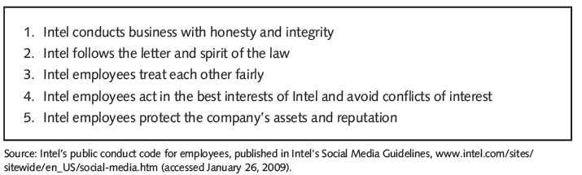
Establishing a Corporate
Code of Ethics (cont’d.)
Figure 1-3 Intel’s five principles of conduct
Ethics in Information Technology, Third Edition

Slide 26
Conducting Social Audits
Social audit
  Reviews how well organization is meeting ethical and social responsibility goals
  Communicates new goals for upcoming year
Ethics in Information Technology, Third Edition

Slide 27
Requiring Employees to
Take Ethics Training
Personal convictions improved through education
Comprehensive ethics education program encourages employees to act responsibly and ethically
  Often presented in small workshop formats
  Employees apply code of ethics to hypothetical but realistic case studies
  Demonstration of recent company decisions based on principles from the code of ethics
Ethics in Information Technology, Third Edition

Slide 28
Including Ethical Criteria in
Employee Appraisals
Some companies base a portion of employee performance evaluations on:
  Treating others fairly and with respect
  Operating effectively in a multicultural environment
  Accepting personal accountability
  Continually developing themselves and others
  Operating openly and honestly with all
Ethics in Information Technology, Third Edition

Slide 29
Creating an Ethical Work Environment
Good employees may make bad ethical choices
May be encouraged to do “whatever it takes” to get the job done
Employees need a knowledgeable resource to discuss perceived unethical practices
Ethics in Information Technology, Third Edition

Slide 30
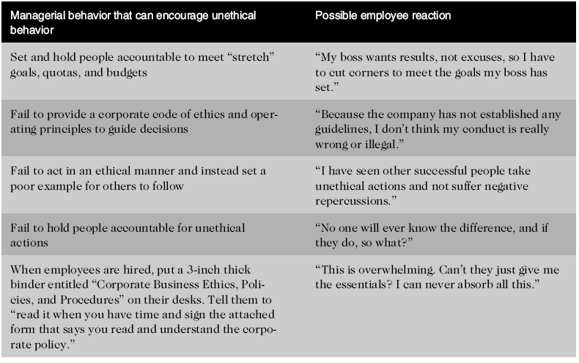
Creating an Ethical Work Environment (cont’d.)
Table 1-3 How management can affect employees’ ethical behavior
Ethics in Information Technology, Third Edition

Slide 31
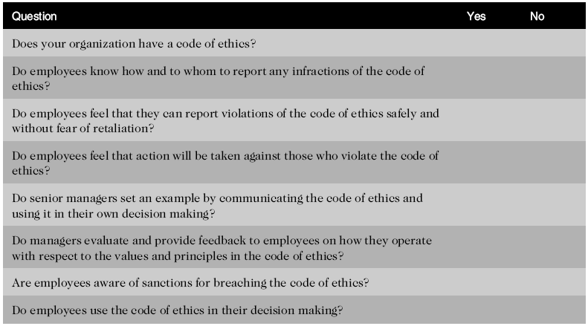
Creating an Ethical Work Environment (cont’d.)
Table 1-4 A manager’s checklist for establishing an ethical work environment
Ethics in Information Technology, Third Edition

Slide 32
Including Ethical Considerations in Decision Making
Steps in a decision making process
  Develop problem statement
    Get the facts; make no assumptions
    Identify stakeholders and their positions
  Identify alternatives
    Involve stakeholders in brainstorming
  Evaluate and choose alternative
    Apply laws, guidelines, policies, and principles
    Evaluate impact on organization
Ethics in Information Technology, Third Edition

Slide 33
Including Ethical Considerations Decision Making (cont’d.)
Implement decision
  Develop and execute implementation plan
  Provide leadership to overcome resistance
Evaluate results
  Evaluate against success criteria
  Monitor any unintended consequences
Success
Ethics in Information Technology, Third Edition

Slide 34
Develop a Problem Statement
Clear, concise description of the issue
Answers these questions:
  What causes people to think there is a problem?
  Who is directly affected by the problem?
  Is there anyone else affected?
  How often does it occur?
  What is the impact of the problem?
  How serious is the problem?
Most critical step in decision-making process
Ethics in Information Technology, Third Edition

Slide 35
Develop a Problem Statement (cont’d.)
Example of a good problem statement:
  “Our product supply organization is continually running out of stock of finished products, creating an out-of-stock situation on over 15 percent of our customer orders, resulting in over $300,000 in lost sales per month.”
Examples of poor problem statements:
  “We need to implement a new inventory control system.” (possible solution, not a problem statement)
  “We have a problem with finished product inventory.” (not specific enough)
Ethics in Information Technology, Third Edition

Slide 36
Identify, Evaluate, and Choose an Alternative
Enlist help to brainstorm alternative solutions
Evaluate by weighing laws, guidelines, and principles
Consider likely consequences of each alternative
Alternative selected must:
  Be ethically and legally defensible
  Be consistent with policies and code of ethics
  Take into account impact on others
  Provide a good solution to problem
Ethics in Information Technology, Third Edition

Slide 37
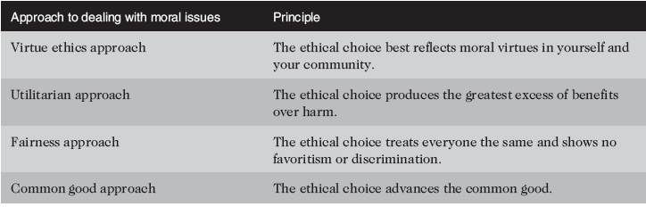
Including Ethical Considerations Decision Making (cont’d.)
Table 1-5 Four common approaches to ethical decision making
Ethics in Information Technology, Third Edition

Slide 38
Virtue Ethics Approach
Virtue ethics approach
  Focuses on concern with daily life in a community
  People guided by virtues to reach “right” decision
  More effective than following set of principles/rules
Problems
  Does not provide guide for action
  Virtue cannot be worked out objectively; depends on circumstances
Ethics in Information Technology, Third Edition

Slide 39
Utilitarian Approach
Utilitarian approach
  Chooses action that has best overall consequences
  Finds the greatest good by balancing all interests
  Fits concept of value in economics and the use of cost-benefit analysis
Problems
  Measuring and comparing values is often difficult
  Predicting resulting benefits and harm is difficult
Ethics in Information Technology, Third Edition

Slide 40
Fairness Approach
Fairness approach
  Focuses on fair distribution of benefits/burdens
  Guiding principle is to treat all people the same
Problems
  Decisions can be influenced by personal bias
  Others may consider the decision unfair
Ethics in Information Technology, Third Edition

Slide 41
Common Good Approach
Common good approach
  Work together for common set of values and goals
  Implement systems that benefit all people
Problems
  Consensus is difficult
  Some required to bear greater costs than others
Ethics in Information Technology, Third Edition

Slide 42
Implement the Decision and
Evaluate the Results
Implement the decision
  Efficient, effective, timely implementation
  Communication is key for people to accept change
  Transition plan made easy and pain-free
Evaluate the results
  Monitor results for desired effect
  Observe impact on organization and stakeholders
  Further refinements may be needed
Ethics in Information Technology, Third Edition

Slide 43
Ethics in Information Technology
Public concern about the ethical use of information technology includes:
  E-mail and Internet access monitoring
  Downloading in violation of copyright laws
  Unsolicited e-mail (spam)
  Hackers and identify theft
  Students and plagiarism
  Cookies and spyware
Ethics in Information Technology, Third Edition

Slide 44
Ethics in Information Technology (cont’d.)
The general public does not understand the critical importance of ethics as applied to IT
Important technical decisions are often left to technical experts
General business managers must assume greater responsibility for these decisions by:
  Making decisions based on technical savvy, business know-how, and a sense of ethics
  Creating an environment where ethical dilemmas can be discussed openly, objectively, and constructively
Ethics in Information Technology, Third Edition

Slide 45
Ethics in Information Technology (cont’d.)
Goals of this text
  To educate people about the tremendous impact of ethical issues in the successful and secure use of information technology
  To motivate people to recognize these issues when making business decisions
  To provide tools, approaches, and useful insights for making ethical decisions
Ethics in Information Technology, Third Edition

Slide 46
Summary
Ethics is important because the risks associated with inappropriate behavior have increased
Organizations have at least five good reasons for promoting employees to act ethically
  To gain the good will of the community
  To create an organization that operates consistently
  To foster good business practices
  To protect the against legal action
  To avoid unfavorable publicity
Ethics in Information Technology, Third Edition

Slide 47
Summary (cont’d.)
Organizations require successful ethics programs
The corporate ethics officer ensures that ethical procedures are installed and followed
Managers’ behavior and expectations can strongly influence employees’ ethical behavior
Most of us have developed a simple decision-making model that includes five steps
Ethical considerations must be incorporated into decision making
Ethics in Information Technology, Third Edition

Slide 48
Summary (cont’d.)
Four common approaches to ethical decision making
  Virtue ethics approach
  Utilitarian approach
  Fairness approach
  Common good approach
Ethics in Information Technology, Third Edition

