Slide 1

6
WELCOME
BS IT JUNIORS & SENIORS
ITETHIC
Theme: Lasallian Achiever for God & Country
Creative & Critical Thinkers
Reflective Life-long Learners
Effective Communicators
Service-Driven Citizens
Expected Lasallian Graduate Attributes

Slide 2

Glory to the Father, to the Son, and to the Holy Spirit…
AS IT WAS IN THE BEGINNING,
IS NOW AND WILL BE, FOREVER. AMEN.

Slide 3
6
WELCOME
BS IT JUNIORS & SENIORS
ITETHIC
Theme: Lasallian Achiever for God & Country
Creative & Critical Thinkers
Reflective Life-long Learners
Effective Communicators
Service-Driven Citizens
Expected Lasallian Graduate Attributes

Slide 4
GRADING SYSTEM:
The students will be graded according to the following:
Group Research and Presentation - 30 %
  Group Lecture (20)
  Learning Activity (10)
Film Reviews - 20%
Departmental Exam - 20%
Class-Based Activities - 10 %
Contract - 10%
Attendance - 10%
TOTAL 100%

Slide 5

Ethics
Ethical Principles:
RIGHTS
COMMON GOOD
JUSTICE
CARE
VIRTUE

Slide 6
Why Ethics?
Ethics
The future of society depends on it
The number of scandals involving unethical behavior in business & government is increasing
The number of Cyber Activities involving ethics are also proliferating

Slide 7
What is Ethics?
Ethics
The basis for developing a sound conscience
The study of how to determine, through reason & values, the rightness or wrongness of a behavior, policy or institution

Slide 8
What is Ethical Management?
Ethics
guided by sound principles of what is right and wrong; also called principle-management
we need role models’ principled management for others to emulate
builds a climate of trustworthiness in organizations and in the society

Slide 9
What is Unethical Management?
Ethics
purely guided by self-interest, even at the expense of others
treats others as things to be used rather than as persons to be respected and treated with dignity
develops a climate of distrust in organizations and in the society

Slide 10
The Critical Role of Core Values
“When values are sufficient, laws are unnecessary…
When values are insufficient, laws are unenforceable.”
Emile Durkheim 1858-1917 French social scientist

Slide 11
Ethics
Ethical Principles:
RIGHTS
COMMON GOOD
JUSTICE
CARE
VIRTUE

Slide 12
Ethical Principle 1:
RIGHTS
Ethics
Does the act respect the moral rights of everyone concerned?
Does it treat everyone as person and not merely as things?
Examples: right to privacy, due process

Slide 13
When you want something you have never had, you have got to do something you have never done.

Slide 14
Ethical Principle 2:
COMMON GOOD
Ethics
Who benefits from the act? Who are burdened?
Does the act maximize the total net benefit to everyone concerned?
Examples: order, health, safety

Slide 15
Sometimes you have to do things you hate to create something you love.

Slide 16
Ethical Principle 3:
JUSTICE
Ethics
Will the act lead to a fair distribution of benefits & burdens?
If it will cause inequality, will it improve the situation of the least advantaged persons?
Examples: avoiding conflicts of interest, being impartial

Slide 17
Whatsoever you do to the least of my brethren, that you do unto Me.
- Jesus Christ

Slide 18
Ethical Principle 4:
CARE
Ethics
Does the act show proper care to people we have special relationships with?
Will it earn the trust of people we value?
Examples: showing concern for friends & family

Slide 19
Trials are not the reason to give up, but a challenge to improve yourself.
Pain is not an excuse to back out, but an inspiration to move on.

Slide 20
Ethical Principle 5:
VIRTUE
Ethics
Will the act help me develop my character?
Will it make me a better person?
Examples: keeping promises, being wise

Slide 21
CASE 1
A student organization announced during membership recruitment that they would be giving tutorial sessions on difficult subjects for members. This encouraged many students to join. By the end of the year, no tutorial sessions had been conducted.

Slide 22
CASE 2
A student leader was running for a higher position in the elections. Her main contender for the position was popular among the members. She heard rumors that her contender had been involved in questionable financial dealings. She used this rumor in her campaign speeches.

Slide 23
What managers can do to build a climate of Ethics
1. Practice using the ethical principles when making decisions; take your time & do not rush
2. Educate all employees on the ethical principles
3. Practice on test cases
4. Model the use of the principles to members
5. Develop a code of ethics
6. Do not pre-judge others

Slide 24
We must become the change we want to see - Mahatma Gandhi
Management is all about getting things done & helping people reach their potential - Anonymous
Go study, study, study … and meditate well what you study… On this battlefield a human being has no better weapon than his/her intelligence, no other force than his/her heart - Jose Rizal

Slide 25
Ethical Theories:
Natural Law
Social Contract
Deontological
Consequentialist
The Ethics of Jesus
Ethics

Slide 26
Natural Law Ethics
What is good? Behaving in a manner appropriate to one’s nature, and developing this nature to its fullest extent, is good.
There is a universal moral nature common to all humans, and there is a universal law, called the natural law, defined by this moral nature.
One can know the natural law through reason.

Slide 27
Social Contract Theory
What is good? Obeying the social contract is good.
What is a social contract? It is an agreement voluntarily (possibly even tacitly) entered into by individuals for their sake (self-preservation) and that of the common good.
Government exists to realize the social contract.

Slide 28
Deontological Theory
What is good? Doing one’s duty is good.
What is a duty? A duty (categorical imperative) is a moral obligation that one must fulfill regardless of circumstance or personal desires.
Why should man fulfill his duty? Because he is rational (can reason) and autonomous (has free will).

Slide 29
Consequentialist Theories
What is good? Acting so as to maximize pleasure and minimize pain is good.
Views on what constitutes pleasure range from the selfish (epicureanism) to the altruistic (altruistic utilitarianism).

Slide 30
The Ethics of Jesus
Jesus’ ethics can be seen primarily from the:
Sermon on the Mount (Matthew 5-7) and the Parables
Greatest commandment (Matthew 22:37-40)
Upper Room Discourse (John 13-17)

Slide 31
The Virtues of the Kingdom
From the Sermon on the Mount (Matthew 5-7):
Humility before God
Holiness
The Fruit of the Spirit (Galatians 5:22)

Slide 32
The Duties of God’s People
From the Great Commandment (Matthew 22:37-40):
To love God with all of one’s being
To love others as oneself (a.k.a. the Golden Rule (Matthew 7:12): Do to others what you would have them do to you.)
From the Upper Room Discourse (John 13-17)
To love the brethren as Jesus loved

Slide 33
The Need to Bear Fruit
From the Upper Room Discourse (John 15:8):
“This is to my Father’s glory, that you bear much fruit, showing yourselves to be my disciples.”
What kinds of fruit?
  Changed lives
  Saved souls
  Good works

Slide 34

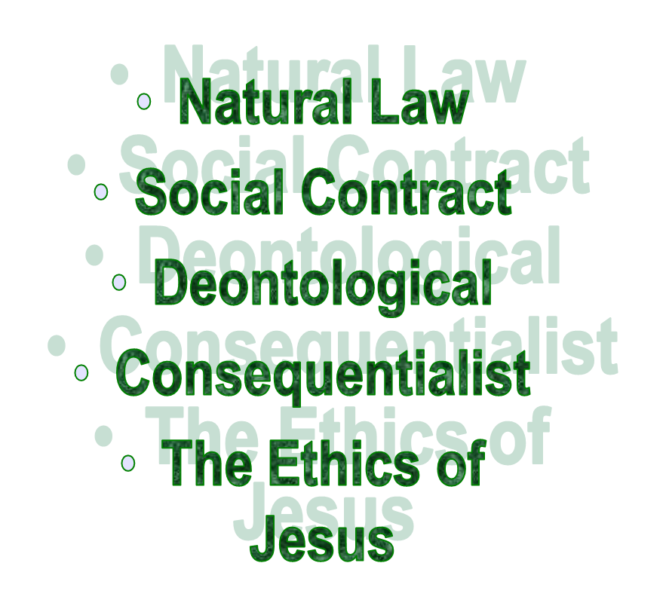
Ethical Principles & Theories

Slide 35

Short Film Videos

Slide 36
For this term’s
Course
GROUP RESEARCH & PRESENTATION TOPICS & APPLICATION/DEBATE
June 7 An Overview of Ethics (Chapter 1)
June 14 Ethics in the ICT Workplace (Chapter 2, Appendix B)
June 19 Ethics of IT Organizations (Chapter 10, Appendices C-D)
June 21 Computer and Internet Crime (Chapter 3)
June 28 Privacy and ICT (Chapter 4)
June 26 tentative (holiday?)
July 3 Review Game July 10 DepEx 1
July 12 Freedom of Expression and ICT (Chapter 5)
July 17 Intellectual Property and ICT (Chapter 6)
July 19 Software Development (Chapter 7)
July 24 Impact of ICT on Productivity & Quality of Life (Chapter 8)
July 26 Social Networking and ICT (Chapter 9)
July 31 Film Showing
Aug 2 Review Game Aug 7 DepEx 2
S16
Grp6
Grp2
Grp3
Grp9
Grp1
Grp7
Grp4
Grp8
Grp5

Slide 37
For this term’s
Course
GROUP RESEARCH & PRESENTATION TOPICS & APPLICATION/DEBATE
June 7 An Overview of Ethics (Chapter 1)
June 14 Ethics in the ICT Workplace (Chapter 2, Appendix B)
June 19 Ethics of IT Organizations (Chapter 10, Appendices C-D)
June 21 Computer and Internet Crime (Chapter 3)
June 28 Privacy and ICT (Chapter 4)
June 26 tentative (holiday?)
July 3 Review Game July 10 DepEx 1
July 12 Freedom of Expression and ICT (Chapter 5)
July 17 Intellectual Property and ICT (Chapter 6)
July 19 Software Development (Chapter 7)
July 24 Impact of ICT on Productivity & Quality of Life (Chapter 8)
July 26 Social Networking and ICT (Chapter 9)
July 31 Film Showing
Aug 2 Review Game Aug 7 DepEx 2
S15
Grp10
Gp4
Grp2
Grp7
Grp3
Grp1
Grp8
Grp9
Grp5
Grp6

Slide 38
Group Exam: a Test of Understanding
Please prepare one whole sheet of yellow paper per team.
For the next film we will view, identify one scenario for each of the five (5) principles of ethics & the five (5) theories of ethics.
Reminder: 10 ethical type, and a minimum of 1 scene or situation for each type. Ex:
  1. Rights: (identify & explain the scene)
  2. Common Good: (identify & explain the scene)
  3. Justice: (identify & explain the scene)
  4. Care: (identify & explain the scene)
  5. Virtue: (identify & explain the scene)
  6. Natural Law:(identify & explain the scene)
  7. Social Contract: (identify & explain the scene)
  8. Deontological: (identify & explain the scene)
  9. Consequentialist: (identify & explain the scene)
  10. Ethics of Jesus: (identify & explain the scene)

Slide 39
Individual Exam
We shall have a film viewing in a while
After the film viewing, we shall draw lots as to which film will be assigned to us individually to reflect on. ☺
What is/are the main ethical lesson/s in the film you drew?
Explain your answer in 7-10 sentences.
☺

Slide 40
6
WELCOME
BS IT JUNIORS & SENIORS
ITETHIC
Theme: Lasallian Achiever for God & Country
Creative & Critical Thinkers
Reflective Life-long Learners
Effective Communicators
Service-Driven Citizens
Expected Lasallian Graduate Attributes

