Slide 1
Engine
Responsible: Zhang Wei
Date: 2026-05-27

Slide 2
Status Overview
2
2
Related Issues
P0 Critical

Slide 3
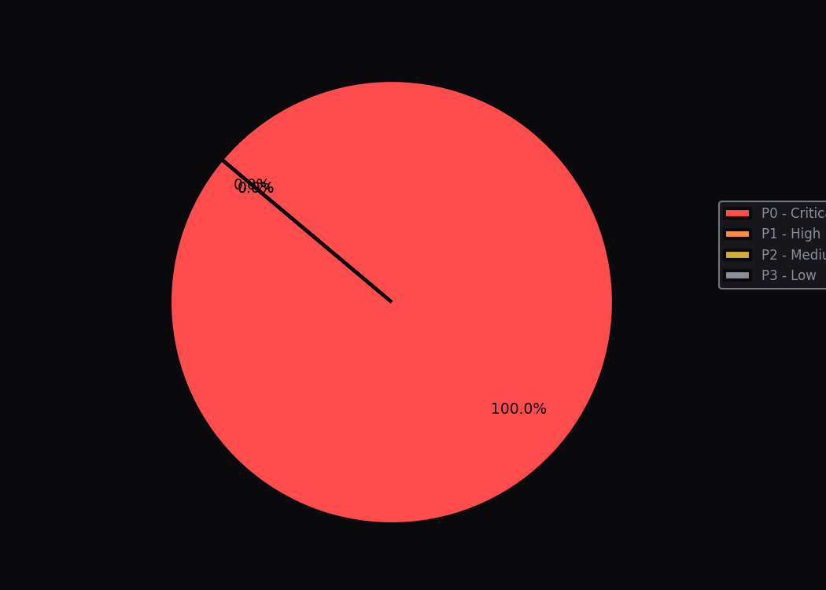
Related Issues
{{table_issues}}

