Slide 1
NEO Project 项目周报
05/25 - 05/31
Lynch

Slide 2
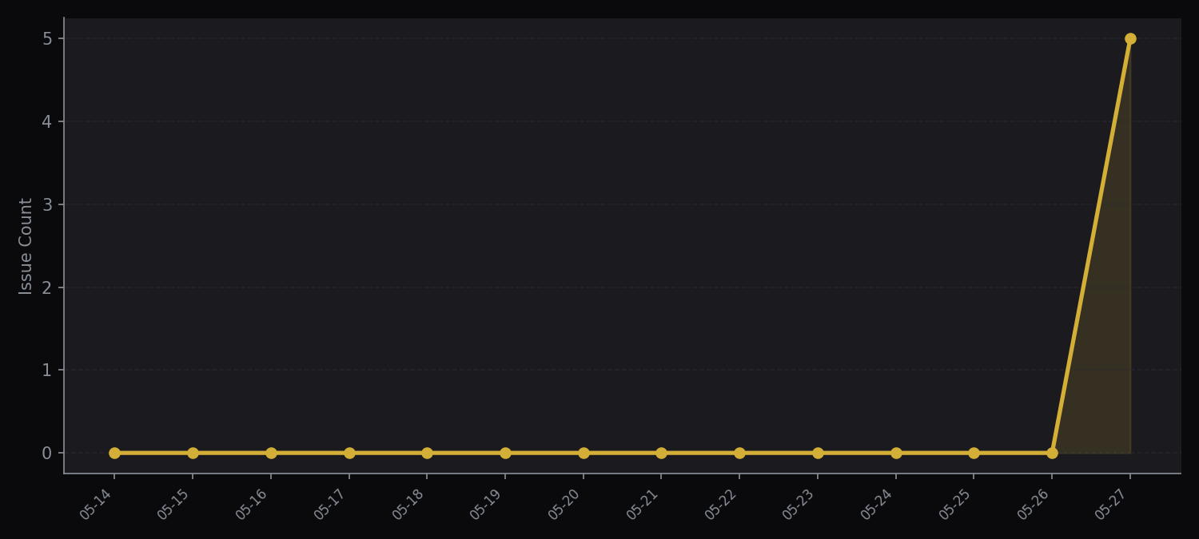
KPI Overview
5
5
0
2
Open Issues
New This Week
Closed This Week
High Risk (P0)

Slide 3
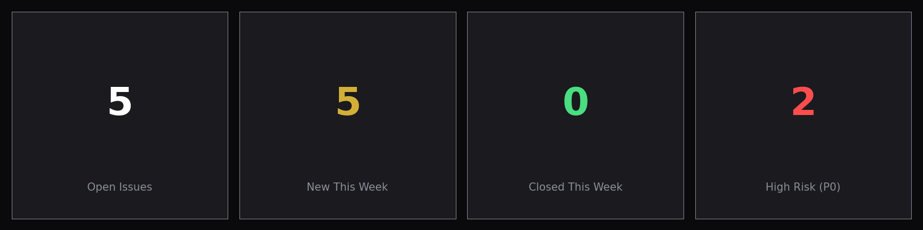
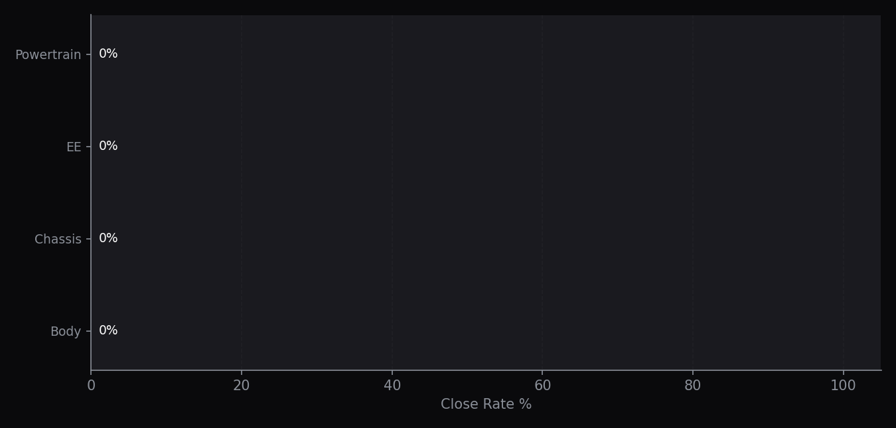
Issue Tracking
{{table_issues}}

Slide 4
Milestones
{{table_milestones}}

