Slide 1
PM 项目周报
05/25 - 05/31
项目管理部

Slide 2
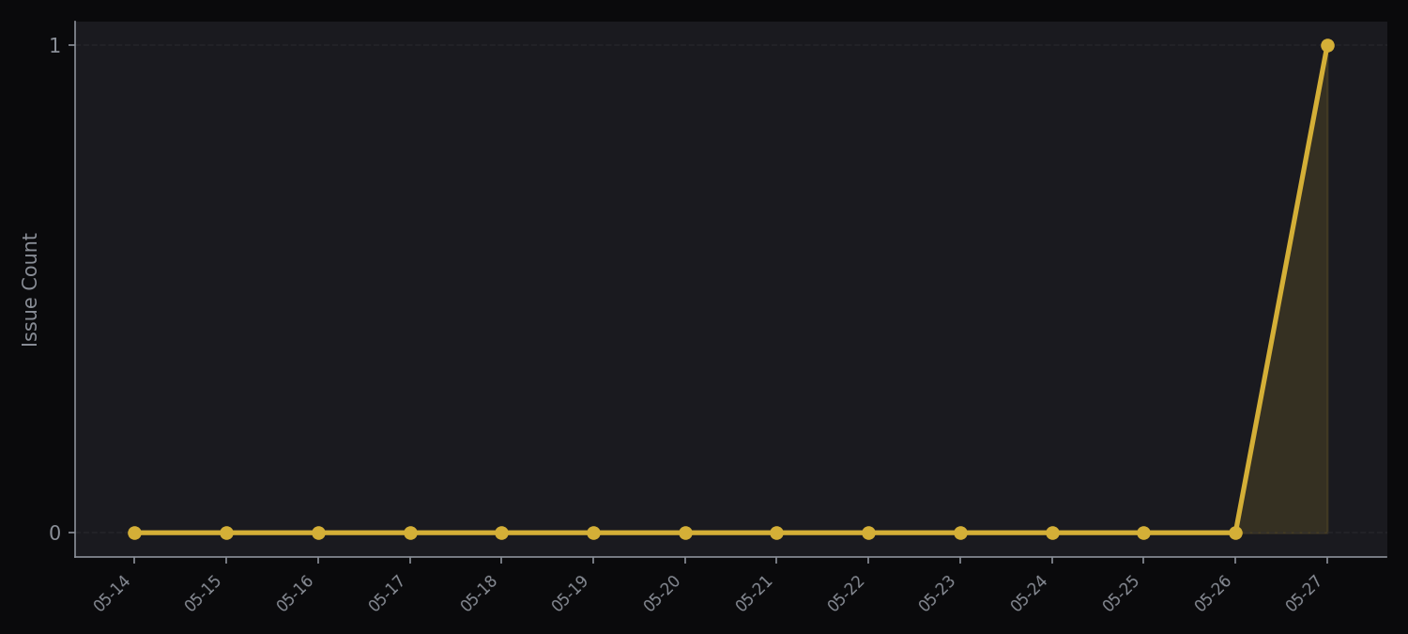
KPI Overview
1
1
0
0
Open Issues
New This Week
Closed This Week
High Risk (P0)

Slide 3
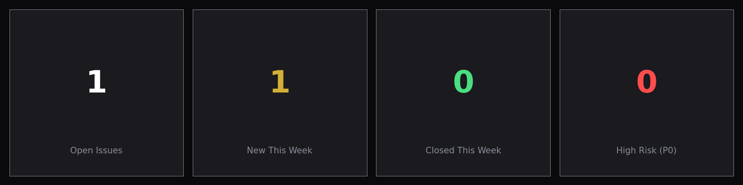
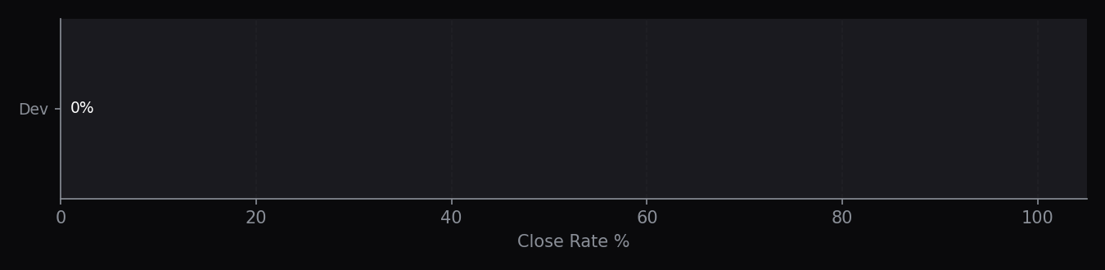
Issue Tracking
{{table_issues}}

Slide 4
Milestones
{{table_milestones}}

