Slide 1


Slide 2
Introduction
Intended audience:
This project is intended for real estate agents who frequently work with out of town clients who may be unfamiliar with the area.
The hypothetical situation is:
You are a real estate agent in Toronto and have a client who accepted an awesome new data science position. You have shown the client 6 houses and they have narrowed their choices down to 3 wonderful homes in 3 different neighborhoods in Toronto.
The clients are not concerned with commute time. However, the 3 most important factors to them are that there is a 1) park , 2) coffee shop, 3) gym
Neighborhoods:
The 3 houses are in the neighborhoods of 1) Berczy Park, 2) Queen's Park, and 3) Rosedale
Goal:
The goal of this notebook and capstone project is to determine which neighborhood would best fit the client's criteria and thus, which house they should by.

Slide 3
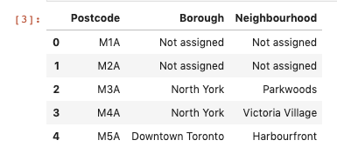
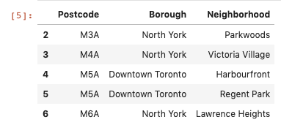
Data/Methods
To solve this problem, I used 3 data sources
Wikipedia page with postal code, borough, and neighborhood listings for Canada
https://en.wikipedia.org/wiki/List_of_postal_codes_of_Canada:_M.
I scraped the Wikipedia page containing postal codes in Canada. This allowed me to get the postcode data from the table and then transform it into a dataframe. The resulting dataframe contained 3 columns for ‘Postcode’, ‘Borough’, and ‘Neighborhood.’
I dropped (ignored) boroughs that were 'Not assigned'. I also corrected the spelling of Neighborhood in the dataframe.

Slide 4
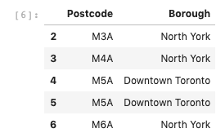
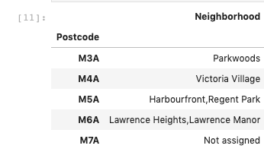
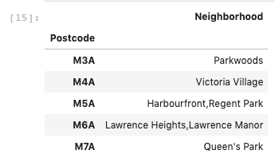
Data/Methods
I split the wiki df into 2 new dataframes called ‘borough’ and ‘neighborhood’ that contained only the postal code along with either the borough or neighborhood, respectively
I then cleaned the borough df by eliminating duplicate postal codes and cleaned the neighborhood df by combining multiple neighborhoods into their appropriate single postal codes. I also changed the “Not assigned” neighborhood to the name of the borough.

Slide 5
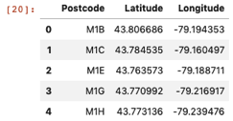
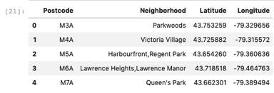
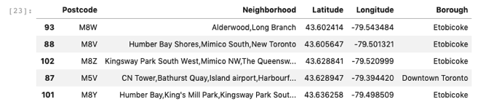
Data/Methods
2) Geospatial Data for Toronto
http://cocl.us/Geospatial_data
This data contains all of the latitude and longitude coordinates for postcodes in the Toronto area.
I first loaded in the data as a panda dataframe
I then merged it with the neighborhood dataframe
Finally, I merged these with the borough dataframe

Slide 6
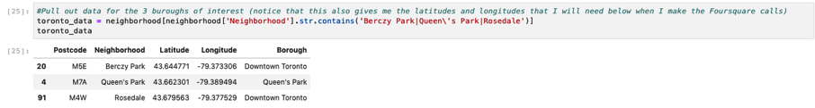
Data/Methods
Continued….
I then created a new dataframe (tornonto_data) that only contained the 3 neighborhoods our clients are interested in
This dataframe was then used for further analysis
3) Foursquare location data
Finally, I used the Foursquare location data to determine what venues (specifically those that our clients are interested in) are in the neighborhoods.
I then utilized this data to make a final determination of which neighborhood was the best choice for our clients.

Slide 7
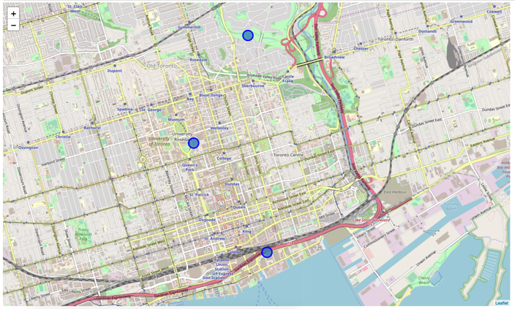
Results
Geopy library was used with folium to create a map of Toronto with the 3 neighborhoods of interest superimposed over it.

Slide 8
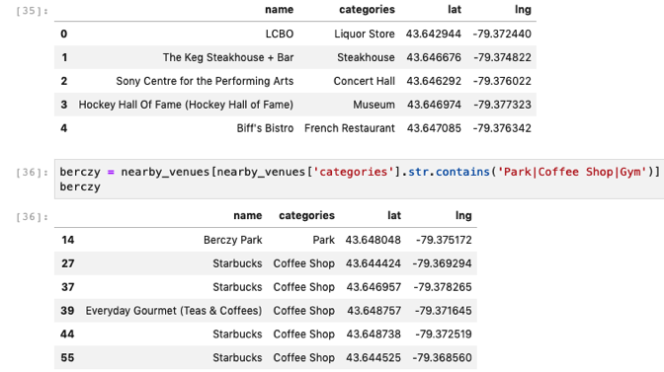
Results
Next, I analyzed each of the 3 neighborhoods individually, using Foursquare location data to pull all the venues in each neighborhood
I started with the Berczy Park neighborhood
Pulled out all venues
Consolidated the list down to only those venues of interest to our clients (park, coffee shop, and gym)

Slide 9
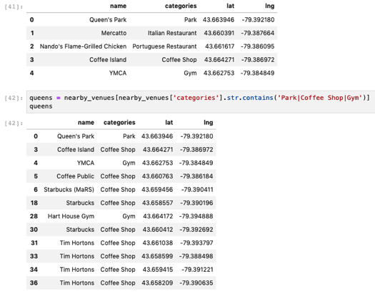
Results
I next did the same analysis for the Queen’s Park neighborhood
Pulled out all venues
Consolidated the list down to only those venues of interest to our clients (park, coffee shop, and gym)

Slide 10
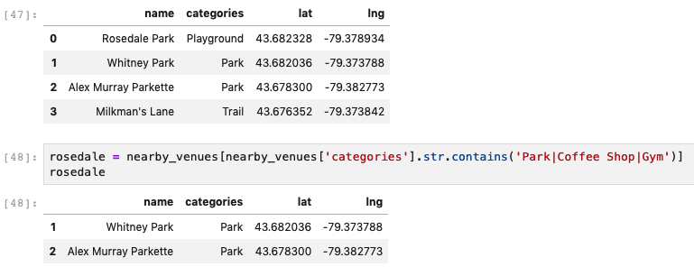
Results
Last, I performed the same analysis for the Rosedale neighborhood
Pulled out all venues
Consolidated the list down to only those venues of interest to our clients (park, coffee shop, and gym)

Slide 11
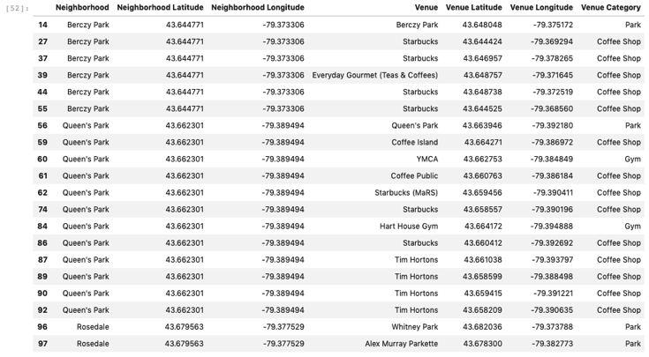
Results
My next step was to write a function to combine all of this data into a single dataframe called “wantlist.” The resulting dataframe is shown below.

Slide 12
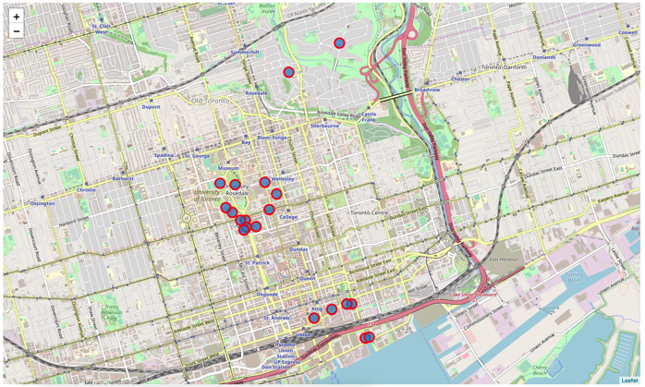
Results
Folium was used to create a map of Toronto with all of the parks, coffee shops, and gyms for the 3 neighborhoods superimposed

Slide 13
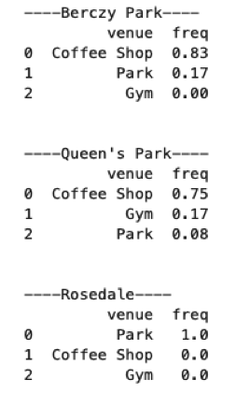
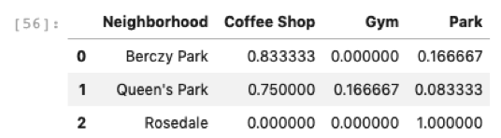
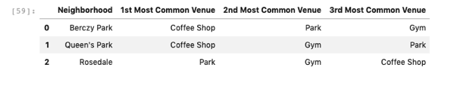
Results
I then grouped rows by neighborhood and took the mean of the frequency of occurrence of each category
I also created a dataframe to show the top 3 results from each neighborhood
These results are shown below

Slide 14
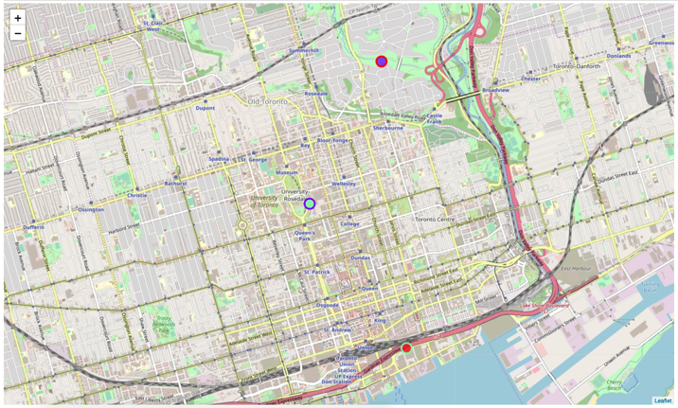
Results
Finally, I used K-means to cluster the venues (k=3) and used folium to visualize the clusters

Slide 15
Conclusions
Rosedale only has parks. It does not have coffee shops or gyms. So we will eliminate Rosedale from our choices since it doesn't meet the client's requirements.
Berczy Park has lots of coffee shops and 1 park, but does not have a gym. So we will also eliminate Berczy Park since it doesn't meet the client's requirements.
Queen's Park, however, has lots of coffee shops, some gyms, and a park. It definitely meets the client's requirements!
It turned out that the K-means clustering wasn't really needed to answer the question, but I showed it anyway.
ANSWER: We choose to suggest that the clients buy the house in Queen's Park since it has all the things they want in a neighborhood!! New data science job... here they come!!

Slide 16
Thank you
This Capstone Project with all notebooks, final report, data, and other appropriate files can be found at:
https://github.com/CaptainNano77/Coursera_Capstone

