Slide 1

UT Coding Bootcamp
UTA-VIRT-BO-FSF-PT
Instructor: Richard Hosek
Fall 2020
Group 1:
Stockman Application
Richard Ay
Tony Zeuch

Slide 2
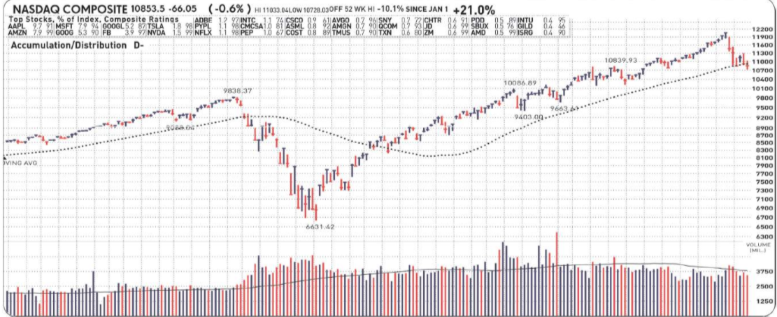
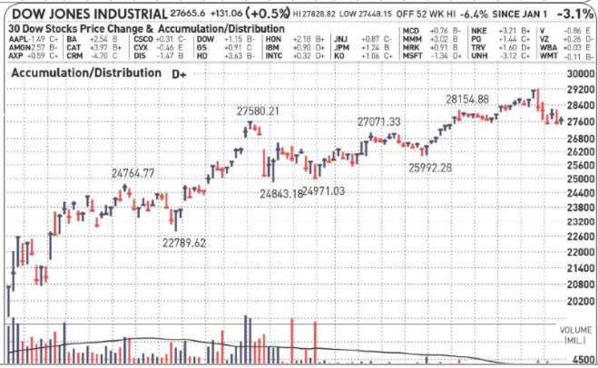
Stockman – An Investment Monitor
Investments increase and decrease in value.
Corporate decisions and focus.
Competitor actions.
Macro-economic events.
Constantly watching a brokerage website is often not feasible:
Lack of accessibility.
Time constraints and other priorities.
How can investment positions be protected against sudden changes in value?
“Stop-Loss” orders sell at the prevailing market price.
“Stop-Limit” orders may or may not sell,
Active intervention is needed for volatile stocks and/or fast markets.
Notes:
This is the ‘elevator pitch’ – why this application is needed.
Constant monitoring of a brokerage website is not feasible.
“Stop-Loss” orders sell at the prevailing market price – you can lose a lot.
“Stop-Limit” orders may or may not sell – review is suggested.

Slide 3

Stockman – The Concept (User Story)
As an investor, I want an efficient way to monitor my investments without logging onto a brokerage website. I want to specify a list of important investments with minimum and maximum values for key parameters, and have an application (running on my phone or tablet) indicate when an investment value moves outside this range. I can then pursue further research on a full service brokerage site.
Notes:
The user story

Slide 4

Stockman – The Concept, Details
The application permits the specification of up to 5 stocks and 5 crypto currencies. Duplicate investments are prevented.
For each specified investment:
Various investment parameters are obtained
A minimum and a maximum value for each parameter can be defined..
When the investments are updated (refreshed):
The current value of all parameters is obtained.
The application page is updated.
The current parameters values are each compared to the specified minimum and maximum values.
Parameters with a current value outside the specified range are noted in the “alert” column – indicating further scrutiny is warranted.
Notes:
A description of what the application does.
The motivation for development

Slide 5
Stockman – Processes, Tasks, Challenges, and Successes
The ‘Bulma’ framework, as well as ‘Fontawesome’ and ‘moment.js’ are used the application’s browser presentation.
A number of API endpoints are used to acquire the necessary investment data:
- AlphaAdvantage.co - Finnhub.io
- Nomics.com
Project roles: Tony & Rich worked on each project component together. We did individually initiate different parts of the project: (Tony – HTML & CSS, Rich – JavaScript, Git Issues, and documentation). Later we both worked on each component as the need arose.
Challenges & Success:
Some API-endpoints limit the number of uses (per-minute and per-day). Logic changes avoid this limitation.
Not all API-endpoints provide all of the desired data needed.
Nuances of certain features/functions slowed development: promise chaining, number formatting, and numeric object names
Playing sound crippled by anti-Virus software.
Notes:
A description of what the application does.
The motivation for development

Slide 6
Stockman – Application Details
The home page permits users to define investment tickers. Modals are used if tickers cannot be found, and for the parameter range definitions.
For each ticker, minimum and maximum values for characteristic parameters can be defined.
Ticker pricing (and other data) are periodically obtained and compared to the defined range. Values outside of the desired range are noted for further investigation.
With each update from an API endpoint, all parameters are checked against their respective range.
Tickers, parameter ranges, and pricing are saved and retrieved to/from local storage.
Users can switch investment views from each detail page via a drop list.
Notes:
The process/execution flow through the application
Discuss investment specification, page updating, the use of “modals”, other behavior.

Slide 7
Stockman – Application Demonstration
The demonstration:
Note that “equity data” (stocks) will not be updated during this live demo because the stock market is closed.
Crypto currencies will be updated live.
Investment tickers are saved and retrieved to/from local storage.
The “Alert” column always indicates if current parameters are defined, inside, or outside the defined ranges.
Notes:
A live demo of the application
We may want to consider linking in a “screencast” video showing the stock page updating.

Slide 8

Stockman – Future Development
This application can be improved for the next version by considering.
Subscribing to “paid” APIs, which will remove (unlock) access restrictions.
Additional calls to the same API can be made for additional data.
The update/refresh frequency can be increased.
More investments can be monitored
Using technologies other than APIs (custom widgets offered by some web sites.
Widgets can provide additional data not available in the public APIs.
Other investments outside of equities and crypto currencies can be added for monitoring.
Back-end technologies can be used to actually alert the user when a monitored parameter moves out of the desired range, without active monitoring of the browser window.
Notes:
This slide discusses ideas and improvements that could be made in a future version of the application.
FinancialModelingPrep.com was initially used to obtain the Market Indexes, but this API has a limit of 250 calls total for a free account. Market indexes were removed from the application due to this restriction.

Slide 9
Stockman – Important Links
Link to deployed application:
https://team-antman-project-1.github.io/stockman/
Link to GitHub Repository:
https://github.com/Team-Antman-Project-1/stockman .
Notes:
This slide shows the links to the “live” application as well as the GitHub repository.

Slide 10

Stockman – Questions
Thank you for watching this presentation.
Questions ?
Notes:
Closing slide

