Slide 1
Data Science Project: Netflix
By Priya Harry

Slide 2
TABLE OF CONTENTS
01
PROJECT SETUP
02
THE DATA
03
ANALYSIS
04
TAKEAWAYS
01
02
Just logistics and stuff
Now we are talking about the graphs
03
04
What can we learn from this data?
What did I learn from this project?

Slide 3
01
Project Setup
01
ChatGPT, Medium Article, RStudio, etc

Slide 4





Tools that I used

Slide 5
The Data
02
Let’s take a look at some graphs!
*Debbie = my mom
Mehul = my dad
Nikhil = my brother
Priya = me

Slide 6
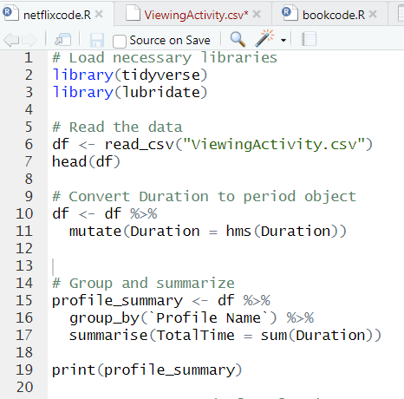
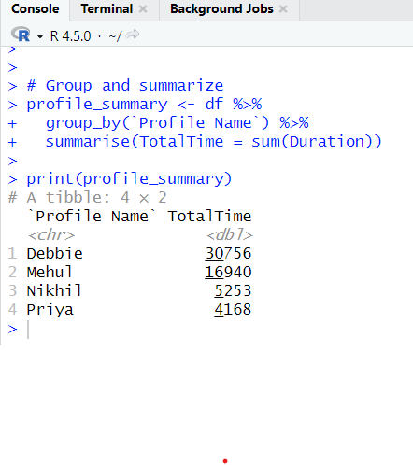
Total Time by Profile
First, let’s take a look at the total time by profile measured in minutes.

Slide 7
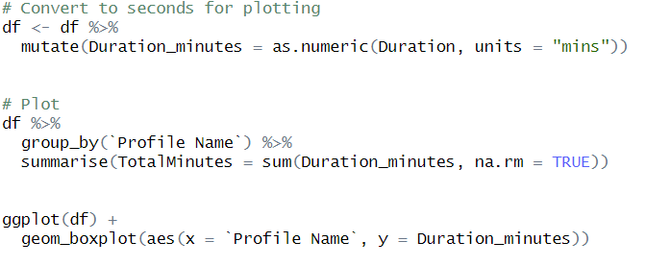
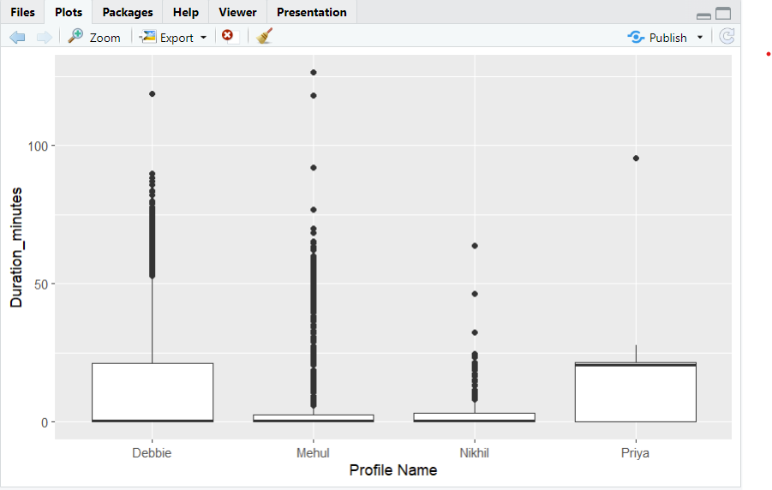
Total Time by Profile (2)

Slide 8
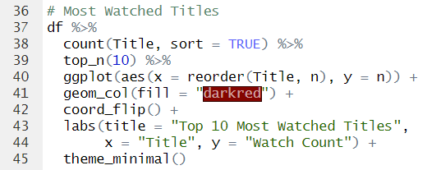
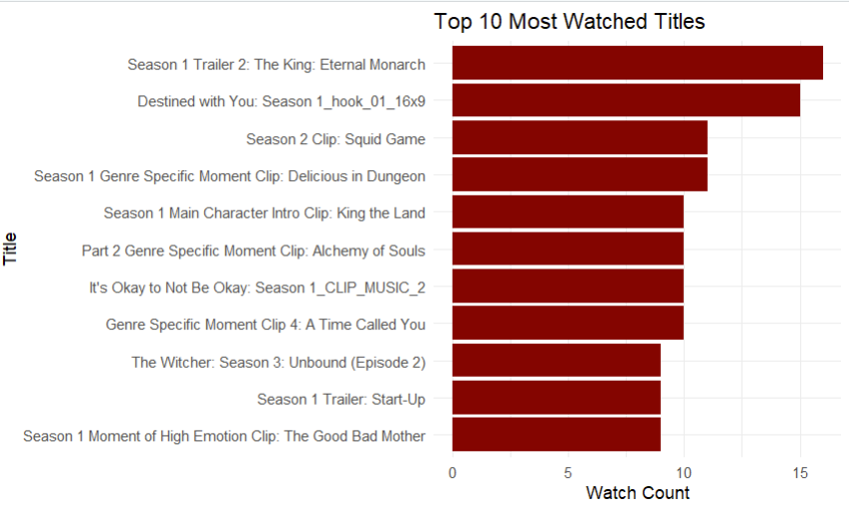
Most Watched Titles
First, let’s take a look at the total time by profile measured in minutes.

Slide 9
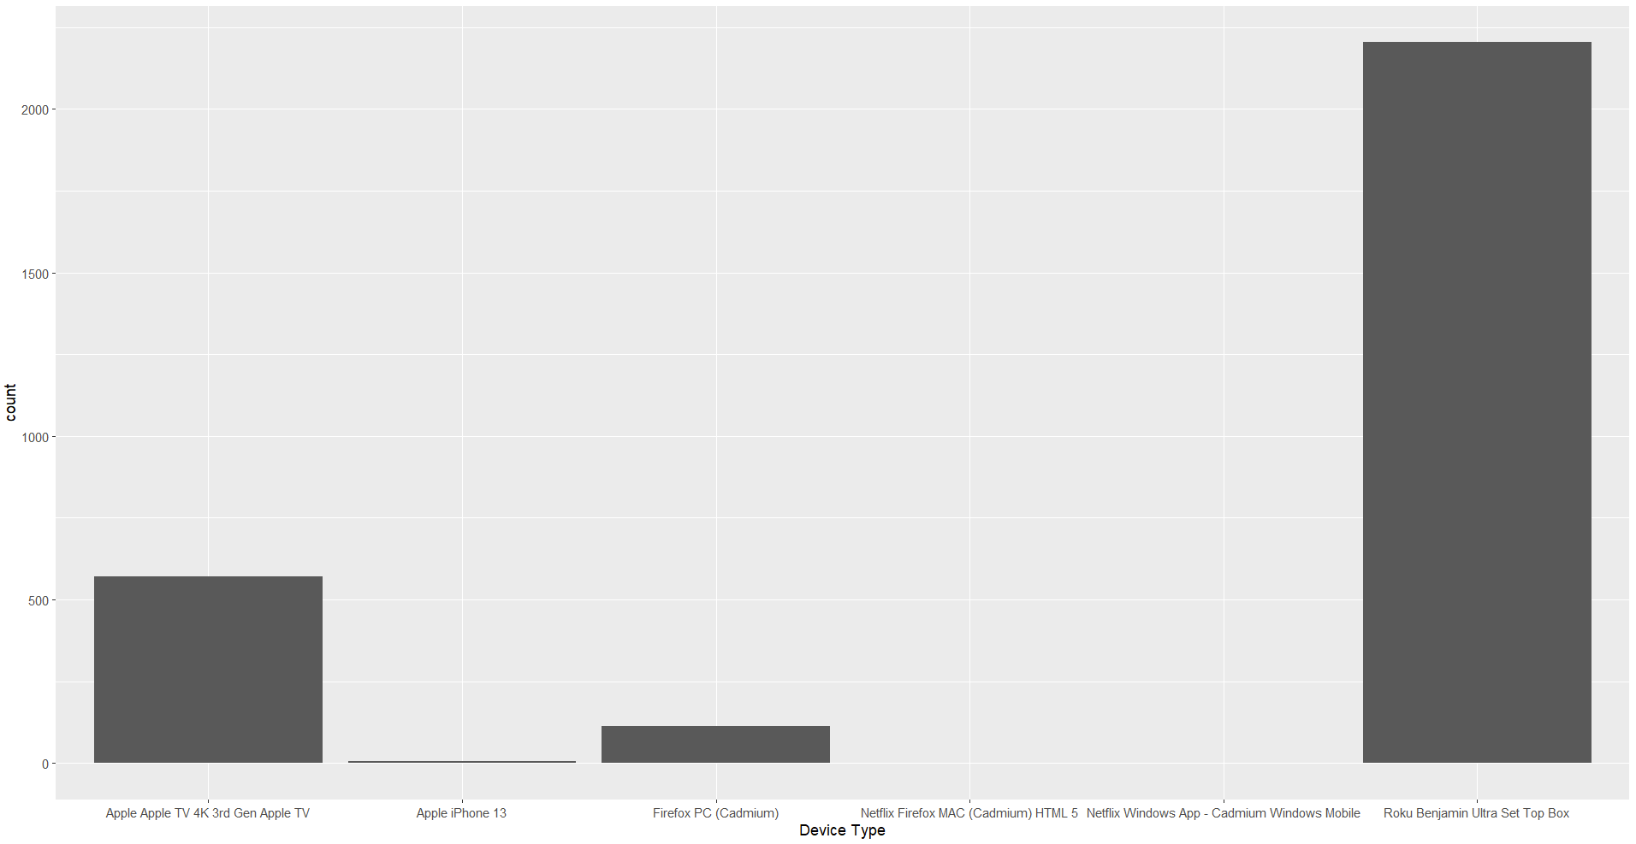
Most Watched Devices
First, let’s take a look at the total time by profile measured in minutes.

Slide 10
Let’s Analyze
03
What can we learn from this data?

Slide 11

My mom likes watching k-dramas on our TV
My mom is the one using the most + watches k-dramas the most (series) + TV is the most watched device

Slide 12
TAKEAWAYS
04
What did I TAKEAWAY from this project :))

Slide 13
What did I learn?
I learned a lot, including but not limited to the following:
Uhhh list #1
You can use ChatGPT to access Medium articles (morally questionable)
How to install Python and Rstudio on a computer
How to make a set of graphs on my own
What type of questions to ask when looking at this sort of dataset (Netflix data)
How to draw conclusions from that data

Slide 14
—ABRAHAM LINKEDIN
“It would be so awesome… it would be so cool… to check out my other socials”

Slide 15
THANKS!
Do you have any questions?
youremail@freepik.com
+91 620 421 838
yourwebsite.com
Please keep this slide for attribution

