Slide 1
Content Optimizer Release 1 – Traffic Analysis with Datapub

Slide 2
Details
Members: Aayush Naik
Rohan Karnawat
Vinayak Athavale
Mohammed Sharfuddin
I. Vinay Reddy
TA: Shivam Khandelwal
Client: Digitant Co.
Faculty: Prof. Y. Raghu Reddy

Slide 3
Introduction
What is Datapub?
A publisher oriented data management system to provide niche targeting opportunity for publishers.

Slide 4
Problem Statement
Existing state of digital ecosystem has skewed the marketplace towards advertisers compared to content publishers.
Datapub is a niche tool specially designed for publishers whereas other analytics tools are either generic or marketers' focussed.

Slide 5
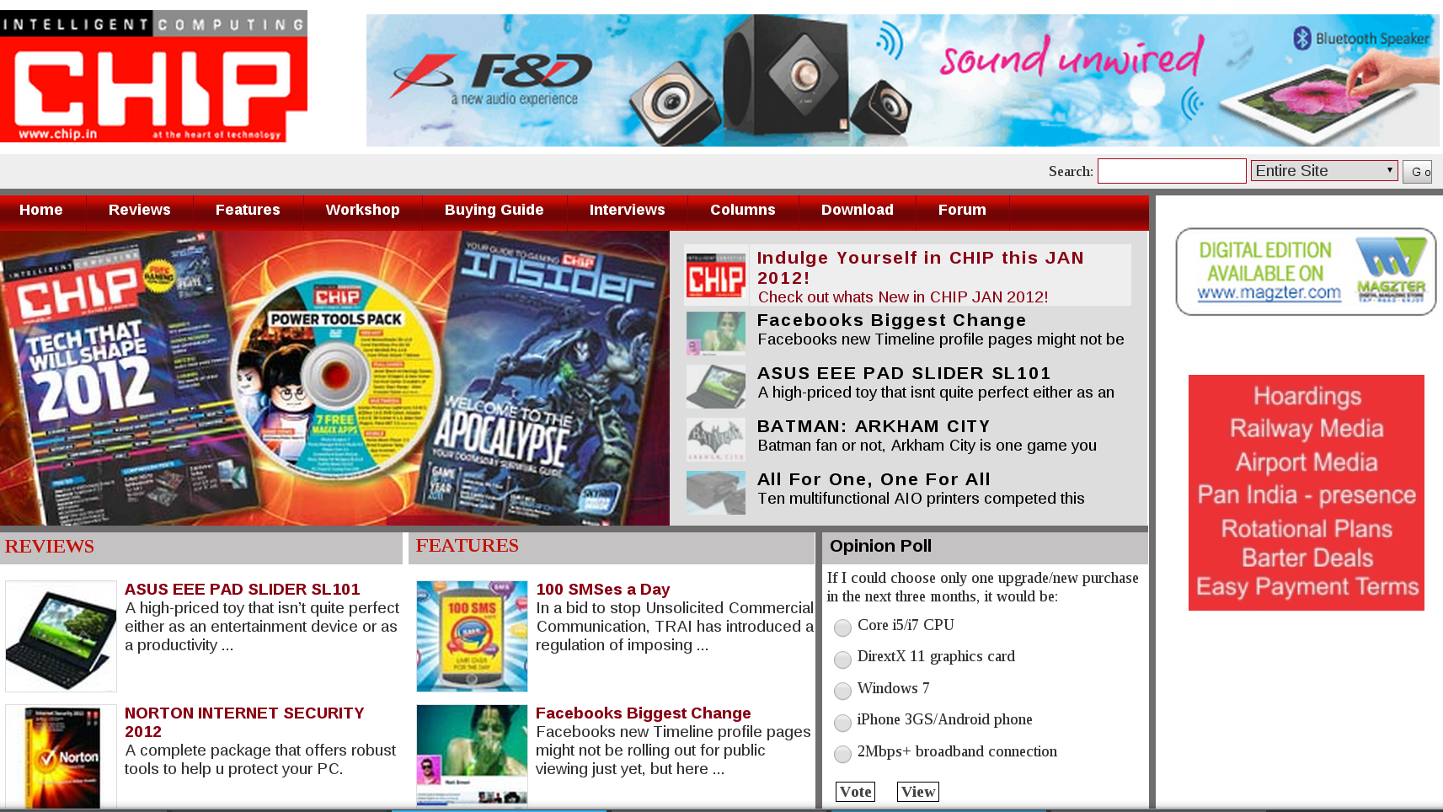
An Example
A Tech Magazine

Slide 6
Advantages
Information about most profitable sections of the website
Information about most profitable user segments
Identification of profitable placements by user groups
Real time access to website performance data
Easy to use UI

Slide 7
Technologies/Tools Used
Datapub UI (skin)
Piwik (open-source analytics tool, HTTP API)
Web technologies (AngularJS, Javascript, jQuery, PHP)

Slide 8
Work Flow
Visitor
id:String location:String type:String
visitPage()
Piwik
getData() sendData() logData()
Logs data to and gets data from
Server
loggedData:String auth_token:String
1
1
1
1
1
Visits
Gets data from
Sends data to
*
Page
id:Integer title:String tags:List
*
1
Datapub
processObject() renderGraph()

Slide 9
Difficulties faced
Change of analytics tool (Clicky → Piwik)
Piwik Geolocation

Slide 10
What have we done so far
Successfully used Piwik analytics
Successfully implemented graphical representation of visitor traffic on Datapub

Slide 11
What we will do
Enable filters for location, visitors and sources.
Integration of Datapub as a plugin for general content publishers' websites.
Implement rendering of optimised content on the home page of the website on the basis location(popular page hits from the area the user is in) and visitor activity(recently searched or read articles).
Enable personalisation for visitors who are registered users by enabling them to set their own preferences (tags), so they can choose what content they wish to view

