Slide 1
Personal Content Optimisation and Analysis
Team Number: 6
Rohan Karnawat, Aayush Naik, Vinayak Athavale
Mohammed Sharfuddin, Itilaya Vinay Reddy

Slide 2

About the Project
Our Client:
Objectives:
To develop a service, which involves tracking of a visitor's activity on the host site, and displaying optimised content on the basis of a scoring algorithm.
To provide a tool to the managers of the tracked site that helps them analyse traffic. (datapub).

Slide 3
Deliverables : 1st Release
Successfully used Piwik analytics to track host site.
Successfully implemented graphical representation of visitor traffic on Datapub.
Target users
Wordpress based sites
Content Publishers (Bloggers, online magazines)

Slide 4









2nd Release
Technologies Used:

Slide 5
Deliverables: 2nd Release

Slide 6
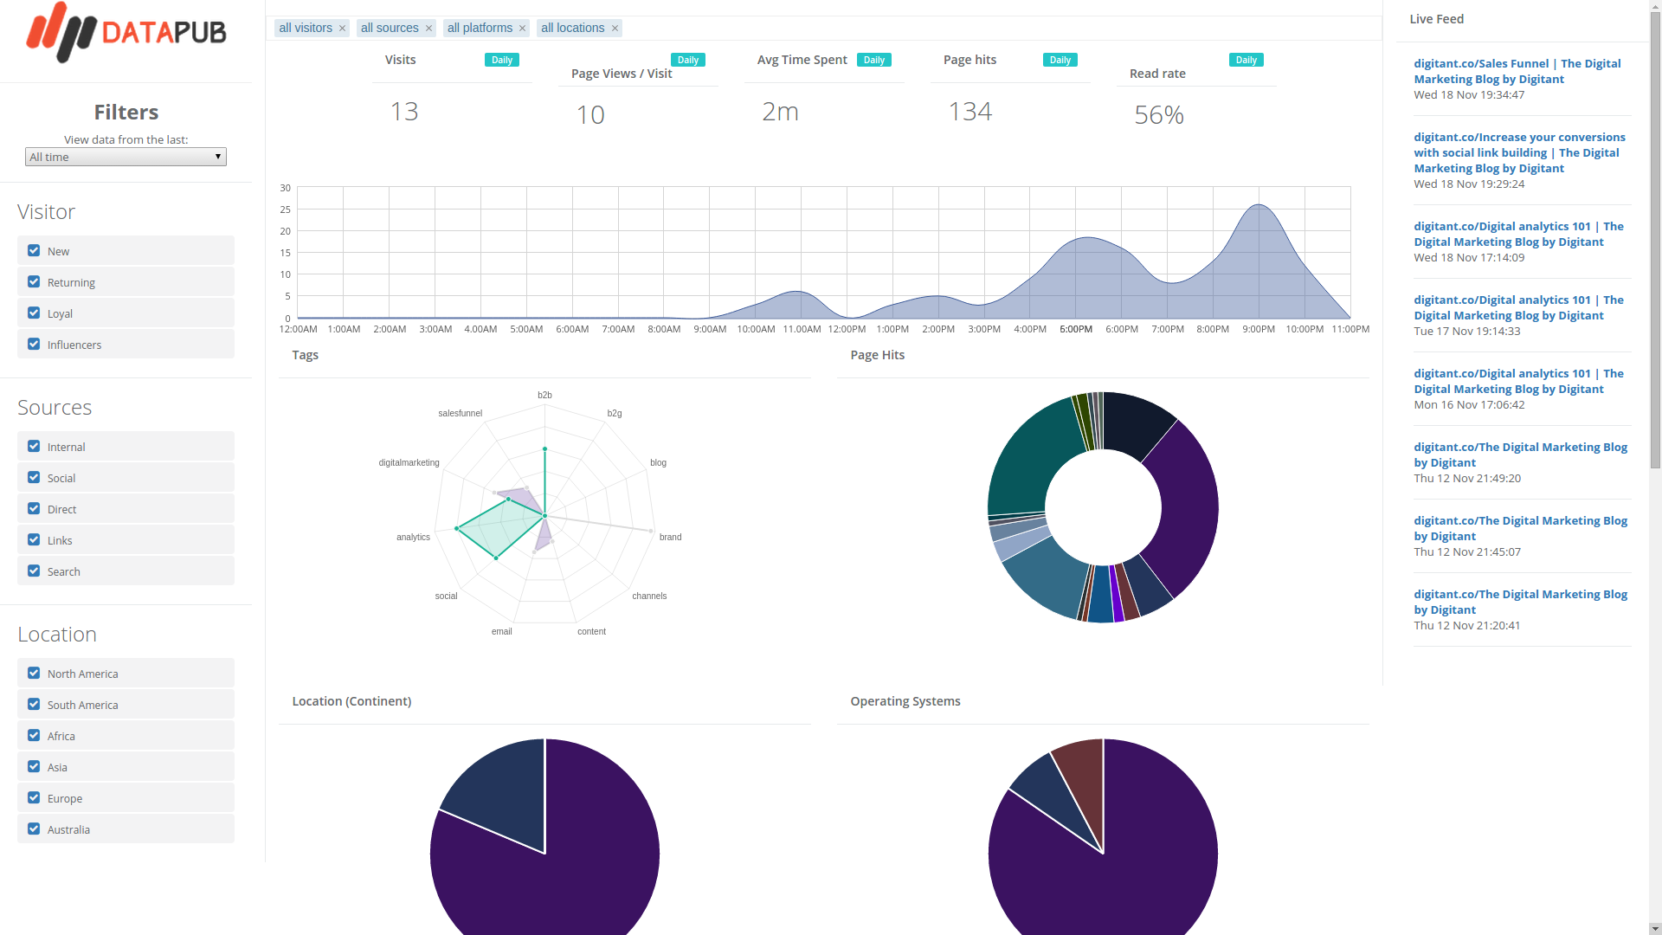
Datapub : Additional features

Slide 7
Datapub screencast

Slide 8
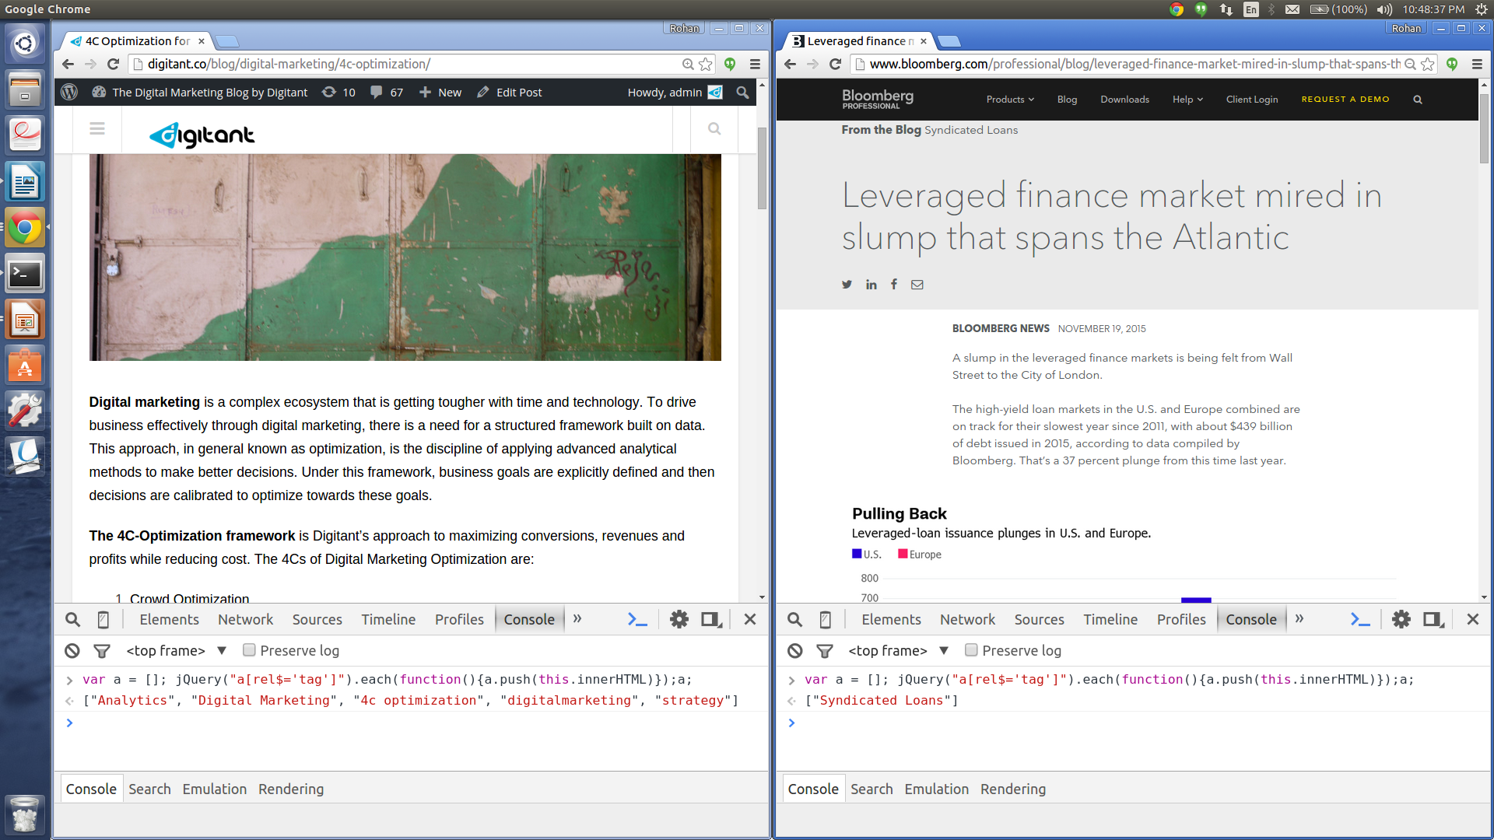
Tags

Slide 9
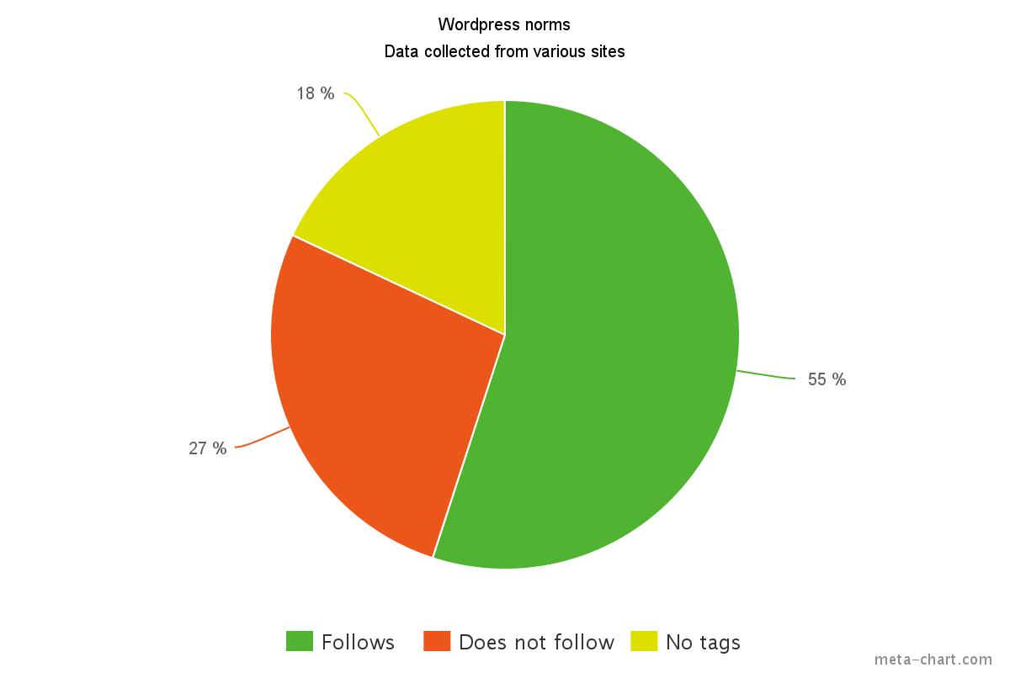
Wordpress standards

Slide 10
Page Ranking Algorithm
The page score is the sum of 3 components
1. Base score :
Common for all users.
Based on:
Creation time of the page
Number of views of the page

Slide 11
Page Ranking Algorithm
The page score is the sum of 3 components
2. Tag score :
Needs Content to be tagged
Different for each user
Depends on the pages viewed by a user

Slide 12
Page Ranking Algorithm
The page score is the sum of 3 components
3. Viewed score
Reduces score of viewed page

Slide 13
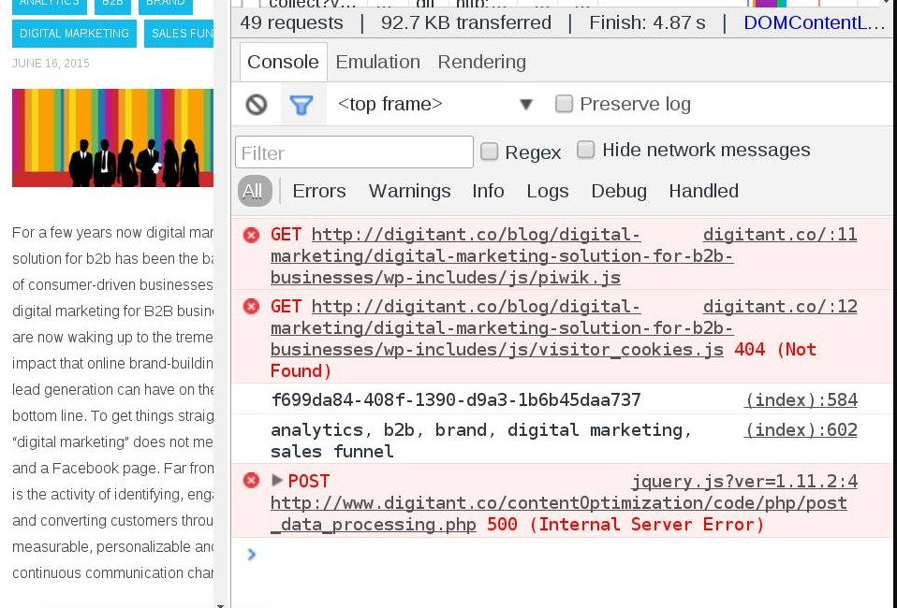
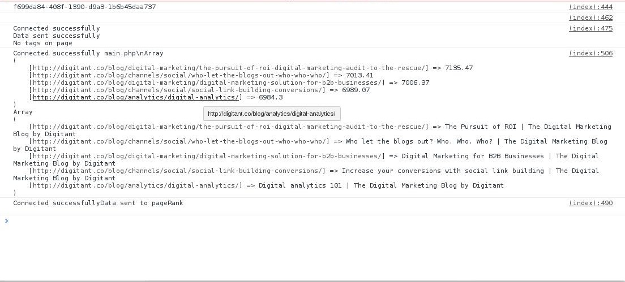
Testing the page ranking algorithm
The list of pages ranked based on their score.
Unique visitor ID

Slide 14
Demo

Slide 15
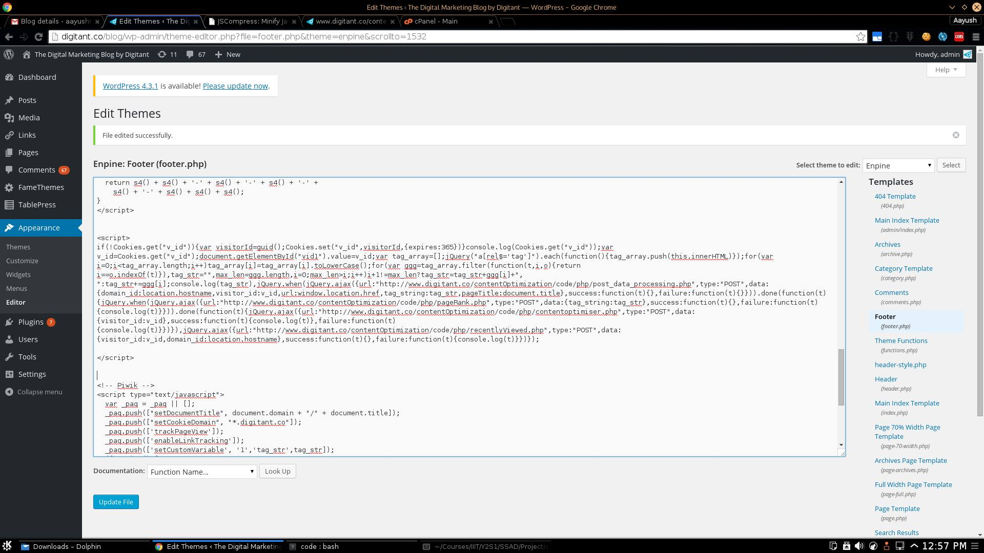
Optimization snippet

