Slide 1

Behavioral operations management
The use of Behavioral Sciences in the Organizational Strategic Decision-Making Process
老师：Yanan Song
答辩人：URGIE FEVEN MEKONNEN
学生证号 : M202161060
2021-11-28

Slide 2
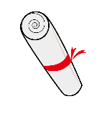
1
INTRODUCTION
目录
2
LITERATURE REVIEW
3
RESEARCH OBJECTIVE
CONTENTS
4
RESEARCH METHODS
5
DISCUSSION &CONCLUSION

Slide 3
第一部分
INTRODUCTION
Background and significance
Theoretical basics

Slide 4


Background and significance
Behavioral Science began being studied predominately in the early 1900s. One of the pioneers of the study is John B Watson.
Sometime in the midst of the last century, Chester Barnard, a retired telephone executive and author of The Functions of the Executive, imported the term “decision making” from the lexicon of public administration into the business world.
Applied behavioral science can have a positive influence on decision making, whether it be in the realm of public policy, designing products and marketing, or developing personal habits. Because there are “predictable” patterns in our irrationality, once we understand these patterns of human behavior, we can use them to design environments that help people make better decisions.
Decision making process

Slide 5
Theoretical basics
A decision-making process is a series of steps taken by an individual to determine the best option or course of action to meet their needs. In a business context, it is a set of steps taken by managers in an enterprise to determine the planned path for business initiatives and to set specific actions in motion.
Behavioral science, any of various disciplines dealing with the subject of human actions, usually including the fields of sociology, social and cultural anthropology, psychology, and behavioral aspects of biology, economics, geography, law, psychiatry, and political science.

Slide 6

第二部分
Literature review

Slide 7
Literature review
1
2
3
In an industry like marketing, where personal opinion and gut feeling continue to inform decision-making at the highest level, the academic, peer-reviewed, scientific rigor offered by behavioral science is a very welcome addition. There is detailed survey of how applied teams use behavioral science in their work, with questions covering the teams’ position and purpose within their organization, the particular techniques they use, and the struggles they’ve faced.
A strategic decision can be defined as one which is “important, in terms of the actions taken, the resources committed, or the precedents set.” Such decisions influence the success or failure of organizations ​In the strategic management literature, there seems to be a consensus that context refers to sets of characteristics which include those of top management, decision-specific, environment and organization
Behavioral scientist focus on the decision-making processes of individuals and institutions. In political science, the subfield of political behavior focuses on attitudes. Sociologists study how human behavior is shaped by the groups to which people belong and by the social interactions that occur within those groups.

Slide 8

第三部分
RESEARCH OBJECTIVE

Slide 9
The presentation and the summarization of the main concepts related to the use of behavioral sciences in the strategic decision-making process.
一
The identification of the elements and of the steps needed to enhance the behavioral sciences research findings use in the organizational decision making processes.
二
三
The development of an outline procedure for the use of behavioral sciences in the organizational decision-making process.

Slide 10
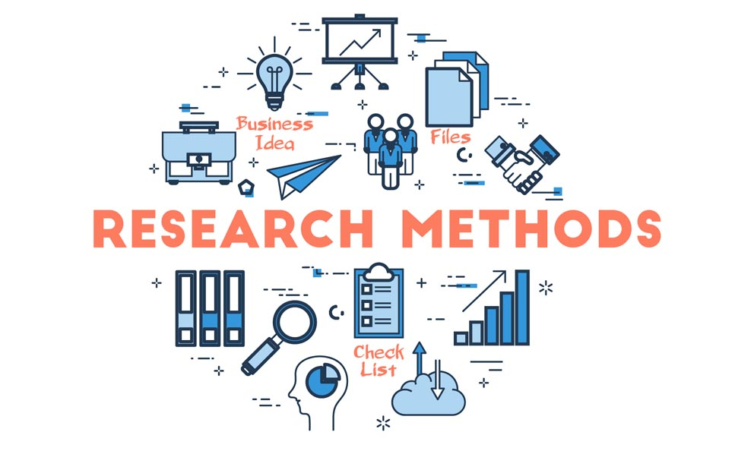
第四部分
RESEARCH METHODS

Slide 11

Experiments
Doing normal experiment in psychological behaviors of some people like sample.
标题关键字
Advantages
- Can establish the causality
(not just correlation)
- Can provide statistically significant results using relatively small samples.
- The essential findings can be applied in other contexts.
Disadvantages
- The samples ’representativeness for a population cannot be
ensured
- The laboratory is an unrealistic and artificial setting
标题关键字
标题关键字

Slide 12
Controlled trials
Doing research in psychological behaviors by location.
标题关键字
Advantages
- (not just the correlation)
- Allow for observations in
natural settings
Disadvantages
-At the level of a vast territory (and to replicate for the results validation)
- The findings from one location are not generalizable to another
标题关键字
标题关键字

Slide 13
Surveys
Doing research or survey in psychological behaviors in large population.
Advantages
-The representativeness for a large population is feasible.
- Relatively cost-efficient.
标题关键字
Disadvantages
-The respondents’ answers to the questions are limited by default options
- The respondents’ answers may not be
Sincere.
- Collect only the data on the self-reported behavior.
- It cannot establish the causality, just the correlation.
标题关键字
标题关键字

Slide 14
Qualitative research
Doing research or survey in psychological behaviors using scientific data's.
Advantages
-Provides richer and more nuanced data about behavior
- Often takes place in realistic settings
- The participants are free to express themselves, with limited intervention of the researcher.
Disadvantages
-Generally, the collected data are not
representative for the larger population
- Usually have small samples due to
financial and time costs involved.
标题关键字

Slide 15
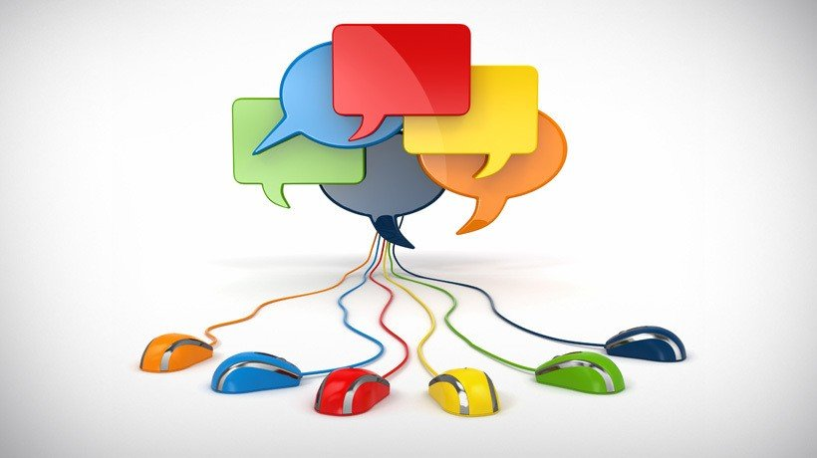
第五部分
DISCUSSION &CONCLUSION

Slide 16
Discussion
1
In this research I will discuss the use of behavioral science in decision making of organization specially on strategic decision making process. We know that behavioral science is useful for making better decision making.
2
The other thing we discuss in this research is identifications of problems in now a days of decision making and discussing applying the behavioral science how much influence it has in making strategic decision making of an organization according to our research using research methods.

Slide 17
Conclusion
Behavioral science
Dealing with human action.
Behavioral science
Applying human action for best option
Behavioral science in decision making
determine the best option or course of action.
Decision making

Slide 18

感谢！
Thank you!

