Slide 1

Top League Scorers
Kevin Appiah
Northeastern University
February 16, 2023

Slide 2

Content
Abstract
Key findings
Observations
Bibliography

Slide 3

Abstract
The dataset Top league Scorers retrieved from Kaggle is a dataset consisting of statistics of players from top leagues in the world from 2016 to 2020
The dataset was scraped from many resources and edited by Mohamed Hany from the website Infogol
This dataset includes top football leagues scorers their Goals, Country, Club, Matches played , Substitution, Min, Goals, xG, xG per Avg Match, Shots, OnTarget, Shots-per Avg Match, OnTarget per Avg Match and Year
Initially Dataset consisted of 15 columns and 621 rows but after adding the assist column it now consists of 16 column and 660 rows.
This Photo by Unknown Author is licensed under CC BY-SA-NC

Slide 4
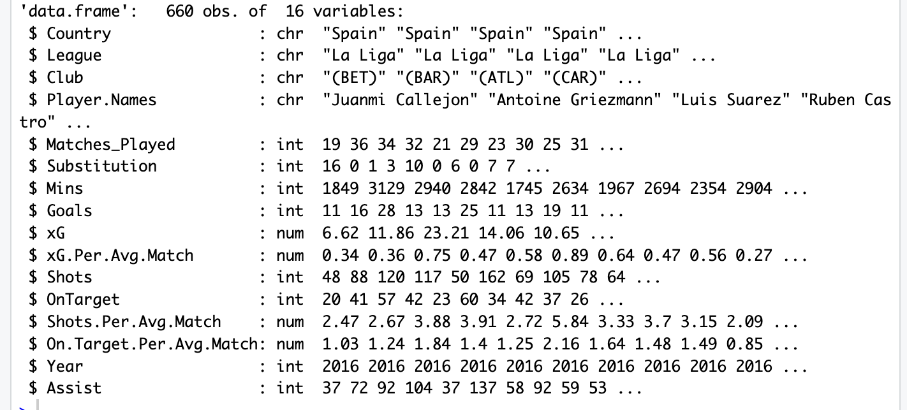
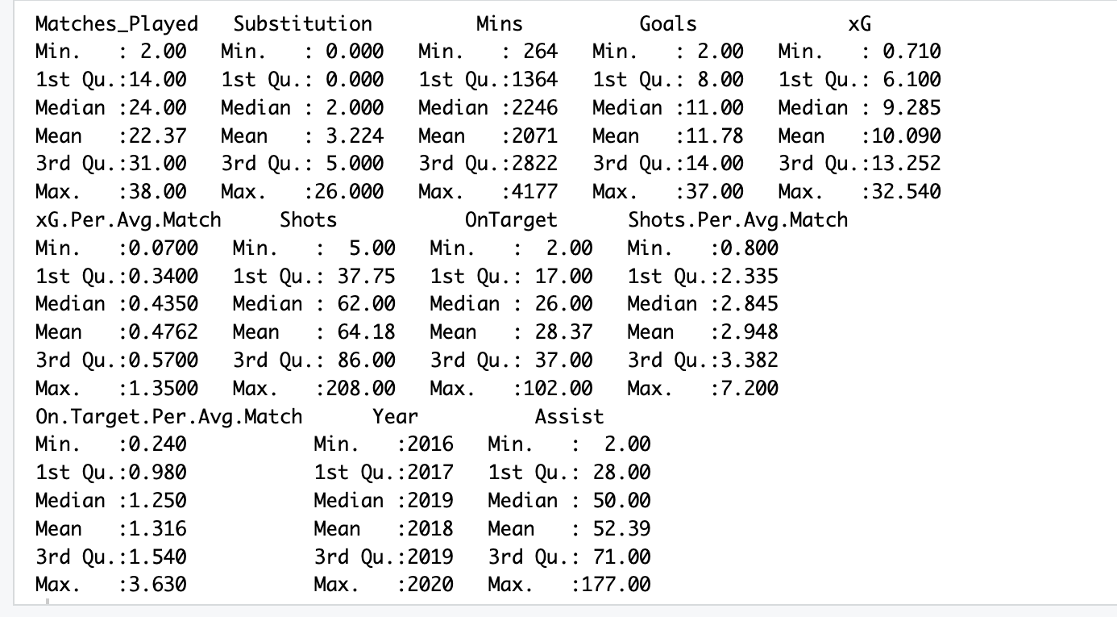
Key Findings
The Figures in this slide show the descriptive analysis of the dataset, such as the number of records, and summary of statistics such as mean median minimum, and maximum of the results

Slide 5
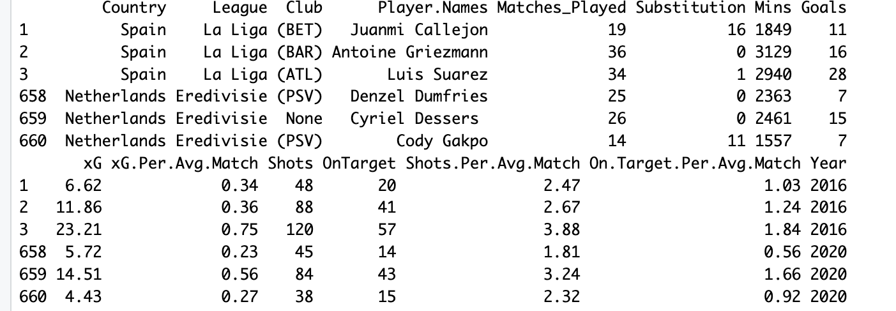
The figure below displays the dataset's first and last three rows To get more information regarding the dataset and some contents of the dataset.

Slide 6
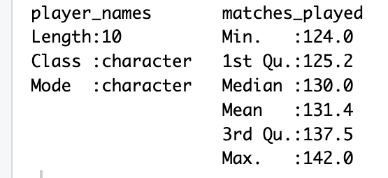
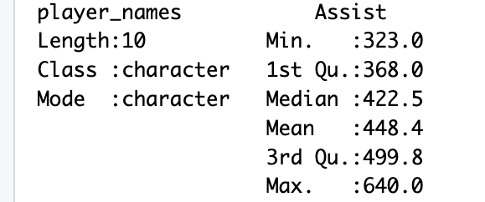
The data was narrowed down to find the top 10 best-performing players in the goals, and newly added column assist, and also the top 10 players with the most matches played these are the summary of statistics of the selected data to be analyzed
Fig1.
Fig 2
Fig 3
Fig 1 shows a summary of matches played among the top 10 players
Fig 2 shows a summary of goals among the top 10 players
Fig 3 shows a summary of assists among the top 10 players

Slide 7
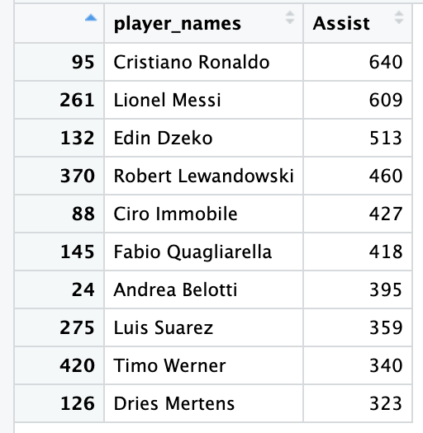
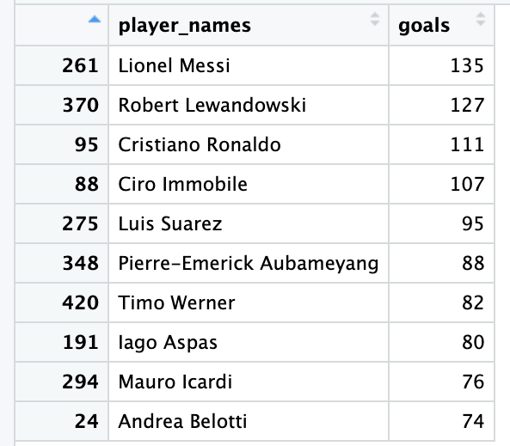
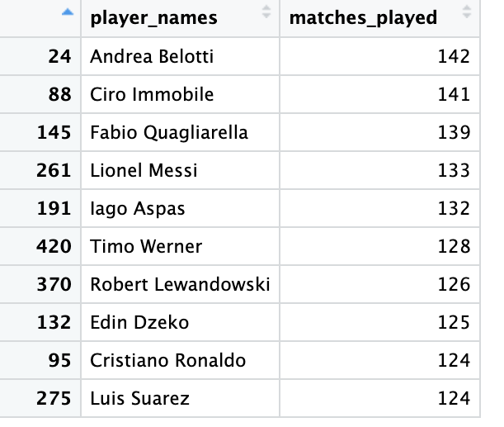
For the focused data to be analyzed these are the results for the top 10 players in terms of goals, assists, and matches played.

Slide 8
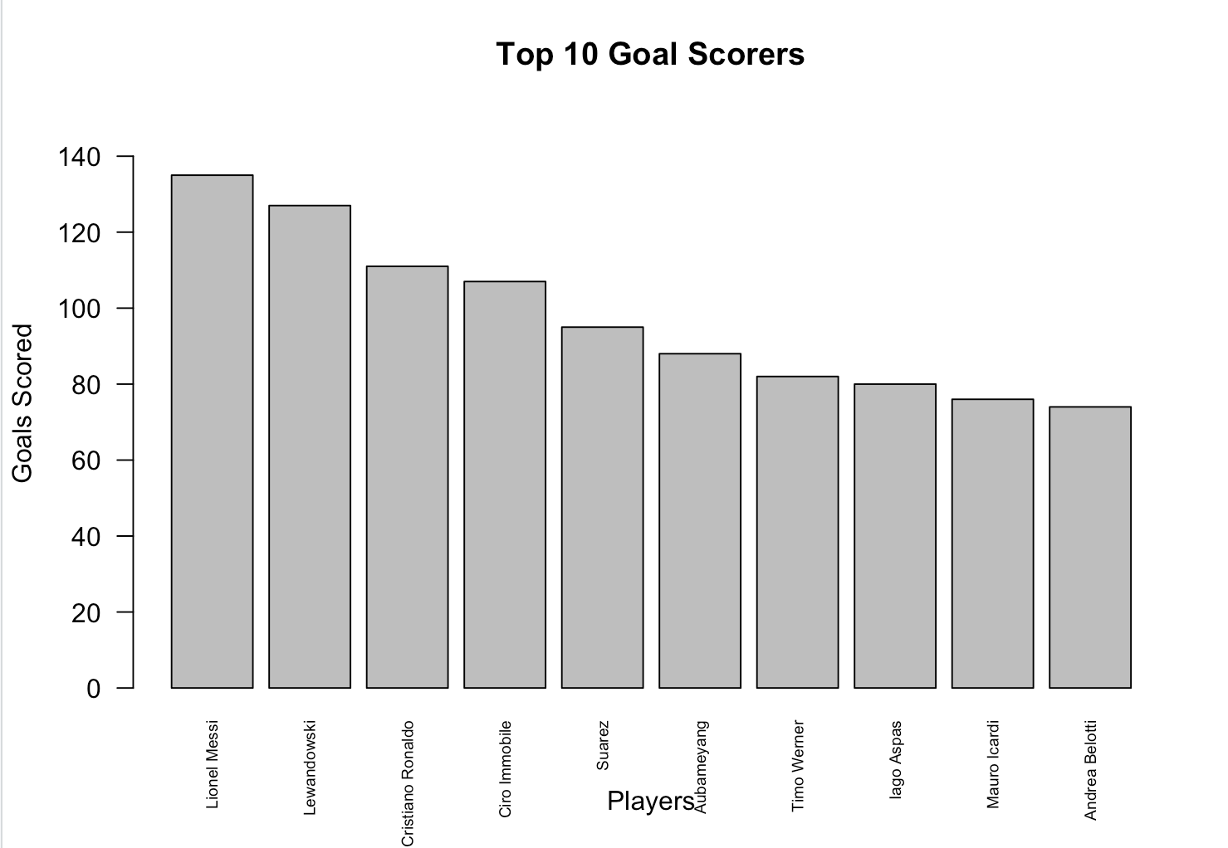
This bar chart displays the number of goals scored by the top 10 players across the top leagues.
The x-axis represents the names of players and the y-axis represents goals scored and it ranges from 0 to 140
From the bar chart, we can see Lionel Messi has the highest number of goals followed by Lewandowski. The player with the least goals is Andrea Belotti.
This distribution is right-skewed which from our previous slides the mean was greater than the median so before plotting this bar chart I expected the distribution to be right skewed

Slide 9
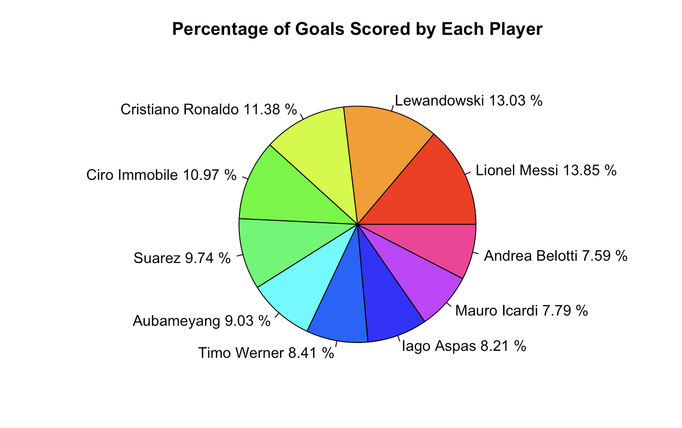
Percentage of goals scored by top 10 players across the top leagues
The sum of goals scored by the top 10 players scored was 975 and the percentage was calculated and the result is displayed in the pie chart.

Slide 10
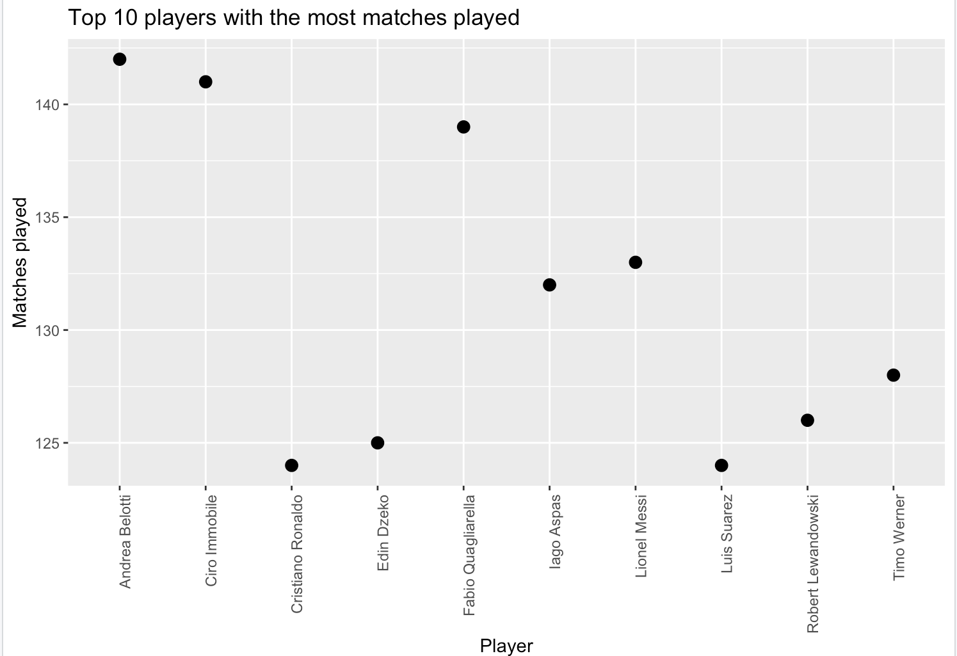
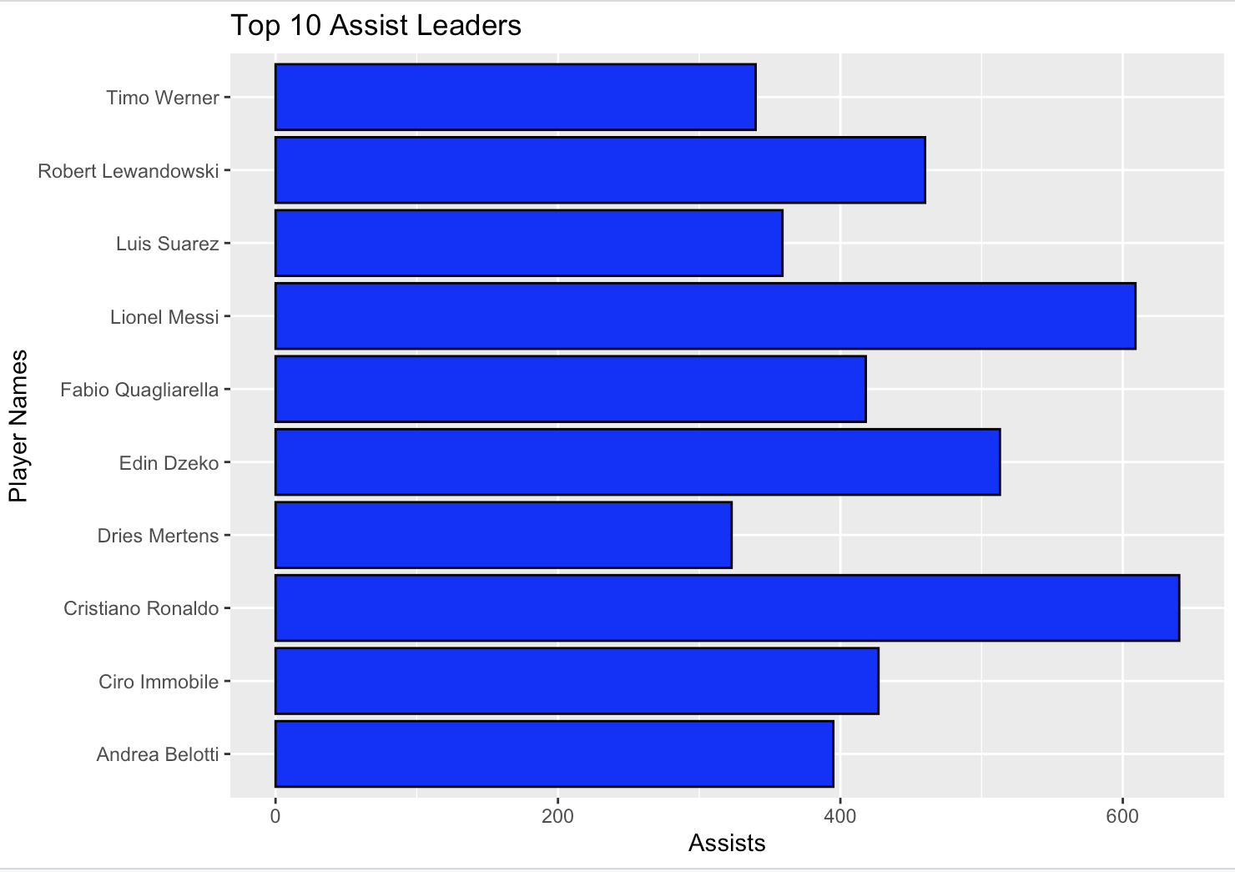
In this scattered plot the x-axis represents the name of players and the y-axis represents the number of matches played ranging from 120 to155
This scattered plot shows the distribution of the top 10 players with the most matches played, Andrea Belotti who was the player with the last spot in the top 10 goals ranking came first with 142 matches played and Luiz Suarez came last in the top 10 category of matches played.
The x axis represents the number of assists and ranges from 0 to 650 and the y-axis represents the name of the top 10 players
This histogram also displays the distribution of the Top 10 Assist Leaders, Cristiano Ronaldo comes first in this category with 640 assists followed by Lionel Messi with 609. Dries Mertens comes in 10th with 323 assists out of the top 10 assist leaders.

Slide 11
0bservations
In this dataset, we can say by the analysis of the various categories the best player, in general, will be Lionel Messi as he is among the top 2 in both goals and assists from the year 2016 to 2020and playing fewer games than some players has higher goals and assist
In the case of an award scheme for the best top 3 players in the world from this dataset, Lionel Messi will be adjudged the winner followed by Ronaldo with Lewandowski in 3rd Place based on the data provided.
From this we can see the player with the most matches played doesn’t necessarily have the most goals scored it takes special abilities and talent to be the best.
There was a total of 7775 goals scored by the selected players Across the top leagues in the dataset.

Slide 12

THANK YOU
This Photo by Unknown Author is licensed under CC BY-NC-ND

Slide 13
Bibliography
Hany, M. (2020, December 4). Top football leagues scorers. Kaggle. Retrieved February 15, 2023, from https://www.kaggle.com/datasets/mohamedhanyyy/top-football-leagues-scorers
Kabacoff, R. (2015). R in action: Data analysis and graphics with R. Manning.
GeeksforGeeks. (2021, December 9). R - charts and graphs. GeeksforGeeks. Retrieved February 7, 2023, from https://www.geeksforgeeks.org/r-charts-and-graphs/
jaannawaz2007. (2020, September 25). Create simple graphs in R studio | R beginners graphs tutorial | bar plot | scattered | box plot. YouTube. Retrieved January 24, 2023, from https://www.youtube.com/watch?v=yBvOS91jIXI

