Slide 1


ALMEIDA Mickael
ZERARKA Samy

Slide 2
Summary
I – The Data Structures
II – The functions
1) Index
2) Add
3) Load
4) Display Salary
5) Display Between
6) Conflicts Number
7) Conflict Average Size
8) Delete
9) Delete Between
10) Best Index Size

Slide 3
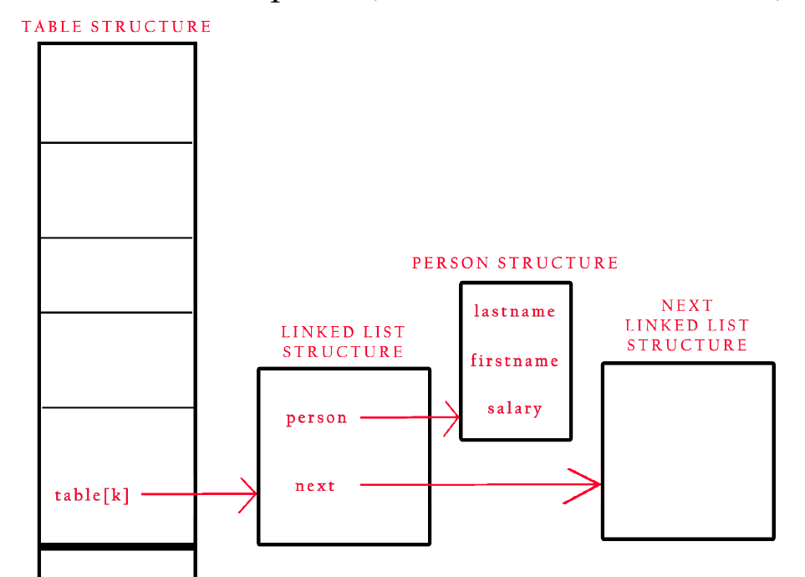
The Data Structures

Slide 4
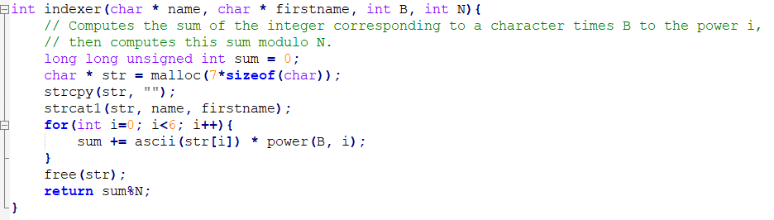
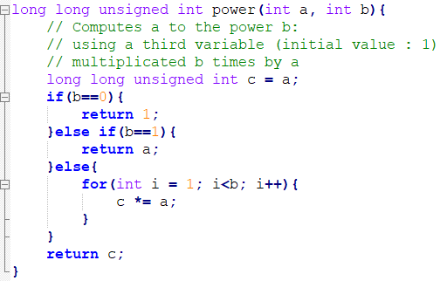
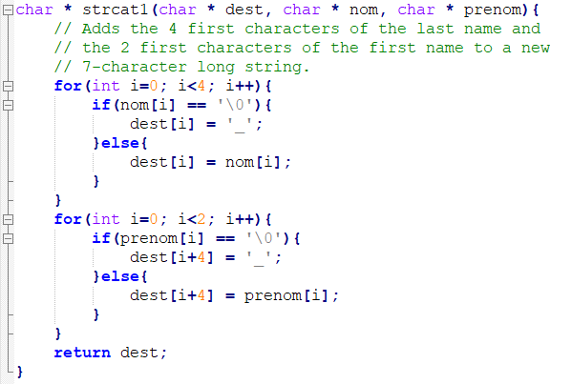
The Functions – 1 : Index

Slide 5
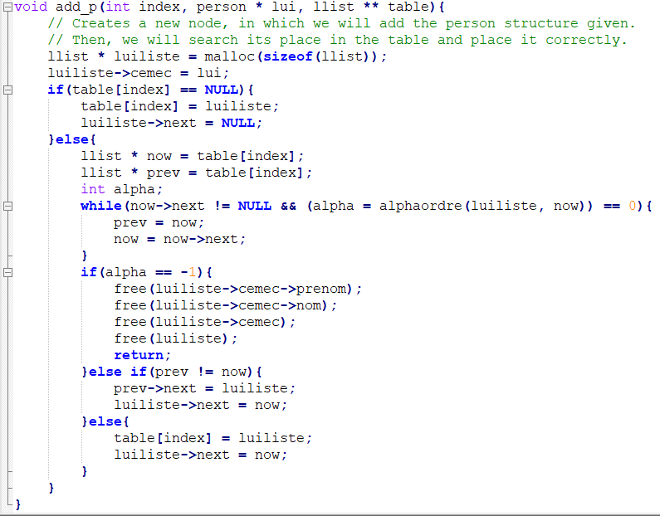
The Functions – 2 : Add

Slide 6
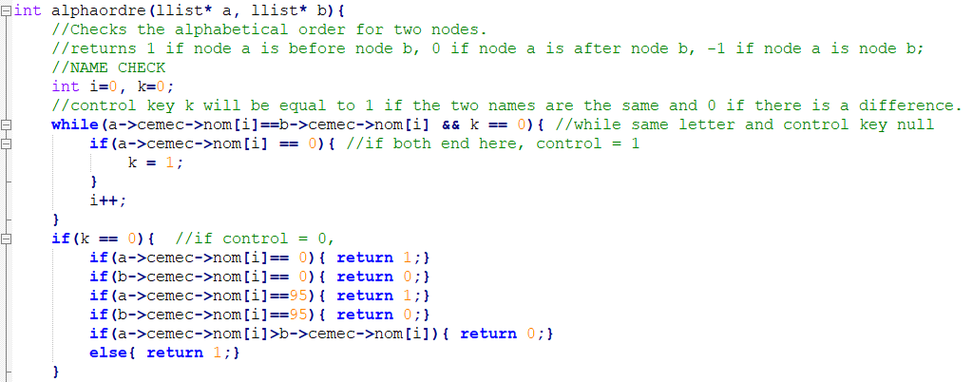
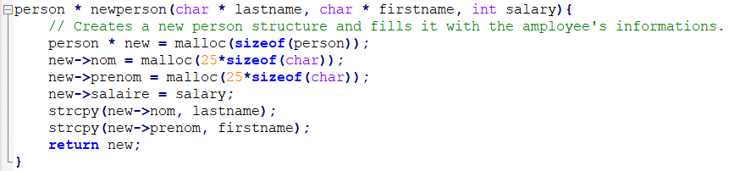

Slide 7
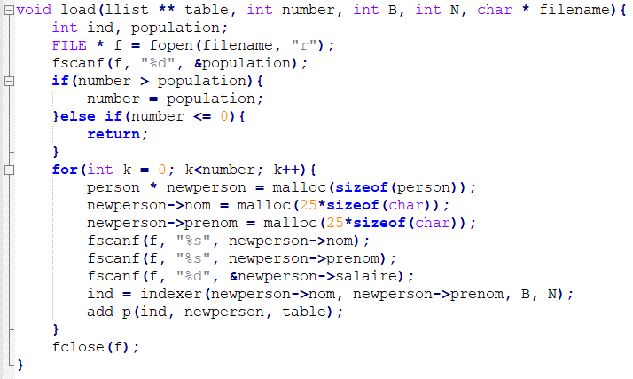
The Function – 3 : Load

Slide 8
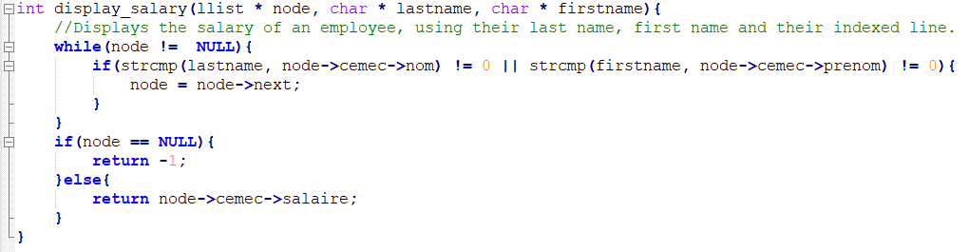
The Functions – 4 : Display Salary

Slide 9
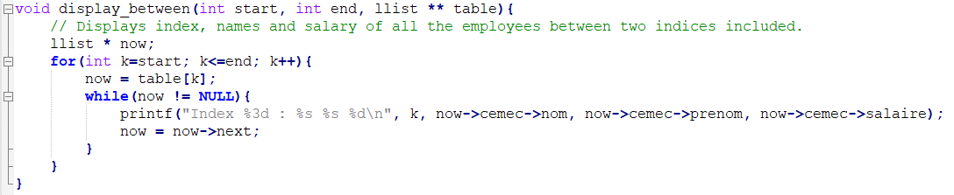
The Function – 5 : Display between

Slide 10
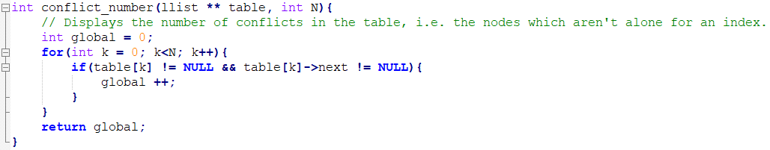
The Functions – 6 : Conflicts Number

Slide 11
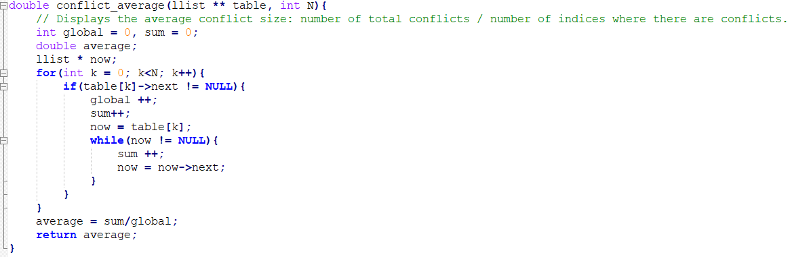
The Functions – 7 : Conflict Average Size

Slide 12
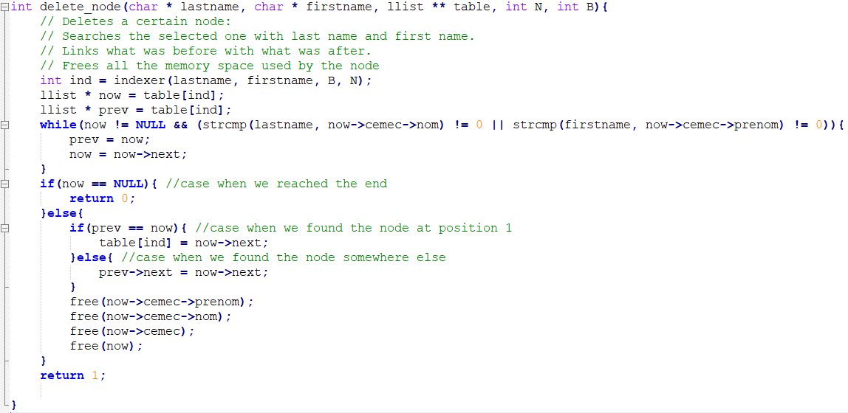
The Functions – 8 : Delete

Slide 13

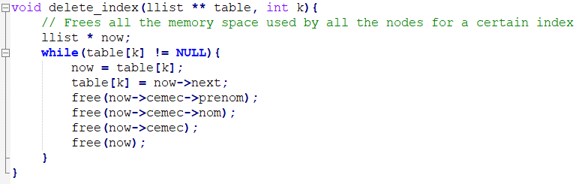
The Functions – 9 : Delete Between

Slide 14
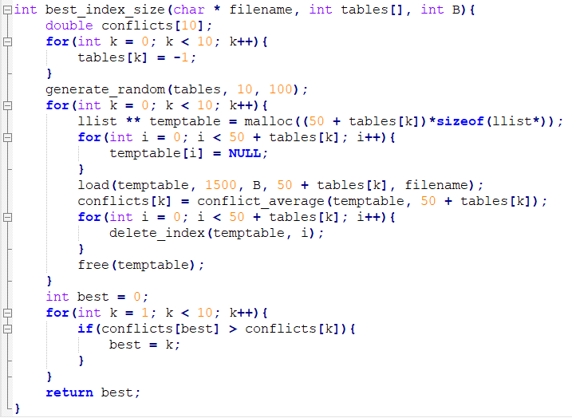
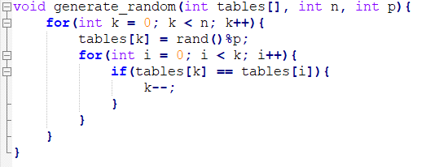
The Functions – 10 : Best Index Size

Slide 15
