Slide 1
v_diff
The only DIFF tool you’ll ever need by now

Slide 2
Arguments
 | --help | Display help message and exit
-v | --version | Display version information and exit
 | --normal | Output normal v_diff
-q | --brief | Report when files differ
-s | --report-identical-files | Report when two files are identical
-s | --ignore-case | Ignore case differences in file contents
-E | --ignore-case-expansion | Ignore changes due to tab expansion
-Z | --ignore-trailing-space | Ignore white space at line end
-b | --ignore-space-change | Ignore changes in the amount of white spaces
-w | --ignore-all-space | Ignore all white spaces
-B | --ignore-blank-lines | Ignore changes whose lines are all blank
-N | --new-file | Treat absent files as empty
 | --ignore-file-name-case | Ignore case when comparing file names
 | --no-ignore-file-name-case | Consider case when commparing file names
-r | --recursive | Recursively compare any subdirectories found
-c -C <int> | --context=<int> | Output <int> (default 3) lines of copied context
-u -U <int> | --unified=<int> | Output <int> (default 3) lines of unified context
-y | --side-by-side | Output in two columns
-e | --ed | Output an ed script
 | --hash=<str> | Hash type (default djb2, possible : djb2, djb2a, sdbm)

Slide 3
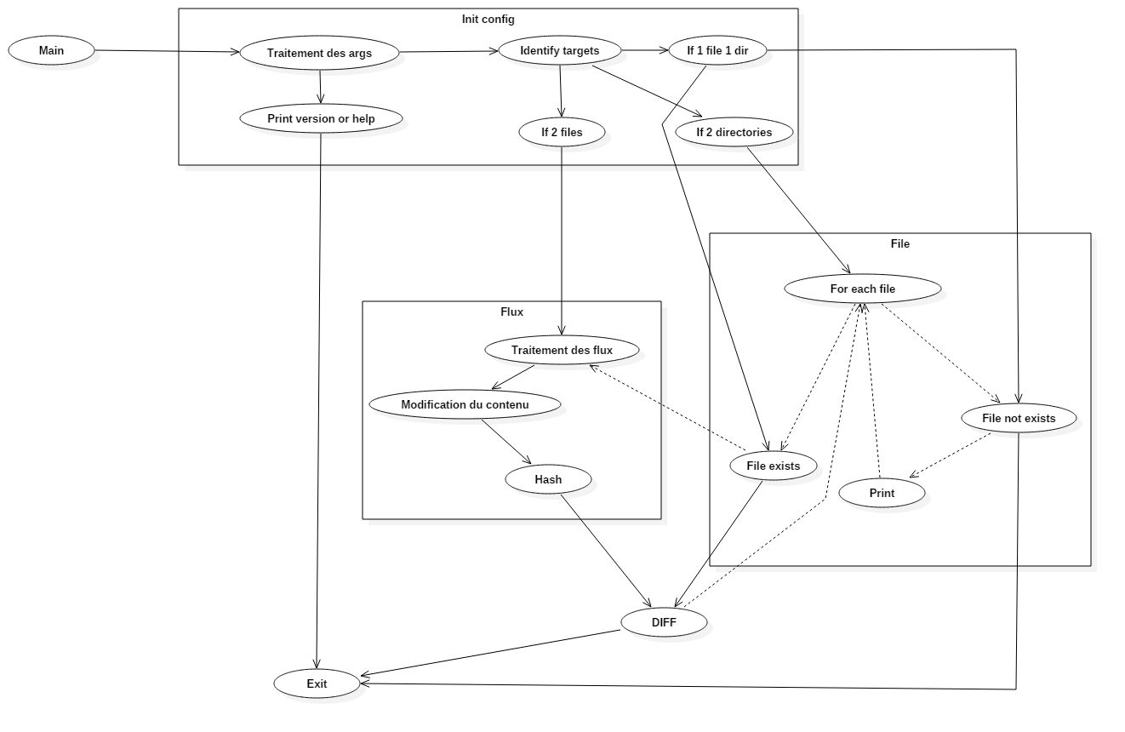
Workflow

Slide 4
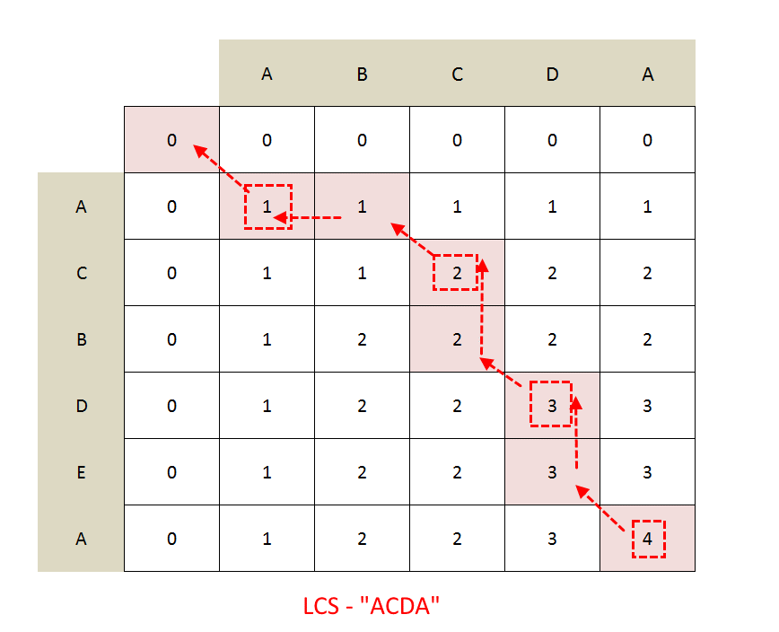
Algorithm: LCS

