Slide 1

Analyzing Customer Behavior
A Taobao Example
Yue HUANG / Xueting WANG / Kaiyu MU / Tianqi CAO / Zhen ZHAO / Xiao FANG / Surya PUTTA

Slide 2
Background
Taobao is one of the largest C2C e-commerce platforms owned by The Alibaba Group, China.
Sellers post products for sale either through a fixed price or auction.
Has approximately 300 million daily active users (DAU) .
Last year’s general merchandise sales were $853 billion.

Slide 3

Project Objectives
Analyze the traffic/activity, conversion rate, sales distribution and customer value
Gain insights on adveritising, sales promotions, top selling categories and customer segmentation
Decompose customer retention and average transaction value
Notes:
changed a little to match with 5 steps and flow charts

Slide 4

Data Source
Source: Tianchi, cloud sourcing community (https://tianchi.aliyun.com/dataset/dataDetail?dataId=53)
Datasets: Taobao’s sales data for Dec., 2014; 10 million data, covering 10000 users, 2.87million items, 8916 categories.
Notes:
TIANCHI is a crowd sourcing community of global data scientists which hosts big data competitions in various industries. Chinese version of Kaggle.
Behaviours: viewings, clickings, adding to wishlists, adding shopping carts, purchasing.
Timestamp: timing for viewing, clicking, purchasing.
User_geohash: location.

Slide 5
Analysis Flow Chart
User Views
Traffic
User Activity
Frequency
Sales
Item / SKU
Customer Behavior Analysis
Click
Wishlist
Conversion
Shopping Cart
(Re-) Purchasing
Segmentation
Customer Value
RFM Model
Notes:
Customer Behavior Analysis | Traffic: Page Viewings, UV | Conversion Rate: Clicks, Shopping cart, Wishlist, Purchasing, Repurchasing | Sales: Item, Category | Customer Value(RFM Model)

Slide 6


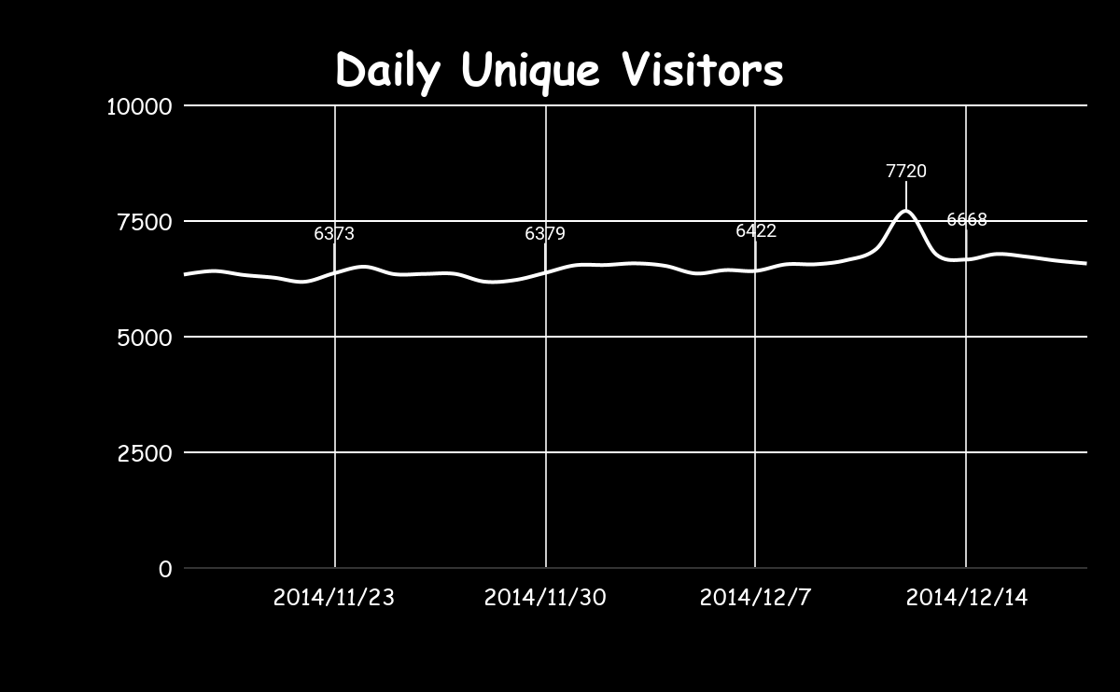
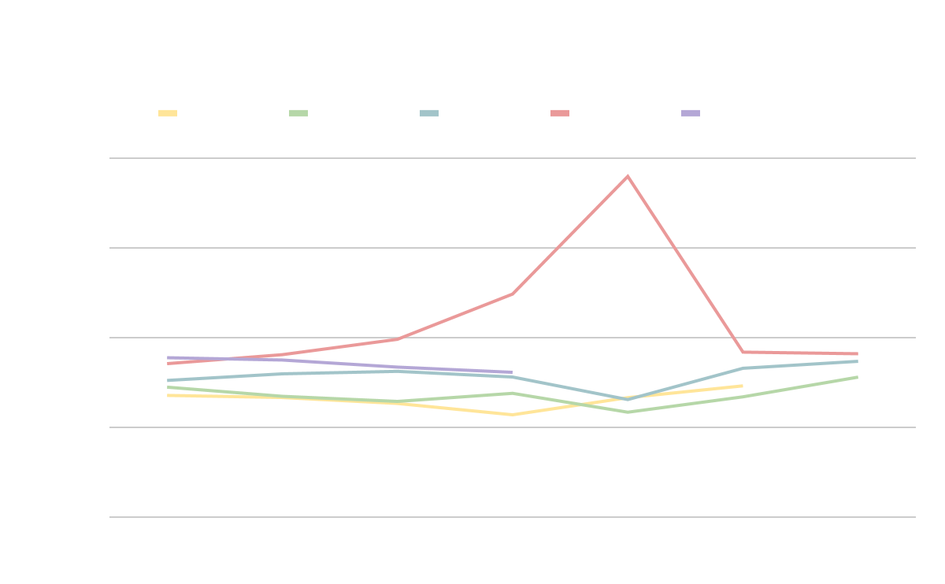
Weekly Viewings
Traffic Analysis
Daily Viewings
Daily Unique Visitors
Hourly Viewings
Notes:
Line charts to be inserted on the right with animations - well done
weekly:usual trend VS unusual trend , explain reasons
DU means a visitor with an IP while PV covers every refreshing

Slide 7
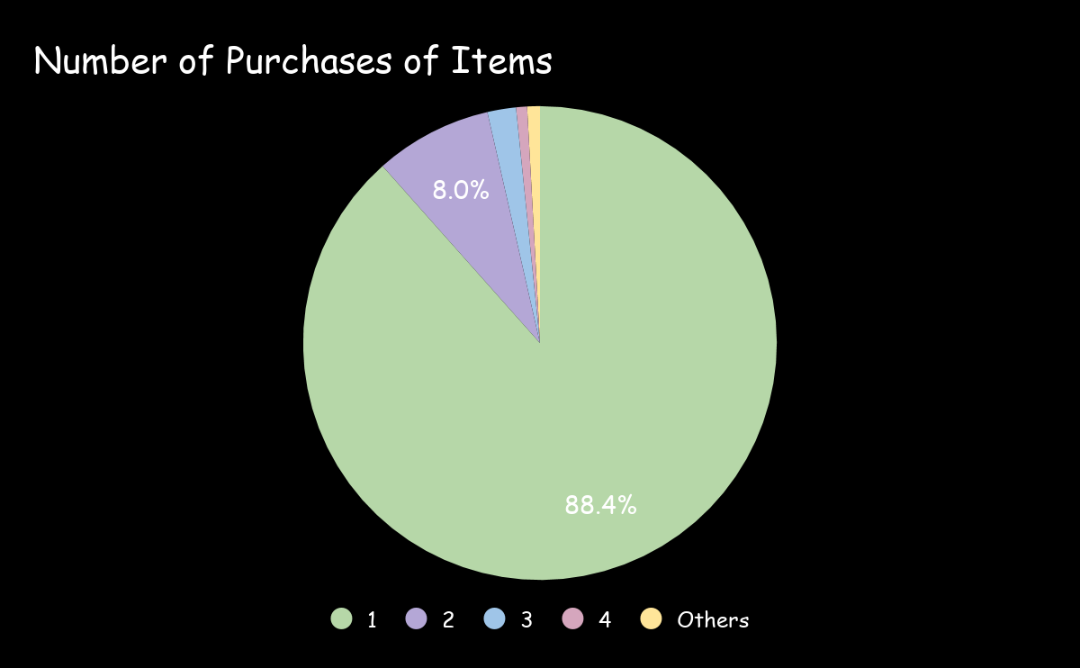
Sales Frequency
One-time purchases accounted for 88.4% of the total number of items sold
Sales were mainly concentrated on one-time customer’s good instead of daily and FMCGs.

Slide 8

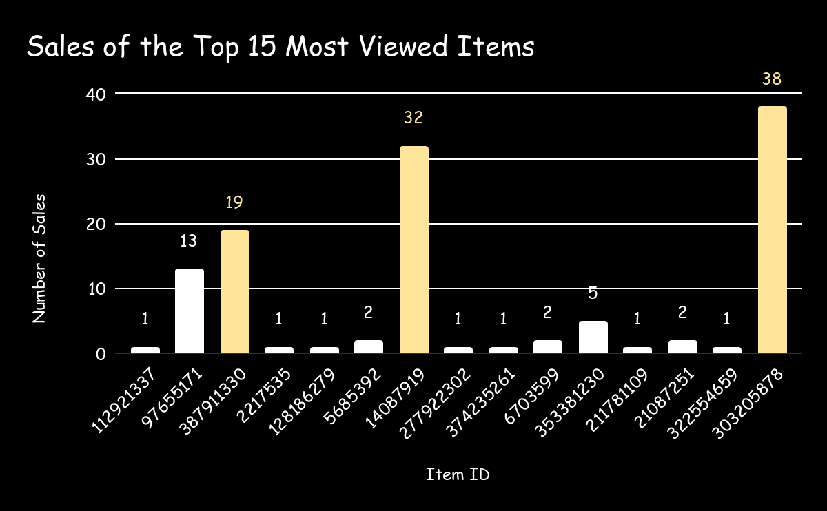
Sales of Items
The sequence of the most viewed items and the sales were not consistent.
Only 3 of the top 15 most viewed items were actually of the top 15 sales items.

Slide 9
Purchasing Process Analysis
Purchase
Conversion in
Purcharsing
Process
View
Wishlist
Purchase
Shopping Cart
Purchase
Notes:
All rates to be added later

Slide 10
Conversion Rate Analysis
User Views | View & Buy | User Conversion Rate | Frequency Conversion Rate
10000 | 8868 | 88.68% | 0.1272
Wishlist | Wishlist & Buy | User Conversion Rate | Frequency Conversion Rate
6730 | 3578 | 53.16% | 1.0448
Shopping Cart | Shopping Cart & Buy | User Conversion Rate | Frequency Conversion Rate
8614 | 7084 | 82.24% | 0.8915
User Conversion Rate = Percentage of users conducted actual purchases after previous actions
Frequency Conversion Rate = Total Purchase Times/ Total View/Wishlist/Cart Times (of active users)

Slide 11
Customer Value Analysis
88.9%
Users are PAYING customers
87.2% of them repurchased at least once within a month

Slide 12
Customer Value Analysis
Customer Segmentaion - RFM Model (Recency, Frequency, Monetary)
Segmentation | Recency | Frequency
Valued Customers | High | High
New Customers | High | Low
Risky Customers | Low | High
Lost Customers | Low | Low
Notes:
Need to talk about how we manipulated data and made this table, since we don’t have monetary information in our data

Slide 13
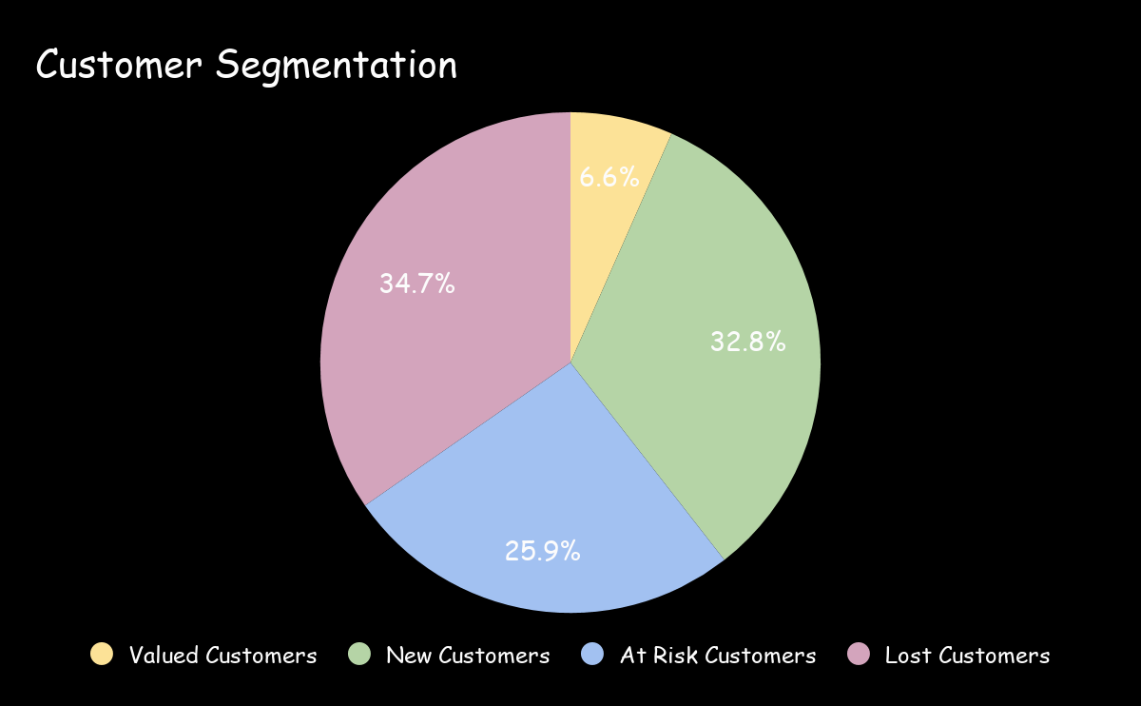
Customer Value Analysis
Vip service ( 88 membership)
Contact to figure out why
Coupon or special offer
Personalized Reactivation Campaign

Slide 14
Future Usage of Findings
Executives at Taobao:
Improve Customer Loyalty (88.86%)
VIP service to key customers
Advertisers
New Startups/ Business Owners
Time Preference
- peak viewing hours/days
Process Optimization
- shopping cart and wishlist
Research and invest on top items and categories
Logistics
Members
Prepare for promotions
Adocate for VIP service
Support brands/stores in communities

Slide 15
References
https://www.researchgate.net/publication/221186477_Beyond_Taobaocom_A_Case_Study_on_C2C_Market_in_China
https://expandedramblings.com/index.php/taobao-statistics/
https://tianchi.aliyun.com/dataset/dataDetail?dataId=53

Slide 16

THANK YOU
Any questions?

