Slide 1
Evolutionary Computation
An enhanced genetic approach to optimizing auto-reply accuracy of an e-learning system
Cara
10890021

Slide 2
https://www.ypppt.com/
CONTENTS
1
2
Introduction
Optimization Problem
3
4
Genetic algorithm
Enhanced genetic approach
5
Conclusions

Slide 3
01
Introduction

Slide 4
Introduction
Introduction
The rapid development of information technology has made the Internet the main learning medium.
The existing online learning system lacks real-time help and only provides subject materials for browsing.
Lack of immediate help when students encounter problems can lead to lower academic performance.
Online discussion groups are often used to solve problems, but the answers are often inaccurate or incomplete.
A self-regulating virtual tutoring assistant system is proposed that can automatically answer student questions based on training cases provided by teachers.
The system accepts student feedback and adjusts the keyword weights of candidate answers to provide more accurate answers.
Experimental results show that the system can provide more accurate answers and provide student Q&A services around the clock, helping to improve academic performance.

Slide 5
02
Definition of auto-reply accuracy optimization problem

Slide 6
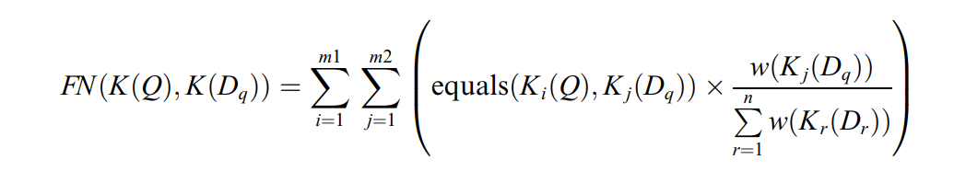

Definition of auto-reply accuracy optimization problem
Automatic reply system based on keyword similarity
Optimization of automatic reply accuracy: Improved performance of automatic reply system based on training weights

Slide 7
03
Genetic algorithm

Slide 8
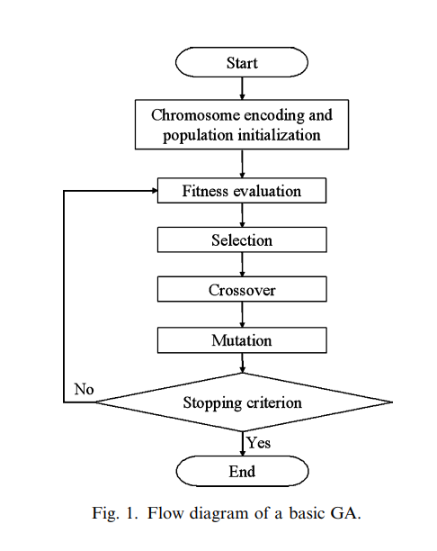
Genetic algorithm
FLOW CHART
GA consists of several components
1
Chromosome encoding and population initialization
2
Fitness evaluation
3
Selection
4
Crossover
5
Mutation

Slide 9
04
Enhanced genetic approach

Slide 10
Enhanced genetic approach to optimizing the weights of keywords
Segment n training questions, construct keyword vector
Step 1
Use roulette wheel selection for next population.
Step 4
Genetic approach: initial population of chromosomes. Each chromosome is a candidate keyword weight matrix. One uses TF·IDF model values, others random [0.0, 1.0].
Use two-point crossover for offspring.
Step 2
Step 5
Evaluate fitness using
Introduce new genes through mutation.
Step 6
Step 3
Repeat Steps 3-6 until reaching a specified number of generations or a predefined fitness threshold.
Step 7

Slide 11
Example
Q1 = ‘‘What is constructive knowledge?’’
Q2 = ‘‘What are the properties of procedural knowledge?’’
Q3 = ‘‘What is strategic knowledge?’’
Q4 = ‘‘What is semantic knowledge from the learner’s point of view?’’
Q5 = ‘‘What are the four categories of knowledge classified based on the learner’s point of view?’’
D1 = ‘‘The constructive knowledge indicates what kind of knowledge has been derived and accumulated via interactions among other people and this knowledge is classified based on the learner’s point of view.’’
D2 = ‘‘Procedural knowledge indicates a set of step-by-step operations that follow a specified sequence to achieve the goal.’’
D3 = ‘‘Strategic knowledge is the knowledge derived and accumulated via a series of learning activities.’’
D4 = ‘‘Semantic knowledge is the knowledge obtained via the analysis of the meanings in the context.’’
D5 = ‘‘From the learner’s point of view, there are four categories of knowledge, that is, constructive knowledge, procedural knowledge, strategic knowledge and semantic knowledge.’’

Slide 12
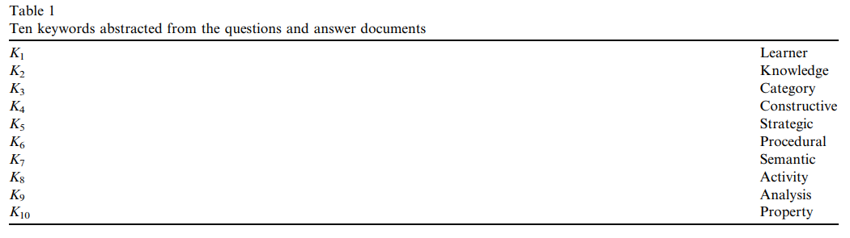
Example
K(Q1) = {constructive, knowledge}
K(Q2) = {property, procedural, knowledge}
K(Q3) = {strategic, knowledge}
K(Q4) = {semantic, knowledge, learner}
K(Q5) = {knowledge, learner, category}
K(D1) = {constructive, knowledge, learner}
K(D2) = {procedural, knowledge}
K(D3) = {Strategic, knowledge, activity}
K(D4) = {Semantic, knowledge, analysis}
K(D5) = {learner, category, knowledge, constructive, procedural, strategic, semantic}.

Slide 13
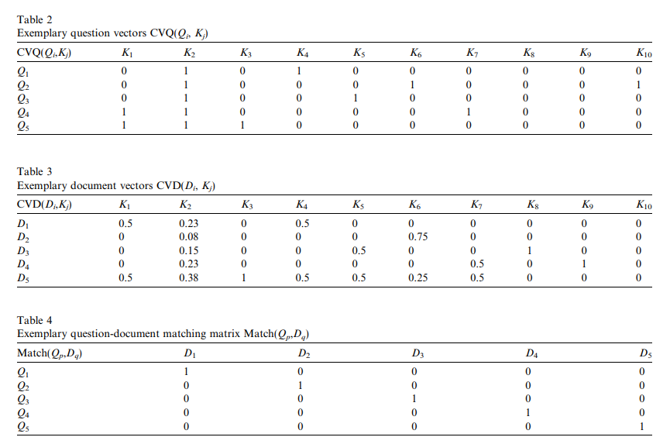
Example

Slide 14
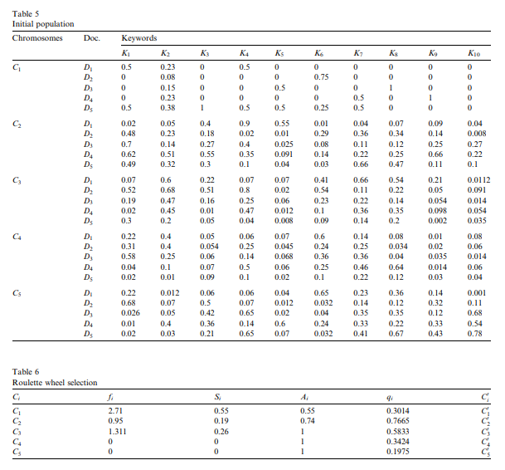
Example

Slide 15
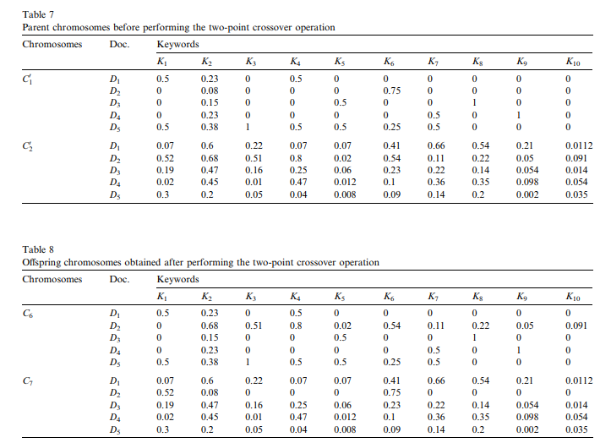
Example

Slide 16
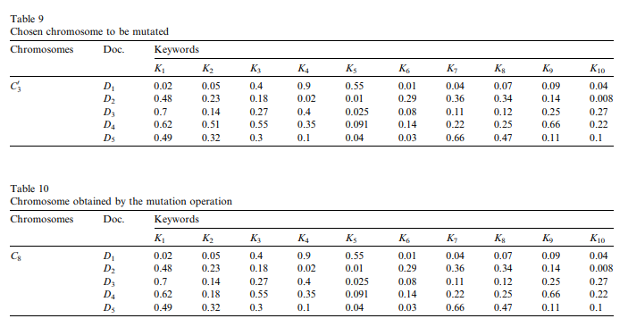
Example

Slide 17
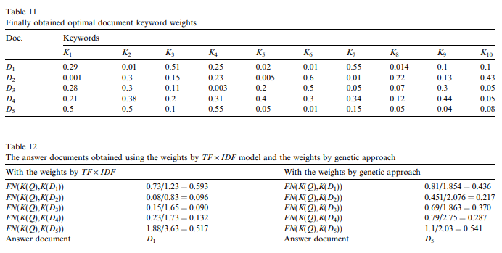
Example

Slide 18
05
Conclusions

Slide 19
Thank You
For Your Listening

