Slide 1
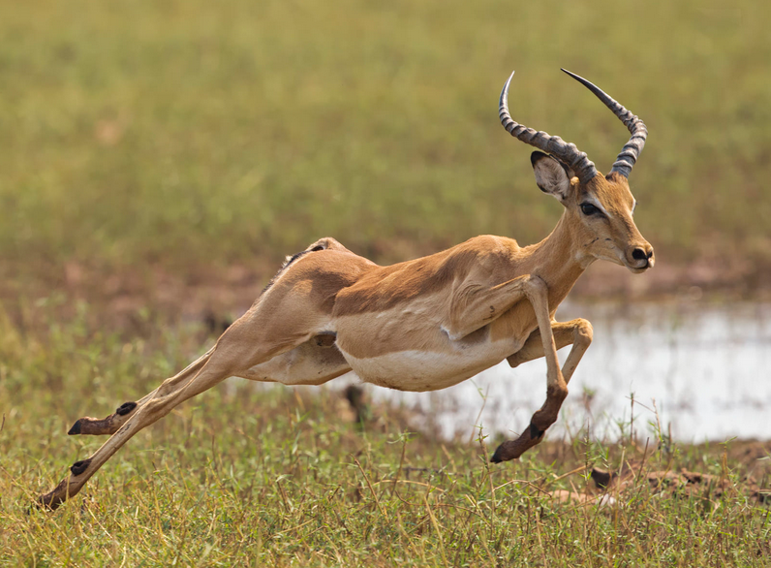
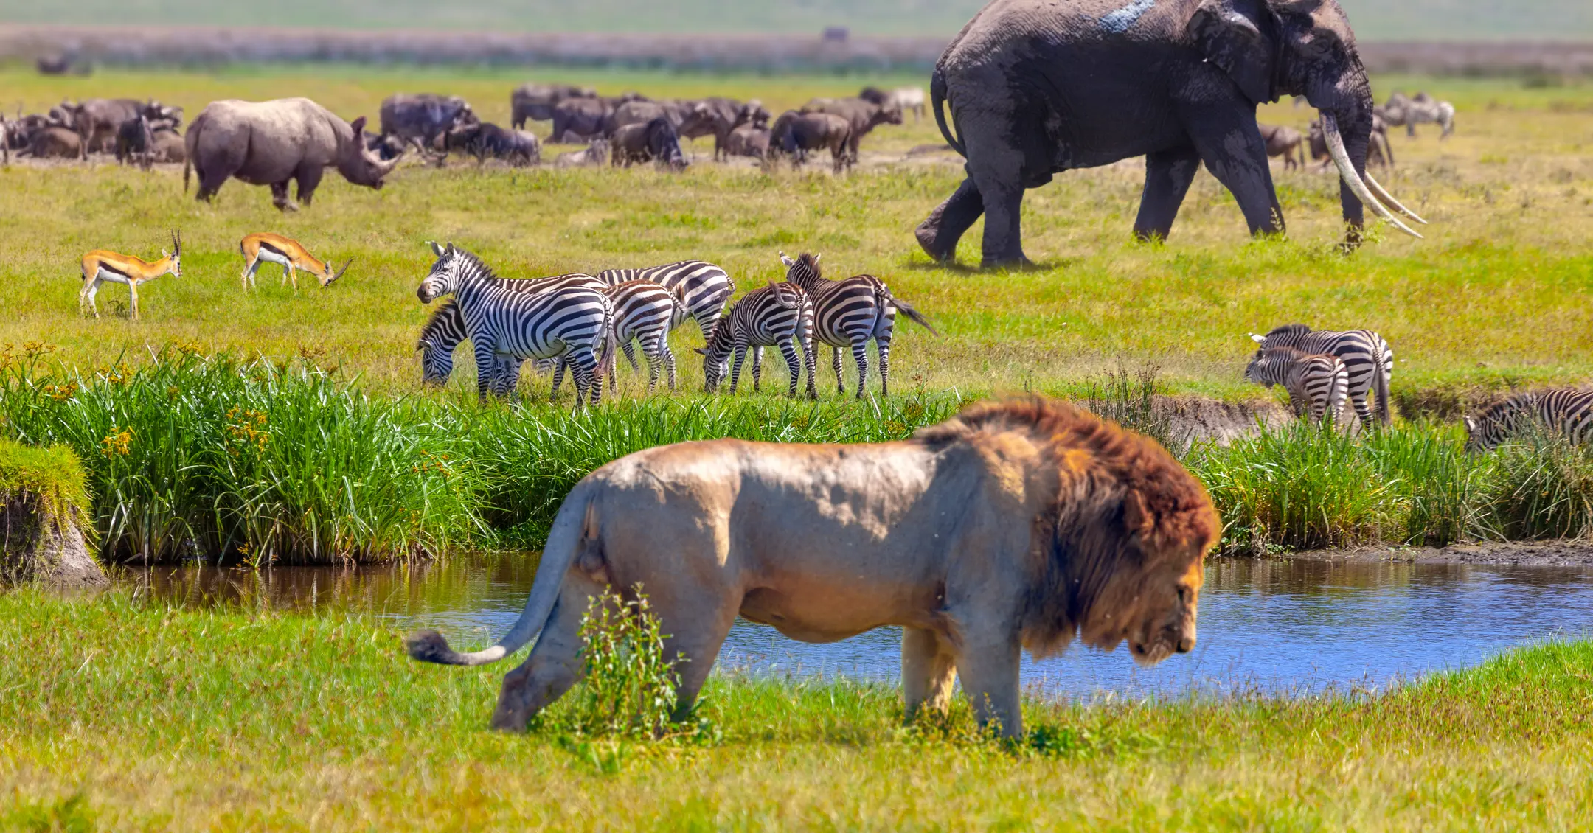
From individual energetics to biodiversity patterns
Ken Watkins
iStock

Slide 2

On the population level
Movement
behavior
Energetics

Slide 3
Why do animals differ in their energy use?
5 MJ day⁻¹
10 MJ day⁻¹
Body size, ecology
Interspecies
5 MJ day⁻¹
6 MJ day⁻¹
Genetics, development, personality, etc.
Intraspecies, Among-individual
5 MJ day⁻¹
4 MJ day⁻¹
Activity, behavior, health, compensation, etc.
Within-individual

Slide 4
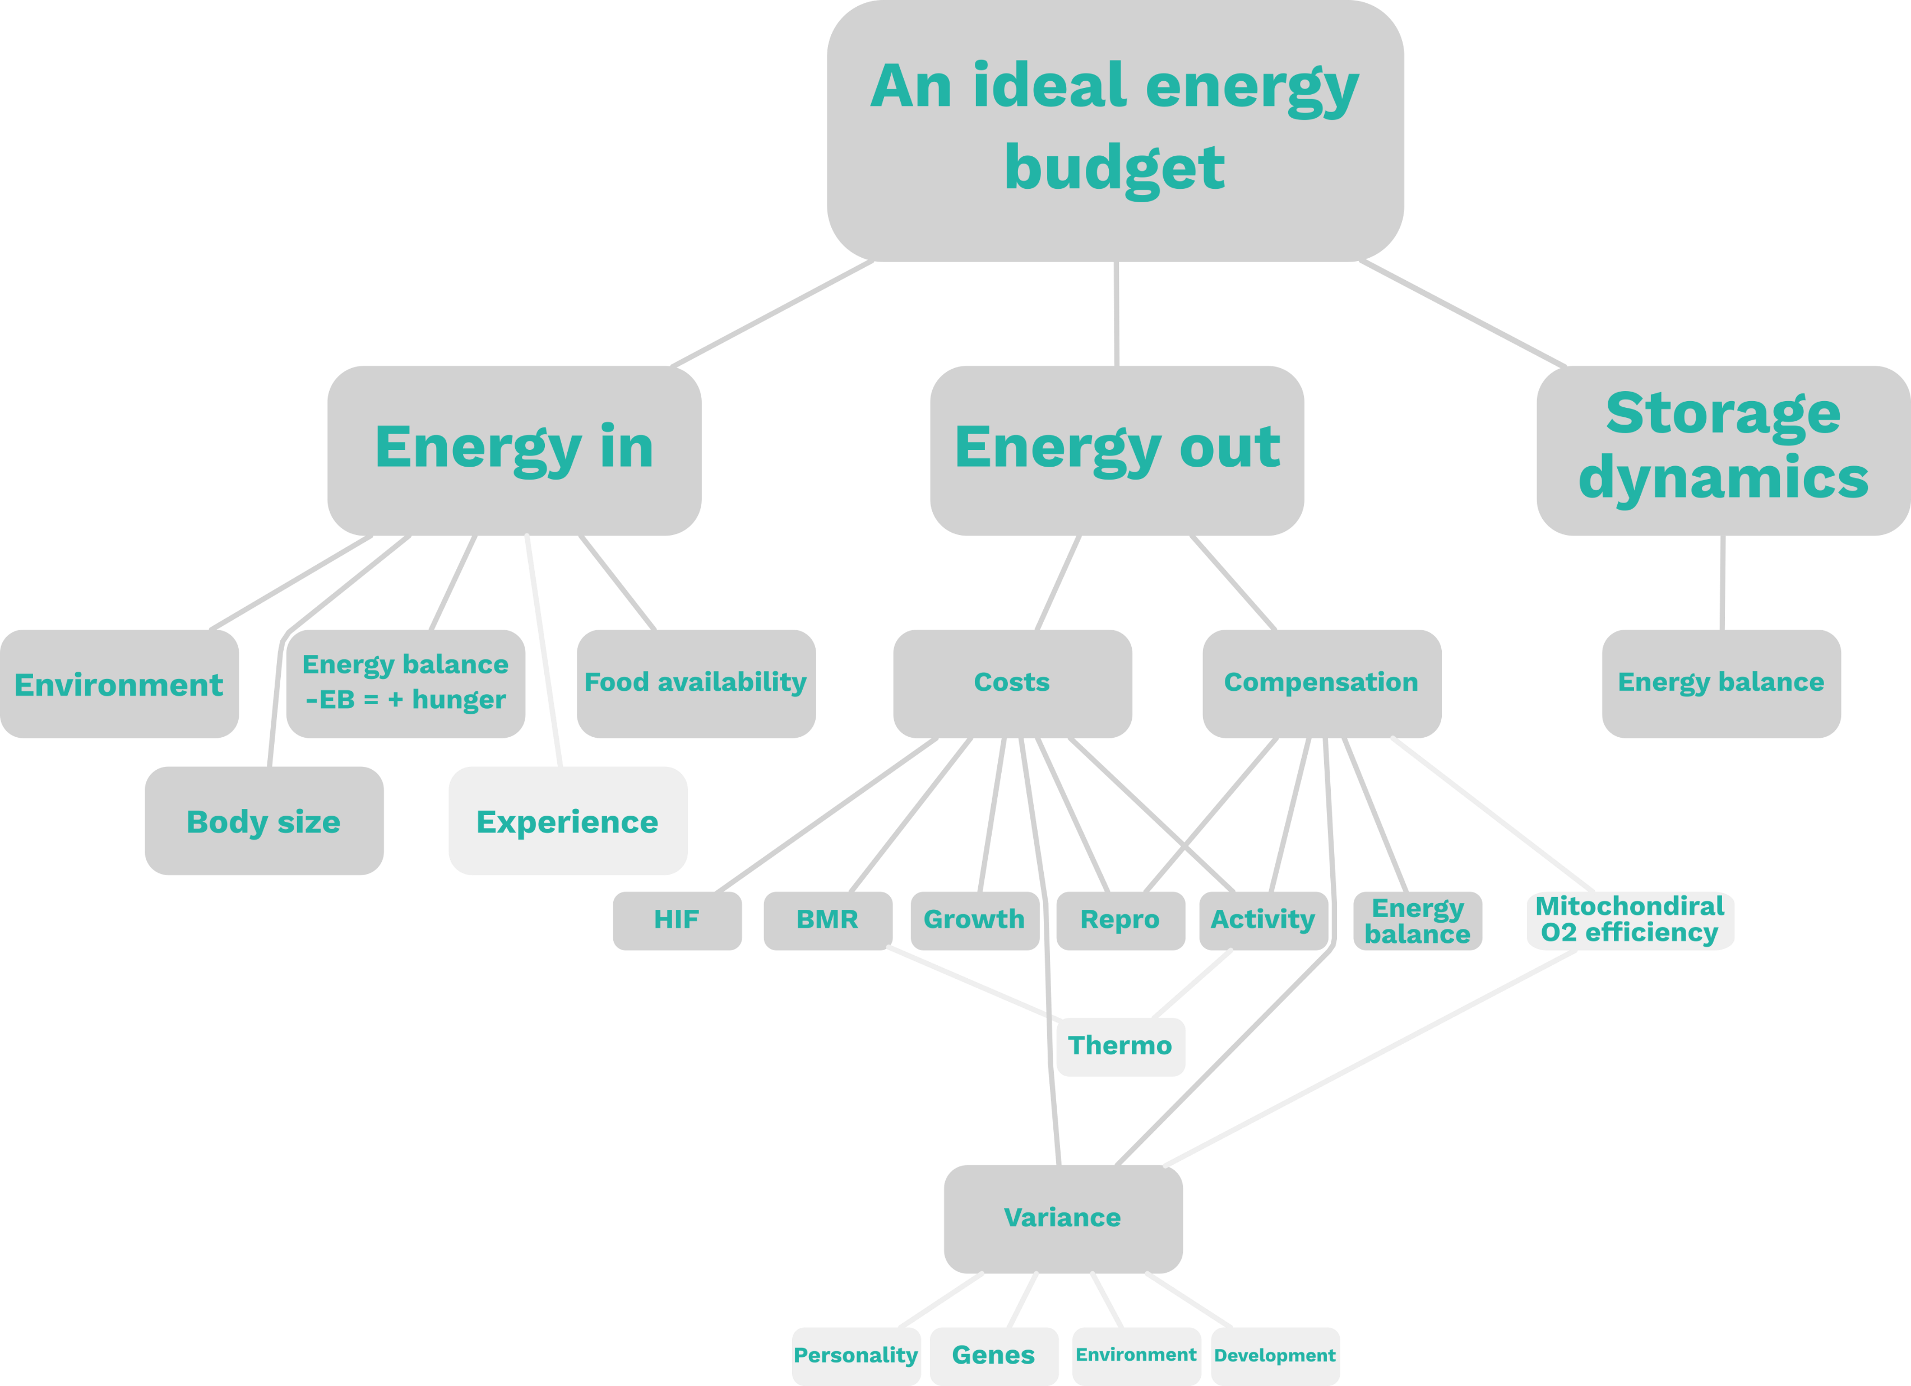
Causal diagram drafting

Slide 5
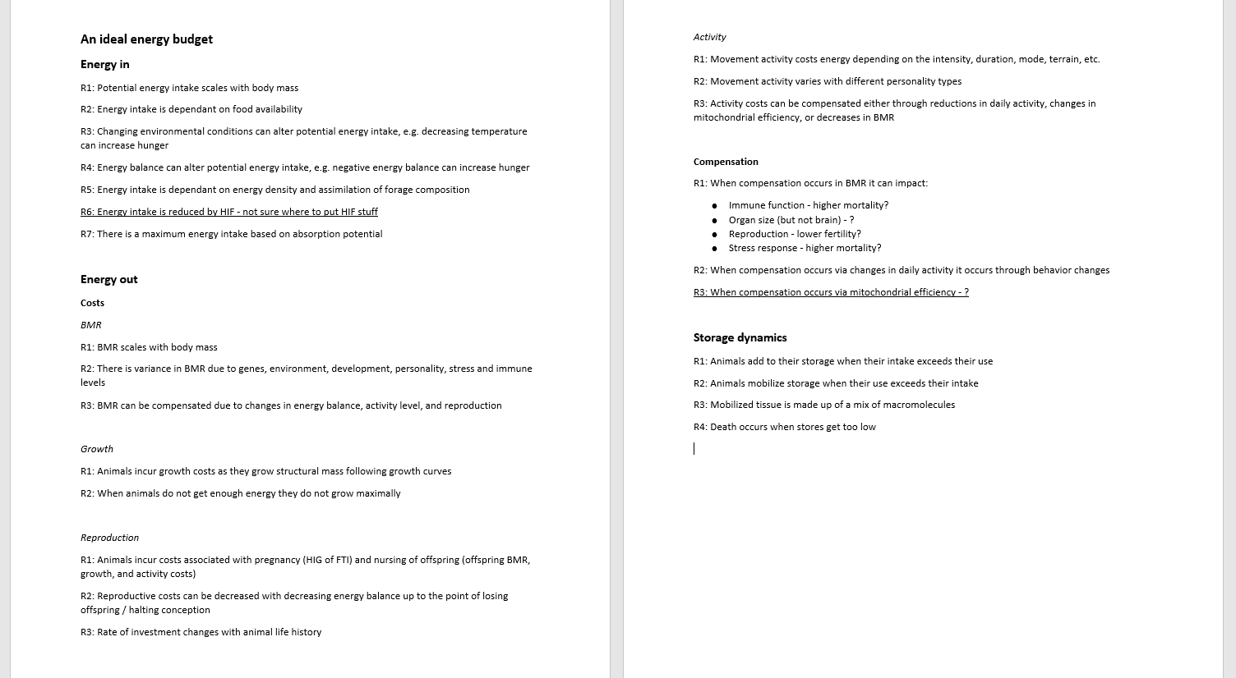
Rule set drafting

Slide 6
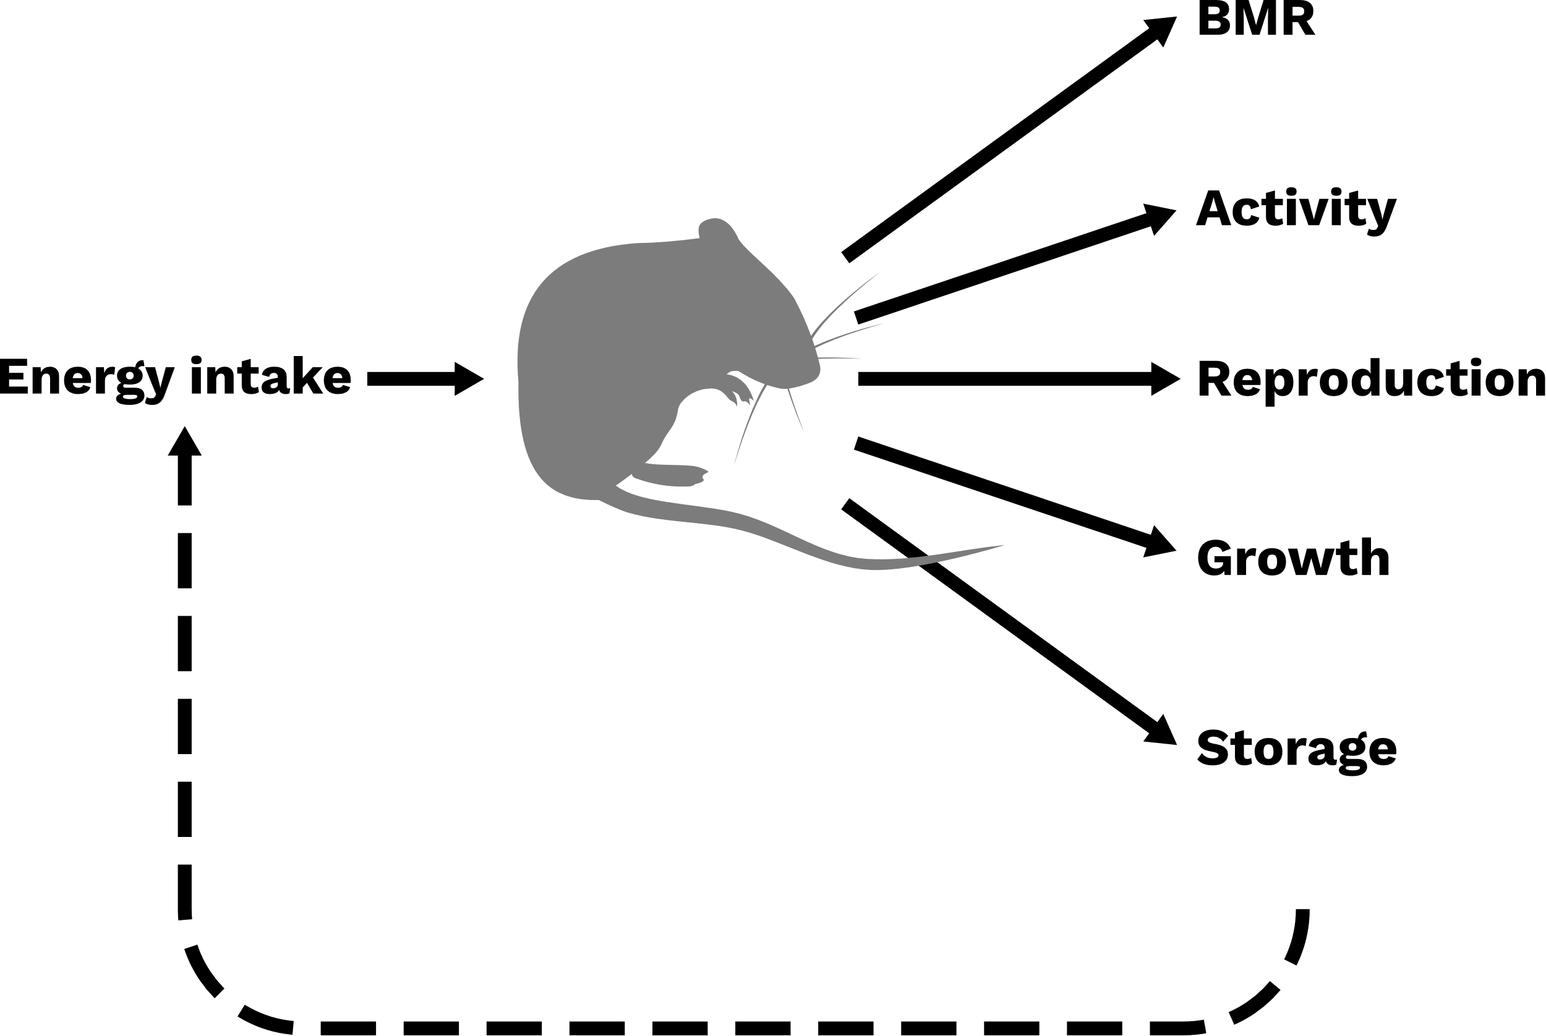
Parameterized with small mammal data?

Slide 7

An empirical study?
With Jana and the Animal Ecology group
Personality
Activity
Energy use

Slide 8


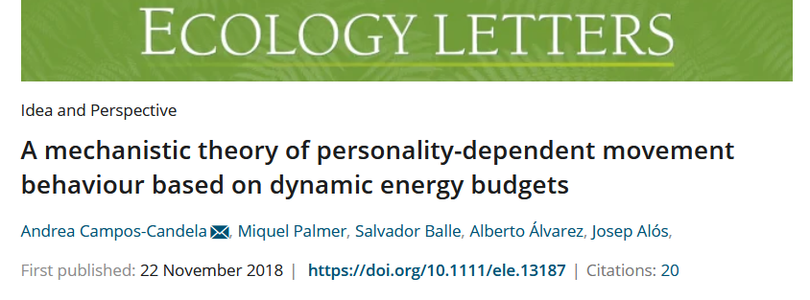
Question 1
How does the environment and food availability shape the metabolisms of species?
Body mass
Slow POL
Fast POL
4 MJ day⁻¹
5 MJ day⁻¹
6 MJ day⁻¹
4 MJ day⁻¹
5 MJ day⁻¹
6 MJ day⁻¹
4 MJ day⁻¹
5 MJ day⁻¹
6 MJ day⁻¹
Under varying conditions & food shortage
Population size, reproductive success, body mass

Slide 9
Question 2
How does individual metabolic variation impact population dynamics?
5 MJ day⁻¹
4 MJ day⁻¹
6 MJ day⁻¹

Slide 10




Question 3
How does energy compensation impact population dynamics?

Slide 11
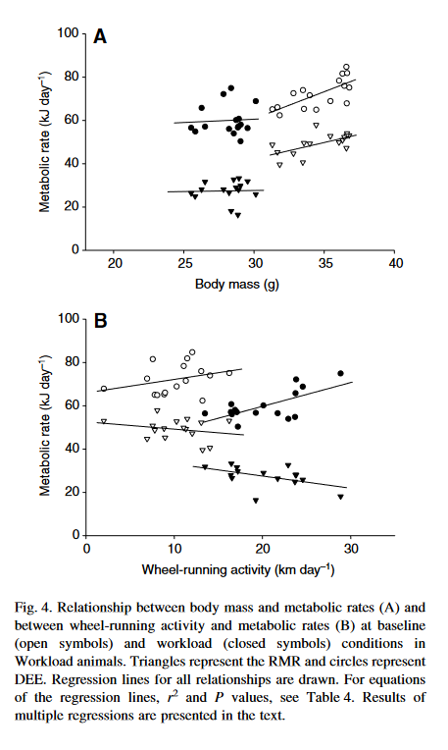
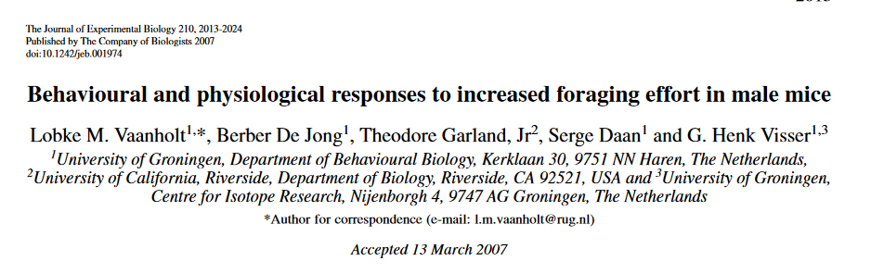
Question 3
How does energy compensation impact population dynamics?

Slide 12
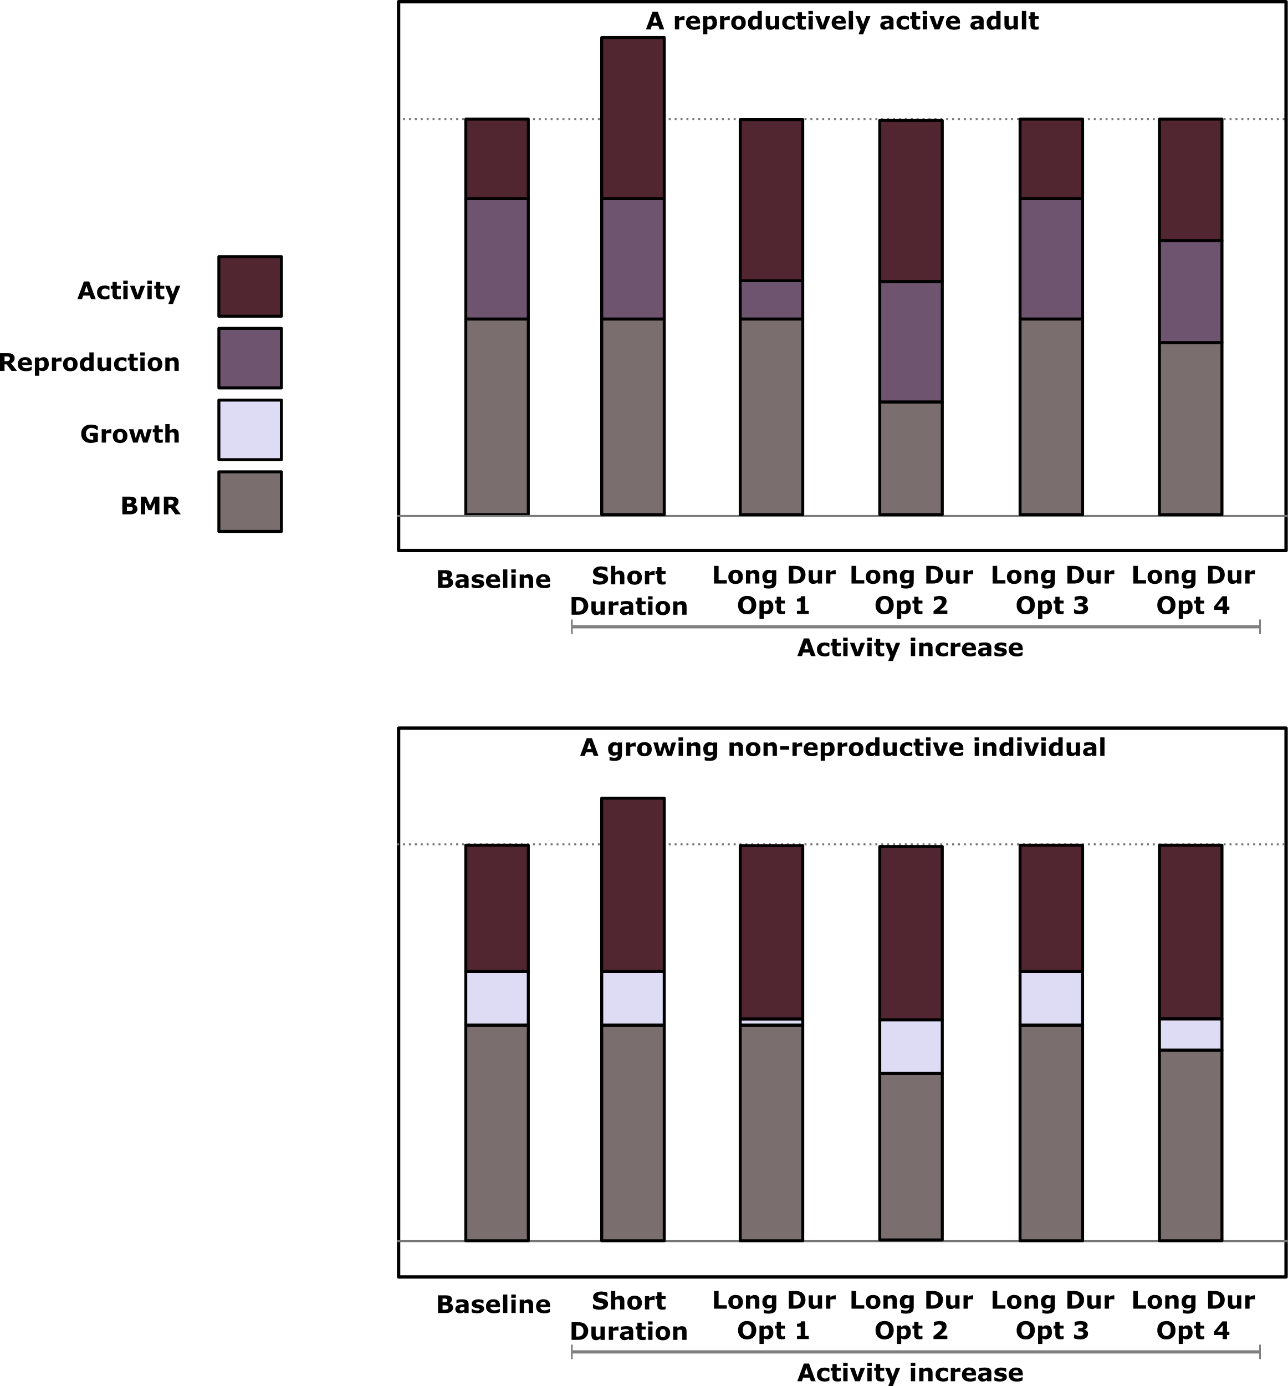

Slide 13
Going forward…
Need to think about how to implement movements
Sort out details for how to model processes
Look for parameters and patterns
Make some timelines

