Slide 1

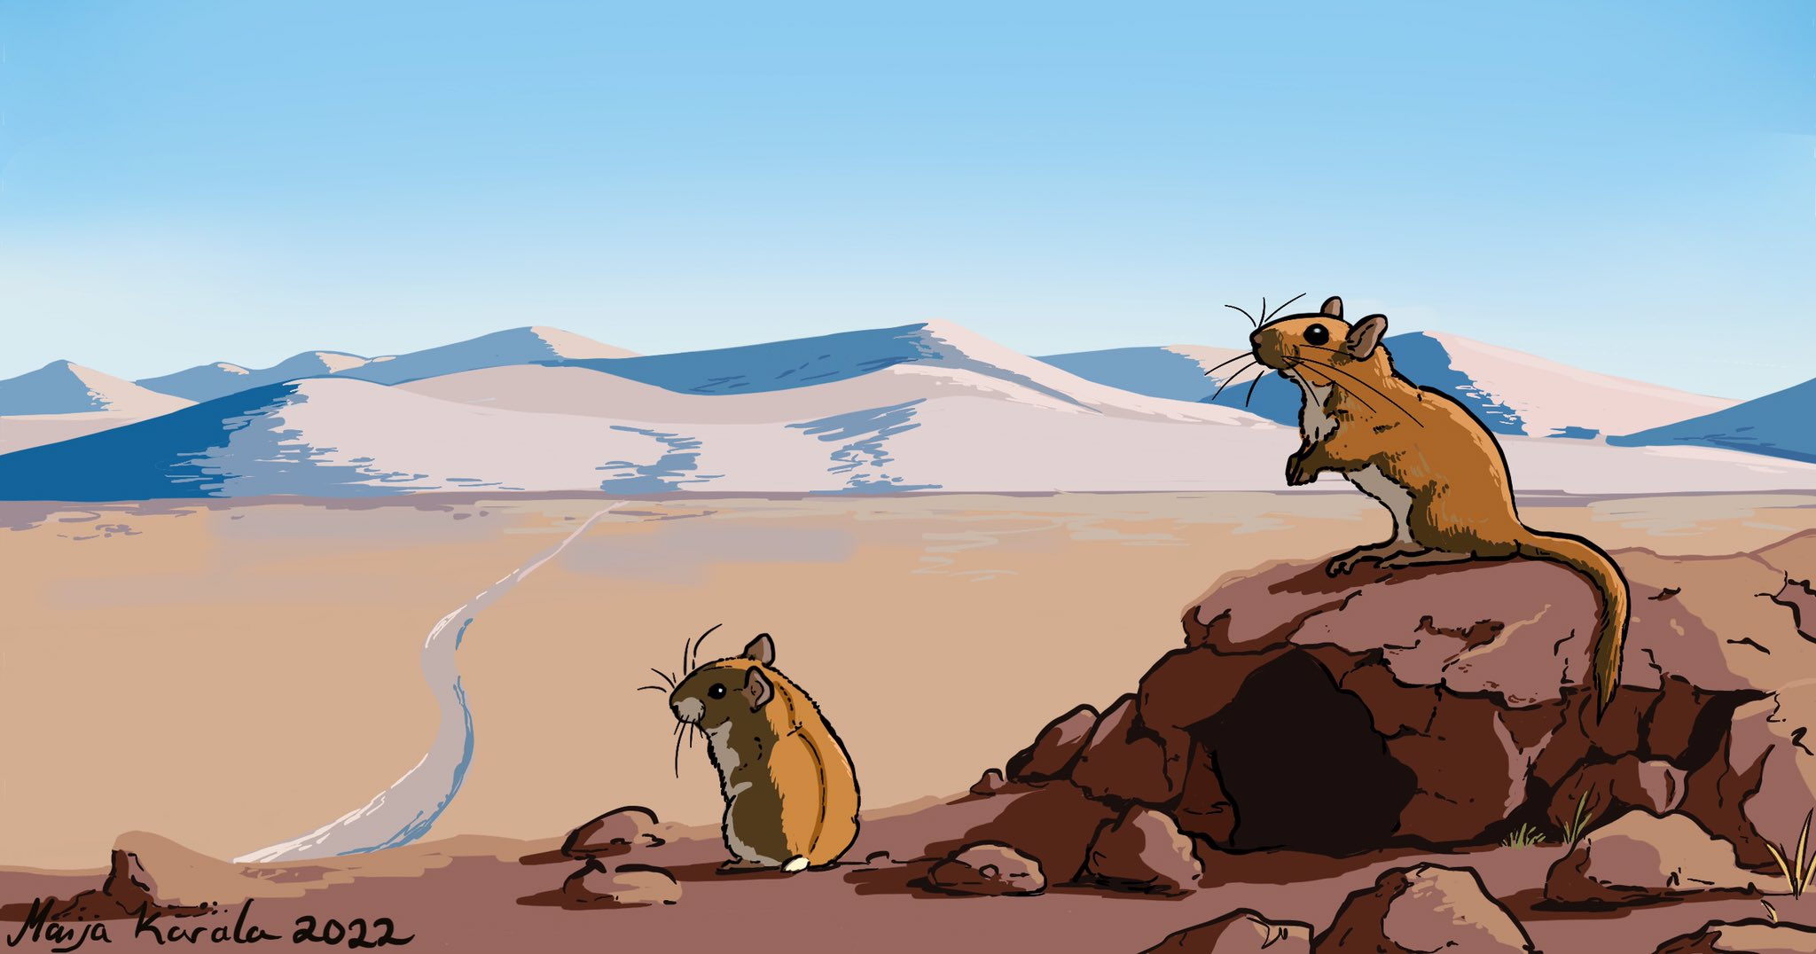
Modelling the evolution of metabolic phenotypes in terrestrial mammals

Slide 2


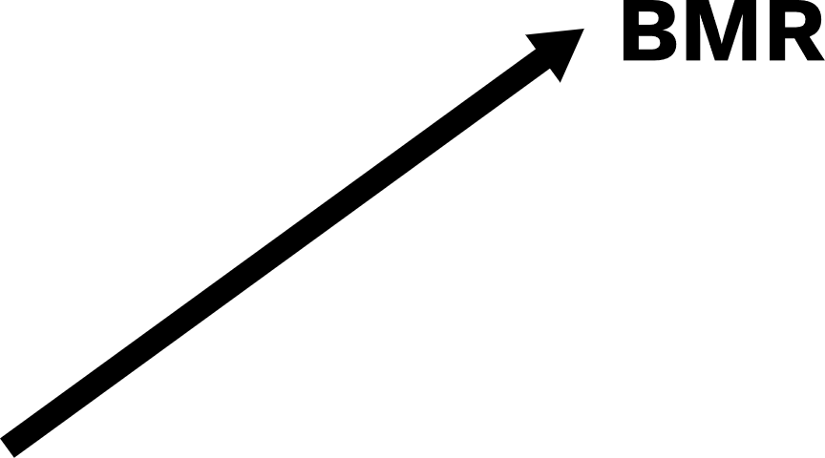




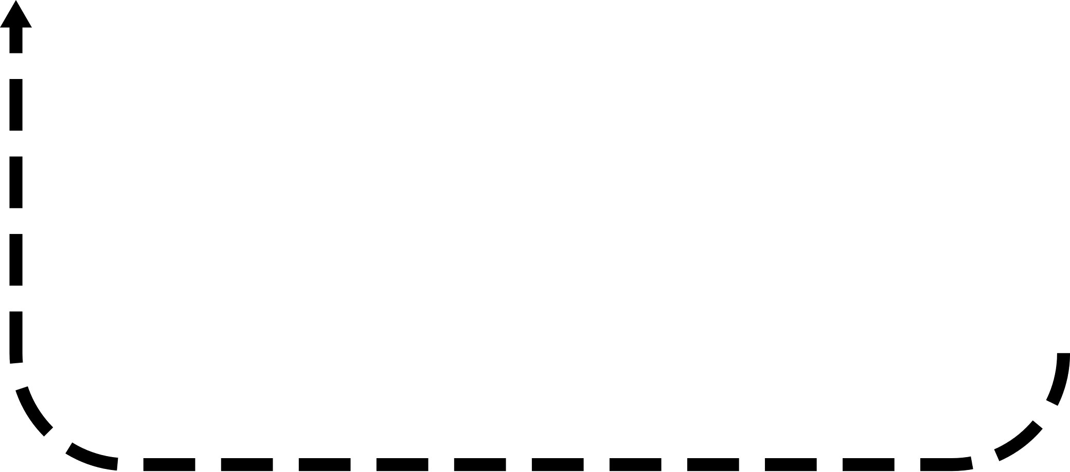



Energy budget model overview

Slide 3
First application
DEE
Mass
Notes:
240 Calories to 1 MJ

Slide 4
First application
How does the environment shape the evolution of different metabolic phenotypes?
The food habits hypothesis identifies 3 dietary components that can drive average and variability of metabolic rates:
Quality, Availability, and Predictability
Bozinovic et al. 2007
Notes:
“….the evolution of a low mass-independent BMR is likely to occur in habitats where food availability is low and/ or unpredictable (McNab 2002; Cruz-Neto and Jones 2005)”

Slide 5
First application
How does the environment shape the evolution of different metabolic phenotypes?
Introduce variation in and heritability of three metabolic traits:
Maintenance costs
Energy allocation to growth
Energy allocation to reproduction
Separate to account for different management models (Careau & Garland 2012, Glazier 2015)
Other approaches instead link these processes

Slide 6


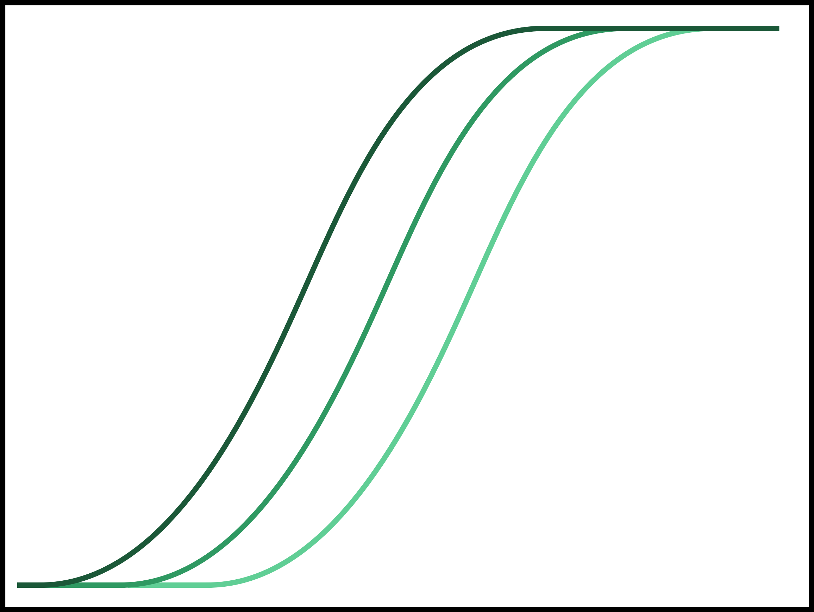
First application
How does the environment shape the evolution of different metabolic phenotypes?
Maintenance costs
Energy allocation to growth
Energy allocation to reproduction
BMR
Allocation %
Allocation %
Body mass
Body fat %
Body fat %

Slide 7
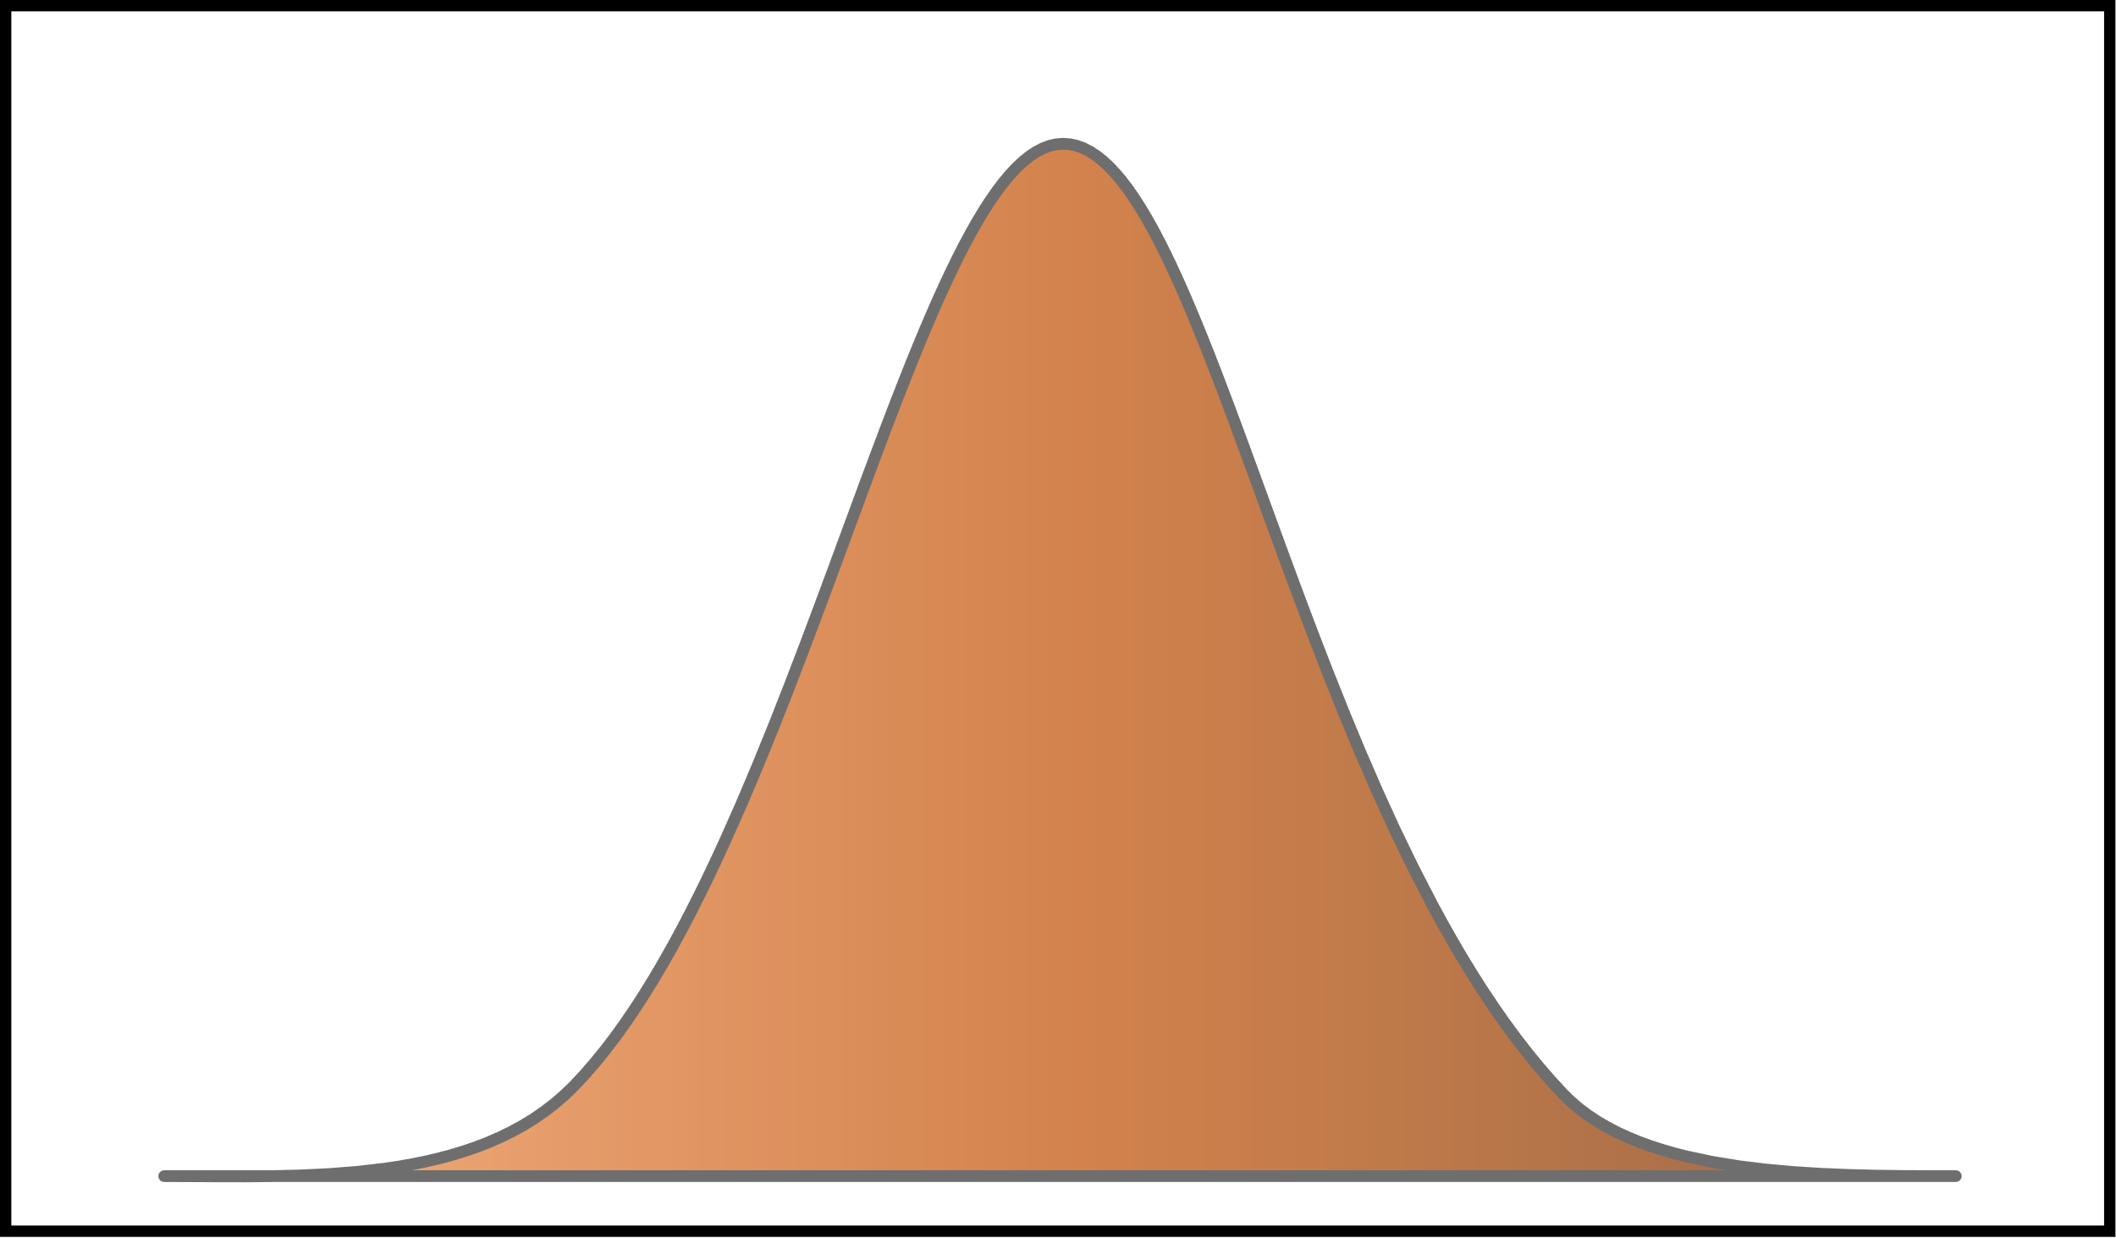
Inheritance
BMR modifier
Probability
Mother’s value
Variance
Based on Milles et al. 2022

Slide 8




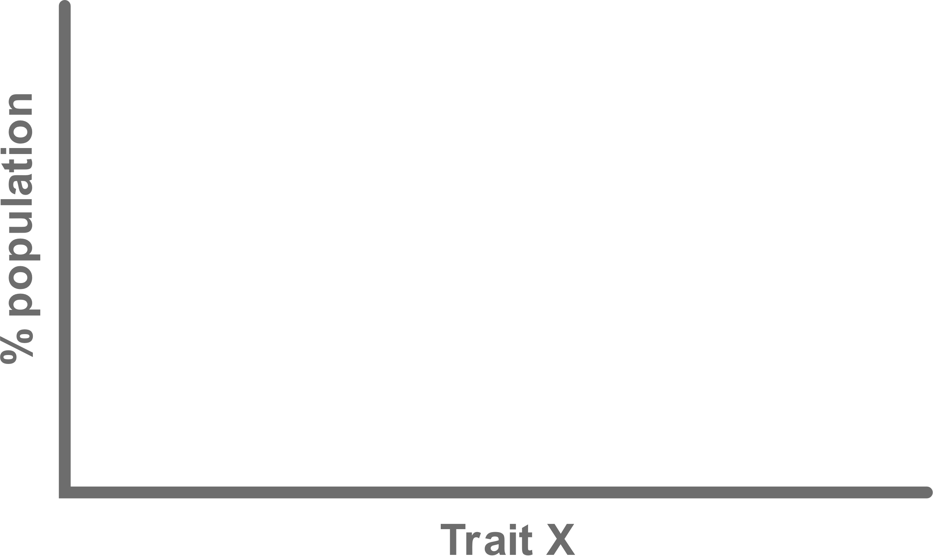
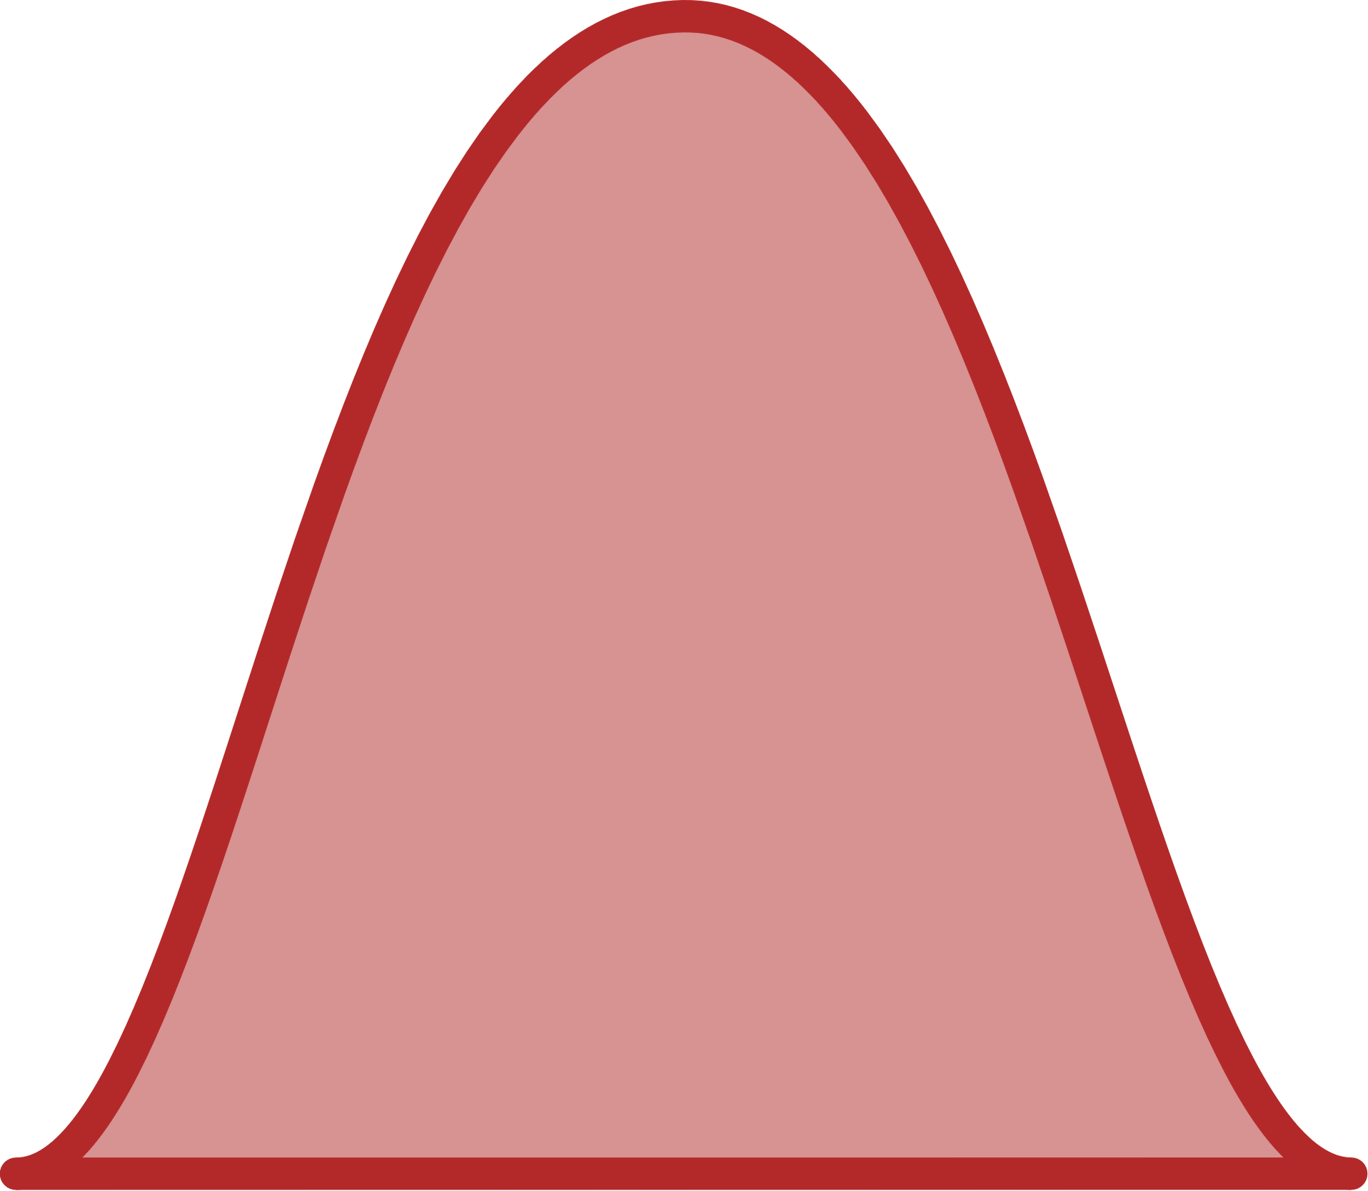
How does the environment shape the evolution of different metabolic phenotypes?
Notes:
Can test things like how the rate of change affects success, long term versus short term environmental changes, combine with other stressors like predation, etc.

Slide 9
Trade-offs
For reproduction and growth, trade-offs are fairly clear….
…. but for BMR, not so much

Slide 10
Theoretical benefits of high BMRs
Aerobic capacity model - higher maximal rates of energy expenditure (Bennett and Ruben 1979; Taigen 1983; Bozinovic 1992; Hayes and Garland 1995)
Sustained maximal limit model - higher sustained rates of energy expenditure (Drent and Daan 1980)
Central limits theory – rates limited by processing capability of alimentary system (Speakman et al. 2004)
All have support for and against

Slide 11
Relationships with high BMR
+ immune capacity (Careau et al. 2009)
+ capacity for thermogenesis (e.g. activity induced) (Careau et al. 2009)
+ cold tolerance & acclimation (e.g. seasonal) (Nilsson & Nilsson 2016)
+ growth when fed ab lib (but no growth advantage when not) (Burton et al. 2011)
+ sustained metabolism (Biro and Stamps 2010, Ksia ̨z ̇ek et al. 2004, Hill et al. 2017)
Across groups but maybe not individuals? (Speakman et al. 2004)
+ VO₂max (Sadowska et al. 2015) but also maybe not (Ksia ̨z ̇ek et al. 2004)
+ organ masses (in Brandt's voles) (Song & Wang 2006) but also maybe not (Chappell et al. 2007, Russell and Chappell, 2007, Selman et al., 2001, Speakman et al., 2004)
+ energy assimilation - not necessarily digestibility though (Ksia ̨z ̇ek et al. 2004, Song & Wang 2006)
+ intestinal glucose uptake capacity (in Peromyscus mice) (Mueller and Diamond 2001)
+ immediate spare capacities for upregulation of internal organ function when challenged with increased energy demands (Ksia ̨z ̇ek et al. 2009)
+ mitochondrial production of reactive oxygen species (ROS), but also maybe not (Burton et al. 2011)
- predation risk? (Burton et al. 2011) but also maybe not
- age at first reproduction (interspecies) (Careau et al. 2009)

Slide 12
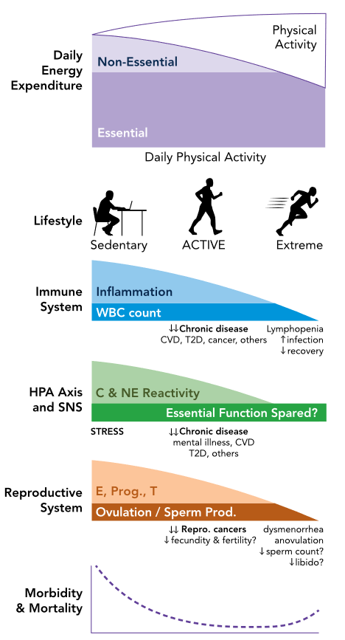
Maybe similarities with intra-individual compensatory mechanisms?
Though also not well understood…
Pontzer 2018

Slide 13
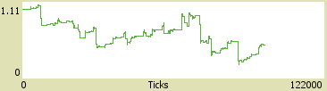
Current status
BMR modifier

