Slide 1
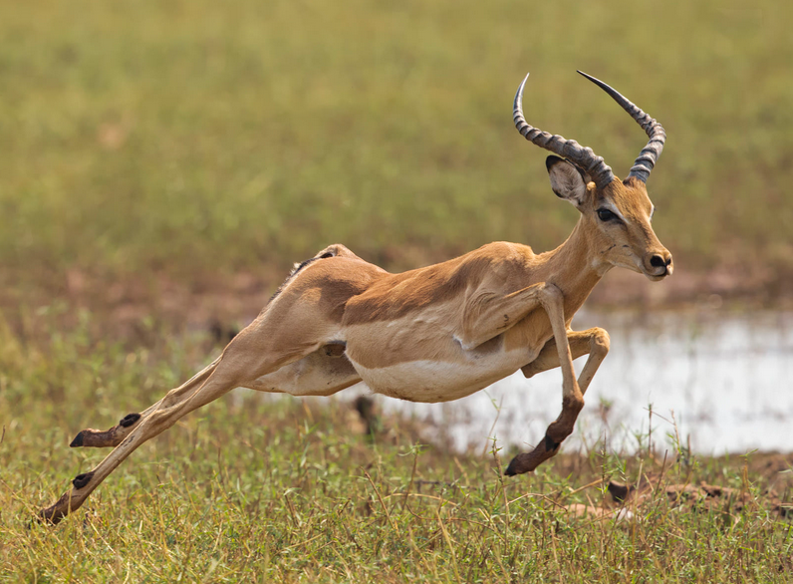
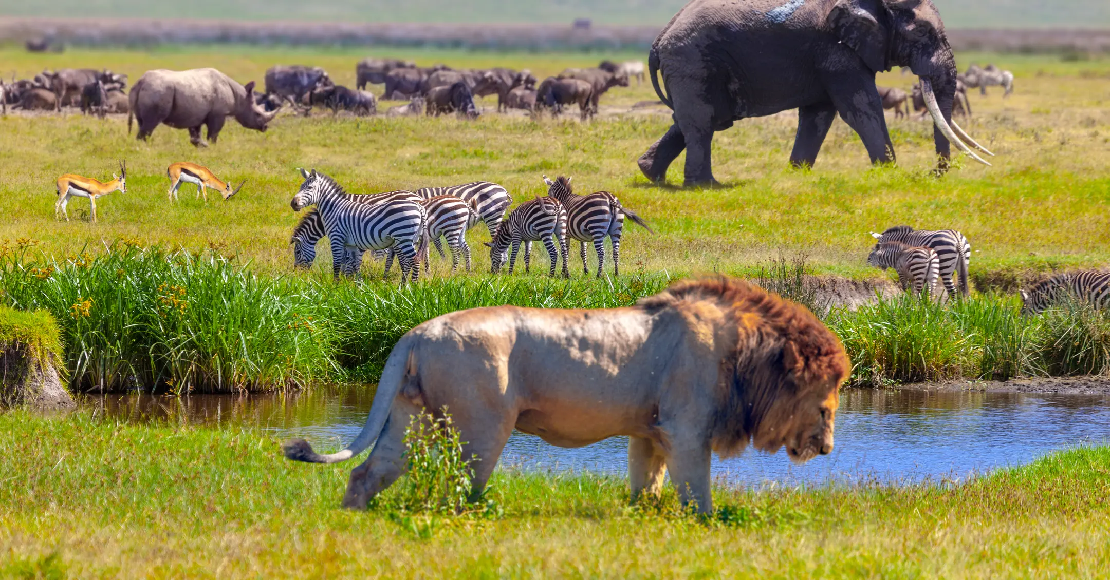
From individual energetics to biodiversity patterns
Ken Watkins
iStock

Slide 2





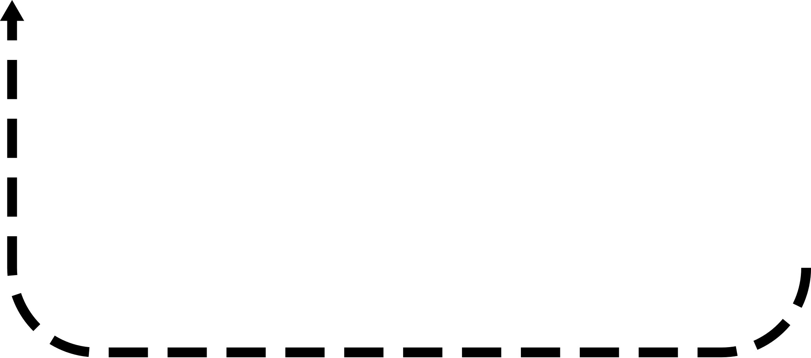




Slide 3
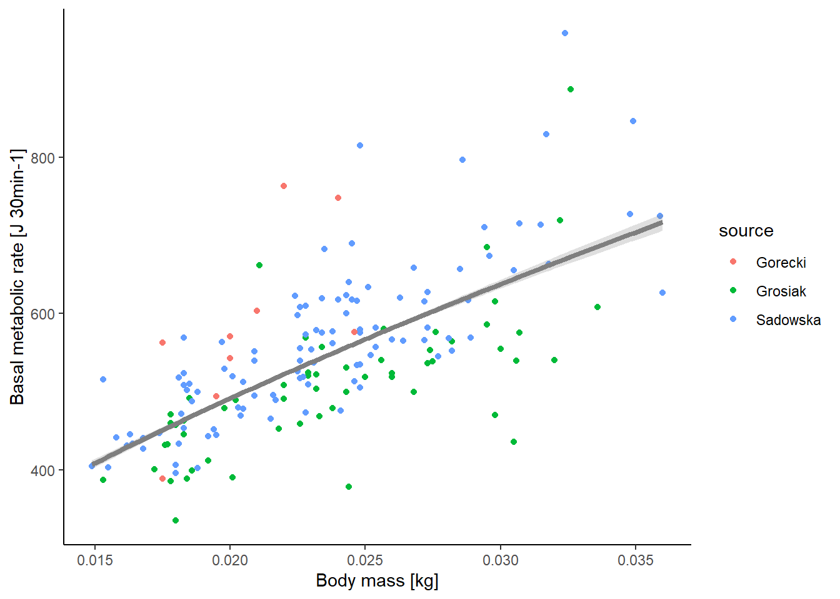
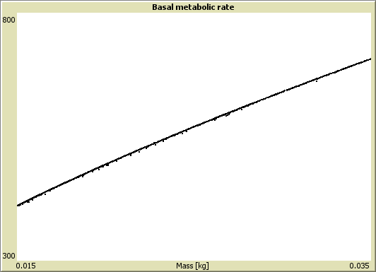

$${M_{B}=B}_{0}m^{γ}$$
Kleiber 1975; Sibly et al. 2013
Calibrated using data from Sadowska et al. 2015, Grosiak et al. 2020, & Górecki 1968

Slide 4
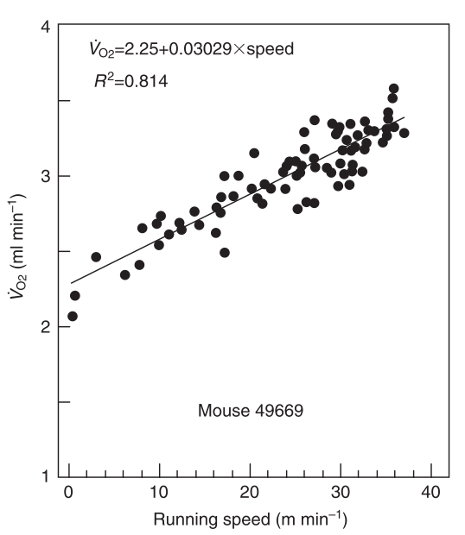
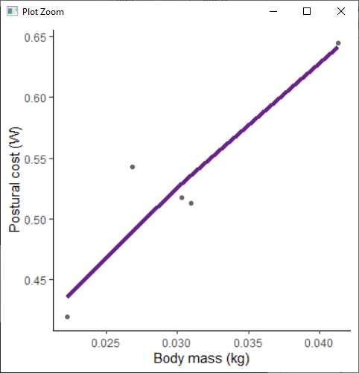
Postural costs
Incremental costs
$$M_{L}=\left(B_{pcot}m^{γ_{pcot}}+ B_{icot}m^{γ_{icot}}×m×v\right)$$
Not available as a separate component
Pontzer 2016
Three papers measured this cost explicitly for mice
(Chappell et al. 2004, Dlugosz et al. 2009 & Rezende et al. 2006)
RMR =
0.73 ml O² min^{–1}

Slide 5
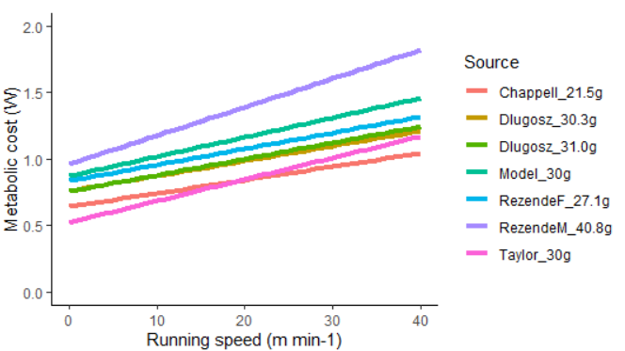
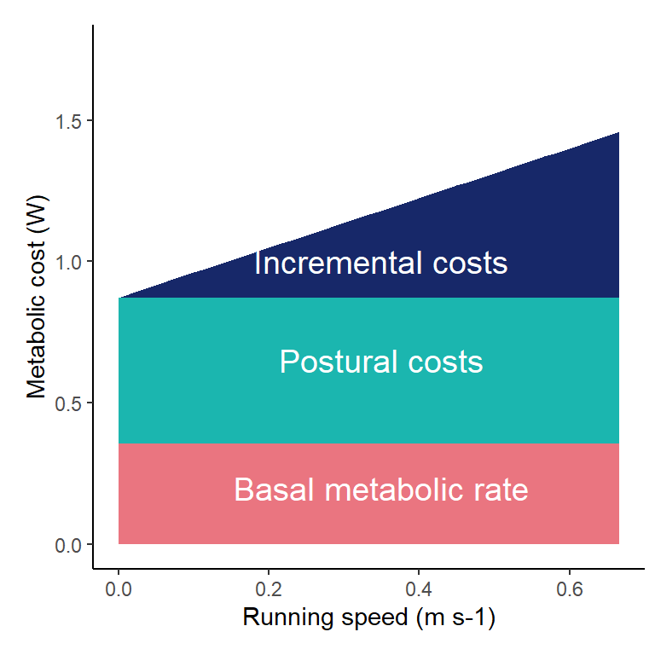
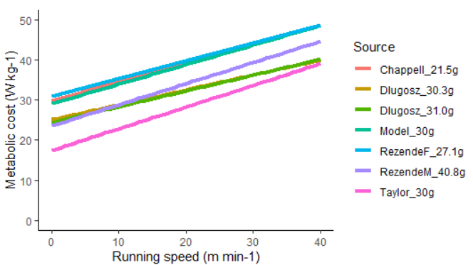
$$M_{L}=\left(B_{pcot}m^{γ_{pcot}}+ B_{icot}m^{γ_{icot}}×m×v\right)$$
*The importance of rest

Slide 6
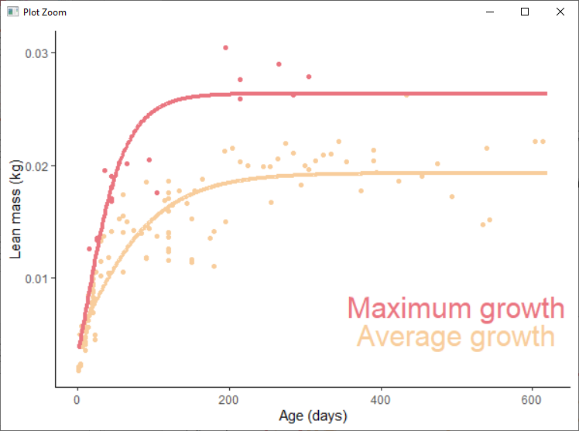
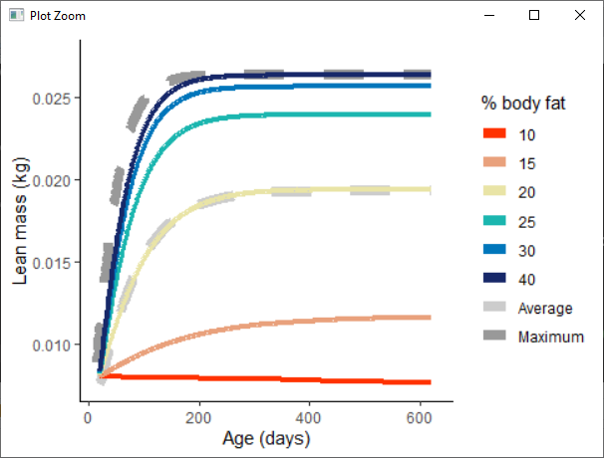


Change in mass:
$${∆m}_{lm}=\frac{k×κ_{G}}{48}\left({\left(m_{lm,∞}×κ_{G}\right)}^{\frac{1}{3}}×{m_{lm}}^{\frac{2}{3}}−m_{lm}\right)$$
Growth cost:
$$M_{G,max}=\frac{{∆m}_{lm}×{ED}_{lm}}{ε_{pro}}$$
Growth curves fit to results from six studies:
Fedyk 1974, Hansson 1991, Rudolf et al. 2017, Sawicka-Kapusta 1974, Balčiauskienė 2007, & Gębczyński 1975
With extremely large animals in
Adjusted for lean mass using fat mass in papers or the relationships in Sawicka-Kapusta 1974
Fit using Gompertz, Logistic, and Von Bertalanffy and assessed using AIC - Von Bertalanffy fit best

Slide 7
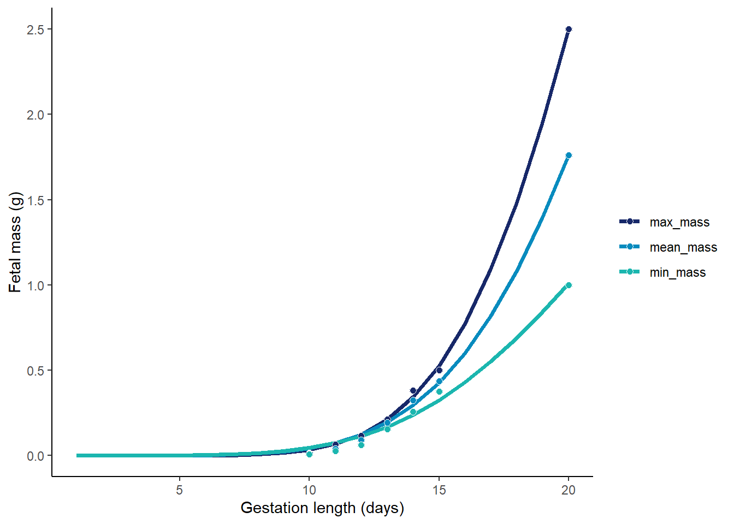
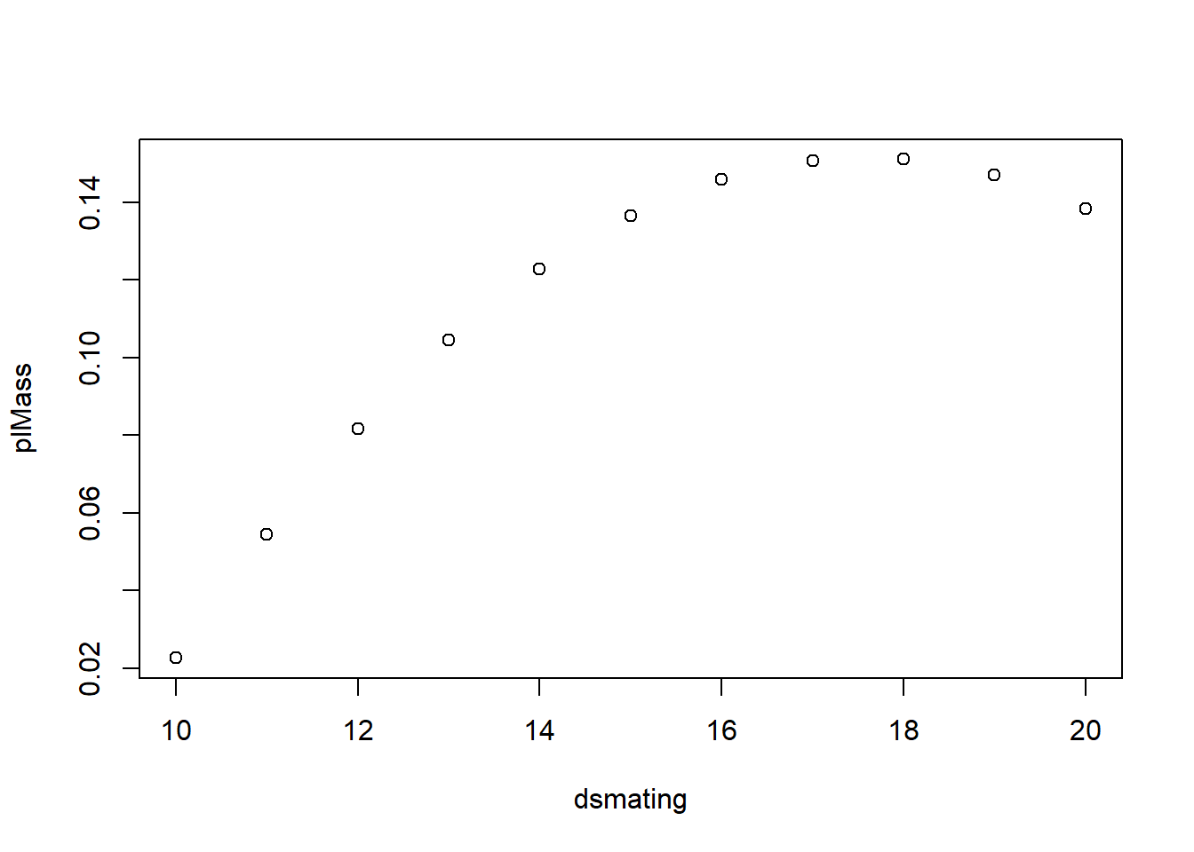



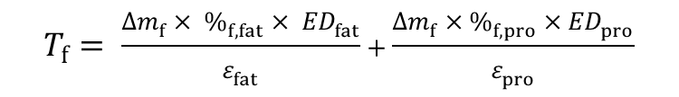
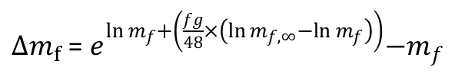

Pregnancy
$$M_{P}=\sum_{i=off \#}^{n_{off}}{\left({T_{f}}_{i}+{T_{Pl}}_{i}\right)}$$
$n_{off}$ = $0.1144×m + 1.92$
For bank voles
$∆m_{f}$ =${ e}^{ln m_{f}+\left(\frac{fg}{48}×\left(\ln{m_{f,∞}}−ln m_{f}\right)\right)}−m_{f}$
$$∆m_{Pl}=$$
$$\left(−0.54180+0.07887×{age}_{gest}−0.002243×{{age}_{gest}}^{2}\right)−m_{p}$$
$$T_{f}= \frac{∆m_{f}× \%_{f,fat}× {ED}_{fat}}{ε_{fat}}+\frac{∆m_{f}×\%_{f,pro}×{ED}_{pro}}{ε_{pro}}$$
$$T_{Pl}= \frac{∆m_{Pl}×3249.9}{0.501}$$
Fetal mass
Ożdżeński and Mystkowska 1976
-Bank voles
Placental mass
Mu et al. 2008
- Lab mice

Slide 8
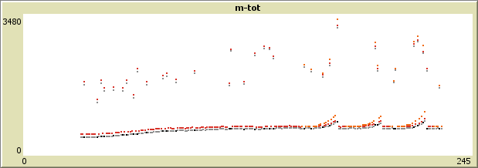
Pregnancy
$$M_{P}=\sum_{i=off \#}^{n_{off}}{\left({T_{f}}_{i}+{T_{Pl}}_{i}\right)}$$
Also increased BMR for females due to increased mass
– as in Trebatická et al. 2007

Slide 9
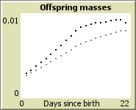
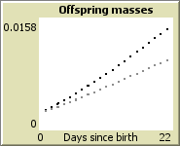
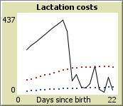
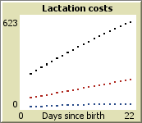

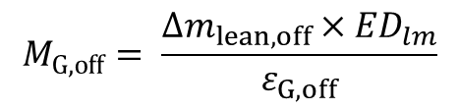

Lactation
$${M_{B,off}= B}_{0}{m_{off}}^{γ}×ε_{B,off}$$
$$M_{G,off}= \frac{∆m_{lean,off}×{ED}_{lm}}{ε_{G,off}}$$
$$M_{Lact}= \frac{\sum_{i=off \#}^{n_{off}}{{M_{B,off}}_{i}+{M_{G,off}}_{i}}}{ε_{mp}}$$
Total mass
Any extra goes to fat storage
Lean mass
Maximum
Total costs
Offspring BMR
Offspring growth

Slide 10
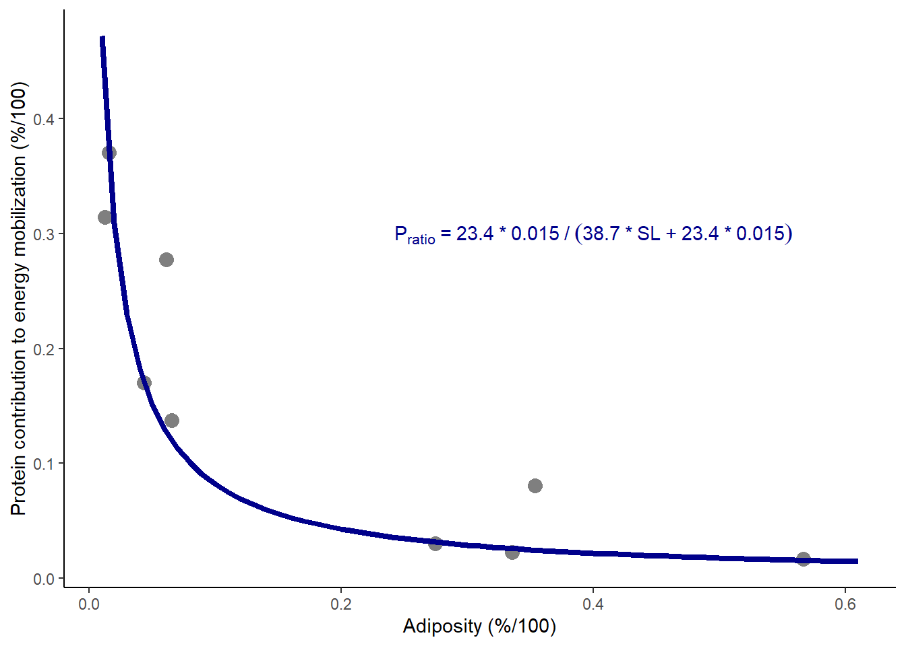

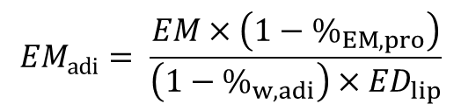
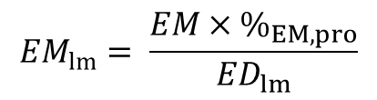
Synthesis
$∆m_{adi}$ = $\frac{EA×{DE}_{fat}}{{ED}_{fat}×(1−\%_{w,adi})}$
Extra energy is stored as fat
Mobilization
$${EM}_{lm}= \frac{EM×\%_{EM,pro}}{{ED}_{lm}}$$
$${EM}_{adi}= \frac{EM×\left(1−\%_{EM,pro}\right)}{\left(1−\%_{w,adi}\right)×{ED}_{lip}}$$

Slide 11
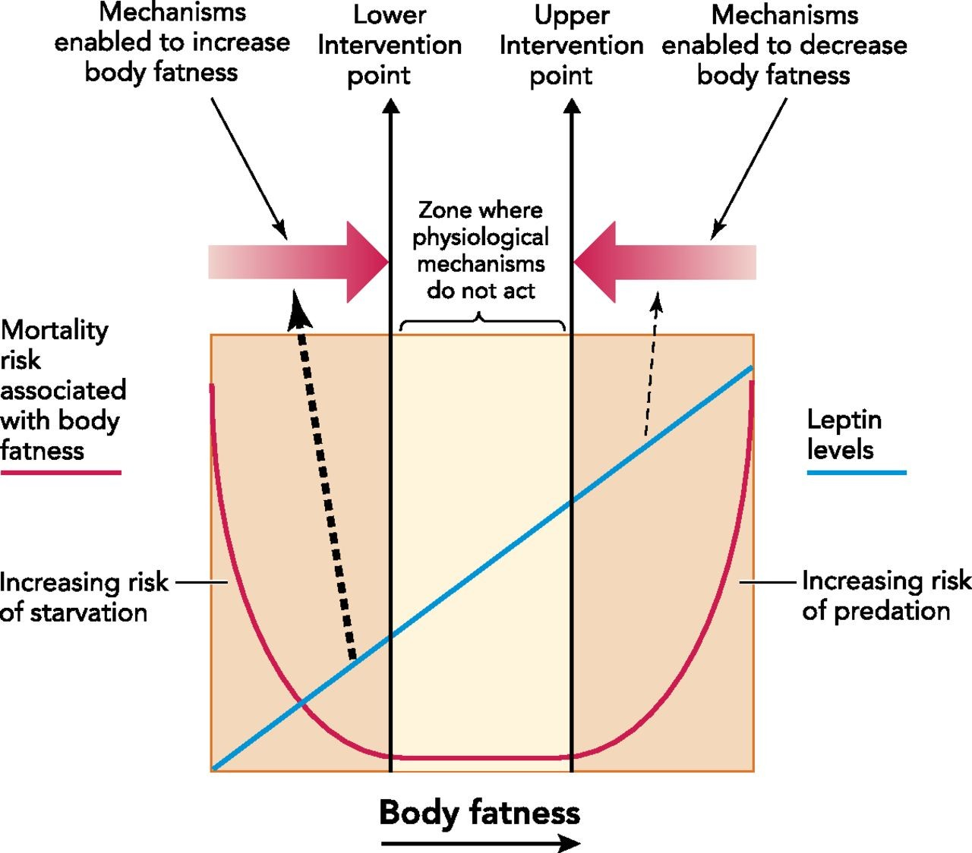
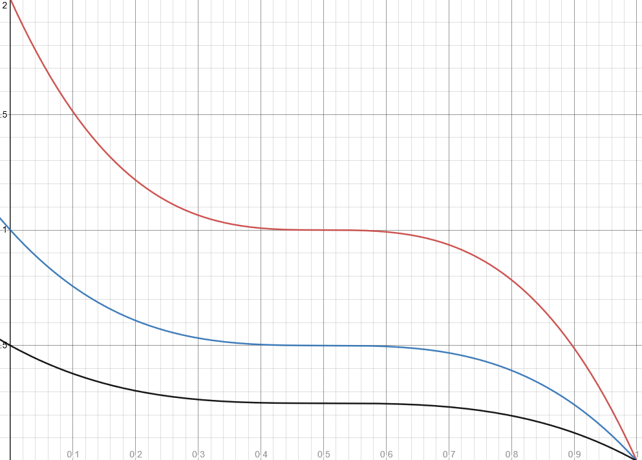


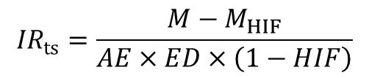
Ingestion rate calculated in a timestep
$${IR}_{ts}=\frac{M−M_{HIF}}{AE×ED×\left(1−HIF\right)}$$
Ingestion rate can then be modified by storage level
$${IR}_{mod}=−c_{SL}×{{SL}_{scaled}}^{3}+c_{SL}$$
Increase
Reduce
Realized ingestion rate based on food available, ingestion rate, and maximum ingestion rate
To limit max ingestion, I tried a functional response curve but wasn’t flexible enough
- One maximum consumption value regardless of mass, age, reproductive status, etc.
Using maximum daily energy assimilated per unit metabolic body mass
- Based on Sadowska et al. 2016 (bank voles)
$${EA= IR}_{real}×AE×ED−M_{HIF}$$
Speakman 2014

Slide 12
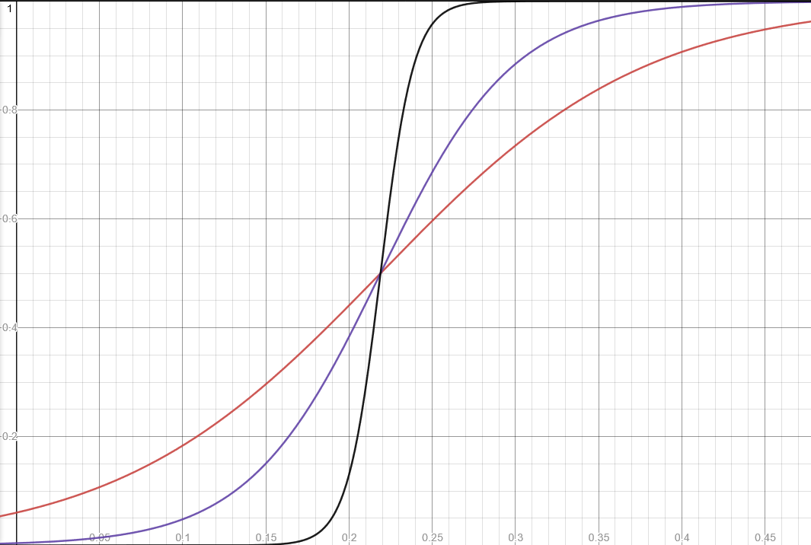
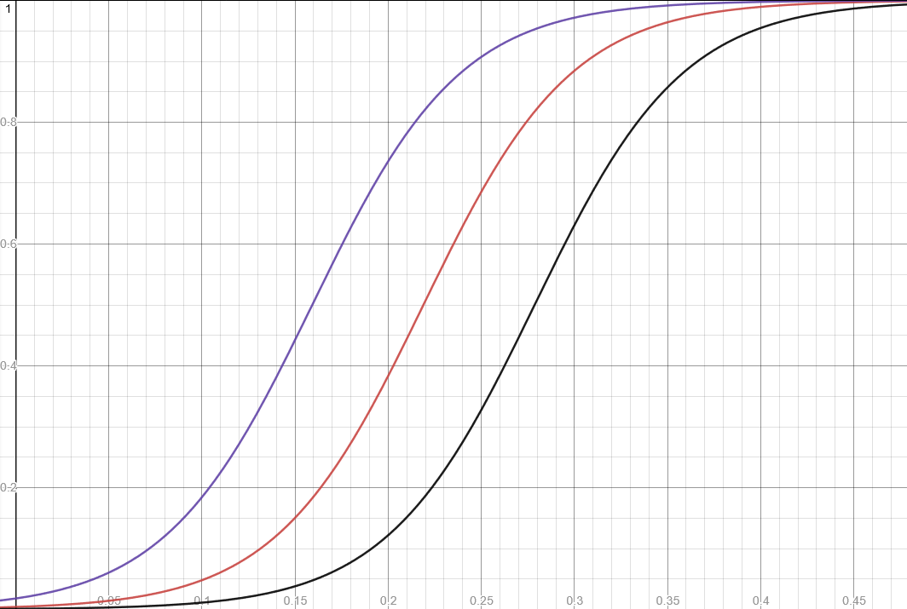

Energy allocation to Growth & Reproduction is affected by body fat
$$κ_{X}= \frac{1}{1+e^{−k_{X}\left(\frac{SL}{{SL}_{max}} − c_{X}\right)}}$$
Increased allocation
Survival probability is also modelled in this way
Used in Sibly et al. 2013 & DEB approaches (e.g. Nabe-Nielsen et al. 2018; Desforges et al. 2019)

Slide 13
Parameterized with bank vole data

Slide 14
To-do list
Still needs some bug testing and verifying (e.g. ingestion during lactation)
Arrange a meeting with Jana, Melanie, etc.?
Implement environment specs & movements
ID calibration & evaluation patterns
Calibrate & evaluate
Scenarios!

Slide 15



Question 1
How does the environment and food availability shape the metabolisms of species? Or How do species’ metabolic rates equip them to persist in their environments?
Body mass
Slow POL
Fast POL
4 MJ day⁻¹
5 MJ day⁻¹
6 MJ day⁻¹
4 MJ day⁻¹
5 MJ day⁻¹
6 MJ day⁻¹
4 MJ day⁻¹
5 MJ day⁻¹
6 MJ day⁻¹
Under varying conditions & food shortage (resource pulses and shortages)
Population size, reproductive success, body mass

