Slide 1

Super Soaker Prototype: A Preliminary Analysis for Keep It Dry
Cara Arena

Slide 2
Setting the Scene
Super Soaker: A product used in factories to absorb spills and leaks.
Keep It Dry is testing different product prototypes.
Each product is used in a simulated real-world environment experiment, and absorbs a certain amount of fluid (loading) to see whether or not it fails.
26,570 prototypes
More data isn’t *always* better, but having this much data should help us develop a more robust predictive model.
17 measurement values for each individual product, representing various lab testing methods.

Slide 3
It’s handled
The missing data, that is:
There was missing data from all measurement variables, except for measurement 0, measurement 1, and measurement 2.
Given relatively large amounts of missing data for some of the measurement variables (upwards of 8%), imputation was used.
Missing values were replaced with estimated values.

Slide 4
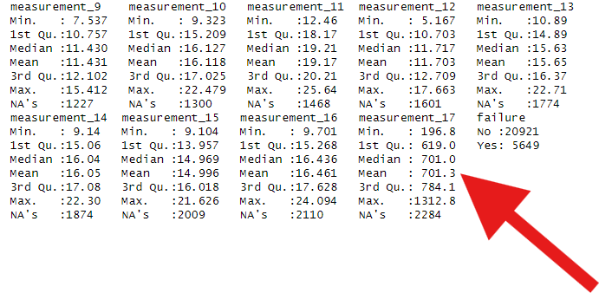
Additional wrangling
Attributes 0 and 1, entered in a different format, were converted to numerical data.
The response variable (failure) was converted to a factor with two groups: yes (failed) or no (did not fail).
Measurement 17 was removed entirely; with values significantly higher than the other measurement values, it is assumed there were errors.
Summary data of measurements 9-17; measurement 17 shows significantly higher values than the other measurements.

Slide 5
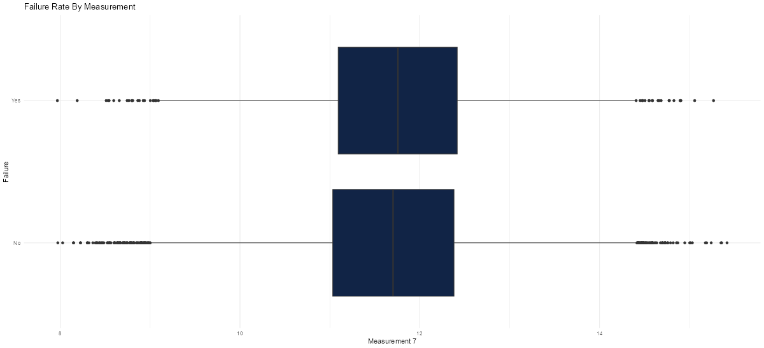
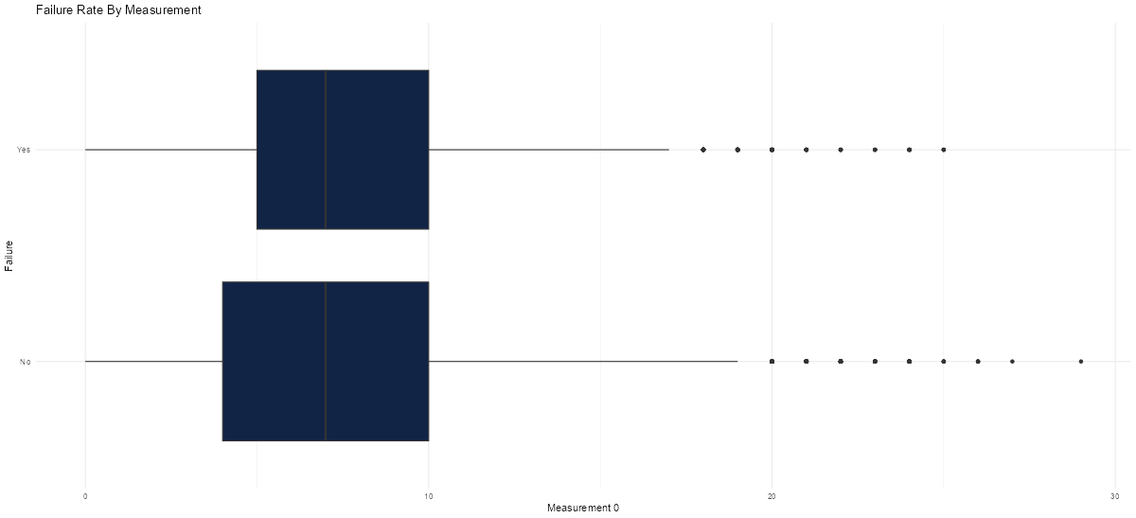
Preliminary analysis
Measures 5-9, and measure 12 appear to be strong predictors of failure.
Though there seems to be an even split between failing or not, there is a difference in median measurement values between failing and not failing.
Measurement 0 is also a variable of interest; though the median measurement values between failing and not failing are similar, it is the only measurement that is not evenly split between failing and not failing.

Slide 6
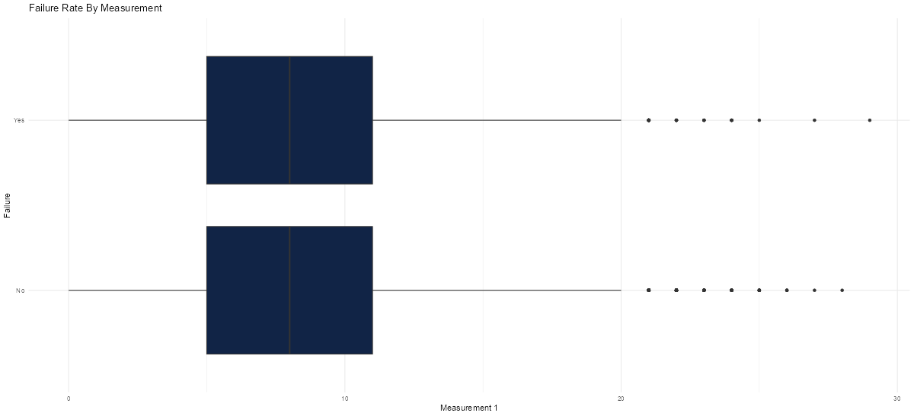
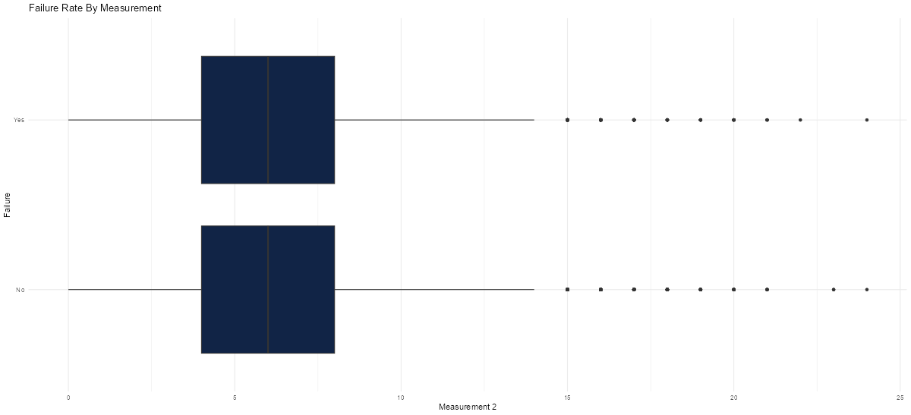
You can’t sit with us
With relatively even distributions and medians, the following measures appear to not be strong predictors of failure:
Measures 1-4
Measures 10 & 11
Measures 13-16
Measure 17 was omitted, due to significantly larger values.

Slide 7
Conclusion
For next stage (predictive modeling), the focus will be on the following measures:
Measures 5-9, and measure 12
Measure 0 may be worth looking into, either in the next phase of predicting failure, or for a future phase in predicting success, with fewer prototypes failing.

