Slide 1

Super Soaker Prototype: Findings for Keep It Dry
Cara Arena

Slide 2
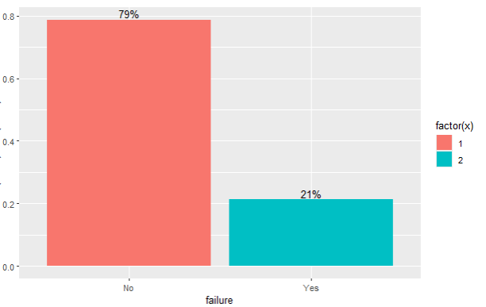
Where we stand
In the preliminary analysis, it was initially thought that Measurement 17 should be removed.
Per the team’s recommendations, Measurement 17 was brought back in.
Additionally, Product Code and all attribute variables were converted to factors, as they are categorical variables.
Filtering of variables was used in place of imputation, to better reduce extreme values.
Initial models used all of the variables.
Variable importance analysis led to removing variables, in an effort to reduce noise.
More details on which variables were removed will be covered in future slides.
Data leakage was also indicated through variable importance analysis.
The training data was somewhat imbalanced, which led to complications with several models.
79% of the data in the training dataset fell in the “no” category (did not fail), showing an imbalanced dataset.

Slide 3
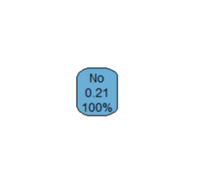
Model 1: ClAssification Tree
This model was deemed inappropriate for this data, despite several attempts to fine tune which variables to use.
Normally, a classification tree will result in many branches after working through different decisions.
This classification tree resulted in every prediction falling into the “no” (did not fail) category, likely due to:
The imbalanced dataset
Complex relationships between the variables
Results from the classification tree model.

Slide 4
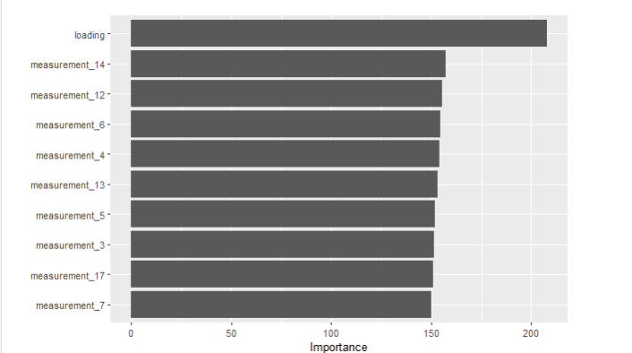
Model 2: Random Forests
Initial Accuracy: 99%
What does this tell us?
Likely, overfitting is happening, due to too many variables.
Variable importance showed the most important predictor variables.
Updated model included the following variables: ID, Product Code, Loading, Measurements 3-7, Measurements 12-14, Measurement 17, and Failure.
Final model (trial and error): ID, Product Code, Loading, Measurements 0-7, Measurement 9, Measurement 12, Measurement 14, Measurement 17, and Failure.
Final Accuracy: 91%
Variable Importance Analysis

Slide 5
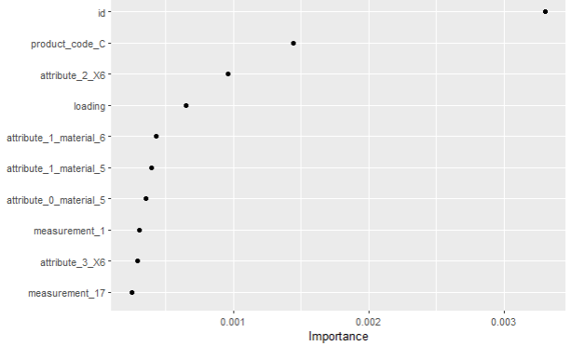
An important note…
Another random forest model was used, with the addition of a tuning grid—rather than using the default parameters.
Result
Lower accuracy (79%)
Variable importance analysis indicated data leakage, as discussed previously and shown to the right.
Variable importance analysis, indicating data leakage

Slide 6
Models 3 & 4: XGBoost & Neural Network
Extreme Gradient (XG) Boost
Neural Network
XGBoost makes predictions by combining the opinions of many small, mistake-fixing decision trees.
It’s like crowdsourcing your decisions from a team of specialists.
Considered a “black box” model, meaning figuring out how to tune the variables and parameters take more finesse.
Accuracy: 79%
What does this tell us?
Overfitting is likely.
Recommendation: utilize Shapley values to better tune the variables in the model.
A neural network learns from examples.
It figures out patterns by lighting up the right pathways between the input (predictor variables) and the answer (response variable).
Also considered a “black box” model.
Accuracy: 80%
Honestly, this is a strong contender. I would like the accuracy to be a little bit stronger, if possible, and to do some additional variable and parameter tuning to see if it would better generalize to the test data and new prototypes.
Recommendation: utilize Shapley values to better tune the variables in the model.

Slide 7
And the Verdict is…
Random Forests (using default parameters) was the winner, based on these models!
Implications and Future Considerations:
Loading appeared to be the strongest predictor of failure
Future question: Can or should this be standardized?
There may have been some data leakage, given that ID, product code, and attributes appeared to be predictors of failure when they should not have been.
This means that our models may not generalize well with the testing study done on the new prototypes.
Additional parameter and variable tuning may result in better models.

