Slide 1
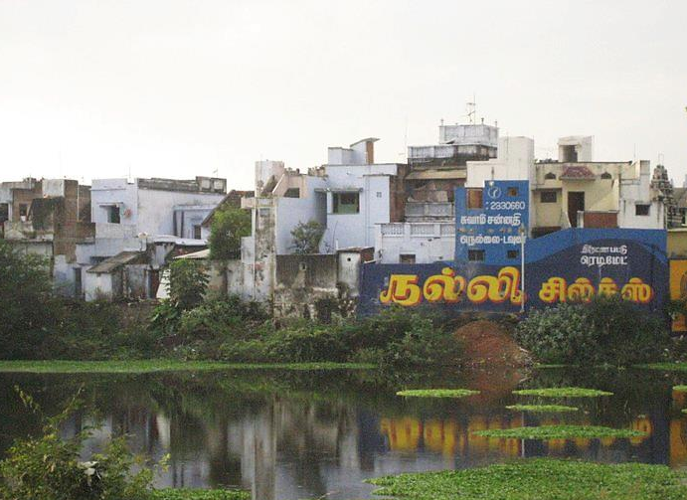
In the southern Indian city of Tirunelveli, rural and urban overlap. According to legend, a farmer prayed to Shiva to protect his crop. The god appeared in the form of a protective hedge surrounding the rice fields and the farmer prospered. As a sign of gratitude, he built a temple around which the city grew, a lasting reminder of the importance of the harvest.
Here, an irrigation pond remains, while the surrounding paddy fields have given way to a jumble of residential construction, complete with advertisement visible from the central roadway.

Slide 2
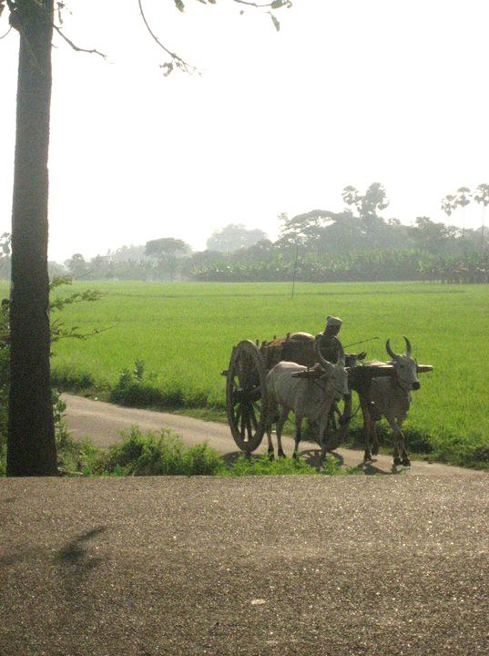
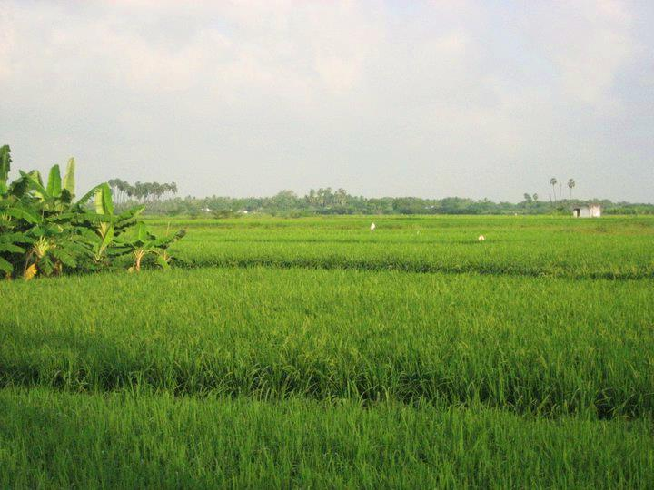
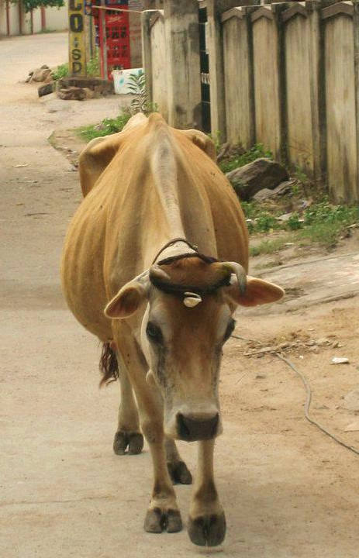
Although it is home to several colleges and universities, life in Tirunelveli remains closely bound to animals and the land. Host to a sprawling produce market, the city also serves as a distribution hub for vegetables, fruits, and grains grown in the surrounding areas. Many households keep cows or goats for milk, and mornings in the city begin with the tinkle of bells on a herdsman’s bicycle, as he passes house to house selling milk from his water buffalo. The milk is so fresh it is still warm; on cool mornings, delicate curls of vapor rise from the tin vessels bearing it into the house.
By morning you might meet a bullock cart on its way out to the paddy fields
While by evening you might pass a cow on your way home through the city’s streets.

Slide 3
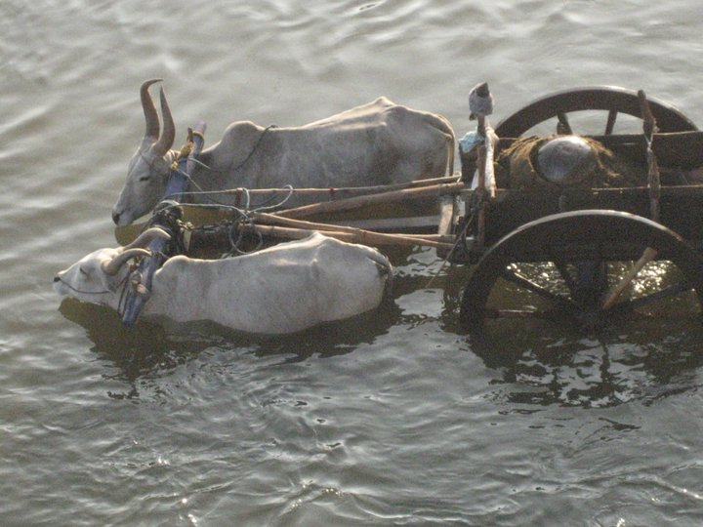
If you’re lucky, you might witness a sight as magical and improbable as a unicorn emerging from the mist: in the soft light of dawn, the distinctive grey bullocks that perform the region’s draft labor stand up to their chins in the Thamirabarani River. Standing patiently, the animals seem to enjoy the cool water before their hot day’s work, their gentle sighs audible in the early morning quiet.
The bullocks’ owner is harvesting sand from the river bed, to be sold to a construction supplier. Damaging to the environment, the practice is illegal but widely practiced nevertheless: the constant demand for housing for India’s increasing population means there’s no shortage of buyers. Thus, the graceful bulls in the river stand as an emblem of a place juggling modern problems and traditional ways of life. The river too, bears witness to environmental strain, subject to pollution and named for the copper that has long since been mined out of its waters.

Slide 4
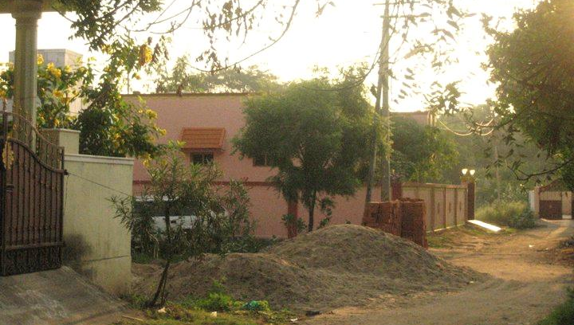
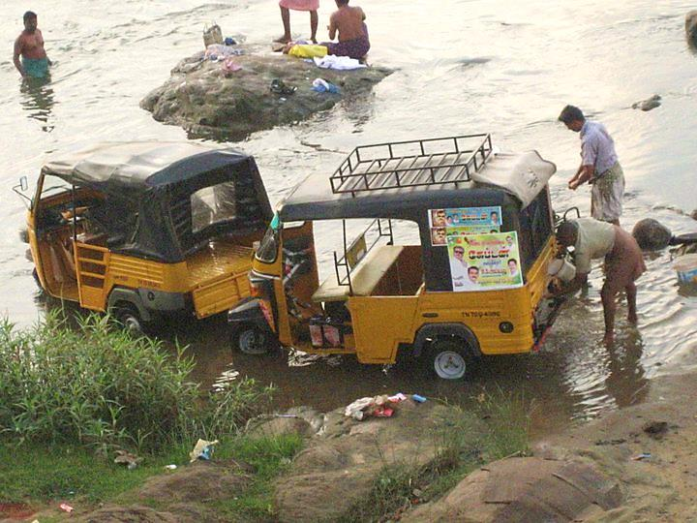
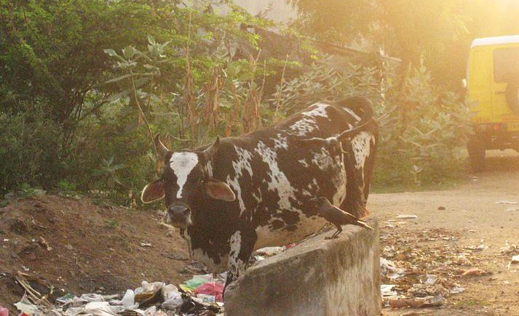
Like all of India, Tirunelveli struggles with the environmental consequences of an expanding populace and limited resources. Statewide, demand for electricity outpaces supply, necessitating a regime of scheduled power cuts for several hours multiple times a day.
Rapid conversion of farmland to housing leads to haphazard neighborhood design, difficulty connecting to public utilities, and poor integration with existing traffic routes.
Residential waste removal is sporadic at best; people often leave their household garbage in piles along the roadway. Detritus lines most streets and washes into the river with each rain.
Above, auto-rickshaw drivers wash their vehicles in the Thamirabarani River while other men bathe nearby. The bright yellow autos constitute a transportation staple for the city, but feature inefficient engines which generate large quantities of pollution.
Bathing and washing clothes in the river are common among the city’s poorer residents. These activities are hard on the river, but make up part of the connection between indoor and outdoor life which differentiates Tirunelveli from much western experience.

Slide 5
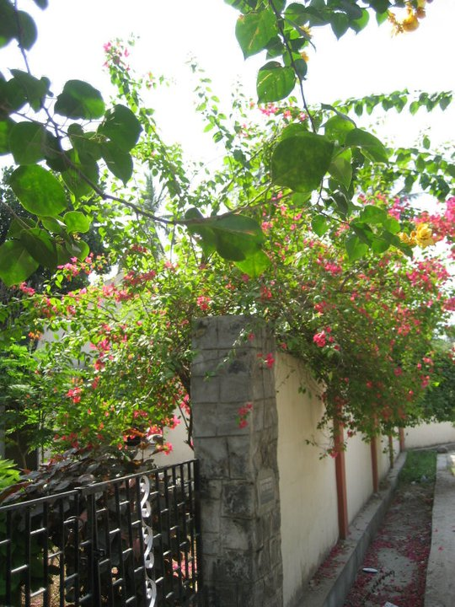
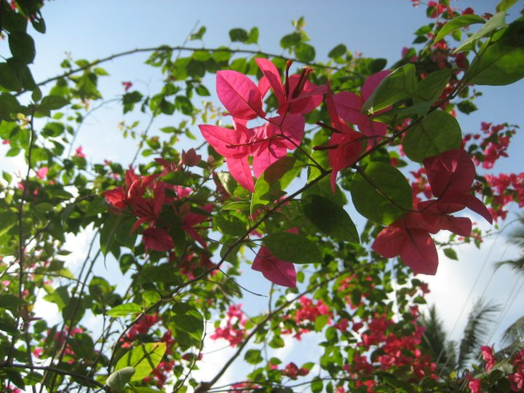
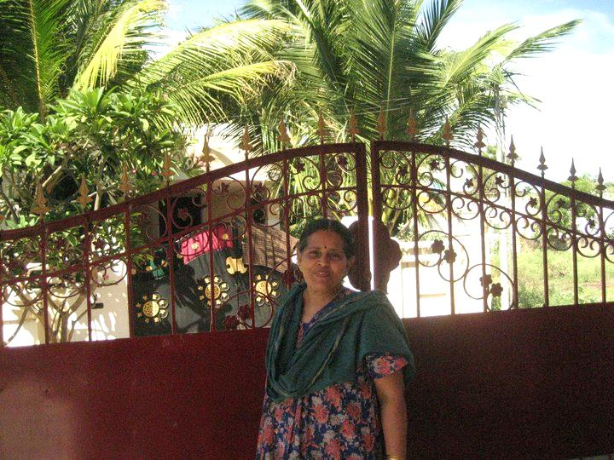
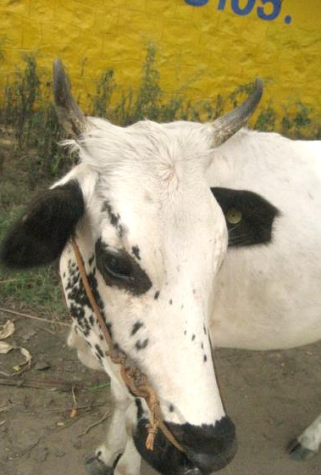
Vibrant with life and color, Tirunelveli brims with activity:
Tireless tiny mosquitoes dive, soundless salamanders stalk them, kid goats play on half-built houses, cows nose through vegetable scraps near the market, and buffalo graze sedately in the subtropical sun. Alongside them, men and women labor in the rice fields or bank branches, on construction sites or college campuses.
Habitual divisions of human and animal, city and country meet and merge in a dense tapestry of industry and spontaneity.
Tirunelveli, like many cities worldwide, faces significant organizational and environmental challenges for a sustainable future. In this category-confounding place born of a god’s descent to earth, where daily life encompasses both seventh-century temple and twenty-first-century university, both hand-cut garments and digitally-assisted engineering, one hopes that the ingenuity and determination which have made the city what it is today will enable its evolution for many more centuries to come.

