Slide 1

Compiler Course Program Assignment
Speaker: Jeff Liaw

Slide 2
Program Assignment
Goal: Build a compiler for C
Deadline: 6/16 23:40
Demo: 6/17
Upload your project to moodle
A zipped file(.rar, .zip, .7z, ...) contain your source code and readme
do not hand in corpse(e.g. can not be compiled or be ran)!
Filename: StudentID
e.g. F74012345.rar
Post your problems on moodle or ask TAs
Environment: Ubuntu 14.04 with gcc 4.8.4

Slide 3
Compile Process
lex
Lexical Analyzer
Aid tools:
lex(flex 2.5.35)
yacc(bison 3.0.2)
Lex is a program generator designed for lexical processing of character input streams
Yacc provides a general tool for imposing structure on the input to a computer program
yacc
token stream
Syntax Analyzer
syntax tree
Semantic Analyzer
syntax tree
Code Generator
target machine code

Slide 4
Token Format(1)
Keywords
int char return if else while break print read
Arithmetic Operators
= ! + - * /
Comparison Operators
== != < > <= >= && ||
Special Symbols
[ ] ( ) { } ; ,

Slide 5
Token Format(2)
Identifier
所有Identifier都以id為開頭，後面接一串大寫開頭的英文字母
字母字串開頭為大寫，其他小寫，長度不限
正確範例：idVariable, idApple, idFunction, idL
錯誤範例：IdVariable, idapple, varid
Number
一串以0到9的digit組成的字串，長度不限
正確範例：0, 3456, 655453
錯誤範例：abc123

Slide 6
Token Format(3)
Char
雙引號中間夾任意一個字元
正確範例：”a”, “3”
錯誤範例：’a’, ‘321’, “123”
Comment
單行中，//以及//後面的內容都是註解
e.g. int main { // main function
其他都算是錯誤

Slide 7
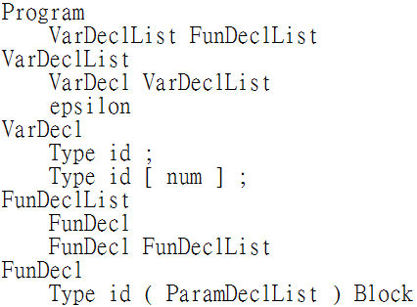
Grammar
參考附件grammar.txt
head(left side)
Program → VarDeclList FunDeclList
VarDeclList → VarDecl VarDeclList | epsilon
VarDecl → Type id ; | Type id [ num ] ;
FunDeclList → FunDecl | FunDecl FunDecList
FunDecl → Type id ( ParamDeclList ) Block
body(right side)
production 1
production 2

Slide 8
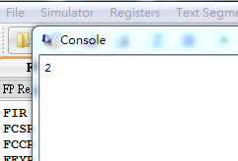
Expected Result
Input: test.c
Output: test.s
Run test.s with SPIM, check the console output
test.c
your_compiler
test.s
SPIM
Console Output
int main() {
int x;
x = 2;
print x;
}
.text
.globl main
main:
li $a0, 2
li $v0, 1
syscall
your_compiler
SPIM

Slide 9
Grading
IO: read/print - 10%
Arithmetic - 10%
priority - 5%
Conditional - 15%
Loop - 15%
Array - 15%
Function call - 20%
Demo - 10%

Slide 10
Introduction to Flex
Flex allows you to implement a lexical analyzer by writing rules
Flex compiles your rule file(e.g. lexer.l) to C source code implementing a finite automaton
you don’t need to understand the C source file
Usage
$ flex lexer.l
$ gcc lex.yy.c -ll
Input
lexer.l
flex
lex.yy.c
g++
a.out
Lexer Output

Slide 11
Rule Files
Declarations and User subroutines sections are optional
write declarations and helper function in C
Definitions section is also optional
useful to name regular expression
e.g. DIGIT [0-9]
Rule File Structure
%{ Declarations %} Definitions %% Rules %% User subroutines

Slide 12
Lex Regular Expression
x | the character “x”
“x” | an “x”, even if x is an operator
\x | an “x”, even if x is an operator
[xy] | the character x or y
[x-z] | the characters x, y or z
[^x] | any character but x
. | any character but newline
^x | an x at the beginning of a line
<y>x | an x When Lex is in start condition y
x$ | an x at the end of a line
x? | an optional x
x* | 0,1,2, ... instances of x
x+ | 1,2,3, ... instances of x
x|y | an x or an y
(x) | an x
x/y | an x but only if followed by y
{xx} | the translation of xx from the definitions section
x{m,n} | m through n occurrences of x
Operators
" \ [ ] ^ - ? . * + | ( ) $ / { } % < >

Slide 13
Lex Actions
Rule specifies an action to perform if input matches the regular expression or definition
The action is specified by writing regular C code
The default action is copying input to output
e.g. [0-9] { printf(“%s”, yytext); } [ \t\n] ; . ;
Rule File Structure
%{ Declarations %} Definitions %% Rules %% User subroutines

Slide 14
Lex Predefined Variables
Name | Function
int yylex(void) | call to invoke lexer, returns token
int yywrap(void) | wrapup, return 1 if done, 0 if not done
char *yytext | pointer to matched string
yyleng | length of matched string
yylineno | current line number
yylval | value associated with token
FILE *yyout | output file
FILE *yyin | input file
INITIAL | initial start condition
BEGIN | condition switch start condition
ECHO | write matched string

Slide 15
Calculator Example
A lexical analyzer of simple calculator
only plus and multiply
only integer
Token
Integer Constant: [0-9]+
Plus Operator: “+”
Multiply Operator: “*”

Slide 16
Declarations
Between “%{“ and “%}”
Content between those is copied verbatim into output file
A helper function to show the error message
we need to declare function prototype, so that we can use later
Rule File Structure
%{ Declarations %} Definitions %% Rules %% User subroutines
Code Section
1 2 3 | %{ void yyerror(); %}

Slide 17
Definitions
Name two useful regular expression
digit: [0-9]
int_const: {digit}+
Rule File Structure
%{ Declarations %} Definitions %% Rules %% User subroutines
Code Section
1 2 | digit [0-9] int_const {digit}+

Slide 18
Rules
Print some message during lexical analyzing
integer_const, plus and multiply
Rule File Structure
%{ Declarations %} Definitions %% Rules %% User subroutines
Code Section
1 2 3 4 5 6 7 8 | {int_const} { printf(“ INTEGER_CONST %s”, yytext); } “+” { printf(“ PLUS ”); } “*” { printf(“ MULT ”); } [ \t]* {} [\n] { yylineno++; } . { fprintf(stderr, “LEXER ”); yyerror(); exit(1)}

Slide 19
User Subroutines
Main program and error printer
Rule File Structure
%{ Declarations %} Definitions %% Rules %% User subroutines
Code Section
1 2 3 4 5 6 7 8 9 10 11 12 | int main() { yylex(); return 0; } void yyerror() { extern int yylineno; extern char *yytext; fprintf(stderr, “Error: at symbol \”%s\” on line %d\n” , yytext, yylineno); }

Slide 20
Reference
http://flex.sourceforge.net/#overview
http://dinosaur.compilertools.net/lex/index.html

Slide 21
Introduction to Bison
Input
LALR(1) parser generator under the GNU license
Context Free Grammar Specification(.y)
bison
LALR(1) Parser(.c)
g++
LALR(1) Parser(.out)
Grammar File Structure
%{ Prologue %} Bison Declarations %% Grammar Rules %% Epilogue
Parser Output

Slide 22
Calculator Example
We just implemented a simple number lexer in flex
Now we can implement a parser which will take actions on this file
do real calculate!
Usage:
$ flex calc.lex
$ gcc -c lex.yy.c
$ bison -d -v calc.y
$ gcc -c calc.tab.c
$ gcc lex.yy.o calc.tab.o -o calc

Slide 23
Prologue
Between “%{“ and “%}”
Content between those is copied verbatim into output file
Declare functions prototype, so we can use later
Grammar File Structure
%{ Prologue %} Bison Declarations %% Grammar Rules %% Epilogue
Code Section
1 2 3 4 | %{ int yyerror(); int yylex(); %}

Slide 24
Bison Declarations(1)
Define the symbols used in formulating the grammar and the data of semantic values
%token name - declare a token name (terminal symbol)
%type symbol - declare value type of nonterminal symbol
Specify precedence
lower the rule, the higher the precedence
%left symbol - left associativity
%right symbol - right associativity
%union - specify the entire collection of possible data type for semantic values
%start symbol - specify the start symbol
Grammar File Structure
%{ Prologue %} Bison Declarations %% Grammar Rules %% Epilogue

Slide 25
Bison Declarations(2)
Code Section
1 2 3 4 5 6 7 8 9 10 11 | %union{ int int_val; string* op_val; } %start input %token <int_val> INTEGER_LITERAL %type <int_val> exp %left PLUS %left MULT
Grammar File Structure
%{ Prologue %} Bison Declarations %% Grammar Rules %% Epilogue

Slide 26
Grammar Rules(1)
A Bison grammar rule has the following generate form:
result: components...;
e.g. exp: exp ‘+’ exp;
Can be followed by braces to indicates actions to take
e.g. exp: exp ‘+’ exp { printf(“sum two numbers\n”); }
Multiple rules for the same result can be separately by vertical-bar character ‘|’
e.g. result: rule1-components... | rule2-components... ;
Grammar File Structure
%{ Prologue %} Bison Declarations %% Grammar Rules %% Epilogue

Slide 27
Grammar Rules(2)
Semantic values
value of component n is $n
modifiable lvalue is $$
Grammar File Structure
%{ Prologue %} Bison Declarations %% Grammar Rules %% Epilogue
Code Section
1 2 3 4 5 6 | input: /* empty */ | exp { cout << “Result: ” << $1 << endl; } exp: INTEGER_LITERAL { $$ = $1; } | exp PLUS exp { $$ = $1 + $3; } | exp MULT exp { $$ = $1 * $3; }

Slide 28
Epilogue
Copy verbatim to the end of the output file
Put your subroutine here
Grammar File Structure
%{ Prologue %} Bison Declarations %% Grammar Rules %% Epilogue
Code Section
1 2 3 4 5 | int main() { yyparse(); return 0; }

Slide 29
Combine Flex and Bison
cal.lex
flex
lex.yy.c
lex.yy.o
g++ -c
Input
g++ -o calc
calc
cal.tab.h
cal.y
cal.tab.o
bison -d
g++ -c
cal.tab.c
Calculator Result

Slide 30
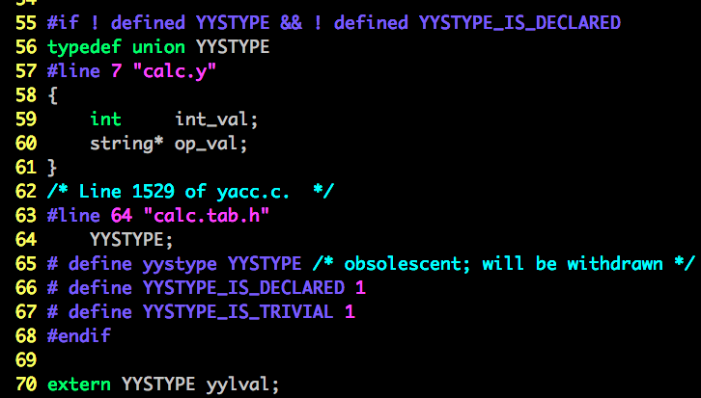
Pass Token from Flex to Bison
Name | Function
int yylex(void) | call to invoke lexer, returns token
int yywrap(void) | wrapup, return 1 if done, 0 if not done
char *yytext | pointer to matched string
yyleng | length of matched string
yylineno | current line number
yylval | value associated with token
FILE *yyout | output file
FILE *yyin | input file
INITIAL | initial start condition
BEGIN | condition switch start condition
ECHO | write matched string
Recall lex predefined variables
yylval
Filename: cal.tab.h

Slide 31
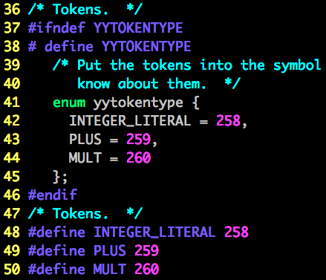
Pass Token from Flex to Bison
Filename: cal.tab.h
lexer have to modify yylval and return token id
parser will take the yylval and token id to make proper action - $$, $n
Code Section: calc.y(grammar rules segment)
1 2 3 | exp: INTEGER_LITERAL { $$ = $1; } | exp PLUS exp { $$ = $1 + $3; } | exp MULT exp { $$ = $1 * $3; }
Code Section: calc.lex(rules segment)
1 2 3 | {int_const} { yylval.int_val = atoi(yytext); return INTEGER_LITERAL} “+” { yylval.op_val = new std::string(yytext); return PLUS } “*” { yylval.op_val = new std::string(yytext); return MULT }

Slide 32
Reference
http://alumni.cs.ucr.edu/~lgao/teaching/bison.html
http://www.gnu.org/software/bison/manual/bison.html

Slide 33
Introduction to SPIM
SPIM: MIPS32 simulator
Installation: http://pages.cs.wisc.edu/~larus/spim.html
Windows: PCSpim
Linux/MacOSX: spim/xspim

Slide 34
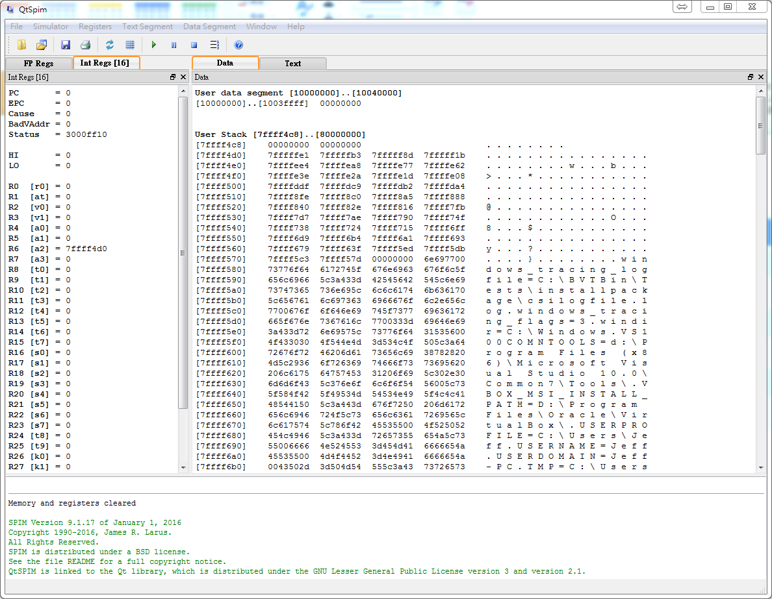
Environment
Registers
Text/Data Segment
SPIM messages

Slide 35
Environment - Execution
Run program
Load asm and reset simulator
Next step

Slide 36
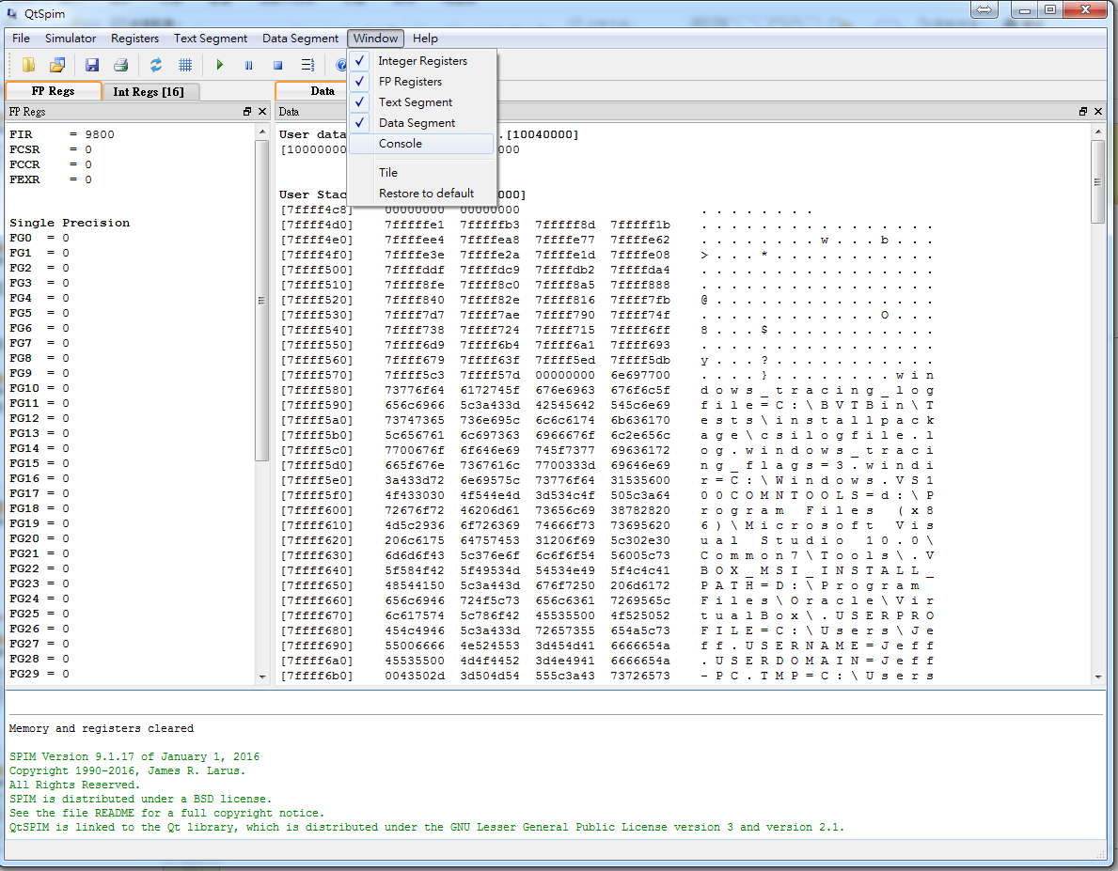
Environment - Enable Console

Slide 37
Registers
Number | Name | Usage | Number | Name | Usage
$0 | $0 | Constant 0 | $24 - $25 | $t8 - $t9 | Temporary
$1 | $at | Reserved for assembler | $26 - $27 | $k0 - $k1 | Reserved for OS kernel
$2 - $3 | $v0 - $v1 | Value returned by subroutines | $28 | $gp | Pointer to global area
$4 - $7 | $a0 - $a3 | Subroutine Arguments | $29 | $sp | Stack pointer
$8 - $15 | $t0 - $t7 | Temporary(not preserved across call) | $30 | $fp | Frame pointer
$16 - $23 | $s0 - $s7 | Saved temporary(preserved across call) | $31 | $ra | Return address

Slide 38
Assembler Directives
Directives | Usage
.asciiz str | Store the string in memory and null-terminate it
.byte b1, ..., bn | Store the n values in successive bytes of memory
.data | The following data items should be store in the data segment
.globl sym | Declare that symbol sym is global and can be referenced from other files
.half h1, ..., hn | Store the n values in successive memory halfwords
.space n | Allocate n bytes of space in the current segment(must be data segment)
.text | The next items are put in the user text segment
.word w1, ..., wn | Store the n 32-bit quantities in successive memory words
data and space directive are useful for heap manipulation

Slide 39
System Services
Service | System Call Code($v0) | Arguments | Result
print_int | 1 | $a0 = integer
print_float | 2 | $f12 = float
print_double | 3 | $f12 = double
print_string | 4 | $a0 = string
read_int | 5 |  | integer (in $v0)
read_float | 6 |  | float (in $f0)
read_double | 7 |  | double (in $f0)
read_string | 8 | $a0 = buffer, $a1 = length
sbrk | 9 | $a0 = amount | address (in $v0)
exit | 10

Slide 40
System Service Example
L4~L5: read a integer from console into $v0
L6: move the value from $v0 to $a0
L7~L8: print a integer in $a0
L9~L10: stop program
Filename: service.s
1 2 3 4 5 6 7 8 9 10 | .text .globl main main: li $v0, 5 syscall move $a0, $v0 li $v0, 1 syscall li $v0, 10 syscall

Slide 41
Instruction Set - Arithmetic
Operation | Destination | Source 1 | Source 2 | Mnemonic | Remark
add | Rdest, | Rsrc1, | Src2 | Rdest = Rsrc1 + Src2 | Add
div | Rdest, | Rsrc1, | Src2 | Rdest = Rsrc1 / Src2 | Divide
mul | Rdest, | Rsrc1, | Src2 | Rdest = Rsrc1 * Src2 | Multiply
neg | Rdest, | Rsrc |  | Rdest = -Rsrc | Negate Value
not | Rdest, | Rsrc |  | Rdest = !Rsrc
sub | Rdest, | Rsrc1, | Src2 | Rdest = Rsrc1 - Src2 | Subtract
li | Rdest, | imm |  | Rdest = imm | Load immediate
move | Rdest, | Rsrc |  | Rdest = Rsrc | Move
Src2 can either be a register or an immediate value(a 16 bit integer)
All instructions with overflow, expects multiply operation

Slide 42
Arithmetic Example
Filename: arithmetic.s
1 2 3 4 5 6 7 8 9 10 11 12 13 14 15 16 17 18 19 | .text .globl main main: li $t0, 0 move $a0, $t0 jal print add $t0, $t0, 1 move $a0, $t0 jal print sub $t0, $t0, 2 move $a0, $t0 jal print mul $t0, $t0, -2 move $a0, $t0 jal print div $t0, $t0, -1 move $a0, $t0 jal print b exit
jal label - jump and link
jump to label and update return address
b label - branch
jump to label
print - function
print $a0 and newline
exit - function
stop program
0
1
-1
2
-2

Slide 43
Instruction Set - Comparison
Operation | Destination | Source 1 | Source 2 | Mnemonic | Remark
seq | Rdest, | Rsrc1, | Src2 | Rdest = (Rsrc1 == Src2 ? 1 : 0) | Equal
sge | Rdest, | Rsrc1, | Src2 | Rdest = (Rsrc1 >= Src2 ? 1 : 0) | Greater Than Equal
sgt | Rdest, | Rsrc1, | Src2 | Rdest = (Rsrc1 > Src2 ? 1 : 0) | Greater Than
sle | Rdest, | Rsrc1, | Src2 | Rdest = (Rsrc1 <= Src2 ? 1 : 0) | Less Than Equal
slt | Rdest, | Rsrc1, | Src2 | Rdest = (Rsrc1 < Src2 ? 1 : 0) | Less Than
sne | Rdest, | Rsrc1, | Src2 | Rdest = (Rsrc1 != Src2 ? 1 : 0) | Not Equal
Src2 can either be a register or an immediate value(a 16 bit integer)

Slide 44
Comparison Example
Filename: comparison.s
1 2 3 4 5 6 7 8 9 10 11 12 13 14 15 16 17 18 | .text .globl main main: li $t0, 0 li $t1, 1 seq $a0, $t0, $t1 jal print sge $a0, $t0, $t1 jal print sgt $a0, $t0, $t1 jal print sle $a0, $t0, $t1 jal print slt $a0, $t0, $t1 jal print sne $a0, $t0, $t1 jal print b exit
0
0
0
1
1
1

Slide 45
Instruction Set - Memory Access
Operation | Register | Address | Mnemonic | Remark
la | Rdest | address | Rdest = address | Load Address
lw | Rdest | address | Rdest = Mem[address] | Load Word
sw | Rsrc | address | Mem[address] = Rsrc | Store Word
There are different data type you can manipulate
e.g. byte, half-word, double-word
operation with suffix “b”, “h”, “d”, e.g. lb, lh, sd, etc...

Slide 46
Memory Access Example
Filename: memory.s
1 2 3 4 5 6 7 8 9 10 11 12 13 14 15 16 17 18 | .data varA: .word 1024 varB: .word 4096 .text .globl main main: la $a0, varA jal print lw $a0, varA jal print la $a0, varB jal print li $t0, 777 sw $t0, varB lw $a0, varB jal print b exit
268500992(memory address)
1024
4096
777

Slide 47
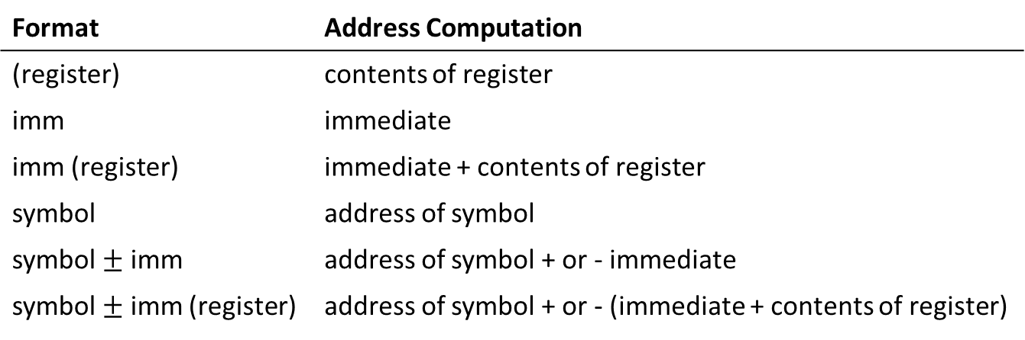
Addressing Modes
Format | Address Computation
(register) | contents of register
imm | immediate
imm (register) | immediate + contents of register
symbol | address of symbol
symbol imm | address of symbol + or - immediate
symbol imm (register) | address of symbol + or - (immediate + contents of register)

Slide 48
Address Modes Example
Filename: addressing.s
1 2 3 4 5 6 7 8 9 10 11 12 | .data varA: .word 1024 varB: .word 4096 varC: .word 512 .text .globl main main: li $t0, 4 lw $a0, varA + 4($t0) jal print b exit
512

Slide 49
Instruction Set - Branch and Jump
Operation | Source 1 | Source 2 | Destination | Mnemonic | Remark
b |  |  | label | Branch to label | Branch
beq | Rsrc1, | Src2, | labal | Branch to label if Rsrc1 == Src2 | Branch on Equal
bge | Rsrc1, | Src2, | labal | Branch to label if Rsrc1 >= Src2 | Branch on GTE
bgt | Rsrc1, | Src2, | labal | Branch to label if Rsrc1 > Src2 | Branch on GT
ble | Rsrc1, | Src2, | labal | Branch to label if Rsrc1 <= Src2 | Branch on LTE
blt | Rsrc1, | Src2, | labal | Branch to label if Rsrc1 < Src2 | Branch on LT
bne | Rsrc1, | Src2, | labal | Branch to label if Rsrc1 != Src2 | Branch on NEQ
jal |  |  | label | Branch to label/Rsrc and save address of next instruction in $ra | Branch and Link
jalr |  |  | Rsrc
jal/jalr are used in calling subroutine
There are zero comparison branch, compare to zero instead of Src2
operation suffix with ‘z’, e.g. beqz, bgez, bgtz

Slide 50
Branch and Jump Example
Filename: branch.s
1 2 3 4 5 6 7 8 9 10 11 12 13 14 15 16 17 18 19 20 | .data strEq: asciiz “Equal” strNe: asciiz “Not equal” .text .globl main main: jal read move $t0, $v0 jal read move $t1, $v0 beq $t0, $t1, printEq printNe: la $a0, strNe b endif printEq: la $a0, strEq b endif endif: jal print b exit
Filename: branch.c
1 2 3 4 5 6 7 8 9 10 11 12 13 14 15 16 17 18 | int main { int x, y; char *strEq = “Equal”; char *strNe = “Not equal”; char *output; scanf(“%d”, &x) scanf(“%d”, &y) if(x == y) output = strEq; else output = strNe; printf(“%s”, output); return 0; }

Slide 51
Function Example
jal will store the address of the next instruction
e.g. L6
L11 can jump back to L6
address of L6 is stored in $ra
branch to $ra directly
Filename: function.s
1 2 3 4 5 6 7 8 9 10 11 12 13 14 15 | .text .globl main main: li $a0, 123 jal print b exit print: li $v0, 1 syscall b $ra exit: li $v0, 10 syscall

Slide 52
Reference
https://www.cs.tcd.ie/John.Waldron/itral/spim_ref.html#directives
http://courses.cs.washington.edu/courses/cse410/08sp/notes/spim/SpimTutorial.pdf
http://students.cs.tamu.edu/tanzir/csce350/reference/syscalls.html
http://www.mrc.uidaho.edu/mrc/people/jff/digital/MIPSir.html
http://logos.cs.uic.edu/366/notes/mips%20quick%20tutorial.htm

