Slide 1
File_in && file_out

Slide 2
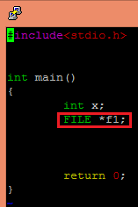
Tpye : File
new type : FILE* (全大寫)
FILE *f1;

Slide 3
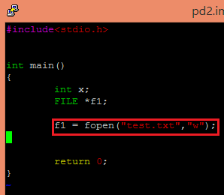
Fopen()
fopen(char*,char*);
↑ ↑
filename mode
type is FILE*
return the address of the file
f1 = fopen(“test.txt”,”w”);
↑ ↑
filename mode

Slide 4
Fopen() － mode
mode | explanation
"r" | 開啟一個文字檔(text)，供程式讀取。
"w" | 開啟一個文字檔(text)，供程式將資料寫入此檔案內。如果磁碟內不包含這個檔案，則系統會自行建立這個檔案。如果磁碟內包含這個檔案，則此檔案內容會被蓋過而消失。
"a" | 開啟一個文字檔(text)，供程式將資料寫入此檔案的末端。如果此檔案不存在，則系統會自行建立此檔案。

Slide 5
Fclose()
fclose(FILE*);
type is int
when fclose() fails,
it will return a nonzero number
fclose(f1);
↑
FILE*

Slide 6
check
To check whether your file opens or not…
when fopen() fails,
it will return a NULL pointer
NULL pointer : it seems to be 0 in integer

Slide 7
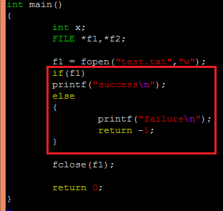
check
So you can…

Slide 8

EXERCISE
To create a text named “test.txt” in your pietty!!

Slide 9
default
There is some default in fopen()……
fopen(filename,mode);
it will find/create the file in the same content
where the executing file is
by default

Slide 10
useful functions
printf(); scanf(); getchar(); putchar();
↓
fprintf(FILE*,”...”) fscanf(FILE*,”…”,…)
fgetc(FILE*) fputc(char*,FILE*)

Slide 11
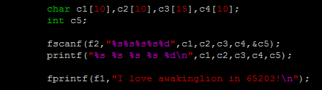
How to use

Slide 12
File_in && file_out exercise
First create a “read.txt”,and input “I love awakinglion in 65203”.
Then print the message in the “read.txt” file
on the screen
Secondly, create a new file “write.txt”with fopen() function.
Then print “I love awakinglion in 65203 forever and ever”

